Slide 1
LÍNGUA INGLESA
ENSINO MÉDIO

Slide 2


UNIT 9
TEENAGERS AND WORK
Qual é a situação retratada no cartum? Você se sente da mesma forma que os personagens?
CARTER, Jon. [Exploring healthcare careers]. [S. l.]: Cartoonstock, 27 ago. 2018. Disponível em: https://www.cartoonstock.com/cartoon?searchID=CS472652. Acesso em: 24 ago. 2024.

Slide 3
UNIT 9
Considering the part-time jobs that fit your personality, which ones may also fit with your school hours?
babysitter
baker
car
washer
data
clerk
dog
walker
farm worker
grocery store cashier
library assistant
music
tutor
social media assistant
web or graphic designer

Slide 4
UNIT 9
LANGUAGE NOTE
Os verbos modais, como can, might e may, são usados antes da forma
básica do verbo principal.
“[…] you can often find a part-time job as a data clerk.”
“[…] you might be able to make some money as a tutor.”
“[…] being a dog walker may be just the right job for you.”

Slide 5
UNIT 9
ESTRUTURA DA CONDICIONAL DO TIPO 1 (FIRST CONDITIONAL)
oração iniciada por if (if clause)
oração principal (main clause)
“If you have basic computer skills […],
you can often find a part-time job as a data clerk.”
“If you like dogs,
being a dog walker may be just the right job for you.”
“If you do a good job,
you will likely attract even more customers […].”
If + verbo no
simple present
can/might/may/will (not) +
forma básica do verbo principal

Slide 6
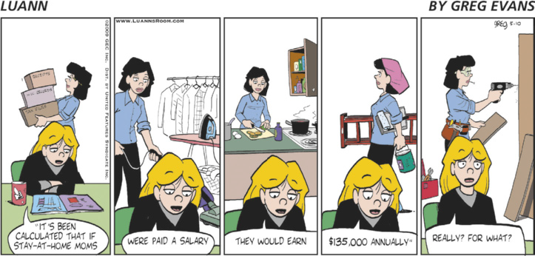
UNIT 9
EVANS, Greg; EVANS, Karen. [Luann]. [S. l.]: Go Comics, 10 maio 2009. Disponível em: www.gocomics.com/luann/2009/05/10. Acesso em: 25 ago. 2024.
Choose the correct statements about the comic strip.
Stay-at-home moms receive $135,000 annually.
Luann doesn’t understand why stay-at-home moms deserve a salary.
The comic strip shows a typical day in the life of Luann’s mom.

Slide 7
UNIT 9
ESTRUTURA DA CONDICIONAL DO TIPO 2 (SECOND CONDITIONAL)
oração iniciada por if (if clause)
oração principal (main clause)
“If stay-at-home moms were paid a salary,
they would earn $135,000 annually.”
“If I were Luann,
I wouldn’t be surprised at the study.”
If + verbo no
simple past
would (not)+
forma básica do verbo principal

Slide 8
LANGUAGE REFERENCE
UNIT 9: if clauses
(types 1 and 2)
Observe, no quadro a seguir, como é formada a oração condicional do tipo 1 (first conditional).
Oração condicional (if clause) | Oração principal (main clause)
If + verbo no simple present, | will (not) + forma básica do verbo principal OU can/may/might/should/be likely + forma básica do verbo principal.

Slide 9
LANGUAGE REFERENCE
UNIT 9: if clauses
(types 1 and 2)
Observe, no quadro a seguir, como é formada a oração condicional do tipo I1 (second conditional).
Oração condicional (if clause) | Oração principal (main clause)
If + verbo no simple past, | would (not) + forma básica do verbo principal

Slide 10
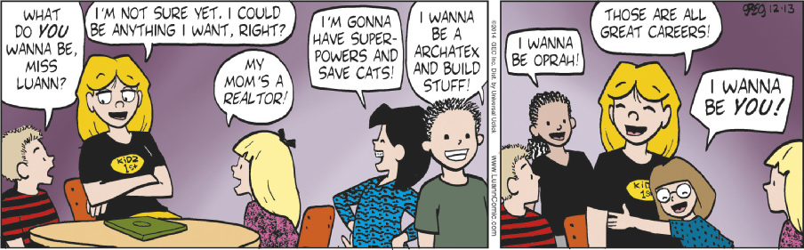
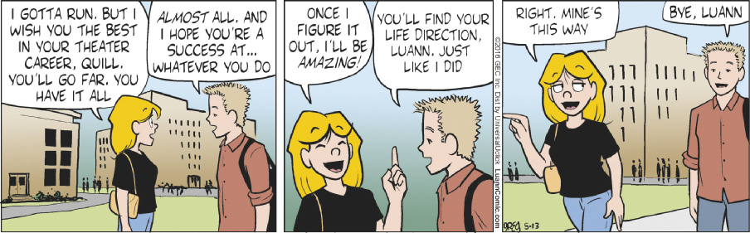
UNIT 9
TIP
Conhecer convenções relacionadas a contextos e a gêneros de texto ajuda-nos a compreender e a produzir textos de cada gênero. Com um colega, identifiquem características do gênero tirinha que vocês encontram nos textos e escrevam-nas em seus cadernos.
EVANS, Greg; EVANS, Karen. [Luann]. [S. l.]: Go Comics, 13 dez. 2014. Disponível em: https://www.gocomics.com/luann/2014/12/13. Acesso em: 25 ago. 2024.
EVANS, Greg; EVANS, Karen. [Luann]. [S. l.]: Go Comics, 13 maio 2016. Disponível em: https://www.gocomics.com/luann/2016/05/13. Acesso em: 25 ago. 2024.

