Slide 1
LÍNGUA INGLESA
ENSINO MÉDIO

Slide 2

UNIT 6
YOUTH REVOLUTION
FOX, MeiMei. Teen titans: 13 young people making an outsized positive impact. Forbes, [Jersey City], 5 nov.2023. Disponível em: https://www.forbes.com/sites/meimeifox/2023/11/05/teen-titans-13-young-peoplemaking-an-outsized-positive-impact/. Acesso em: 17 ago. 2024.
O que as três manchetes têm em comum?
Teen Titans: 13 Young people making an outsized positive impact
If not now, When?: 6 Youth climate activists ask Indians to save Earth
BEDI, Rhea. If not now, when?: 6 youth climate activists ask Indians to save Earth. [India]: Homegrown, 8 jun. 2021. Disponível em: https://homegrown.co.in/homegrownexplore/lifestyle/if-not-now-when-6-youth-climate-activists-ask-indians-to-save-earth. Acesso em: 17 ago. 2024.
Ugandan climate activists speak up: celebrating young Black history-makers
RESULTS CANADA. Ugandan climate activists speak up: celebrating young Black history-makers. Ottawa: Results Canada, 23 fev. 2024. Disponível em: https://resultscanada.ca/ugandan-climateactivists-speak-up-celebrating-young-black-history-makers/. Acesso em: 17 ago. 2024.

Slide 3
UNIT 6
ENVIRONMENTAL PROBLEMS
forest fires
pollution
deforestation
climate change
TIP
Agrupar palavras e expressões por campo semântico pode ajudar você a ampliar e a fixar o vocabulário aprendido.

Slide 4
UNIT 6
SCHOOL
SUBJECTS
science
IT (information technology)
English
mathematics
Portuguese
PE (Physical Education)
TIP
Agrupar palavras e expressões por campo semântico pode ajudar você a ampliar e a fixar o vocabulário aprendido.

Slide 5
UNIT 6
“Growing up, Jakomba Jabbie loved science and technology […]”
“Jakomba’s teachers told her […]”
“Jakomba wanted to change this […]”
“When she was 16, Jakomba set up a robotics club at her school.”
“He decided to combine his love for football with […]”
LANGUAGE NOTE
Alguns exemplos de
expressões de tempo
utilizadas no simple
past:
growing up
when she was 16
in 2024
yesterday
last week/month/year
when I was a child
two days ago.

Slide 6
LANGUAGE REFERENCE
UNIT 6: SIMPLE PAST
(IRREGULAR VERBS)
Observe, nos quadros a seguir, as formas afirmativa e negativa do simple past. Note que, em frases negativas, usamos did not ou didn’t antes do verbo principal em sua forma básica.
Forma afirmativa |  |  | Forma negativa
I/You/He/She/It We/You/They | became | influential in 2015. | I/You/He/She/It We/You/They | didn’t become | influential in 2015.
 |  |  | didn’t = did not

Slide 7
LANGUAGE REFERENCE
UNIT 6: SIMPLE PAST
(IRREGULAR VERBS)
Observe, nos quadros a seguir, a forma interrogativa e as respostas curtas do simple past. Note que, em frases interrogativas, usamos did antes do sujeito e o verbo principal é usado em sua forma básica.
Forma interrogativa |  |  |  | Respostas curtas
Did | I/you/he/she/it we/you/they | become | influential in 2018? | Yes, | I/you/he/she/it we/you/they | did.
 |  |  |  | No, | I/you/he/she/it we/you/they | didn’t.

Slide 8
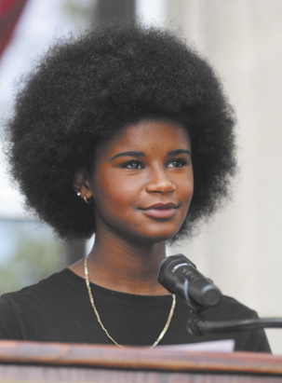
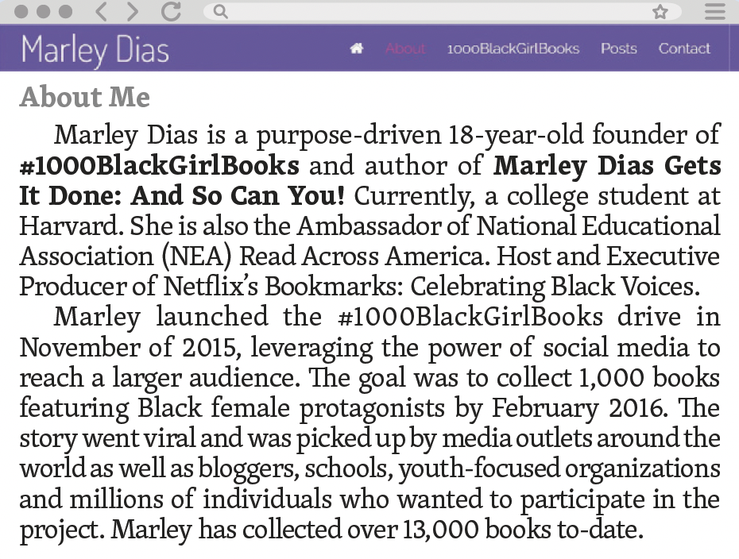
UNIT 6
TIP
Observe que hashtags como #1000BlackGirlBooks são utilizadas nas mídias sociais para divulgação de ideias, pessoas, produtos etc., porque seu uso facilita a localização de conteúdos sobre o assunto indicado em cada hashtag.
ABOUT me. [S. l.]: Marley Dias, c2024. Disponível em: https://www.marleydias.com/about/. Acesso em: 19 ago. 2024.

