Slide 1
LÍNGUA INGLESA
ENSINO MÉDIO

Slide 2
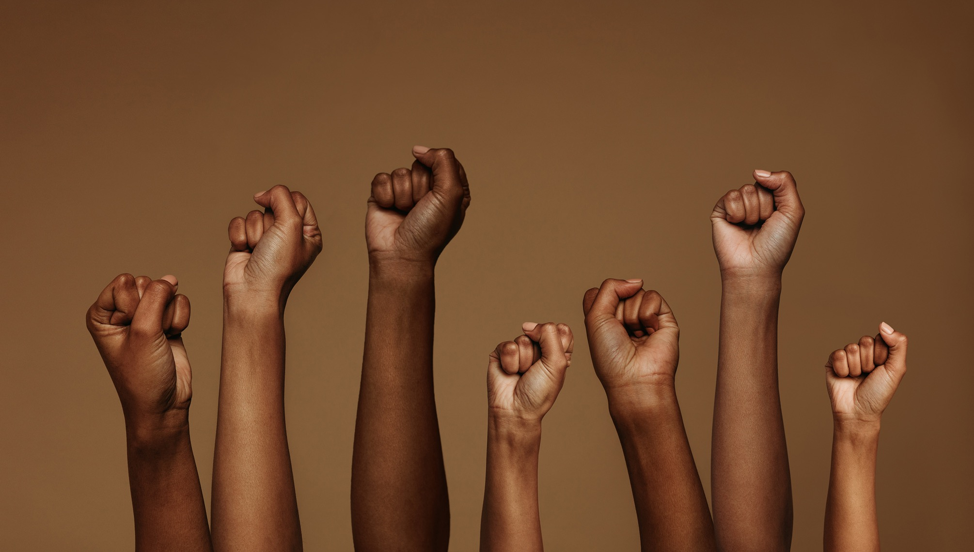
UNIT 5
WOMEN SHAPING THE WORLD
Você concorda com a citação de Shirley Chisholm? Por quê (não)?
“Tremendous amounts of talent are being lost to our society just because that talent wears a skirt.”
– Shirley Chisholm, first Black woman
elected to U.S. Congress.
CHISHOLM apud STEWART, Jessica et al. 50 inspirational quotes by powerful women in history. [S. l.]: My modern met, 24 jun. 2024. Disponível em: https://mymodernmet.com/inspirational-quotes-women/.Acesso em: 19 ago. 2024.

Slide 3
UNIT 5
TIMELINE
Throughout history, many obstacles have stood in the way of women who pursued the sciences. A lack of access to higher education and not being paid a fair wage are just some of those barriers. Let’s celebrate the milestones in history and accomplishments women have made in education and science.
400 AD: Hypatia of Alexandria was the first recorded female mathematician.
1833: Oberlin College was the first college in America to admit women.
1903: Marie Curie was the first woman to receive a Nobel Prize.
1920: Many women gained the right to vote in the United States with the Nineteenth Amendment.
1941-45: WWII created a new workforce of women while men were at war. Female scientists were given new opportunities to show their talents.
1963: The Equal Pay Act passed in America and stipulated that men and women should be paid equally for equal work. This law helps women to overcome the wage gap (the fight is ongoing).
1964: The Civil Rights Act made many forms of discrimination illegal, ending racial segregation in schools and workplaces and giving more opportunities to African Americans.
NOW: More women than ever before are working hard to invent, discover, and explore the unknown.
Elaborado com base em: IGNOTOFSKY, Rachel. Women in science: 50 fearless pioneers who changed the world. New York, USA: Ten Speed Press, 2016. E-book.

Slide 4
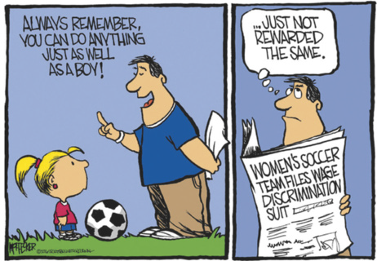
UNIT 5
THINK ABOUT IT!
Com base nos textos lidos e no seu conhecimento
prévio, como a participação da mulher na sociedade foi se modificando ao longo da história? Como você acredita que essa participação pode ser ampliada?
HOFFECKER, Joe. Cartoon: gender gap. Sports Business Journal, [s. l.], 4 nov. 2016. Disponível em: https://www.sportsbusinessjournal.com/Journal/Issues/2016/04/11/Opinion/Cartoon.aspx. Acesso em: 19 ago. 2024.

Slide 5
UNIT 5
“Let’s celebrate the […] accomplishments women have made in education and science.”
“The Civil Rights Act made many forms of discrimination illegal […].”
“More women than ever before are working hard to […] explore the unknown.”
TIP
O acréscimo de um prefixo não costuma modificar a classe gramatical da palavra. O acréscimo de um sufixo costuma modificar a
classe gramatical da palavra. Isso acontece tanto em inglês quanto em português.

Slide 6
UNIT 5
LANGUAGE NOTE
1833: “Oberlin College was the first college in America to admit women.”
1903: “Marie Curie was the first woman to receive a Nobel Prize.”
1941-45: “WWII created a new workforce of women while men were at war.”
“Oberlin College was”
= It was
“Marie Curie was”
= She was
“men were”
= they were

Slide 7
LANGUAGE REFERENCE
UNIT 5: SIMPLE PAST
(BE, REGULAR VERBS)
Observe, nos quadros a seguir, as formas afirmativa e negativa do verbo be no simple past.
Forma afirmativa |  |  | Forma negativa
I/He/She/It | was | born in 1918. | I/He/She/It | wasn’t | born in 1918.
You/We/They | were |  | You/We/They | weren’t
 |  |  | wasn’t = was not; weren’t = were not

Slide 8
LANGUAGE REFERENCE
UNIT 5: SIMPLE PAST
(BE, REGULAR VERBS)
Observe, nos quadros a seguir, a forma interrogativa e as respostas curtas do simple past. Note que, em frases interrogativas, usamos was/were antes do sujeito.
Forma interrogativa |  |  | Respostas curtas
Was | I/he/she/it | born in 1918? | Yes, | I/he/she/it | was.
 |  |  |  | you/we/they | were.
Were | you/we/they |  | No, | I/he/she/it | wasn’t.
 |  |  |  | you/we/they | weren’t.

Slide 9

LANGUAGE REFERENCE
UNIT 5: SIMPLE PAST
(BE, REGULAR VERBS)
Todos os verbos regulares no simple past são formados com o acréscimo da terminação -ed. Observe, no quadro a seguir, as regras ortográficas para verbos regulares no simple past.
 | Exemplos |  | Exemplos
A maioria dos verbos: verbo + ed | attend attended enjoy enjoyed | Verbos terminados em consoante + vogal + consoante*: verbo + última consoante + ed | plan planned shop shopped
Verbos terminados em e: verbo + d | graduate graduated use used | Verbos terminados em consoante + y: verbo – y + ied | study studied try tried
*Não dobramos a última consoante quando a primeira sílaba for tônica, como em happened, listened, offered, visited.

Slide 10
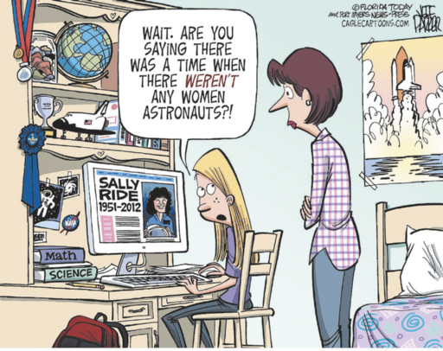
UNIT 5
THINK ABOUT IT!
O que a reação da menina nos diz sobre a importância da representatividade feminina em áreas como Ciência, Tecnologia, Engenharia e Matemática?
PARKER, Jeff. [Sally Ride]. [S. l.]: Cartoonstock, 24 jul. 2012. Disponível em: https://www.cartoonstock.com/cartoon?searchID=EC311300. Acesso em: 19 ago. 2024.

Slide 11
UNIT 5
“1920: Many women gained the right to vote in the United States […].”
“1941-45: WWII created a new workforce of women while men were at war.”
“1963: The Equal Pay Act passed in America and stipulated that men and women should be paid equally for equal work.”
/t/ | /d/ | /id/
passed, worked, watched, helped, developed | gained, used, called, followed, received | created, stipulated, completed, needed, conducted

