Slide 1
LÍNGUA INGLESA
ENSINO MÉDIO

Slide 2

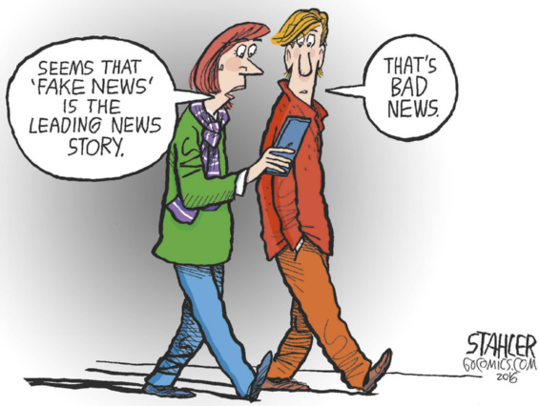
UNIT 3
Getting News online
Segundo o cartum, qual é a principal notícia do momento (the leading news story)? Qual é a reação do homem?
STAHLER, Jeff. [Seems that 'fake news' is the leading news story]. [S. l.]: GoComics, 7 dez. 2016. Disponível em: https://www.gocomics.com/jeffstahler/2016/12/07. Acesso em: 12 ago. 2024.

Slide 3

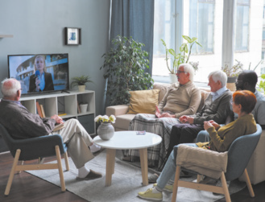


UNIT 3
He’s listening to
a podcast.
They’re watching the news on TV.
She’s reading
the newspaper.
She’s using
her smartphone.

Slide 4
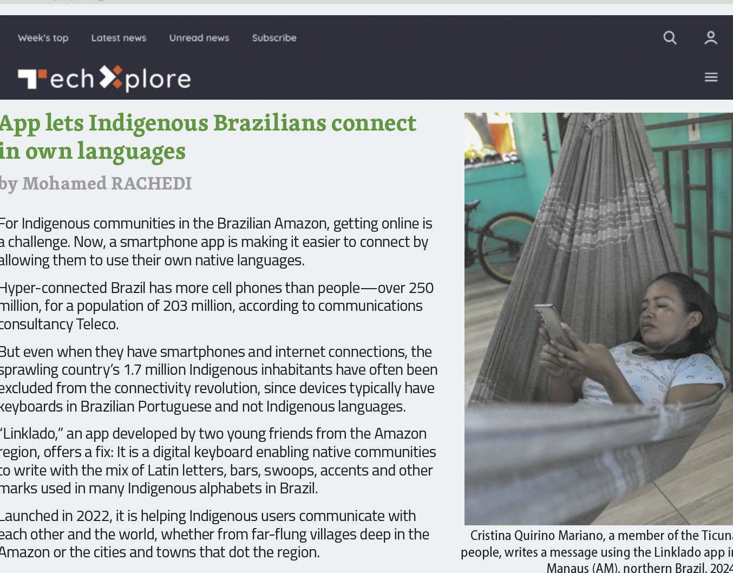
UNIT 3
TIP
Para identificar mais
facilmente a ideia
principal de um texto,
observe o título ou a
manchete e a primeira
frase ou parágrafo.
RACHEDI, Mohamed. App lets Indigenous Brazilians connect in own languages. Tech Xplore, [s. l.], 30 jan. 2024. Disponível em: https://techxplore.com/news/2024-01-app-indigenous-brazilians-languages.html. Acesso em: 12 ago. 2024.

Slide 5
UNIT 3
languages
Indigenous
Latin
Their own native
languages
languages
modificam a palavra principal (núcleo)
palavra principal (núcleo)

Slide 6
UNIT 3
alphabet
Portuguese
Indigenous
simplified Arabic
alphabet
alphabet
modificam a palavra principal (núcleo)
palavra principal (núcleo)

Slide 7

LANGUAGE REFERENCE
UNIT 3: PRESENT continuous
Observe, no quadro a seguir, as regras ortográficas para as formas verbais terminadas em -ing.
 | Exemplos |  | Exemplos
A maioria dos verbos: verbo + ing | do doing read reading | Verbos terminados em consoante + vogal + consoante: verbo + última consoante + ing | put putting swim swimming
Verbos terminados em e: verbo - e + ing | come coming use using | Verbos terminados em ie: verbo - ie + y + ing | die dying lie lying

Slide 8
LANGUAGE REFERENCE
UNIT 3: PRESENT continuous
Observe, nos quadros a seguir, as formas afirmativa e negativa do present continuous.
Forma afirmativa |  |  |  | Forma negativa
I | am | becoming | popular on the web. | I | ’m not | becoming | popular on the web.
He/She/It | is |  |  | He/She/It | isn’t
You/We/They | are |  |  | You/We/They | aren’t
 |  |  |  | ’m not = am not; isn’t = is not; aren’t = are not

Slide 9
LANGUAGE REFERENCE
UNIT 3: PRESENT continuous
Observe, nos quadros a seguir, a forma interrogativa e as respostas curtas do present continuous. Note que, em frases interrogativas, usamos am/is/are antes do sujeito.
Forma interrogativa |  |  |  | Respostas curtas
Am | I | becoming | popular on the web? | Yes, | I | am.
 |  |  |  |  | he/she/it | is.
Is | he/she/it |  |  |  | you/we/they | are.
 |  |  |  | No, | I | ’m not.
Are | you/we/they |  |  |  | he/she/it | isn’t.
 |  |  |  |  | you/we/they | aren’t.

Slide 10
UNIT 3
Social media is making kids sad – and it’s bad news for democracy
BADHAM, Van. Social media is making kids sad – and it’s bad news for democracy. The Guardian. [Londres], 23 mar. 2024. Disponível em: https://www.theguardian.com/media/commentisfree/2024/mar/24/social-media-is-making-kids-sad-and-its-bad-news-for-democracy. Acesso em: 12 ago. 2024.are-helping-shape-the-news-through-social-media-204958. Acesso em: 13 ago. 2024.102684660. Acesso em: 13 ago. 2024.
Community radio: Young South Africans are helping shape the news through social media
NKOALA, Sisanda; MAKWAMBENI, Blessing; MATSILELE, Trust. Community radio: young South Africans are helping shape the News through social media. The Conversation, [São Paulo], 22 out. 2023. Disponível em: https://theconversation.com/community-radio-young-southafricans-are-helping-shape-the-news-through-social-media-204958. Acesso em: 13 ago. 2024.102684660. Acesso em: 13 ago. 2024.
Beijing is considering ways to limit children’s use of mobile devices. But are they addressing the wrong problem?
CAI, Jenny. Beijing is considering ways to limit children’s use of mobile devices. But are they addressing the wrong problem? ABC, [Sydney], 5 ago. 2023. Disponível em: https://www.abc.net.au/news/2023-08-06/china-mulls-mandatory-minor-modes-on-mobiledevices/102684660. Acesso em: 13 ago. 2024.
AI is helping Indigenous teens in Brazil
keep their mother tongue alive
COSTA, MaryLou. AI is helping Indigenous teens in Brazil keep their mother tongue alive. Reasons to be cheerful, [S. l.], 9 nov. 2023. Disponível em: https://reasonstobecheerful.world/artificial-intelligence-teens-indigenous-language-preservation-brazil/. Acesso em: 13 ago. 2024.

Slide 11
UNIT 3
Is social media weakening Africa’s democracy?
NHIKITI, Blessmore. Is social media weakening Africa’s democracy? Mail & Guardian, [Joanesburg], 17 abr. 2024. Disponível em: https://mg.co.za/article/2024-04-17-is-socialmedia-weakening-africas-democracy/. Acesso em: 13 ago. 2024.
TIP
Conhecer convenções
relacionadas a contextos e a gêneros de texto ajuda-nos a compreender e a
produzir textos de cada gênero. Com um colega, identifiquem características do gênero manchete que vocês encontram nos textos e escrevam-nas em
seus cadernos.
Some teens are spending a quarter of their lives on social media. These are the site sucking up their time.
PASSY, Charles. Some teens are spending a quarter of their lives on social media: Theseare the sites sucking up their time. [New York, EUA]: Marketwatch, 17 out. 2023. Disponível em:https://www.marketwatch.com/story/how-many-hours-does-your-teen-spend-on-socialmedia-more-than-on-their-homework-gallup-says-cd0a561. Acesso em: 13 ago. 2024.
Young people are increasingly
getting their news online
STRONG, Amber. Young people are increasingly getting their news online. WPTV,[Palm Beach], 23 jan. 2024. Disponível em: https://www.wptv.com/young-people-areincreasingly-getting-their-news-online. Acesso em: 13 ago. 2024.
The first social media babies are adults now. Some are pushing for laws to protect kids from their parentes’ oversharing
KARIMI, Faith. The first social media babies are adults now. Some are pushing for lawsto protect kids from their parents’ oversharing. CNN, [Atlanta], 29 maio 2024. Disponívelem: https://edition.cnn.com/2024/05/29/us/social-media-children-influencers-cec/index.html?iid=cnn_buildContentRecirc_end_recirc. Acesso em: 13 ago. 2024.

