Slide 1
LÍNGUA INGLESA
ENSINO MÉDIO

Slide 2
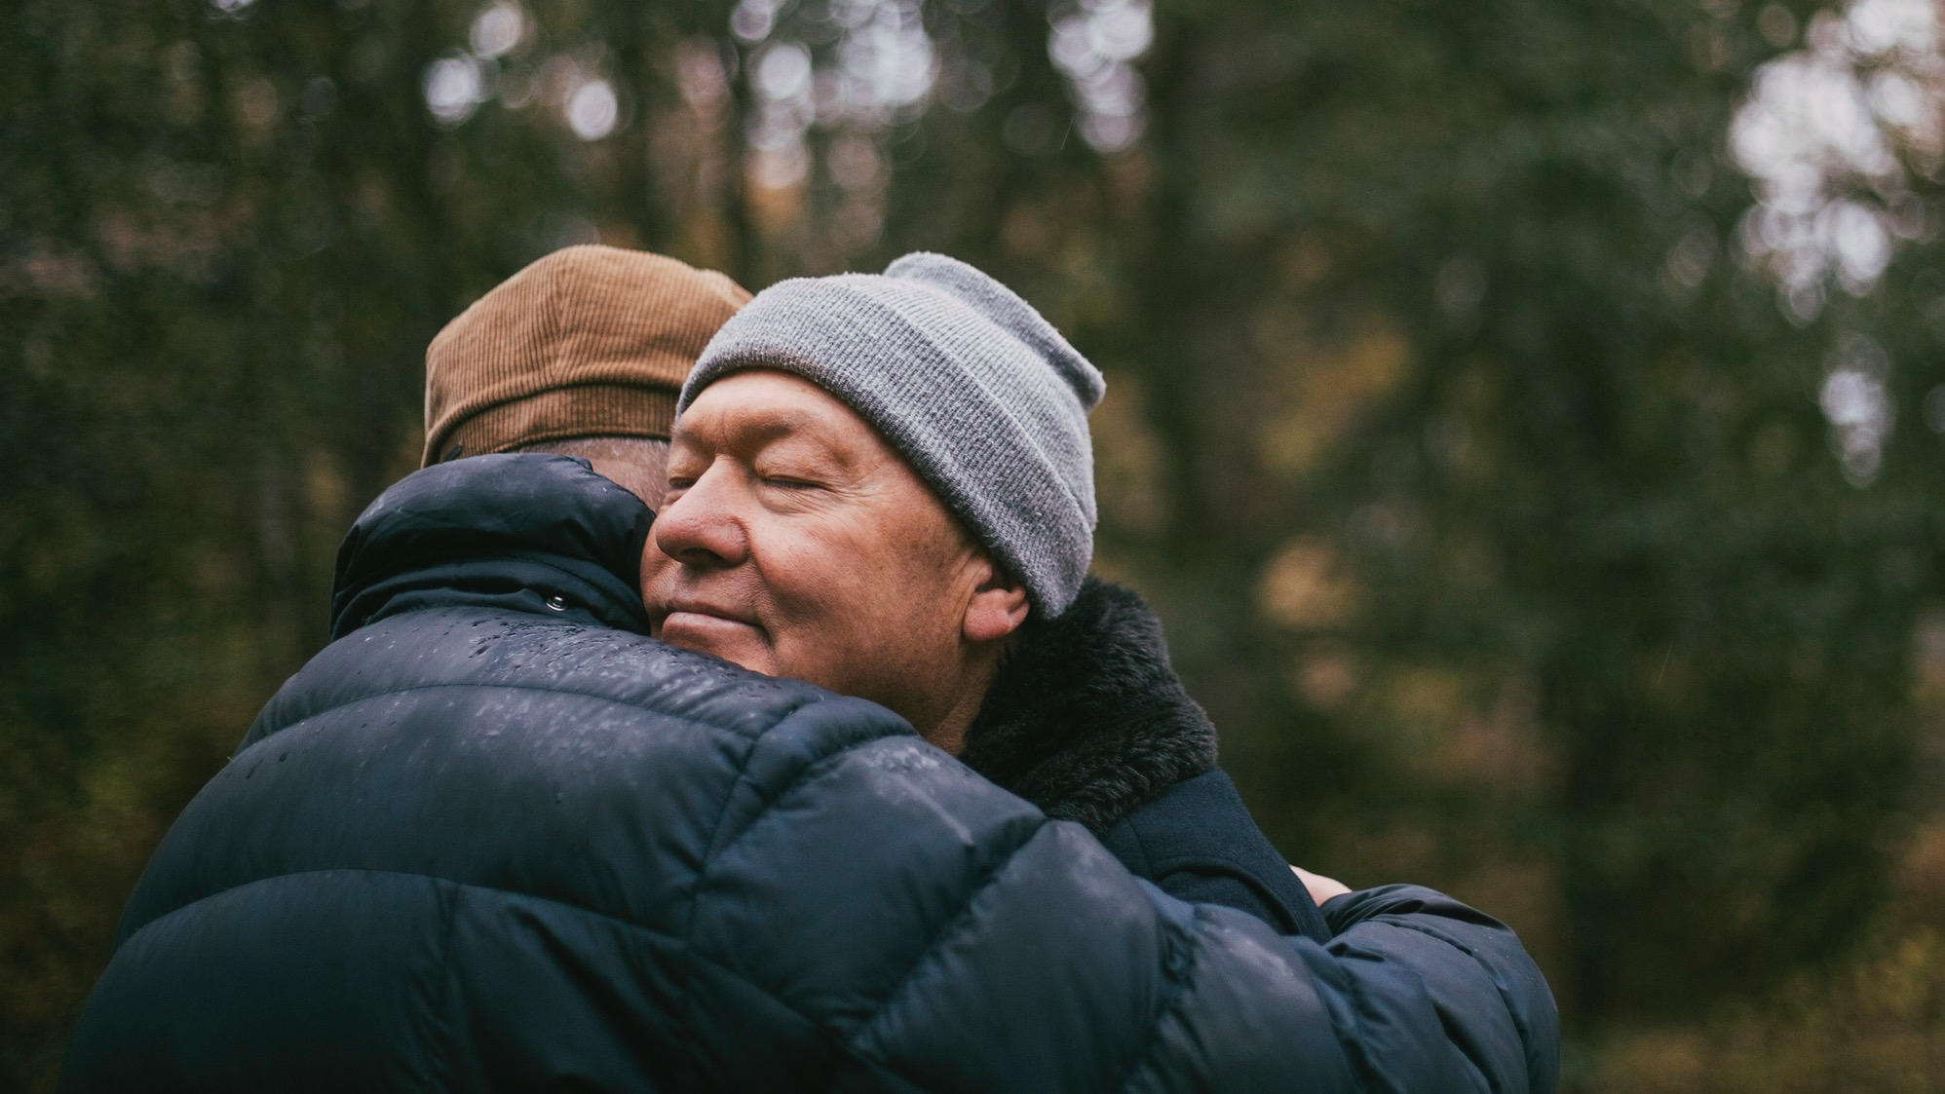
UNIT 12
CHOOSE KINDNESS
“Three things in human life are important: the first is to be kind; the second is to be kind; and the third is to be kind.” (Henry James)
Você concorda com as citações a seguir? Por quê (não)?
JAMES apud MUAH, Stephanie Blay. The importance of kindness. [Alberta, Canada]: Building brains together, 6 abr. 2023. Disponível em: https://www.buildingbrains.ca/blog/the-importance-of-kindness. Acesso em: 17 set. 2024.
“In a world where you can be anything, be kind.” (Caroline Flack)
FLACK, [2019] apud CAROLINE Flack: ‘Be kind,’ social-media users urge. BBC, [London], 17 fev. 2020. Disponível em: https://www.bbc.com/news/blogstrending-51532841. Acesso em: 17 set. 2024.

Slide 3
UNIT 12
Aqui estão alguns exemplos de ações que demonstram gentileza. Em duplas, escolham as ações que vocês costumam realizar.
  Say something nice to a friend.
  Share your lunch with a friend.
  Say “thank you” to your teacher.
  Hold the door open for someone.
  Offer your time to listen to a friend.
  Help a classmate with their homework.
  Offer to carry something heavy for someone.
  Help keep your school clean by picking up trash.
  Give your seat on public transport to someone who looks tired.

Slide 4
UNIT 12
Discuss the following questions with your classmates.
In your opinion, why is kindness a “choice”? Do you always choose to be kind? Why (not)?
Do you believe kindness is something we can practice every day?
How do you feel when someone is kind to you?
In your opinion, why is it important to be kind to yourself?
THINK ABOUT IT!
Há diversas maneiras de praticar a gentileza na comunicação por meio da linguagem verbal. Pequenas frases de apoio ou reconhecimento podem fazer uma grande diferença no dia de alguém. Expressões simples, como “Take care” (Cuide-se) ou “I hope you’re doing well” (Espero que você esteja bem), mostram que nos importamos com a outra pessoa. Quais exemplos de expressões, em inglês e em português, podemos usar nas nossas interações diárias para criar um ambiente mais acolhedor e positivo para todos?

Slide 5
UNIT 12
“I’ve learned that people will forget what you said, people will forget what you did, but people will never forget how you made them feel.”
“Science has now shown that devoting resources to others […]”
“[…] research has also shown that being in a good mood can make you more kind.”
Responda às perguntas a seguir.
a) Qual fragmento apresenta formas verbais no simple past?
b) Quais fragmentos apresentam formas verbais no present perfect?

Slide 6
UNIT 12
“I’ve learned that people will forget what you said, people will forget what you did, but people will never forget how you made them feel.”
“Science has now shown that devoting resources to others […]”
“[…] research has also shown that being in a good mood can make you more kind.”
c) Com exceção de learn (forma básica), que pode ter duas formas no passado e no particípio passado (learned/learnt), todas as formas verbais em negrito são irregulares. Quais são as formas básicas desses verbos?

