Slide 1
VOCABULARY CORNER

Slide 2
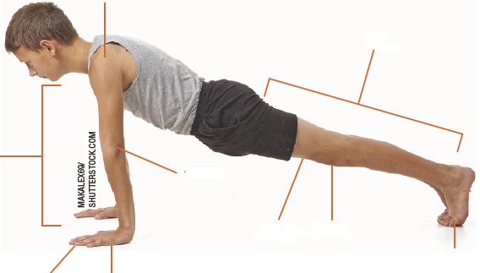
VOCABULARY CORNER
shoulder
foot (sing.)/
feet (pl.)
leg
Unit 1:
THE HUMAN BODY
arm
elbow
knee
thigh
toe
finger
hand

Slide 3
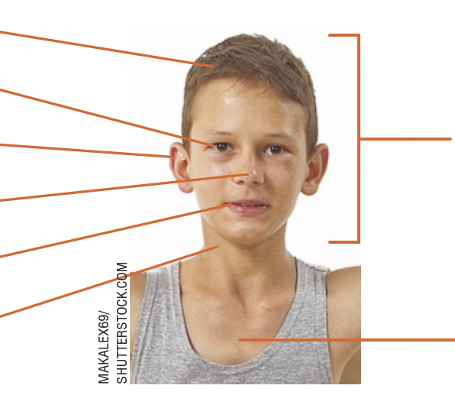
VOCABULARY CORNER
hair
eye
ear
head
Unit 1:
THE HUMAN BODY
nose
mouth
neck
chest

Slide 4
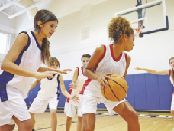
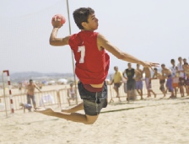
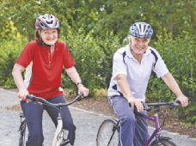
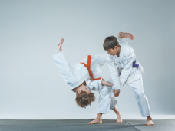
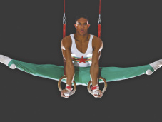
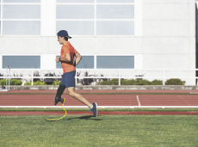
VOCABULARY CORNER
basketball
handball
Unit 2: SPORTS
MASTER1305/
SHUTTERSTOCK.COM
cycling
judo
JUICE DASH/
SHUTTERSTOCK.COM
ANTYPAN/
SHUTTERSTOCK.COM
gymnastics
running

Slide 5
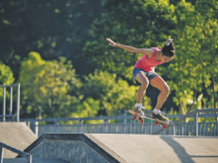
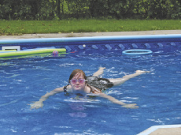
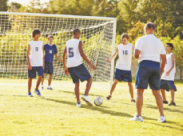
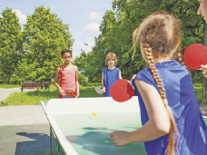
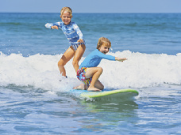
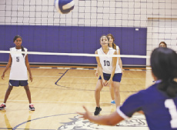
VOCABULARY CORNER
LZF/SHUTTERSTOCK.COM
ANNSCREATIONS/
SHUTTERSTOCK.COM
skateboarding
swimming
MONKEY
BUSINESS IMAGES/
SHUTTERSTOCK.COM
Unit 2: SPORTS
SERGEY NOVIKOV/
SHUTTERSTOCK.COM
soccer
table tennis
MONKEY
BUSINESS IMAGES/
SHUTTERSTOCK.COM
DENIS MOSKVINOV/
SHUTTERSTOCK.COM
surfing
volleyball

Slide 6
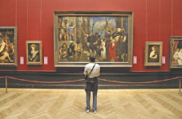
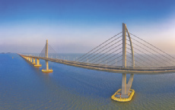
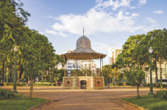
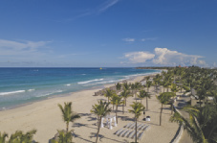
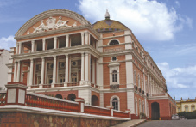
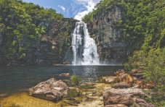
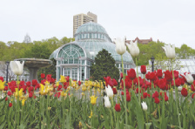
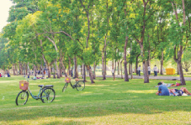
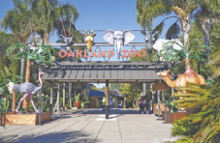
VOCABULARY CORNER
TUPUNGATO/
SHUTTERSTOCK.COM
NICK POON/
SHUTTERSTOCK.COM
HUGO
MARTINS OLIVEIRA/
SHUTTERSTOCK.COM
art museum
bridge
square
WWW.GGGPHOTO.COM/
SHUTTERSTOCK.COM
BUMIHILLS/
SHUTTERSTOCK.COM
VITORMARIGO/
SHUTTERSTOCK.COM
Unit 3: tourist attractions
beach
opera house
waterfall
ANDY-OSK98/
SHUTTERSTOCK.COM
ZENZETA/
SHUTTERSTOCK.COM
BARBARA ASH/
SHUTTERSTOCK.COM
botanical garden
park
zoo

Slide 7
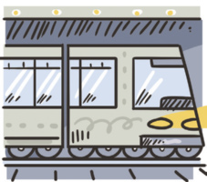
VOCABULARY CORNER
bicycle/bike
car
Unit 3: means of transportation
boat
metro/subway
ILUSTRAÇÕES: GALVÃO BERTAZZI
bus
train

Slide 8
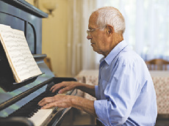
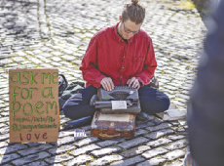
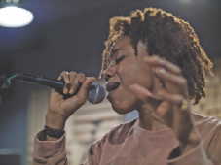
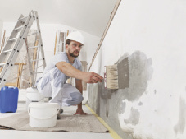
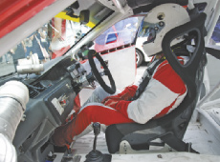
VOCABULARY CORNER
CAFTOR/
SHUTTERSTOCK.COM
ABDUL HAFIZ AB HAMID/
SHUTTERSTOCK.COM
BALANCEFORMCREATIVE/
SHUTTERSTOCK.COM
architect
pianist
scholar
PROSTOCK-STUDIO/
SHUTTERSTOCK.COM
IGEL JARVIS/
SHUTTERSTOCK.COM
BO1982//
SHUTTERSTOCK.COM
Unit 4: occupations
doctor
poet
singer
AMEDEOEMAJA/
SHUTTERSTOCK.COM
THOR JORGEN UDVANG/
SHUTTERSTOCK.COM
EL_CIGARRITO/
SHUTTERSTOCK.COM
painter
racing car driver
writer

Slide 9
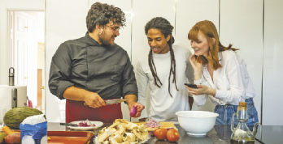
VOCABULARY CORNER
CARTOON NETWORK /
COURTESY EVERETT
COLLECTION / FOTOARENA
cartoon
CARMONAGUERRERO/
CBS/GETTY IMAGES SHUTTERSTOCK.COM
cooking show
Unit 5: kinds of tv shows
VEPOINTSIX/
SHUTTERSTOCK.COM
documentary
CBS/GETTY IMAGES
game show

Slide 10
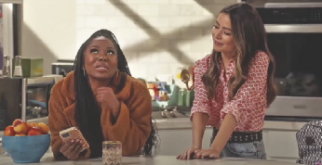
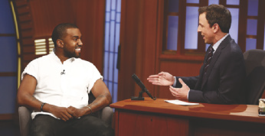
VOCABULARY CORNER
GORODENKOFF/
SHUTTERSTOCK.COM
news
HTTPS://WWW.YOUTUBE.
COM/C/MOVIERAZE
Unit 5: kinds of tv shows
series
ALEXANDRE REZENDE/
FOLHAPRESS
soap (opera)
PETER KRAMER/
GETTY IMAGES
talk show

Slide 11
VOCABULARY CORNER
Inglês - Português |  | Português - Inglês
actually | na verdade, de fato | atualmente | nowadays, today, currently
attend | frequentar, participar de | atender | answer, help
college | faculdade, ensino superior | colégio (Ensino Médio) | high school
confident | confiante | confidente | confidant
expert | especialista | esperto/a | smart, clever
Unit 6: false friends

Slide 12
VOCABULARY CORNER
Inglês - Português |  | Português - Inglês
eventually | finalmente | eventualmente | occasionally
journal | revista científica; diário pessoal; jornal; diário contábil | jornal | newspaper
large | grande, espaçoso/a | largo | wide
lecture | palestra, aula | leitura | reading
library | biblioteca | livraria | book shop
lunch | almoço | lanche | snack
Unit 6: false friends

Slide 13
VOCABULARY CORNER
Inglês - Português |  | Português - Inglês
notice | notar, perceber | notícia | news
novel | romance | novela | soap, soap opera
office | escritório | oficial | official
parents | pais | parentes | relatives
particular | específico/a, exato/a | particular | per sonal, private
policy | política (diretrizes) | polícia | police
Unit 6: false friends

Slide 14
VOCABULARY CORNER
Inglês - Português |  | Português - Inglês
realize | perceber, dar-se conta de | realizar | perform, carry out, fulfill, accomplish
stranger | desconhecido/a, estranho/a | estrangeiro/a | foreigner
support | apoiar | suportar (tolerar) | stand, tolerate
time | tempo | time | team
turn | vez, volta; virar, girar | turno | shift; round
Unit 6: false friends

Slide 15
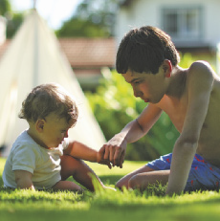
VOCABULARY CORNER
BRICOLAGE/
SHUTTERSTOCK.COM
babysitting
Unit 7: household chores
PROSTOCK-STUDIO/
SHUTTERSTOCK.COM
cooking/ preparing a recipe
ODUA IMAGES/
SHUTTERSTOCK.COM
doing the ironing

Slide 16
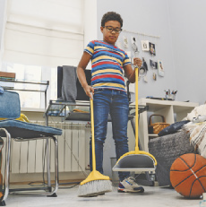
VOCABULARY CORNER
PEOPLEIMAGES.COM - YURI A/
SHUTTERSTOCK.COM
making the bed
Unit 7: household chores
MONKEY BUSINESS IMAGES/
SHUTTERSTOCK.COM
setting the table
DEAN DROBOT/
SHUTTERSTOCK.COM
sweeping the floor

Slide 17
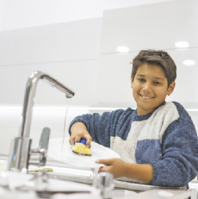
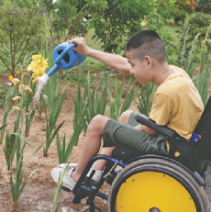
VOCABULARY CORNER
RANTA IMAGES/
SHUTTERSTOCK.COM
taking out the trash
ZURIJETA/
SHUTTERSTOCK.COM
Unit 7: household chores
washing the dishes
ANNGAYSORN/
SHUTTERSTOCK.COM
watering the plants

Slide 18
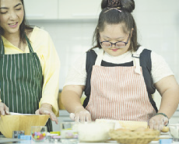
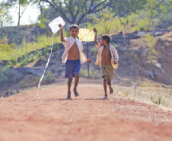
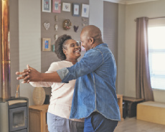
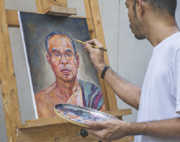
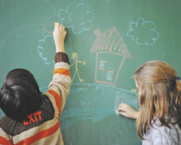
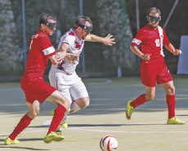
VOCABULARY CORNER
PARTY PEOPLE STUDIO/
SHUTTERSTOCK.COM
NIKS ADS/
SHUTTERSTOCK.COM
cook
fly a kite
MAVO/
SHUTTERSTOCK.COM
HADKHANONG/
SHUTTERSTOCK.COM
Unit 8: abilities
dance
paint
ESB PROFESSIONAL/
SHUTTERSTOCK.COM
VERVERIDIS VASILIS/
SHUTTERSTOCK.COM
draw
play soccer

Slide 19
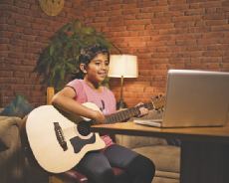
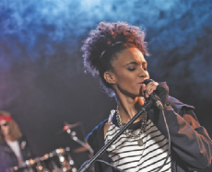
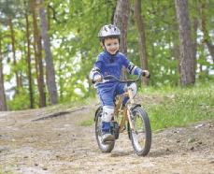
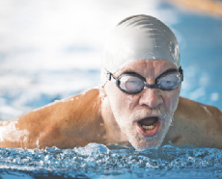
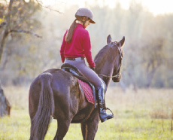
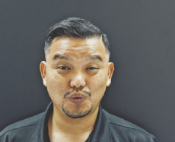
VOCABULARY CORNER
STOCKIMAGEFACTORY.COM/
SHUTTERSTOCK.COM
LIGHTFIELD STUDIOS/
SHUTTERSTOCK.COM
play the guitar
sing
PAVEL KOBYSH/
SHUTTERSTOCK.COM
HALFPOINT/
SHUTTERSTOCK.COM
Unit 8: abilities
ride a bike
swim
SKUMER/
SHUTTERSTOCK.COM
ONGMOJI/
SHUTTERSTOCK.COM
ride a horse
whistle

