Slide 1
Vocabulary corner

Slide 2
VOCABULARY CORNER
2DAY
4EVER
B4
BFF
DM
GR8
ILU
today
forever
before
best friends forever
direct message
great
IMHO
B4N
bye for now
CYA
see ya/see you
FYI
for your information
IDK
I don't know
I love you
in my opinion
IMO
in my humble opinion
Unit 1:
Internet slang

Slide 3
VOCABULARY CORNER
K
PLS
TBT
THX/THKS
U2
UR
XOXO
laughing out loud
please
throwback Thursday
thanks
you too
your
hugs and kisses
OK
LOL
SRY
sorry
TBH
to be honest
TXT
text
Y
why
ZZZ
sleeping
Unit 1:
Internet slang

Slide 4
VOCABULARY CORNER
independent, inevitable
Personal answers.
adjective
Unit 3: word formation: prefixes
unequal, unhappy, unjust,
unsafe, unsustainable
Personal answers.
adjective

Slide 5
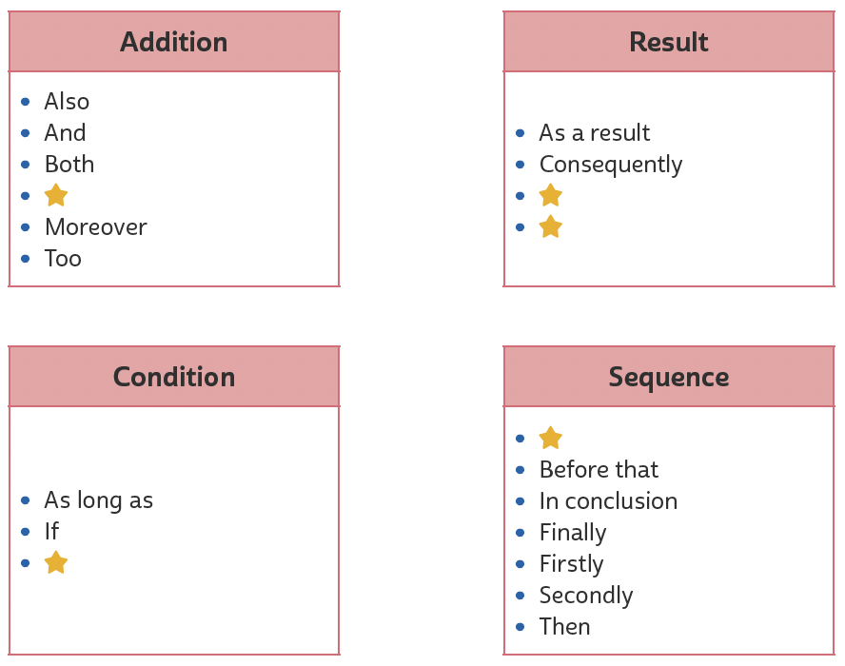
VOCABULARY CORNER
In addition to
So
Therefore
Unit 3: linking words/phrases
After that
Unless

Slide 6
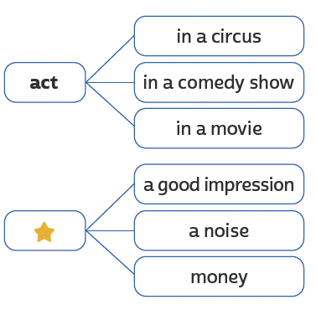
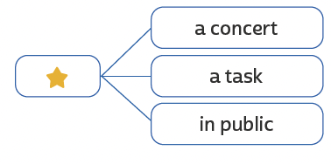
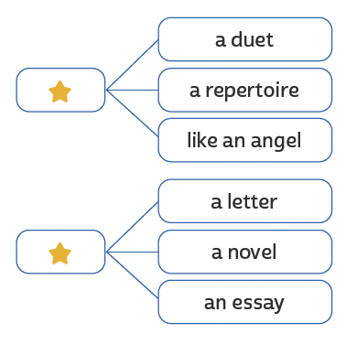
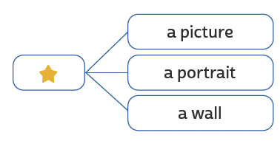
VOCABULARY CORNER
act
perform
Unit 4: collocations
make
sing
paint
write

Slide 7
VOCABULARY CORNER
Unit 4: linking words/phrases
Nevertheless
So
Therefore

Slide 8
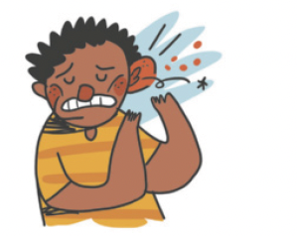
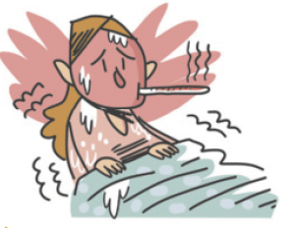
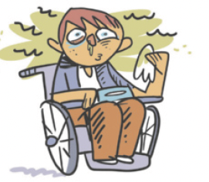
VOCABULARY CORNER
backache
broken leg
cold
Unit 5: health problems
earache
fever
flu

Slide 9
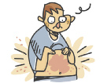
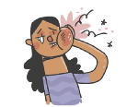
VOCABULARY CORNER
headache
nausea
rash
Unit 5: health problems
ILUTRAÇÕES: GALVÃO BERTAZZI
sore throat
stomachache
toothache

Slide 10
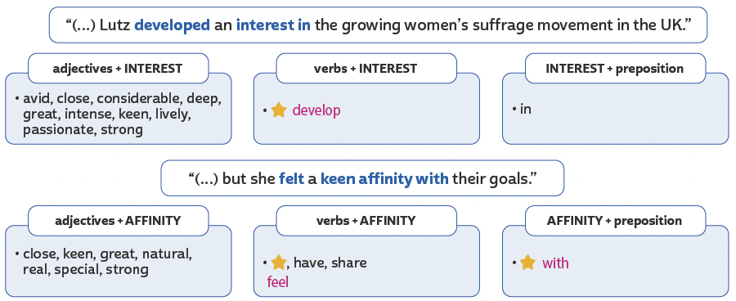
VOCABULARY CORNER
develop
in
Unit 6: collocations
feel, have, share
with

Slide 11
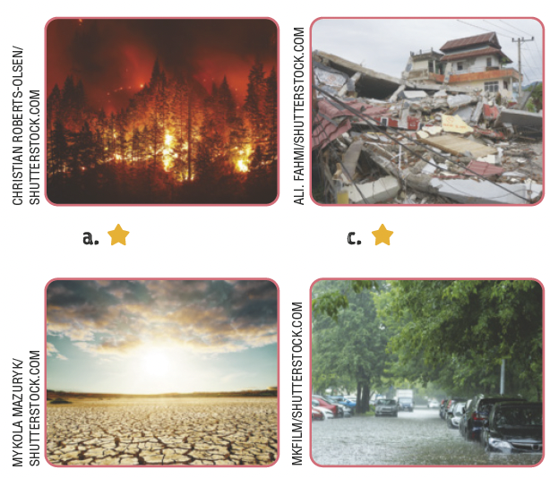
VOCABULARY CORNER
bushfire
earthquake
Unit 7: natural disasters
drought
flood

Slide 12
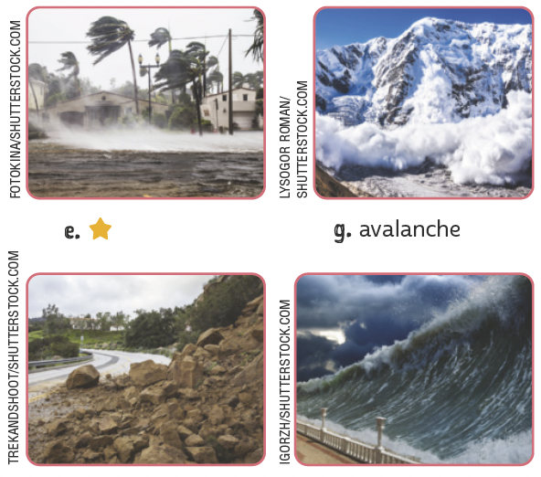
VOCABULARY CORNER
hurricane
avalanche
Unit 7: natural disasters
landslide
tsunami

Slide 13
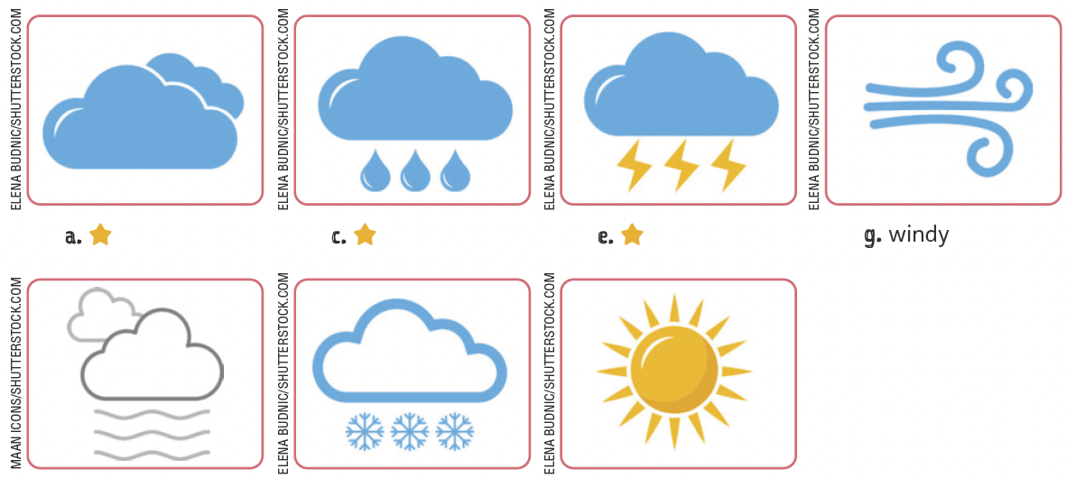
VOCABULARY CORNER
Unit 7: the weather
cloudy
rainy
stormy
windy
foggy
snowy
sunny

Slide 14
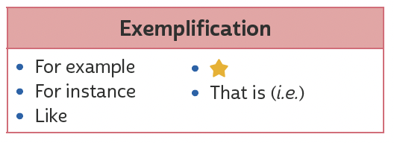
VOCABULARY CORNER
Unit 8: linking words/phrases
Such as

Slide 15
VOCABULARY CORNER
adventure
comedy
Unit 8: kinds of movie
action
documentary
animation
drama

Slide 16
VOCABULARY CORNER
fantasy
musical
Unit 8: kinds of movie
science fiction
thriller
romance
western

