Slide 1
Unit 5

Slide 2
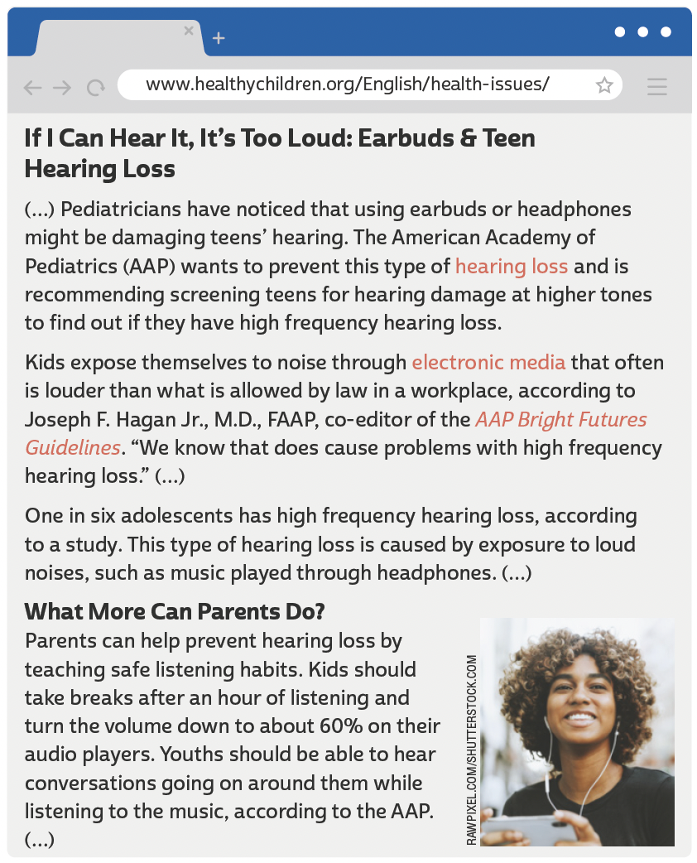
UNIT 5
LANGUAGE NOTE
Damage can be either a noun
(dano) or a verb (danificar).
In “earbuds or headphones
might be damaging teens’
hearing”, damage is a verb.
In “screening teens for
hearing damage at higher
tones”, damage is a noun.
AMERICAN ACADEMY OF PEDIATRICS. If I can hear it, it's too loud: earbuds & teen hearing loss. 16 mar. 2017. Disponível em: www.healthychildren.org/English/health-issues/conditions/ear-nose-throat/Pages/Acoustic-Trauma-Hearing-Loss-in-Teenagers.aspx. Acesso em: 21 jun. 2022.

Slide 3
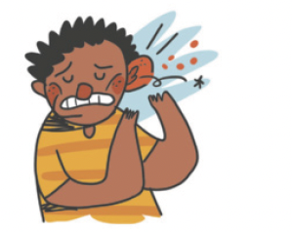
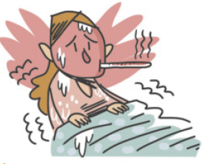
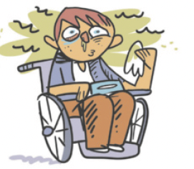
UNIT 5
backache
broken leg
cold
Health problems
earache
fever
flu

Slide 4
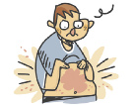
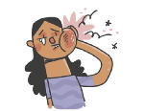
UNIT 5
headache
nausea
rash
Health problems
ILUTRAÇÕES: GALVÃO BERTAZZI
sore throat
stomachache
toothache

Slide 5
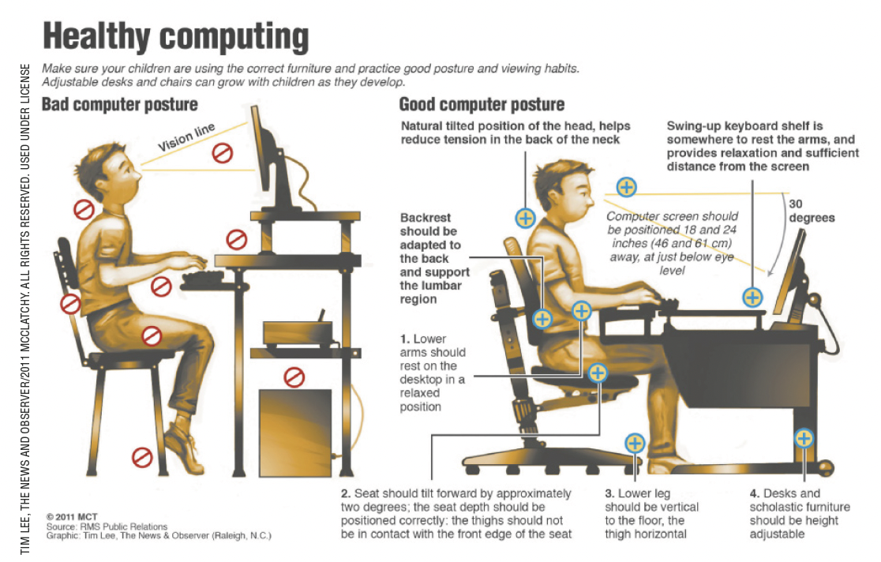
UNIT 5
MCT. Healthy computing. 2011. Infográfico. Disponível em: http://bloximages.chicago2.vip.townnews.com/journalstar.com/content/tncms/assets/v3/editorial/f/fa/ffa22316-f786-5f41-81ce-62198560508b/4d99e78ac99c8.pdf.pdf. Acesso em: 10 jul. 2022.

Slide 6
UNIT 5
I. “Kids should take breaks after an hour of listening (...)”
II. “Youths should be able to hear conversations going on around them (...)”
MODAL VERBS: should, must, have to
The modal verb SHOULD expresses
We use SHOULD
a recommendation.
before the main verb in the infinitive (without to).

Slide 7
UNIT 5
I. “The family will have to know soon because her pregnancy will become obvious”.
II. “When setting limits, it’s important always to be consistent. Rules must stay the same from one day to the next”.
MODAL VERBS: should, must, have to
The modal verbs must and have to express
We use must and have to
necessity, obligation.
before the main verb in the infinitive (without to).
In order to express an obligation/necessity in the past or future, we use the modal verb
have to.
LANGUAGE NOTE
We use must not (= mustn’t) to express a prohibition.
E.g.: You mustn’t come. (You are not allowed to come).
We use not have to to express lack of necessity or obligation.
E.g.: You don’t have to come. (You don’t need to come).

