Slide 1
Unit 2

Slide 2
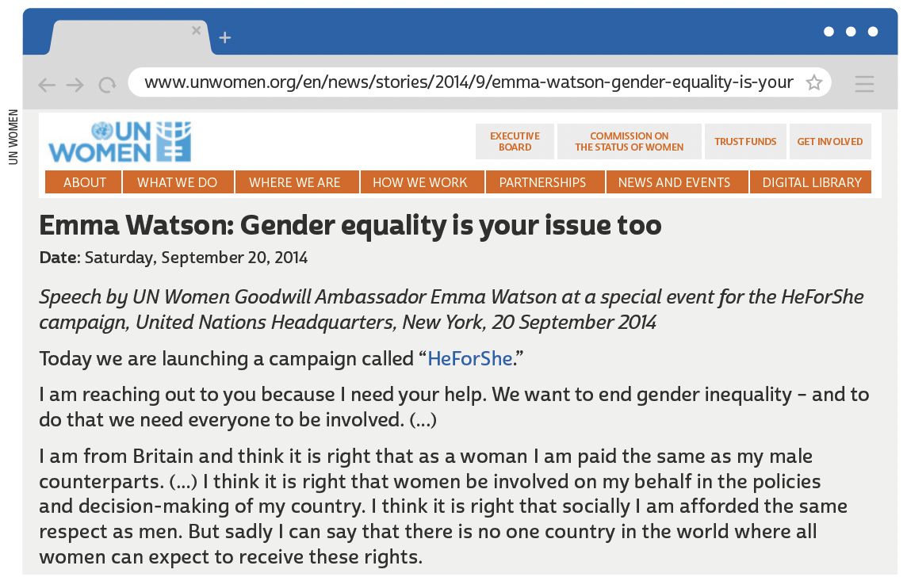
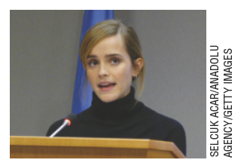
UNIT 2
Emma Watson is an actress and activist. She is famous for her participation in the Harry Potter film series. She is United Nations Women Goodwill Ambassador.

Slide 3
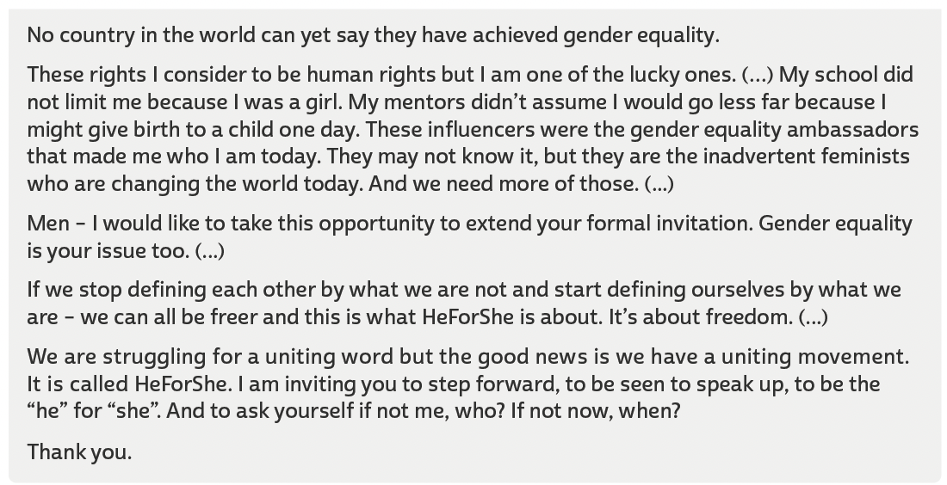
UNIT 2
TIP
Observe a importância da
língua inglesa em textos,
como o discurso de Emma
Watson, para a divulgação
e discussão de diferentes
ideias e posicionamentos
políticos.
UN WOMEN. Emma Watson: gender equality is your issue too. 20 set. 2014. Disponível em: www.unwomen.org/en/news/stories/2014/9/emma-watson-gender-equality-is-your-issue-too. Acesso em: 22 jun. 2022.

Slide 4
UNIT 2
“...Racism is the biggest problem facing football across Europe. People may think it has disappeared, but it hasn’t. It’s time for us all to take a stand – players, fans and authorities. It’s time to stand up and speak up”.
THIERRY HENRY
Multi-word verbs
TIP
Anúncios publicitários
(advertisements ou ads)
empregam recursos verbais e não verbais para chamar a atenção de determinado público-alvo e persuadi-lo a consumir um produto ou a aderir a uma ideia.
What is the meaning of stand up in the advertisement?
a. To be on your feet.
b. To deal effectively with a difficult situation.

Slide 5
UNIT 2
I. “I might give birth to a child one day.”
II. “They may not know it”
“I might give birth to a child one day” is equivalent in meaning to
In fragments I and II, may and might express
Perhaps I will give birth to a child one day.
“They may not know it” is equivalent in meaning to
Perhaps they don’t know it.
possibility.
MODAL VERBS: MAY, MIGHT, MUST
LANGUAGE NOTE
We use modal verbs such as may, might and must before the main verb in the infinitive (without to).

Slide 6
UNIT 2
I. “we must make sure we equip children for all facets of life”
II. “we must ensure that male and female children share equal obligations”
MODAL VERBS: MAY, MIGHT, MUST
“we must ensure that male and female children share equal obligations” is equivalent in meaning to
In fragments I and II, must expresses
it is necessary that we ensure that male and female children share equal obligations.
Necessity,
LANGUAGE NOTE
We use modal verbs such as may, might and must before the main verb in the infinitive (without to).

Slide 7
UNIT 2
“Again, it may be said, that to love justice and equality the people need no great effort of virtue; it is sufficient that they love themselves.” (Maximilien Robespierre)
“One of the things about equality is not just that you be treated equally to a man, but that you treat yourself equally to the way you treat a man.” (Marlo Thomas)
“I want for myself what I want for other women, absolute equality.” (Agnes Macphail)
REFLEXIVE PRONOUNS
ROBESPIERRE, Maximilien. Again, it may be said, that to love justice and equality... In: WREN, Linnea H. (Ed.). Perspectives on Western art. Nova York: Routledge, 1994. v. 2, p. 212.; THOMAS, Marlo. One of the things about equality is not just you be treated equally to a man... In: DEMAKIS, Joseph. The ultimate book of quotations. Raleigh: Lulu, 2012. p. 101.; MacPHAIL, Agnes. I want for... In: GREAT CANADIAN SPEECHES. Agnes Macphail on women's equality, 1925, 1930. [2022?]. Disponível em: https://greatcanadianspeeches.ca/2017/10/27/agnes-macphail-on-womensequality-1925-1930/. Acesso em: 22 jun. 2022.

