Slide 1

Vocabulary corner

Slide 2
VOCABULARY CORNER
Digital devices
mobile (phone)/ cell (phone)
computer
television/ TV
tablet
Unit 1:
WORD GROUPS

Slide 3
VOCABULARY CORNER
Daily activities
take/have a shower
have/eat breakfast
wash face
read (a book)
walk/ go for a walk
stretch
Unit 1:
WORD GROUPS

Slide 4
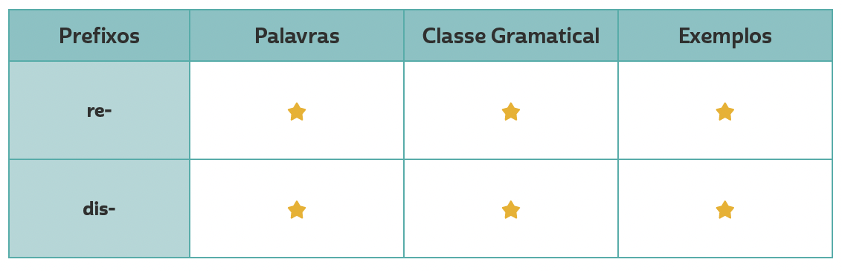
VOCABULARY CORNER
refocus
review
Personal answers.
Unit 1:
WORD FORMATION: PREFIXES
verb
Personal answers.
disconnection
noun

Slide 5
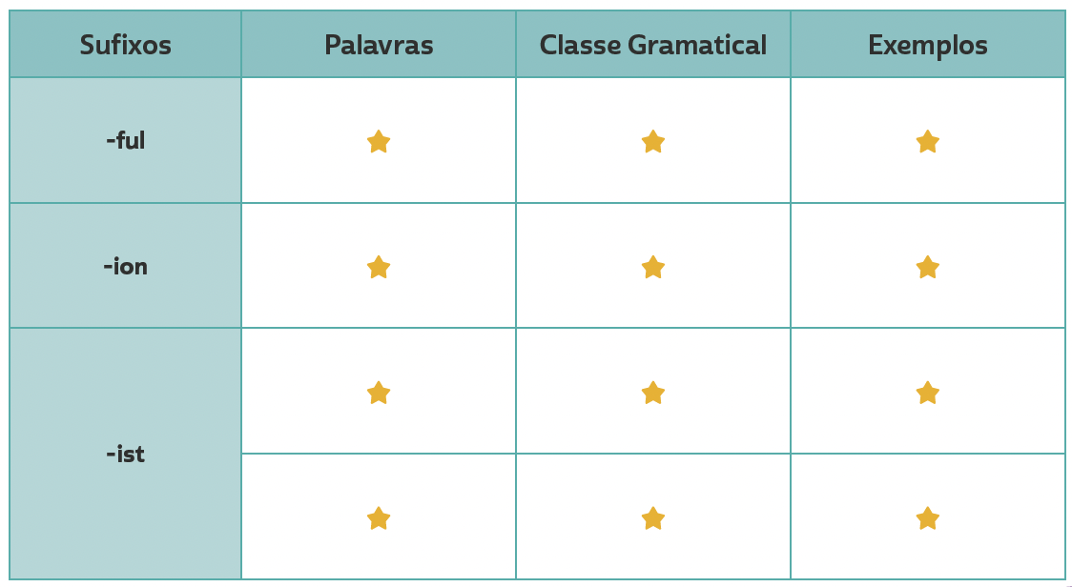
VOCABULARY CORNER
beautiful, painful
Personal answers.
adjective
oppression, separation
Personal answers.
Unit 2: word formation: suffixes
noun
artist, scientist, journalist
noun
Personal answers.
pacifist, racist
Personal answers.
adjective

Slide 6
VOCABULARY CORNER
brave
movie
of course
outgoing
rude
shy
to begin
to cope with
= courageous
= film
= definitely
= sociable
= impolite
= timid
= to start
= to deal with
Unit 3: synonyms

Slide 7
VOCABULARY CORNER
to cope with
to dislodge
to end
to set
useful
vital
wonderful
= to deal with
= to replace
= to finish
= to establish
= helpful
= essential
= marvelous
Unit 3: synonyms

Slide 8
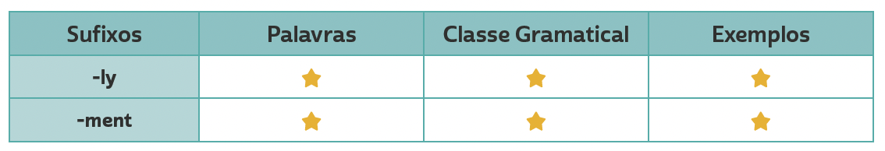
VOCABULARY CORNER
Unit 4: word formation: suffixes
consistenly, deeply
adverb
Personal answers.
commitment
noun
Personal answers.

Slide 9






VOCABULARY CORNER
DISNEY-HYPERION
HARPERCOLLINS
DC
adventure novel
children’s novel
comics
Unit 5: book genres
BROADWAY BOOKS
WORDSWORTH EDITIONS
HARVEST BOOKS
biography
classic
fable

Slide 10






VOCABULARY CORNER
INDEPENDENTLY PUBLISHED
HARPERONE
SCHOLASTIC
fanfiction
memoir
play script
Unit 5: book genres
SCHOLASTIC
WEST MARGIN PRESS
GLOBAL EDITORA
fantasy novel
mystery
poetry

Slide 11






VOCABULARY CORNER
GRAND CENTRAL PUBLISHING
RANDOM HOUSE TRADE
STORM HOUSE BOOKS
romance novel
self-help
suspense/ thriller
Unit 5: book genres
SIMON & SCHUSTER
MARINER BOOKS
PUFFIN BOOKS
science fiction
short stories
young adult novel

Slide 12







VOCABULARY CORNER
quiet
talkative
Unit 6: adjectives
hard-working
lazy
ILUSTRAÇÕES: GALVÃO BERTAZZI
funny
serious

Slide 13


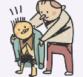

VOCABULARY CORNER
outgoing/sociable
shy/timid
Unit 6: adjectives
ILUSTRAÇÕES: GALVÃO BERTAZZI
generous
mean

Slide 14
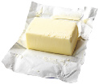



VOCABULARY CORNER
dairy
Unit 7: FOOD
butter
milk
cheese
yogurt

Slide 15



VOCABULARY CORNER
FRUIT
Unit 7: FOOD
apple
blueberries
kiwi
banana
grapes

Slide 16






VOCABULARY CORNER
FRUIT
PHIVE/
SHUTTERSTOCK.COM
Unit 7: FOOD
lemon
mango
orange
lime
melon

Slide 17
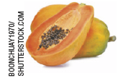




VOCABULARY CORNER
FRUIT
Unit 7: FOOD
papaya
strawberries
watermelon
PIXAHUB/
SHUTTERSTOCK.COM
pineapple
tomato

Slide 18




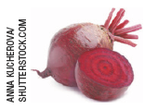
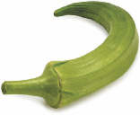


VOCABULARY CORNER
VEGETABLES
Unit 7: FOOD
aubergine/ eggplant
broccoli
lettuce
beetroot/ beet
carrot
okra

Slide 19
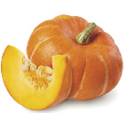

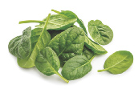

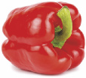



VOCABULARY CORNER
VEGETABLES
HAPPY AUTHOR/
SHUTTERSTOCK.COM
Unit 7: FOOD
pumpkin
spinach
sweetcorn
red pepper
swede/ rutabaga
sweet potato

Slide 20
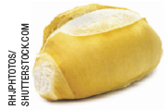

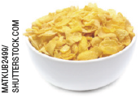

VOCABULARY CORNER
grains
Unit 7: FOOD
bread
pasta
cereal
rice

Slide 21
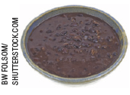




VOCABULARY CORNER
Meat and beans
Unit 7: FOOD
black beans
egg
chicken
fish

Slide 22
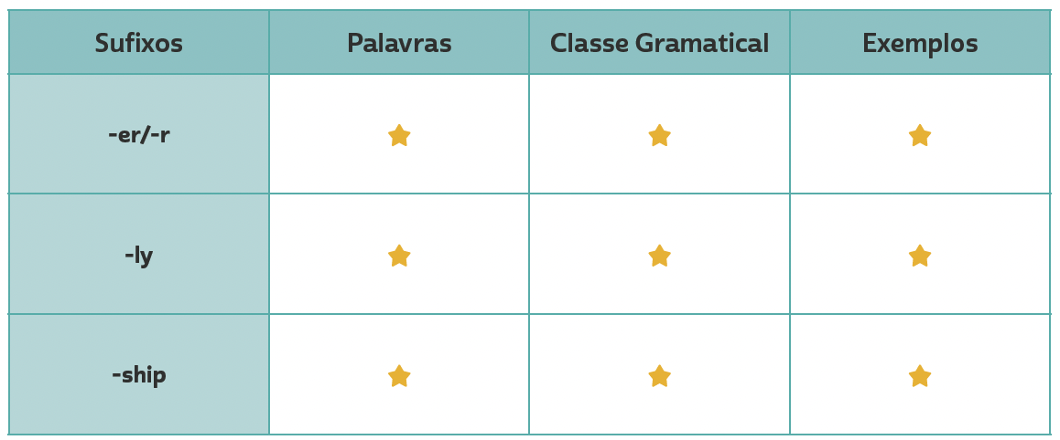
VOCABULARY CORNER
researcher, worker, observer
Personal answers.
noun
Unit 8: word formation: suffixes
gradually, quickly,
surprisingly
adverb
Personal answers.
friendship,
membership,
relationship
Personal answers.
noun

