Slide 1

Unit 7

Slide 2
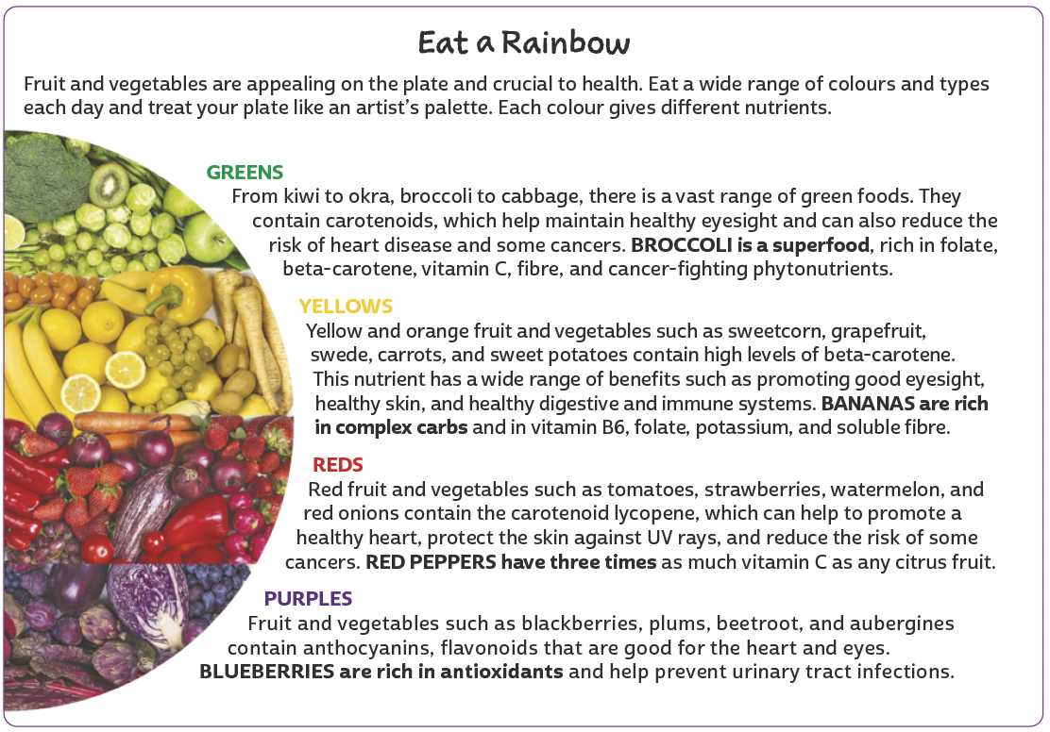
UNIT 7
TIP
Use o que você já sabe sobre
o assunto do texto para
estabelecer hipóteses sobre
o que você vai ler.
ELENA SCHWEITZER/SHUTTERSTOCK.COM
LANGUAGE NOTE
colour (BrE) = color (AmE)
fibre (BrE) = fiber (AmE)
Adaptado de: CLARKE, Jane. Complete family nutrition. Londres: DK Publishing, 2014. p. 34-35.

Slide 3
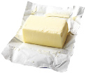



UNIT 7
dairy
FOOD
butter
milk
cheese
yogurt

Slide 4



UNIT 7
FRUIT
FOOD
apple
blueberries
kiwi
banana
grapes

Slide 5






UNIT 7
FRUIT
PHIVE/
SHUTTERSTOCK.COM
FOOD
lemon
mango
orange
lime
melon

Slide 6





UNIT 7
FRUIT
FOOD
papaya
strawberries
watermelon
PIXAHUB/
SHUTTERSTOCK.COM
pineapple
tomato

Slide 7

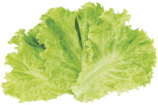


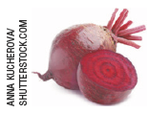



UNIT 7
VEGETABLES
FOOD
aubergine/ eggplant
broccoli
lettuce
TIP
Note que vegetables são plantas ou partes de plantas usadas como comida e
incluem tanto legumes quanto verduras. Informalmente, são chamados de veggies.
beetroot/ beet
carrot
okra

Slide 8
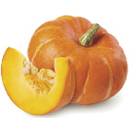



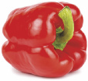



UNIT 7
VEGETABLES
HAPPY AUTHOR/
SHUTTERSTOCK.COM
FOOD
pumpkin
spinach
sweetcorn
red pepper
swede/ rutabaga
sweet potato

Slide 9


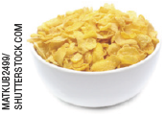

UNIT 7
grains
FOOD
bread
pasta
cereal
rice

Slide 10
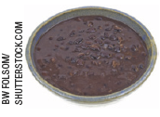




UNIT 7
Meat and beans
FOOD
black beans
egg
chicken
fish

Slide 11
UNIT 7
I. “Broccoli is a superfood, rich in folate (...)”
II. “Red peppers have three times as much vitamin C as any citrus fruit.”
III. “Bananas are rich in complex carbs (...)”
IV. “We do need some sugar, for energy (…)”
Countable and uncountable nouns
COUNTABLE NOUNS
(red pepper, banana)
UNCOUNTABLE NOUNS
(broccoli, sugar)
refer to things you can count. They have a singular and a plural form.
refer to things you can’t count. They only have a singular form.

Slide 12
UNIT 7
I. “Many people are unaware of how much sugar they’re eating”
II. “We do need some sugar, for energy”
III. “refined sugar doesn’t contain any other nutrients.”
Expressions of quantity
LANGUAGE NOTE
MANY
MUCH
refers to people (countable noun).
SOME and ANY
refer to an indefinite quantity.
refers to sugar (uncountable noun).
Some and any are used when it is not important or easy to say exactly how much/ how many of something we are thinking of. We usually use some in affirmative sentences and any in negative and interrogative sentences. We use some in interrogative
sentences (offers and requests) if we expect people to answer “affirmatively”.
E.g.: Can I have some sugar, please?

