Slide 1
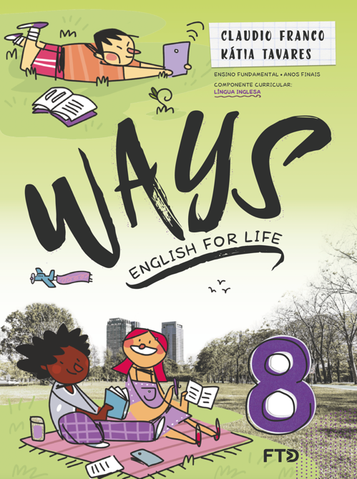
Unit 5

Slide 2
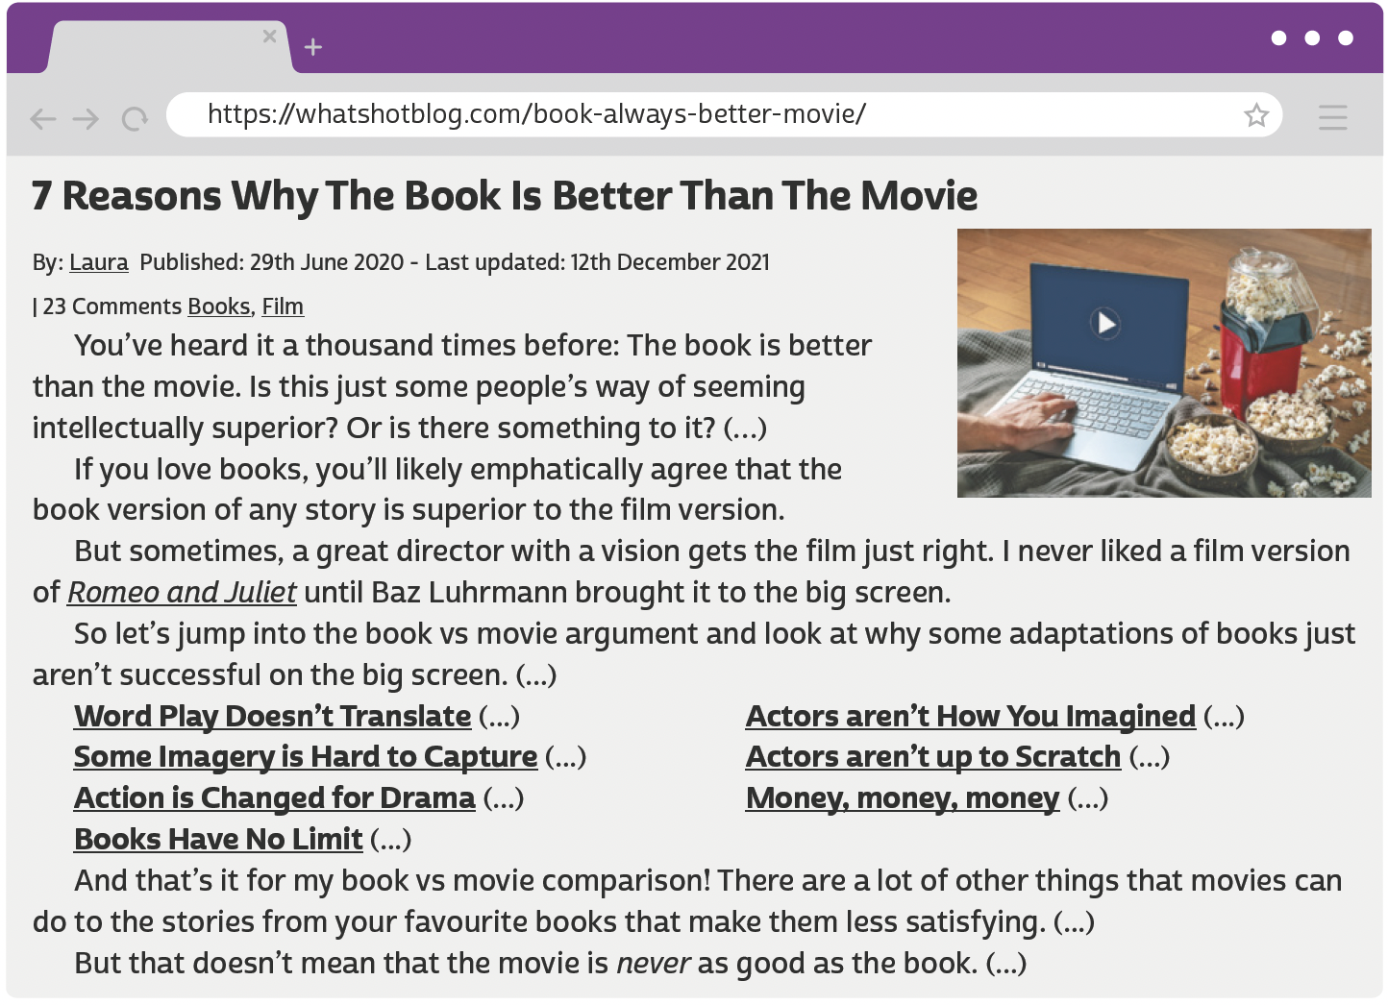
UNIT 5
CLICK98/SHUTTERSTOCK
LANGUAGE NOTE
better ➡️ comparative of good
E.g.: The movie is good, but the book is better.
LAURA. 7 Reasons why the book is better than the movie. What’s Hot?, 29 jun. 2020. Disponível em: https://whatshotblog.com/book-always-better-movie/. Acesso em: 5 jun. 2022.

Slide 3
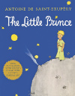
UNIT 5
DISNEY-HYPERION
HARPERCOLLINS
DC
adventure novel
children’s novel
comics
BOOK GENRES
TIP
BROADWAY BOOKS
WORDSWORTH EDITIONS
HARVEST BOOKS
Agrupar as palavras por
assunto é uma boa forma
de aprender e fixar
vocabulário novo.
biography
classic
fable

Slide 4
Unit 5
INDEPENDENTLY PUBLISHED
HARPERONE
SCHOLASTIC
fanfiction
memoir
play script
book genres
SCHOLASTIC
WEST MARGIN PRESS
GLOBAL EDITORA
fantasy novel
mystery
poetry

Slide 5
Unit 5
GRAND CENTRAL PUBLISHING
RANDOM HOUSE TRADE
STORM HOUSE BOOKS
romance novel
self-help
suspense/ thriller
book genres
SIMON & SCHUSTER
MARINER BOOKS
PUFFIN BOOKS
science fiction
short stories
young adult novel

Slide 6
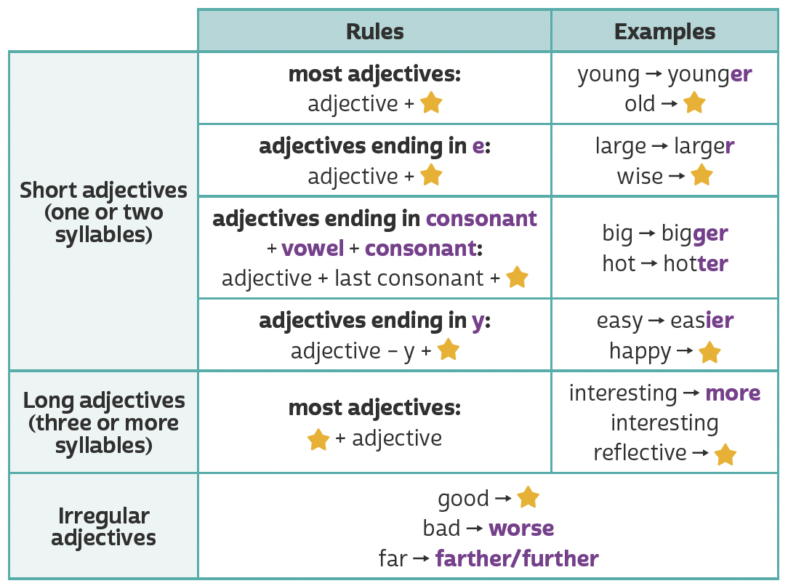
UNIT 5
er
older
r
wiser
Making comparisons (comparative adjectives)
er
ier
happier
TIP
more
more
reflective
A partir da observação dos exemplos, faça
inferências para
compreender regras
de uso da língua inglesa.
better

Slide 7
UNIT 5
What is your favorite book?
What do you think of...?
Is it better/worse/more interesting than...?
Why (not)?
Who is your favorite character?
Why?
What do you think of...?
Is he/she braver/smarter/more intelligent than...?
Who is your favorite writer?
Why?
What do you think of...?
Is he/she more successful/more popular/better than...?
What are you reading right now?
Who is it by?
What is it about?
What was the last book that you read?
Who was it by?
What was it about?
LANGUAGE NOTE
Having a guess: Probably…/I’d say (that)…/Chances are (that)…
Remembering things: As I remember/recall…/If I’m not mistaken…/It’s on the tip of my tongue.
Expressing a preference: I (much) prefer memoirs to biographies./I’d (much) prefer to/I’d rather read a novel./Reading comic books is more my kind of thing.

