Slide 1
Unit 6

Slide 2
UNIT 6
A MUTUAL CALLING
by Lauren Belski, New York, New York
Brian and I have been married three years, but we’ve been together ten. We met as AmeriCorps volunteers on the Pine Ridge Indian Reservation in Porcupine, South Dakota – a tucked-away place with a scattered population of 1,000. He taught computers and played guitar. I taught English and wrote poetry. In the volunteer house, we courted each other by making a phone out of tin cans and a string. I still remember his voice in my ear. Automatic goose bumps. A year later, our mothers discovered we were born in the same hospital in New Jersey, 1,600 miles away.
14 MINI essays that prove the meaning of love in 100 words or less. Reader's Digest, 14 fev. 2019. Disponível em: www.rd.com/article/100-word-love-stories/. Acesso em: 16 jun. 2022.

Slide 3
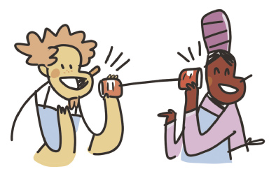
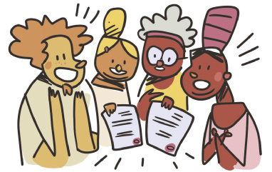
UNIT 6
A MUTUAL CALLING
by Lauren Belski, New York, New York
Lauren and Brian met as AmeriCorps volunteers.
ILUSTRAÇÕES: GALVÃO BERTAZZI
Lauren and Brian courted each other by making a phone out of tin cans and a string.
Lauren and Brian’s mothers discovered they were born in the same hospital.

Slide 4
UNIT 6
LOVE BOAT REUNION
by Rick Bennette, Tequesta, Florida
The moment I met Denise aboard the Love Boat, I knew she was someone special. She became my first love, but we lived 90 miles apart. After the cruise, we maintained our love affair
through handwritten letters. Eventually, geography took its toll. We went on to separate lives, yet I thought about her quite often. Thirty years later, we reunited in Grand Central Station. I hired a violinist to play our love song as we held each other for the first time in three decades. After wishing to be with her all those years apart, we finally married.
14 MINI essays that prove the meaning of love in 100 words or less. Reader's Digest, 14 fev. 2019. Disponível em: www.rd.com/article/100-word-love-stories/. Acesso em: 16 jun. 2022.

Slide 5
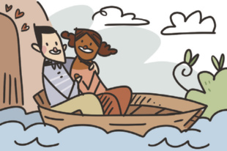
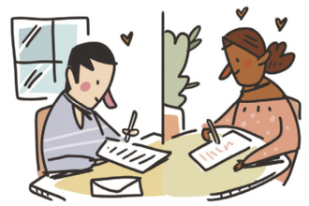
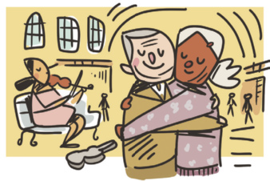
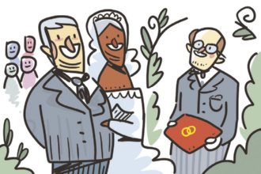
UNIT 6
LOVE BOAT REUNION
by Rick Bennette, Tequesta, Florida
Rick met Denise aboard the Love Boat.
Rick and Denise maintained their love
affair through handwritten letters.
ILUSTRAÇÕES: GALVÃO BERTAZZI
Rick and Denise reunited in Grand Central Station.
Rick and Denise finally married.

Slide 6
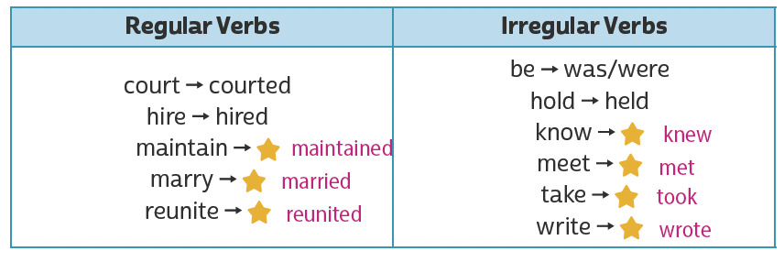
UNIT 6
Simple past (irregular verbs)
TIP
Para ajudar você na fixação de verbos regulares e irregulares
no simple past, organize-os em uma tabela como as apresentadas aqui.

