Slide 1
Unit 4

Slide 2
UNIT 4
T. LESIA/SHUTTERSTOCK.COM;
PER-ANDERS PETTERSSON/
GETTY IMAGES
Adaptado de: THE LIFE of Nelson Mandela. Eyewitness News, 2022. Disponível em: https://ewn.co.za/2013/12/06/The-life-of-Nelson-Mandela. Acesso em: 22 jun. 2022.

Slide 3
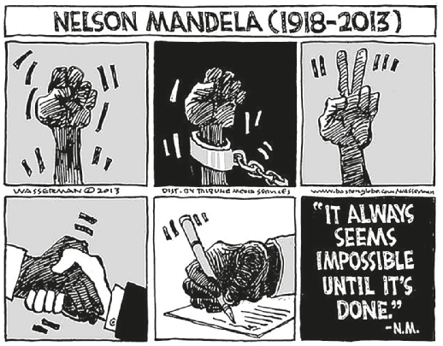
UNIT 4
“sentenced to
life imprisonment”
“co-founds ANC
Youth League”
“released from prison”
TIP
Busque sempre estabelecer
relações entre os textos que você lê para ampliar sua compreensão deles e do mundo.
DAN WASSERMAN/TCA
“wins the Nobel
Peace Prize”
“elected president”
WASSERMAN, Dan. Nelson Mandela (1918-2013). Star Tribune, 6 dez. 2013. Disponível em: www.startribune.com/editorial-cartoon-nelsonmandela/234683131/. Acesso em: 22 jun. 2022.

Slide 4
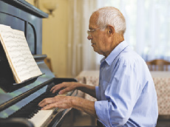
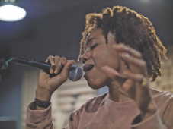
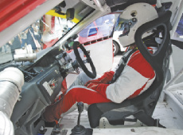
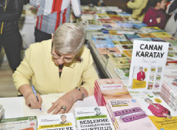
UNIT 4
CAFTOR/
SHUTTERSTOCK.COM
ABDUL HAFIZ AB HAMID/
SHUTTERSTOCK.COM
BALANCEFORMCREATIVE/
SHUTTERSTOCK.COM
architect
pianist
scholar
PROSTOCK-STUDIO/
SHUTTERSTOCK.COM
IGEL JARVIS/
SHUTTERSTOCK.COM
BO1982//
SHUTTERSTOCK.COM
occupations
doctor
poet
singer
AMEDEOEMAJA/
SHUTTERSTOCK.COM
THOR JORGEN UDVANG/
SHUTTERSTOCK.COM
EL_CIGARRITO/
SHUTTERSTOCK.COM
painter
racing car driver
writer

Slide 5
Unit 4
IN
ON
AT
years (1937, 2020)
dates (May 3, my birthday)
ages (12, eighteen)
a specific time (10 a.m., 3 o’clock)
days (Sunday, Tuesdays)
months (May, December)
centuries (the XIX century, last century)
seasons (summer, winter)
long periods (the past, the future)
Prepositions of time (in, on, at)

