Slide 1
VOCABULARY
CORNER

Slide 2
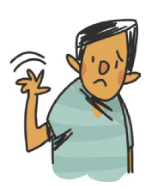
VOCABULARY CORNER
SAYING HELLO:
SAYING GOODBYE:
Unit 1:
GREETINGS AND FAREWELLS
Hi.
Hi, there.
Hiya.
Bye.
Bye bye.
See you./See ya.

Slide 3
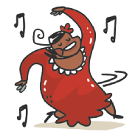
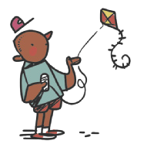
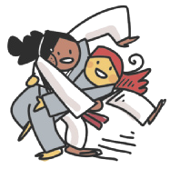
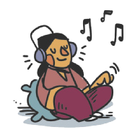
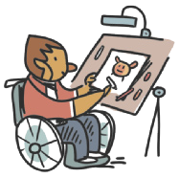
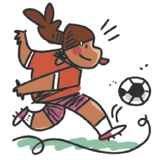
VOCABULARY CORNER
dancing
flying a kite
Unit 2: PERSONAL INTERESTS
doing judo
listening to music
drawing
playing soccer

Slide 4
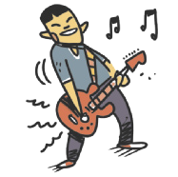
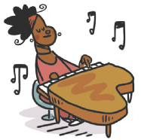
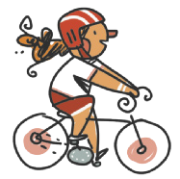
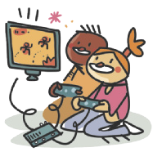
VOCABULARY CORNER
playing the guitar
reading
Unit 2: PERSONAL INTERESTS
playing the piano
riding a bike/cycling
playing video games
singing

Slide 5
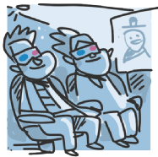
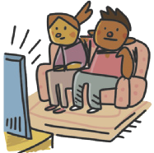
VOCABULARY CORNER
surfing the net
watching movies
Unit 2: PERSONAL INTERESTS
swimming
watching TV

Slide 6
VOCABULARY CORNER
1 one
2 two
3 three
4 four
5 five
6 six
7 seven
8 eight
9 nine
10 ten
11 eleven
12 twelve
13 thirteen
14 fourteen
15 fifteen
16 sixteen
17 seventeen
18 eighteen
19 nineteen
20 twenty
21 twenty-one
22 twenty-two
23 twenty-three
29 twenty-nine
30 thirty
40 forty
50 fifty
60 sixty
70 seventy
80 eighty
90 ninety
100 a/one hundred
Unit 2: CARDINAL NUMBERS
TIP
Observe que os números
de 13 a 19 apresentam a
terminação -teen. A palavra
teenager se refere a quem
tem entre 13 e 19 anos.

Slide 7
VOCABULARY CORNER
1st first
2nd second
3rd third
4th fourth
5th fifth
6th sixth
7th seventh
8th eighth
9th ninth
10th tenth
11th eleventh
12th twelfth
13th thirteenth
14th fourteenth
15th fifteenth
16th sixteenth
17th seventeenth
18th eighteenth
19th nineteenth
20th twentieth
21st twenty-first
22nd twenty-second
23rd twenty-third
29th twenty-ninth
30th thirtieth
40th fortieth
50th fiftieth
60th sixtieth
70th seventieth
80th eightieth
90th ninetieth
100th a/one hundredth
Unit 2: ORDINAL NUMBERS
LANGUAGE NOTE
1st = first
2nd = second
3rd = third
4th = fourth

Slide 8
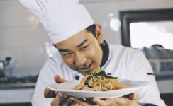
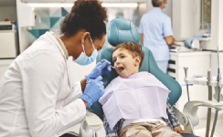
VOCABULARY CORNER
actor/actress
doctor
Unit 3: occupations
chef
engineer
dentist

Slide 9
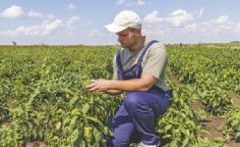
VOCABULARY CORNER
farmer
nurse
Unit 3: occupations
lawyer
police officer
mechanic

Slide 10
VOCABULARY CORNER
singer
student
Unit 3: occupations
vet
teacher
scientist

Slide 11
VOCABULARY CORNER
January
February
March
April
May
June
July
August
September
October
November
December
Unit 3: months of the year

Slide 12
VOCABULARY CORNER
countries
NATIONALITIES
Argentina
Argentine, Argentinean (Argentinian)
Australia
Australian
Unit 3: countries and nationalities
Brazil
Brazilian
TIP
Busque agrupar as palavras
pela terminação, como
Japanese, Portuguese.
Canada
Canadian

Slide 13
VOCABULARY CORNER
countries
NATIONALITIES
China
Chinese
England
English
Unit 3: countries and nationalities
France
French
Germany
German

Slide 14
VOCABULARY CORNER
countries
NATIONALITIES
India
Indian
Italy
Italian
Unit 3: countries and nationalities
Jamaica
Jamaican
Japan
Japanese

Slide 15
VOCABULARY CORNER
countries
NATIONALITIES
Mexico
Mexican
Nigeria
Nigerian
Unit 3: countries and nationalities
Portugal
Portuguese

Slide 16
VOCABULARY CORNER
countries
NATIONALITIES
South Africa
South African
Spain
Spanish
Unit 3: countries and nationalities
The United States
American

Slide 17
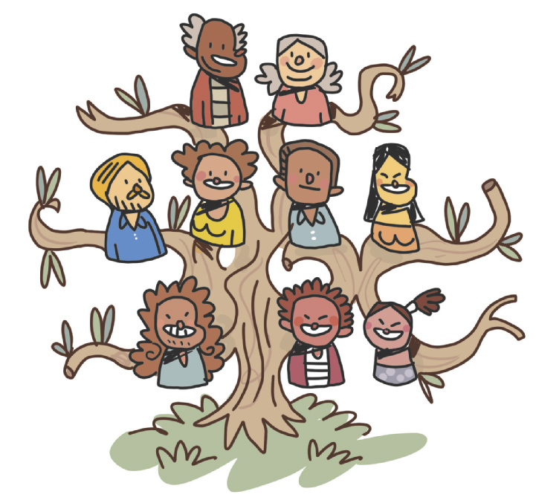
VOCABULARY CORNER
grandfather
grandmother
Unit 4: family members
aunt
father
mother
uncle
ME
cousin
brother
sister

Slide 18
VOCABULARY CORNER
black
green
gray/ grey
purple
white
Unit 4: COLORS
blue
dark green
orange
red
yellow
brown
light green
pink

Slide 19
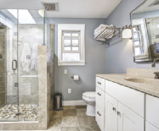
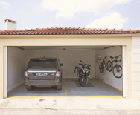
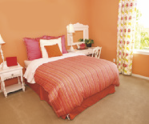
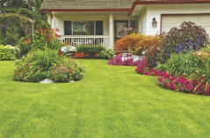
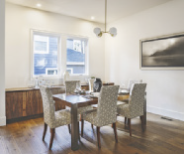
VOCABULARY CORNER
bathroom
garage
Unit 5: PARTS OF THE HOUSE
bedroom
garden
dining room

Slide 20
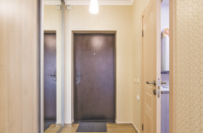
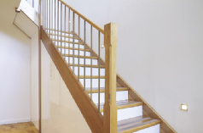
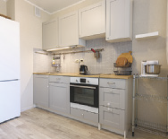
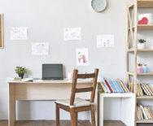
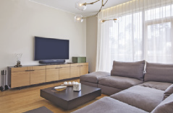
VOCABULARY CORNER
hall
stairs
Unit 5: PARTS OF THE HOUSE
kitchen
study
living room

Slide 21
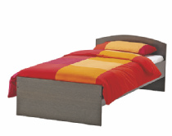
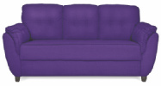
VOCABULARY CORNER
bed
chest of drawers
Unit 5: FURNITURE
bookcase
couch/sofa
chair

Slide 22
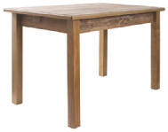
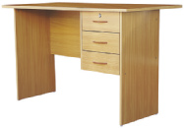
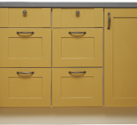
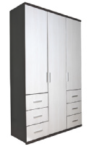
VOCABULARY CORNER
desk
table
Unit 5: FURNITURE
kitchen cabinet
wardrobe
shelf

Slide 23
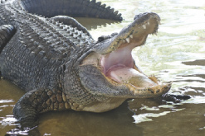
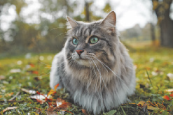
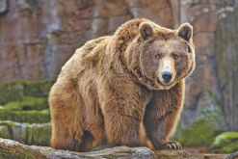
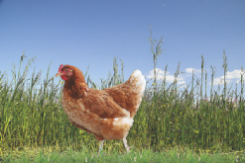
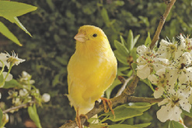
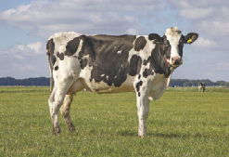
VOCABULARY CORNER
alligator
cat
Unit 6: animals and pets
bear
chicken
canary
cow

Slide 24
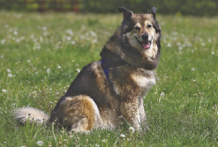
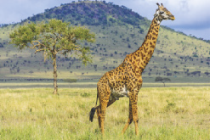
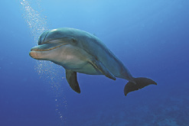
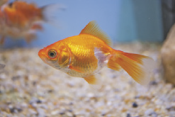
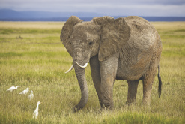
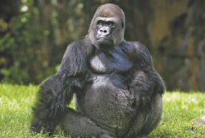
VOCABULARY CORNER
dog
giraffe
Unit 6: animals and pets
dolphin
goldfish
elephant
gorilla

Slide 25
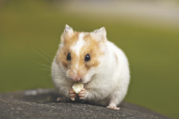
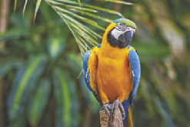
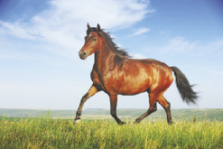
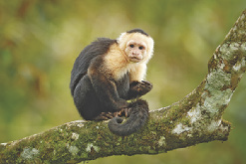
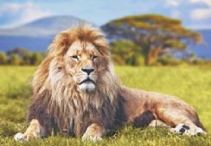
VOCABULARY CORNER
hamster
macaw
Unit 6: animals and pets
horse
monkey
lion
penguin

Slide 26
VOCABULARY CORNER
pig
snake
Unit 6: animals and pets
rabbit
tiger
shark
turtle

Slide 27
VOCABULARY CORNER
accordion
electric guitar
Unit 7: musical instruments
cello
flute
drums
guitar

Slide 28
VOCABULARY CORNER
harmonica
piano
Unit 7: musical instruments
harp
saxophone
keyboard
violin

Slide 29
VOCABULARY CORNER
brush my teeth
go to school
Unit 8: action verbs
do homework
have/eat breakfast
go to bed
have/eat dinner

Slide 30
VOCABULARY CORNER
have/eat lunch
take a shower
Unit 8: action verbs
play with the dog
wake up
sleep
watch TV

Slide 31
VOCABULARY CORNER
Arts/Art
History
Unit 8: school subjects
English
ICT (Information and Communication Technologies)
Geography
Literature

Slide 32
VOCABULARY CORNER
Maths/Math/Mathematics
Science
Unit 8: school subjects
Physical Education (P.E.)
Spanish
Portuguese

Slide 33
VOCABULARY CORNER
Wednesday
Unit 8: days of the week
Thursday
weekend

Slide 34
VOCABULARY CORNER
Unit 8: telling the time

