Slide 1
Unit 8

Slide 2
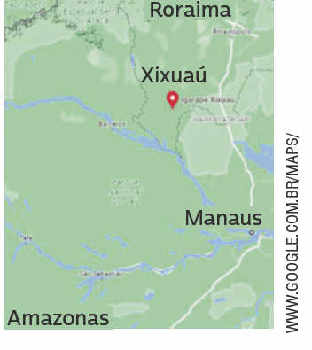
UNIT 8
My name is Mecias, and I am ten years old. I live in a village in the middle of the rainforest.
In my village, there are a few houses surrounded by the jungle, which has lots of animals and birds. We go fishing in
canoes built by the people here in the village. There is a crocodile in the village port!
At my school there are nineteen children, ranging in age from four to sixteen years old. We all study in the same classroom. We have wireless internet and a computer in our classroom! We study mathematics, the Portuguese language, history, natural sciences and geography, and very often we talk about conservation.
We learn not to throw rubbish into the river, not to kill the
animals, and not to cut down trees unnecessarily. I like my class.
My classmates, my teacher, and I like being in the middle of the forest and breathing clean air.
THINK ABOUT IT!
Em algumas regiões do Brasil, é um desafio assegurar acesso a escolas para crianças e adolescentes. Que consequências a falta de educação escolar pode ter na vida desses jovens? Em sua opinião, o que deve ser feito para garantir que todas as
crianças e adolescentes no Brasil frequentem a escola?
HUGHES, Susan. Off to class: incredible and unusual schools around the world. Toronto: Owlkids Books, 2011. p. 12.

Slide 3
UNIT 8
We
go
fishing.
study
about conservation.
talk
mathematics.
the Portuguese language.
history.
natural sciences.
geography.
learn not to throw
rubbish into the river.
Action verbs
TIP
Diagramas como este podem ajudar você a agrupar palavras e expressões por temas e, assim, contribuir para a ampliação e a fixação do vocabulário aprendido. Você pode fazer isso no papel ou no computador.

Slide 4
UNIT 8
TIP
DAVIS, Jim. Garfield. 2022. Disponível em: www.gocomics.com/garfield/1985/08/12. Acesso em: 9 jun. 2022..
Ao ler tirinhas, observe as relações entre os elementos verbais e os não verbais.
LANGUAGE NOTE
Uma forma de organizar o vocabulário que aprendeu é usar antônimos, como em:
before X after
love X hate
sleep X wake up

Slide 5
UNIT 8
Simple present
(He/SHE/IT)

