Slide 1
Unit 7

Slide 2
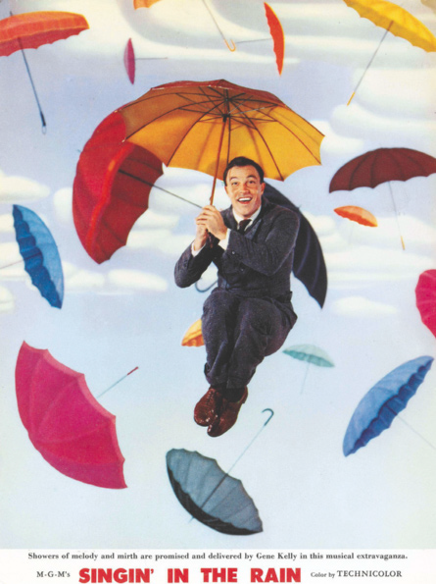
UNIT 7
Singin’ in the Rain
I’m singing in the rain
Just singin’ in the rain
What a glorious feeling
I’m happy again
I’m laughing at clouds
So dark up above
The sun’s in my heart
And I’m ready for love
Let the stormy clouds chase
Everyone from the place
Come on with the rain
I have a smile on my face
I walk down the lane
With a happy refrain
Just singin’, singin’ in the rain
Dancing in the rain
I’m happy again
I’m singin’ and dancin’ in the rain
I’m dancin’ and singin’ in the rain
LANGUAGE NOTE
singin’ = singing
dancin’ = dancing
FREED, Arthur. Singin’ in the Rain. Intérprete: Gene Kelly. In: Singing in the Rain – Original Film Soundtrack. [S.l.]: River Records Scotland, 2008. 1 CD. Faixa 1.

Slide 3
UNIT 7
blues
dance
jazz
reggaeton
bossa nova
fado
pop
rock
classical
heavy metal
rap
samba
country
hip-hop
R&B
tango
Kinds of music
LANGUAGE NOTE
R&B = rhythm and blues

Slide 4
UNIT 7
accordion
cello
drums
electric guitar
flute
guitar
piano
saxophone
violin
Musical instruments
PRONUNCIATION NOTE
Tanto em inglês quanto em português, ao dizermos algumas
palavras, não pronunciamos certas letras. A letra u, por
exemplo, não é pronunciada ao dizermos guitar ou “guitarra”.

Slide 5
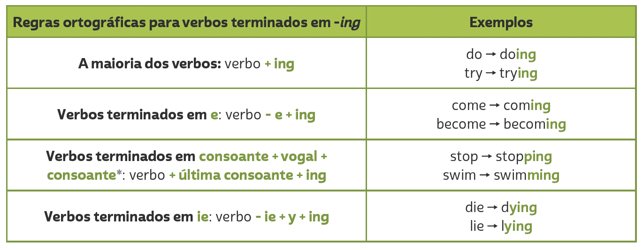
Unit 7
PRESENT CONTINUOUS
TIP
Em verbos terminados em CVC (consoante, vogal, consoante), como admit, get e run, dobramos a última consoante antes de acrescentar -ing (admitting, getting, running). No entanto, não dobramos a última consoante quando a sílaba tônica é a primeira. Dessa forma, em verbos como listen, happen e offer, apenas acrescentamos -ing (listening, happening, offering).

Slide 6
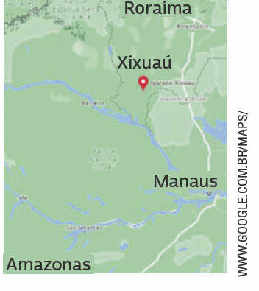
UNIT 8
My name is Mecias, and I am ten years old. I live in a village in the middle of the rainforest.
In my village, there are a few houses surrounded by the jungle, which has lots of animals and birds. We go fishing in
canoes built by the people here in the village. There is a crocodile in the village port!
At my school there are nineteen children, ranging in age from four to sixteen years old. We all study in the same classroom. We have wireless internet and a computer in our classroom! We study mathematics, the Portuguese language, history, natural sciences and geography, and very often we talk about conservation.
We learn not to throw rubbish into the river, not to kill the
animals, and not to cut down trees unnecessarily. I like my class.
My classmates, my teacher, and I like being in the middle of the forest and breathing clean air.
THINK ABOUT IT!
Em algumas regiões do Brasil, é um desafio assegurar acesso a escolas para crianças e adolescentes. Que consequências a falta de educação escolar pode ter na vida desses jovens? Em sua opinião, o que deve ser feito para garantir que todas as
crianças e adolescentes no Brasil frequentem a escola?
HUGHES, Susan. Off to class: incredible and unusual schools around the world. Toronto: Owlkids Books, 2011. p. 12.

