Slide 1
Unit 5

Slide 2
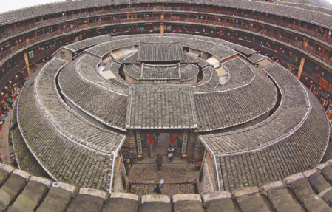
UNIT 5
China
Living Together in a Circle
Deep in the mountains, there is a round building called a tulou. It is surrounded by a thick dirt wall. It is in the Fujian province of China. There are about three hundred people living in this tulou. It is very lively inside.
The tulou has four floors. There are four communal staircases, and more than 200 rooms of about the same size. On the first floor, there are kitchens all in a row. The second floor has warehouses, where the harvest and the farm tools are kept. The long hall is where the children play. The third and fourth floors have bedrooms that are also used for study. Parents and children share one room.
TIP
Não se preocupe em compreender todas as palavras de um texto. Nem sempre isso é necessário para você atingir seus
objetivos de leitura.
Adaptado de: KOMATSU, Yoshio. Wonderful houses around the world. California: Shelter Publications, 2004. p. 6, 8.

Slide 3
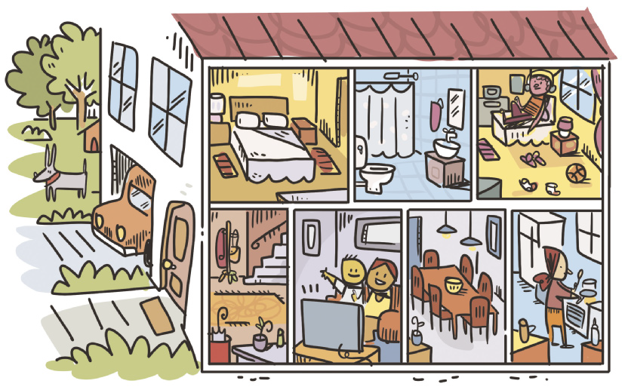
UNIT 5
garden
bedroom
bathroom
PARTS OF THE HOUSE
stairs
garage
hall
living room
dining room
kitchen

Slide 4
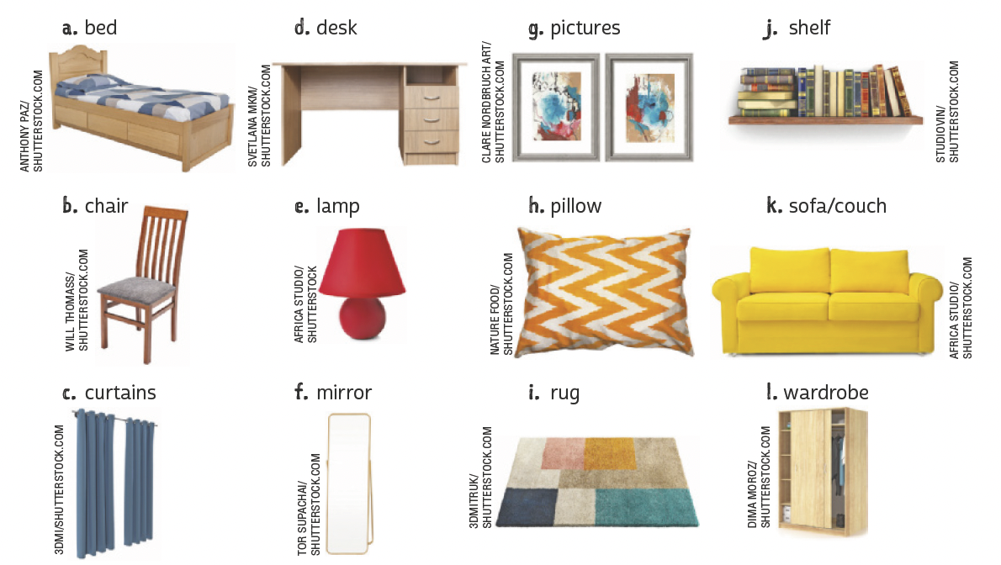
UNIT 5
bed
desk
pictures
shelf
chair
lamp
pillow
sofa/couch
furniture
curtains
mirror
rug
wardrobe

Slide 5
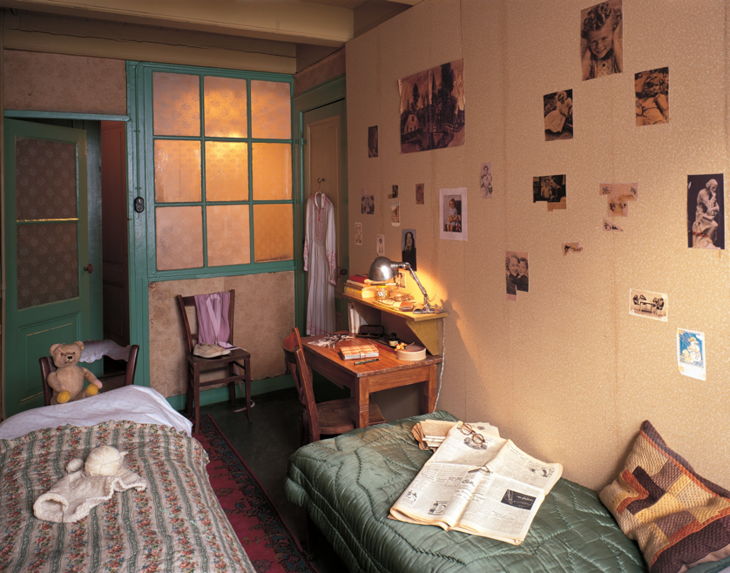
UNIT 5
THINK ABOUT IT!
Na foto da página, vemos o quarto de Anne Frank, que ficava em um anexo secreto da casa. Por segurança, a porta para esse anexo foi escondida por uma estante de livros. Na sua opinião, escrever um diário ajudou Anne Frank a lidar com a difícil realidade que enfrentava? Por quê? Você tem o hábito de escrever sobre suas próprias experiências? Como Anne, você também tem um espaço para escrever e estudar?
BOVENBERG, Allard. Anne Frank's room in the secret annex. Amsterdam, [2018]. 1 fotografia. Disponível em: https://artsandculture. google.com/asset/annefrank-s-room-in-thesecretannex-allard-bovenberg/kAHP7XqswgMtsg. Acesso em: 6 jun. 2022.
There are two beds in the room.
There is a teddy bear on a chair.
There is a desk under the shelf.
There are a lot of pictures on the wall.

Slide 6
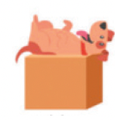
UNIT 5
on
in
between
PREPOSITIONS OF PLACE
under
behind
next to
above
in front of

Slide 7
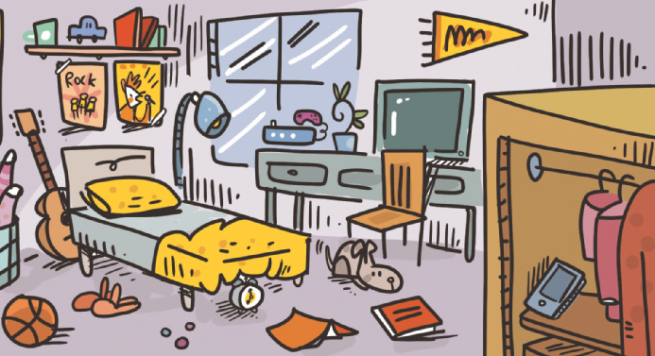
UNIT 5
There is a guitar behind the bed.
There is a dog in front of the chair.
There are two posters on the wall.
There is a cell phone in the wardrobe.
There is a lamp next to the bed.
There is a plant between the television and the video game.
There is an alarm clock under the bed.
There is a shelf above the posters.

