Slide 1
Unit 2

Slide 2
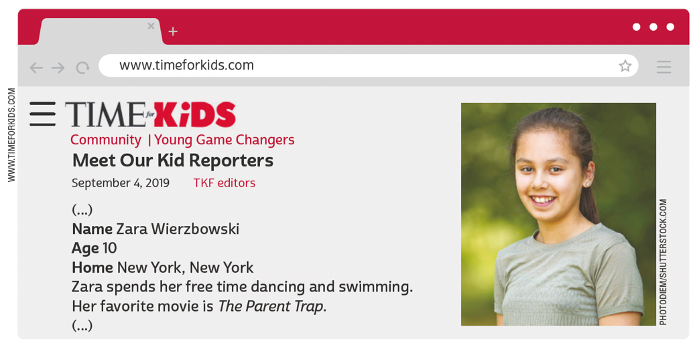
UNIT 2
THINK ABOUT IT!
Ao visitar uma página na internet, geralmente encontramos um menu de navegação com vários links disponíveis. Onde se deve clicar para ter acesso ao menu de navegação do site apresentado?
Adaptado de: MEET Our kid reporters. Time for Kids, 4 set. 2019. Disponível em: www.timeforkids.com/g56/meet-kid-reporters-2019/. Acesso em: 18 maio 2022.
LANGUAGE NOTE
parent = pai/mãe
relative = parente

Slide 3
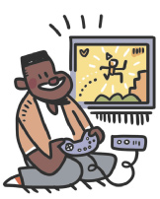
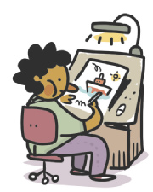
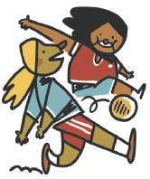
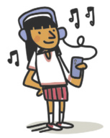
UNIT 2
dancing
playing video games
PERSONAL INTERESTS
drawing
playing soccer
listening to music

Slide 4
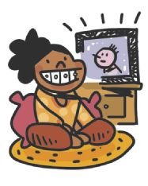
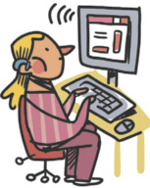
UNIT 2
reading
swimming
PERSONAL INTERESTS
surfing the net
watching TV

Slide 5
UNIT 2
1 one
2 two
3 three
4 four
5 five
6 six
7 seven
8 eight
9 nine
10 ten
11 eleven
12 twelve
13 thirteen
14 fourteen
15 fifteen
16 sixteen
17 seventeen
18 eighteen
19 nineteen
20 twenty
21 twenty-one
22 twenty-two
23 twenty-three
29 twenty-nine
30 thirty
40 forty
50 fifty
60 sixty
70 seventy
80 eighty
90 ninety
100 a/one hundred
CARDINAL NUMBERS
TIP
Observe que os números
de 13 a 19 apresentam a
terminação -teen. A palavra
teenager se refere a quem
tem entre 13 e 19 anos.

Slide 6
UNIT 2
1st first
2nd second
3rd third
4th fourth
5th fifth
6th sixth
7th seventh
8th eighth
9th ninth
10th tenth
11th eleventh
12th twelfth
13th thirteenth
14th fourteenth
15th fifteenth
16th sixteenth
17th seventeenth
18th eighteenth
19th nineteenth
20th twentieth
21st twenty-first
22nd twenty-second
23rd twenty-third
29th twenty-ninth
30th thirtieth
40th fortieth
50th fiftieth
60th sixtieth
70th seventieth
80th eightieth
90th ninetieth
100th a/one hundredth
ORDINAL NUMBERS
LANGUAGE NOTE
1st = first
2nd = second
3rd = third
4th = fourth

Slide 7
UNIT 2
Our favorite singer is Beyoncé.
Our native language is English.
THINK ABOUT IT!
Observe que o pronome our
está no plural e se refere a quem fala. Converse com um(a) colega e escolha qual/quais das três frases se referiria/refeririam a vocês dois.
Our favorite musical is Hamilton.

Slide 8
UNIT 2
Possessive adjectives
my
TIP
Os pronomes possessivos (my, your, his, her etc.) se referem a alguém ou algo que possui algo.

Slide 9
UNIT 2
The alphabet
In pairs, ask a classmate the following questions and answer them. Take turns:
Can you spell your first name?
Can you spell your last name?
Can you spell your English teacher’s name?
TIP
Aprender o alfabeto em inglês fica mais fácil quando agrupamos as letras pelo som.

