Slide 1
LANGUAGE REFERENCE

Slide 2
LANGUAGE REFERENCE
Unit 1:
Subject pronouns

Slide 3
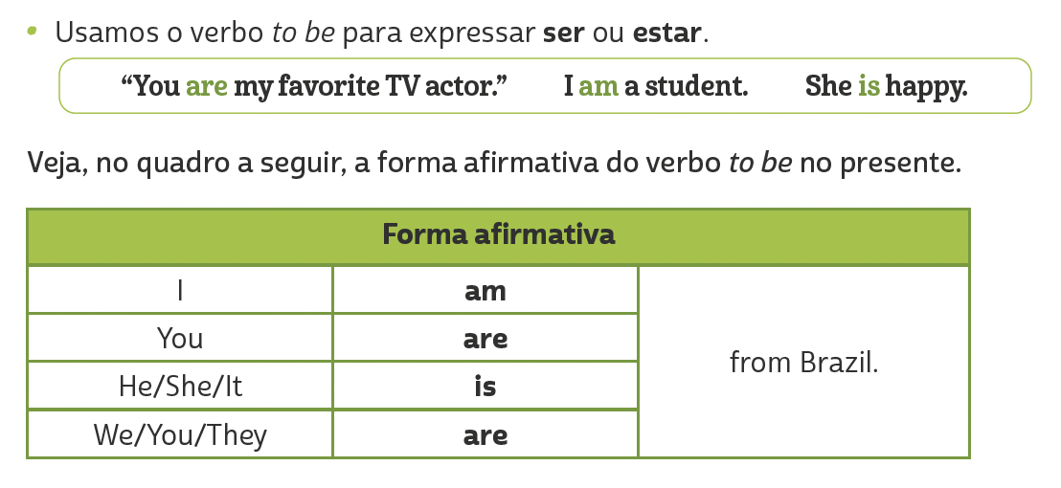
LANGUAGE REFERENCE
Unit 1:
VERB TO BE: AFFIRMATIVE FORM

Slide 4
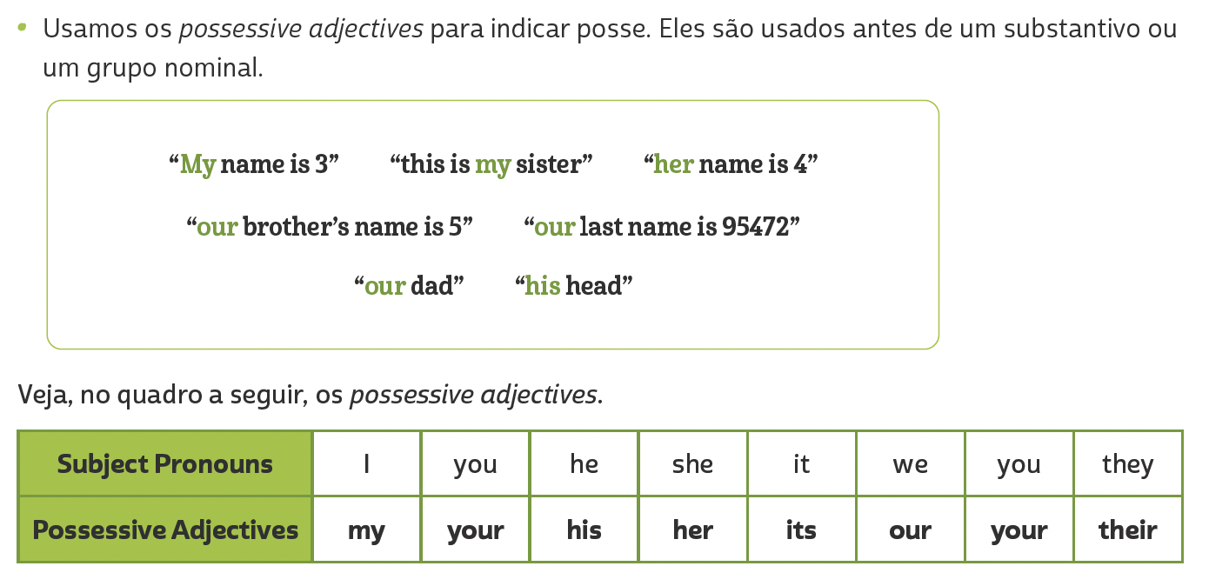
LANGUAGE REFERENCE
Unit 2:
Possessive adjectives

Slide 5
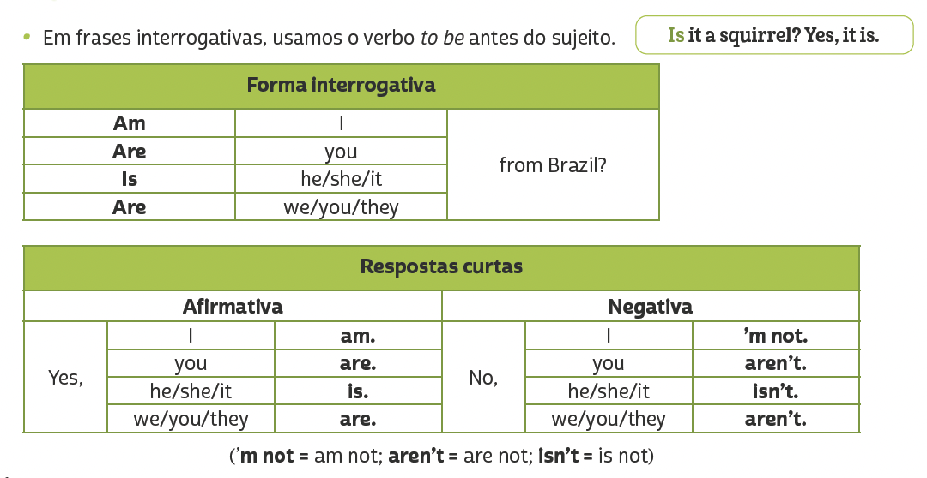
LANGUAGE REFERENCE
Unit 3:
Verb to be: negative and interrogative forms

Slide 6
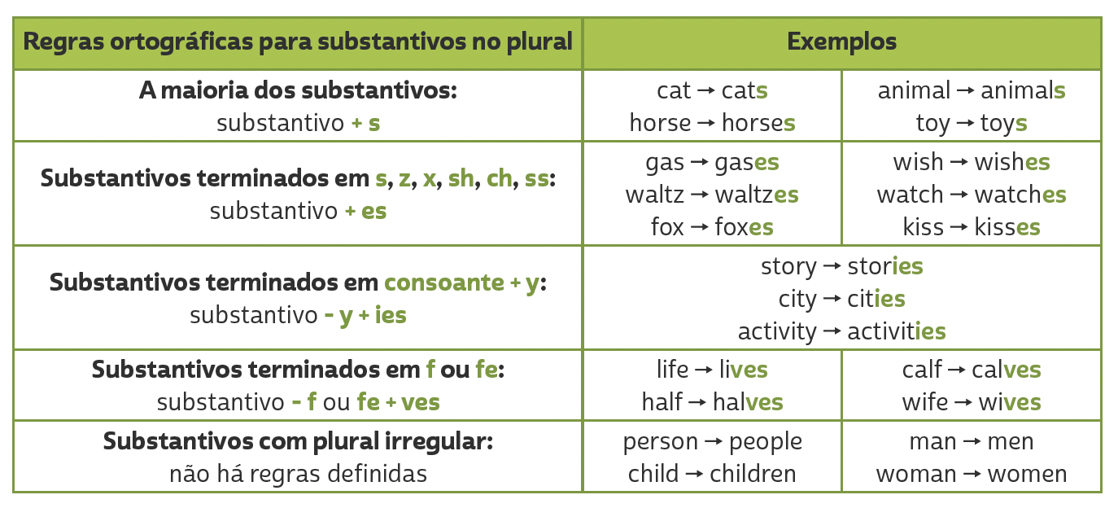
LANGUAGE REFERENCE
Unit 4:
PLURALS

Slide 7
LANGUAGE REFERENCE
Unit 4:
GENITIVE CASE (‘S)

Slide 8
LANGUAGE REFERENCE
Unit 5:
THERE IS/THERE ARE

Slide 9
LANGUAGE REFERENCE
on
in
between
Unit 5: PREPOSITIONS OF PLACE
under
behind
next to
above
in front of

Slide 10
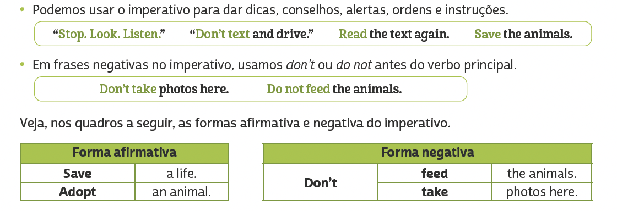
LANGUAGE REFERENCE
Unit 6: imperative

Slide 11
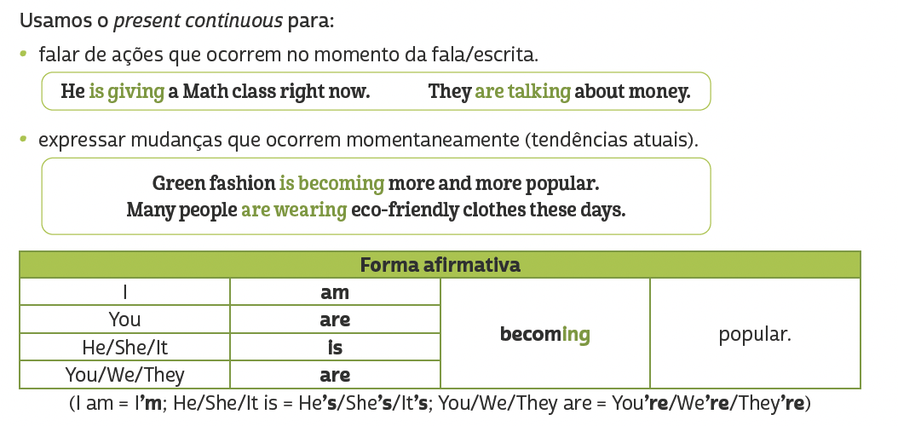
LANGUAGE REFERENCE
Unit 7: present continuous

Slide 12
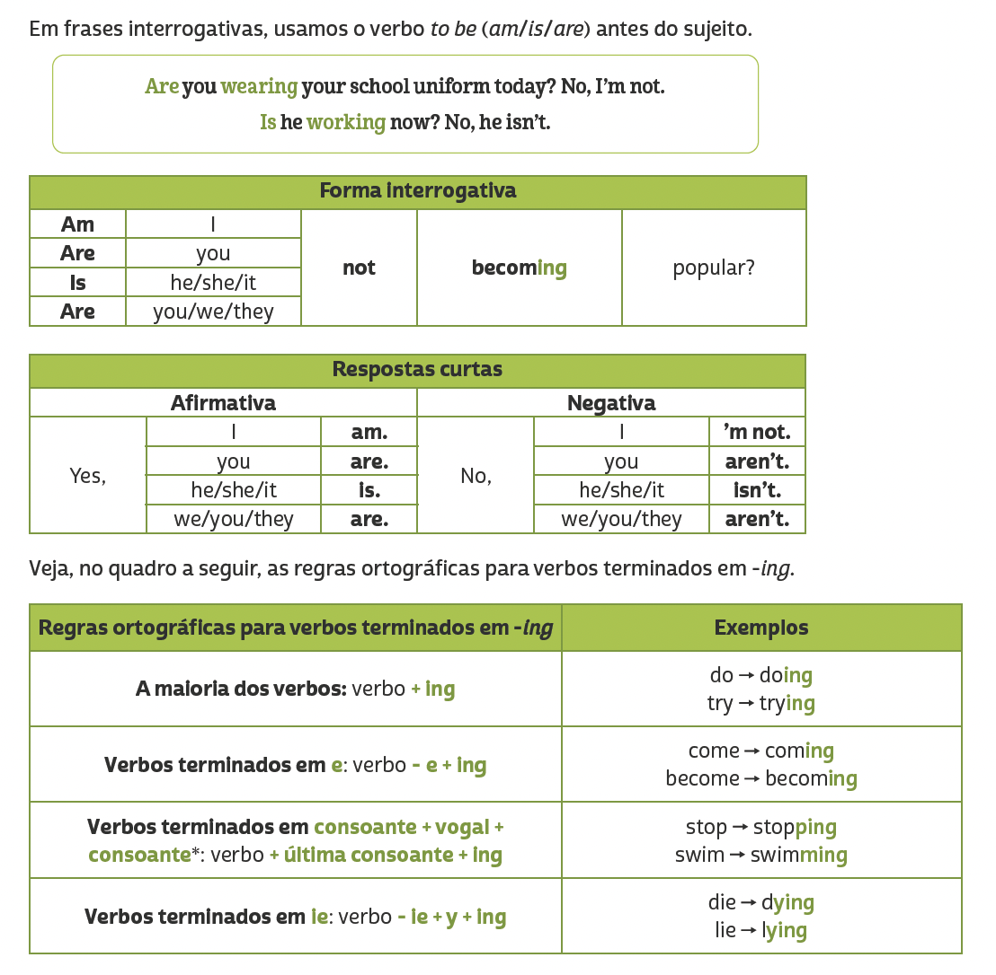
LANGUAGE REFERENCE
Unit 7: present continuous
TIP
Em verbos terminados em CVC (consoante, vogal, consoante), como admit, get e run, dobramos a última consoante antes de acrescentar -ing (admitting, getting, running). No entanto, não dobramos a última consoante quando a sílaba tônica é a primeira. Dessa forma, em verbos como listen, happen e offer, apenas acrescentamos -ing (listening, happening, offering).

Slide 13
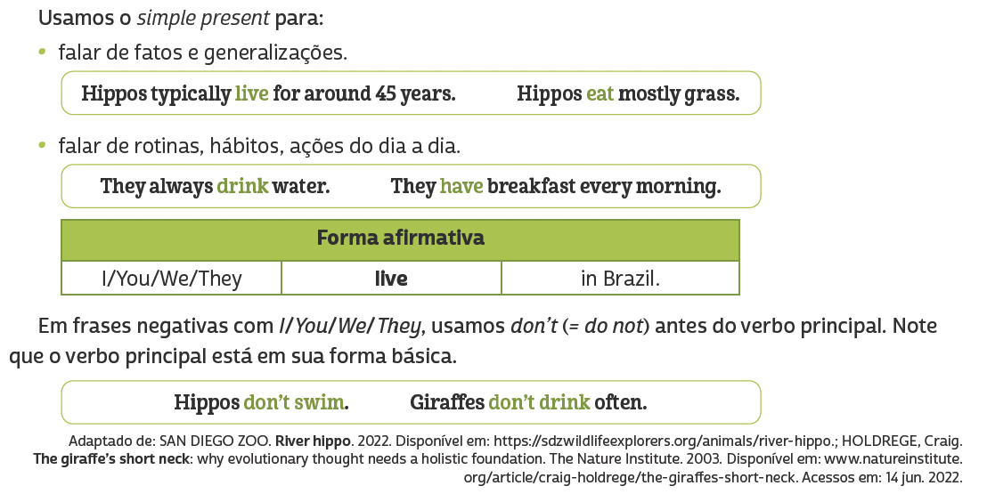
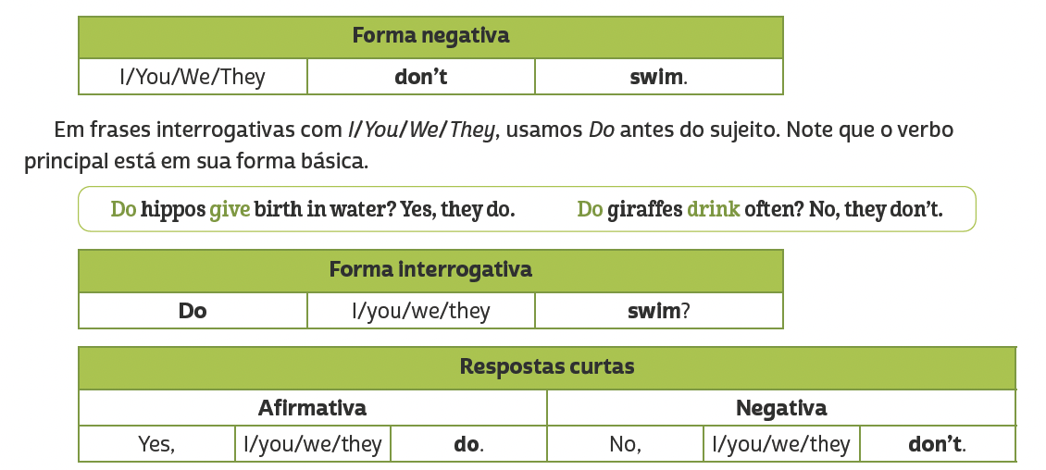
LANGUAGE REFERENCE
Unit 8: simple present (i/you/we/they)

Slide 14
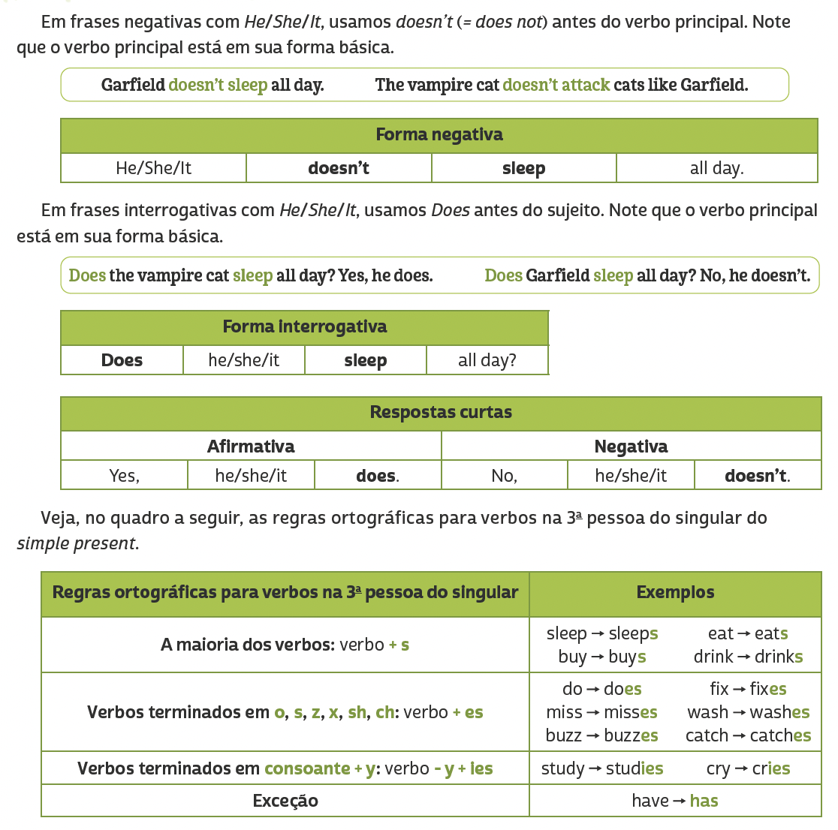
LANGUAGE REFERENCE
Unit 8: simple present (HE/SHE/IT)

