Slide 1
Língua inglesa
9º ano

Slide 2
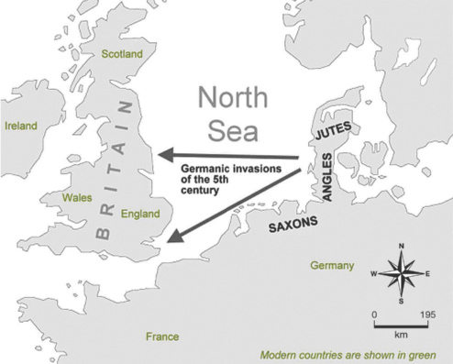
UNIT 0
5th, 6th centuries
9th century
16th century
17th century
18th century
The settlement in Britain of Jutes, Saxons and Angles.
The Viking invasions.
The full flowering of the Renaissance.
The expansion to North America and South Africa.
The expansion to India, Australia, and New Zealand.
Germanic invaders entered Britain on the east and south coasts in the 5th century.
HTTPS://WWW.ENGLISHCLUB.COM
ENGLISH CLUB. History of English. 1997-2022. Disponível em: www.englishclub.com/history-of-english. Acesso em: 1 jul. 2022.

Slide 3
UNIT 0
British colonialism from the seventeenth to the twentieth century.
British leadership in the Industrial Revolution in the eighteenth and nineteenth centuries.
American economic superiority and political leadership in the late nineteenth and early twentieth centuries.
American technological domination in the late twentieth century.
Fonte de pesquisa: FENNELL, A. B. A history of English: a sociolinguistic approach. Hoboken: Blackwell Publishing, 2008.

Slide 4
UNIT 0
TIP
Observe as relações entre os elementos verbais e os não verbais.
PICCOLO, Rina. Tina’s Groove. Cartoonist Group. [2022?]. Disponível em: www.cartoonistgroup.com/properties/tinasgroove/art_images/cg50880434b7b40.jpg. Acesso em: 1 jul. 2022.

Slide 5
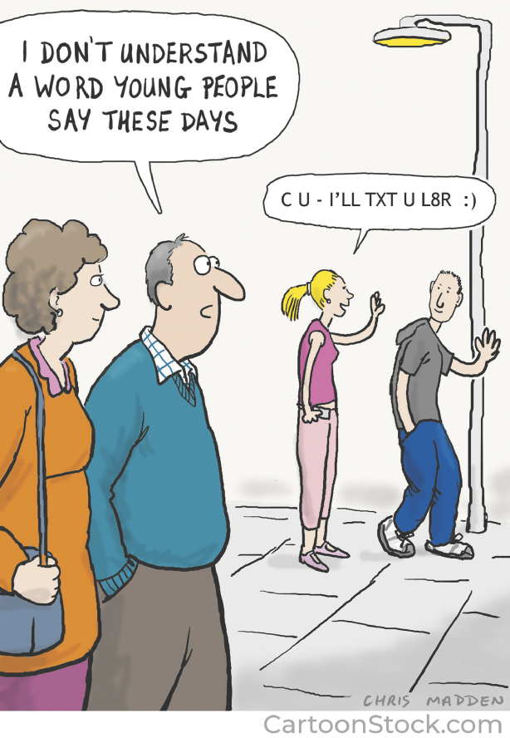
UNIT 0
WWW.CARTOONSTOCK.COM
MADDEN, Chris. I don’t understand a word young people say these days. Cartoonstock. 27 fev. 2020. Disponível em: www.cartoonstock.com/directory/a/abbreviations.asp. Acesso em: 1 jul. 2022.

Slide 6
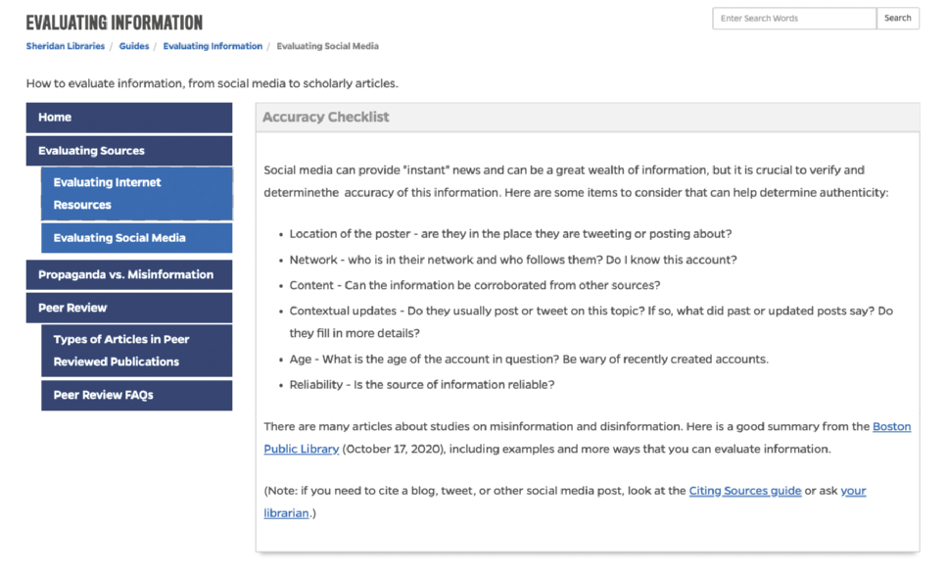
UNIT 0
Evaluating websites
HTTPS://GUIDES.LIBRARY.JHU.EDU/
JOHNS HOPKINS SHERIDAN LIBRARIES. Accuracy checklist. 19 jun. 2021. Disponível em: https://guides.library.jhu.edu/evaluate/social-media. Acesso em: 1 jul. 2022.

Slide 7
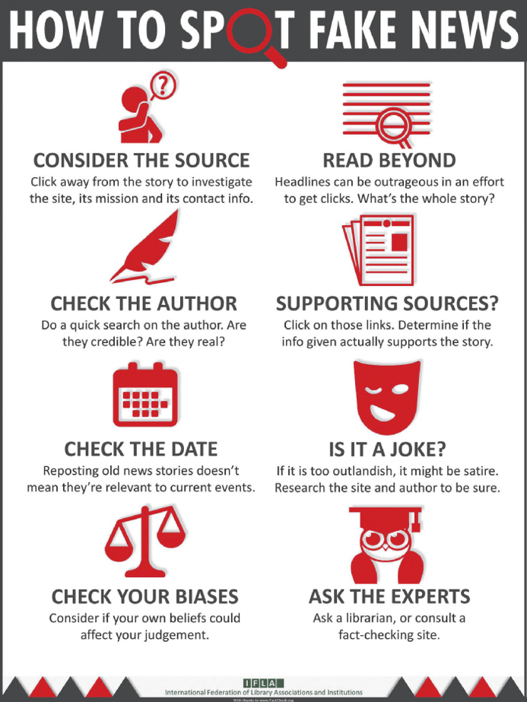
UNIT 0
Evaluating websites
IFLA - INTERNATIONAL FEDERATION OF LIBRARY ASSOCIATIONS AND INSTITUTIONS
McKENZIE, Janis. How to spot fake news: identifying propaganda, satire, and false information. Simon Fraser University. 6 maio 2022. Disponível em: www.lib.sfu.ca/help/research-assistance/fake-news. Acesso em: 1 jul. 2022.

Slide 8
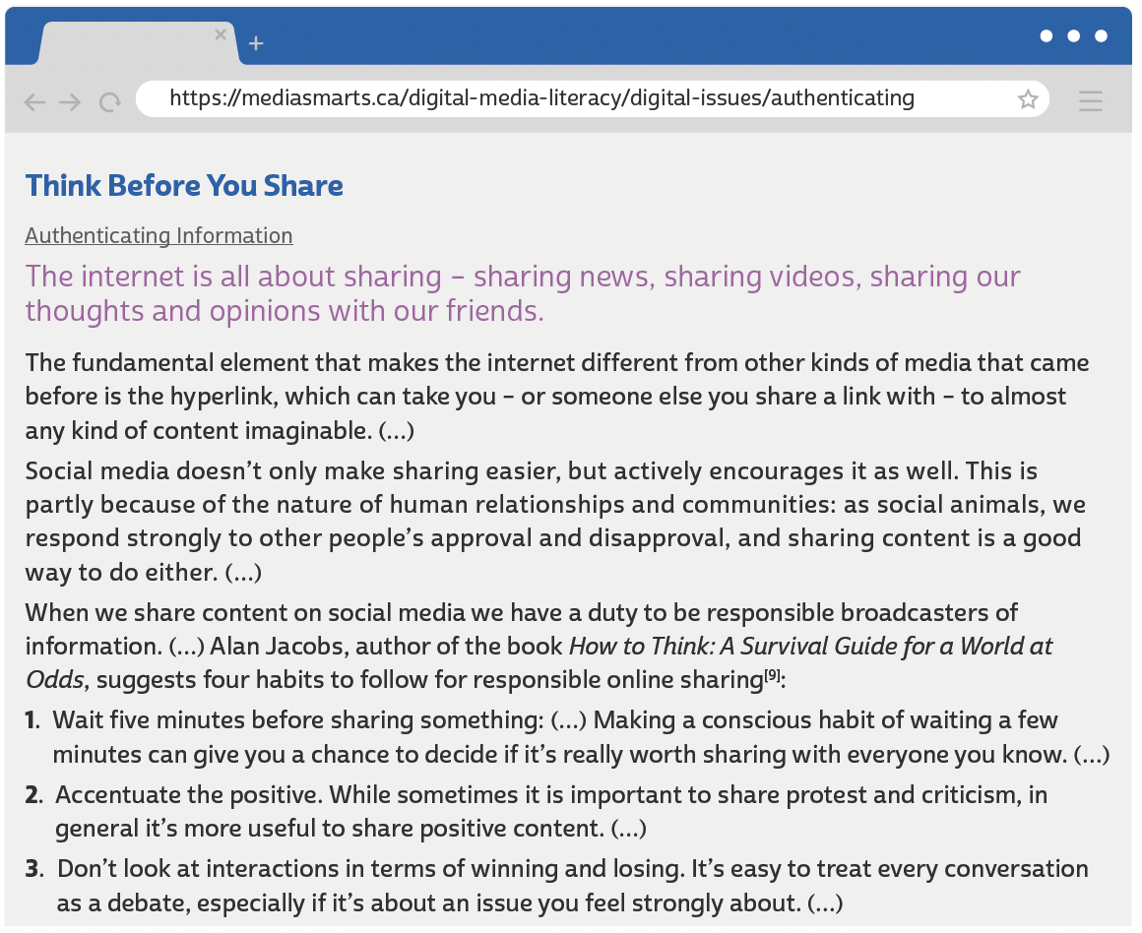
UNIT 1
MEDIA SMARTS. Think before you share. [2022?]. Disponível em: https://mediasmarts.ca/digital-media-literacy/digital-issues/authenticating-information/ethics-sharing-information-online/think-you-share. Acesso em: 6 jul. 2022.

Slide 9
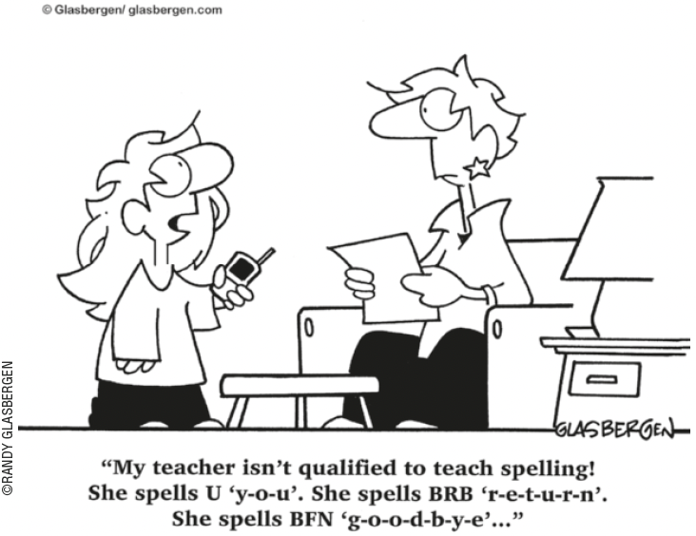
UNIT 1
TIP
Ao ler cartuns, observe as
relações entre os elementos
verbais e os não verbais.
Internet slang
THINK ABOUT IT!
No cartum, por que a menina
diz que sua professora não é qualificada para ensinar a
escrever? Você concorda com
ela? Para a menina, como se deve escrever a palavra “you”?
NSEA.ORG. Língua inglesa. Pinterest, 2022. Disponível em: https://br.pinterest.com/pin/195062227583057030/. Acesso em: 6 jul. 2022.

Slide 10
UNIT 1
2DAY
4EVER
B4
BFF
DM
GR8
ILU
LOL
PLS
TBT
THX/THKS
U2
UR
XOXO
today
forever
before
best friends forever
direct message
great
I love you
laughing out loud
please
throwback Thursday
thanks
you too
your
hugs and kisses
Internet slang

Slide 11
UNIT 1
What to Report
• Anyone you don’t know who asks you for personal information, photos, or videos.
• Inappropriate or obscene material from people or companies you don’t know.
• Misleading URLs on the Internet that point you to sites containing harmful or inappropriate materials rather than what you were looking for.
• Anyone who sends you photos or videos containing obscene content of individuals 18 and younger (the possession, manufacturing, or distributing of child pornography is illegal). (…)
Review: relative pronouns
LANGUAGE NOTE
We use: To refer to:
that people and things
which things
who people
which people and things (possession)
FULTON COUNTY SCHOOLS. FAQ and fact sheet: cyberbullying. 2002-2022. Disponível em: www.fultonschools.org/cms/lib/GA50000114/Centricity/Domain/5419/Cyberbullying%20FAQ%20Fact%20Sheet.pdf. Acesso em: 6 jul. 2022.

Slide 12
UNIT 1
Where and how does your source get its information? A proper article should cite the information and data they are sharing. Investigate their sources for yourself. Does the information line up, was important information left out, or are facts being twisted? If they don’t have a source at all, or it comes from a non-credible source, that should be a red flag.
Modal verbs: should, must
MADISON COUNTY NEW YORK. Combating misinformation. 2006-2022. Disponível em: www.madisoncounty.ny.gov/2842/Combating-Misinformation. Acesso em: 6 jul. 2022.
THINK ABOUT IT!
In “A proper article should cite”, should expresses a recommendation.
In “that should be a red flag”, should expresses the deduction or conclusion that something is certain or highly probable.
We use should before the main verb in the infinitive (without to).
De acordo com o texto, é importante verificar a credibilidade da fonte antes de compartilhar uma informação. Você costuma fazer isso? Você já viu alguma notícia em rede social e descobriu, depois, que era falsa? O que pode ser feito para evitarmos a circulação de informações e notícias falsas (fake news) nas redes sociais?

Slide 13
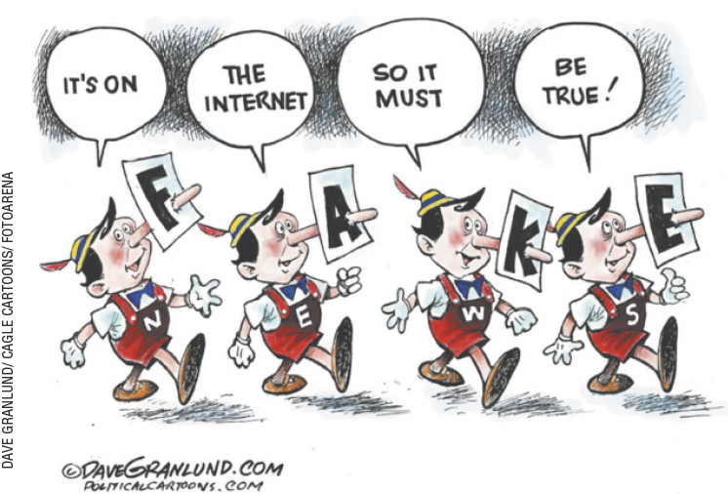
UNIT 1
Modal verbs: should, must
LANGUAGE NOTE
We generally use can’t/cannot to say that something is certainly
not the case.
E.g.: It can’t be true. He’s always
telling lies.
STAFF WRITER. Granlund cartoon: fake news. Gaston Gazette, 8 dez. 2016. Disponível em: www.gastongazette.com/story/opinion/cartoons/2016/12/08/granlund-cartoon-fakenews/24301148007/. Acesso em: 8 jul. 2022.
The modal verb must expresses the deduction or conclusion that something is certain.

Slide 14
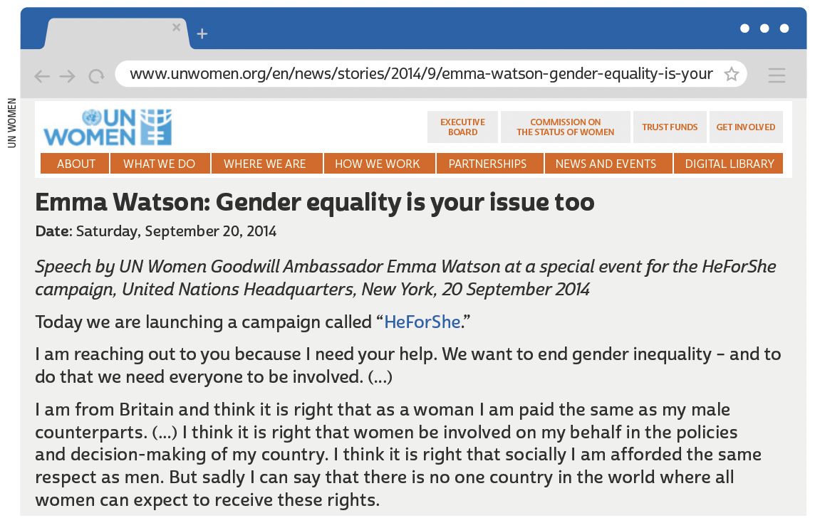
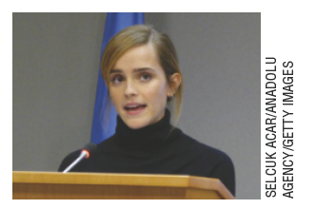
UNIT 2
Emma Watson is an actress and activist. She is famous for her participation in the Harry Potter film series. She is United Nations Women Goodwill Ambassador.

Slide 15
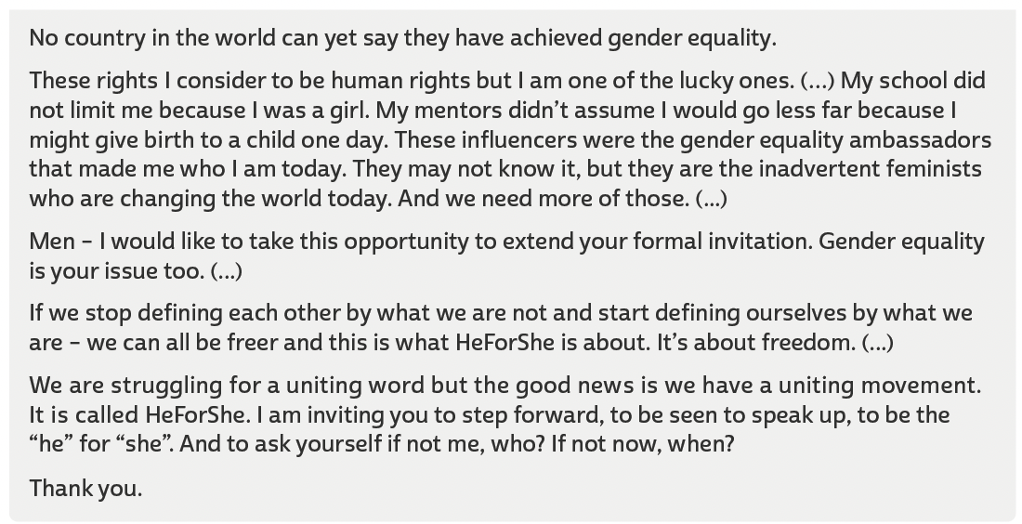
UNIT 2
TIP
Observe a importância da
língua inglesa em textos,
como o discurso de Emma
Watson, para a divulgação
e discussão de diferentes
ideias e posicionamentos
políticos.
UN WOMEN. Emma Watson: gender equality is your issue too. 20 set. 2014. Disponível em: www.unwomen.org/en/news/stories/2014/9/emma-watson-gender-equality-is-your-issue-too. Acesso em: 22 jun. 2022.

Slide 16
UNIT 2
“...Racism is the biggest problem facing football across Europe. People may think it has disappeared, but it hasn’t. It’s time for us all to take a stand – players, fans and authorities. It’s time to stand up and speak up”.
THIERRY HENRY
Multi-word verbs
TIP
Anúncios publicitários
(advertisements ou ads)
empregam recursos verbais e não verbais para chamar a atenção de determinado público-alvo e persuadi-lo a consumir um produto ou a aderir a uma ideia.
What is the meaning of stand up in the advertisement?
a. To be on your feet.
b. To deal effectively with a difficult situation.

Slide 17
UNIT 2
I. “I might give birth to a child one day.”
II. “They may not know it”
“I might give birth to a child one day” is equivalent in meaning to
In fragments I and II, may and might express
Perhaps I will give birth to a child one day.
“They may not know it” is equivalent in meaning to
Perhaps they don’t know it.
possibility.
MODAL VERBS: MAY, MIGHT, MUST
LANGUAGE NOTE
We use modal verbs such as may, might and must before the main verb in the infinitive (without to).

Slide 18
UNIT 2
I. “we must make sure we equip children for all facets of life”
II. “we must ensure that male and female children share equal obligations”
MODAL VERBS: MAY, MIGHT, MUST
“we must ensure that male and female children share equal obligations” is equivalent in meaning to
In fragments I and II, must expresses
it is necessary that we ensure that male and female children share equal obligations.
Necessity,
LANGUAGE NOTE
We use modal verbs such as may, might and must before the main verb in the infinitive (without to).

Slide 19
UNIT 2
“Again, it may be said, that to love justice and equality the people need no great effort of virtue; it is sufficient that they love themselves.” (Maximilien Robespierre)
“One of the things about equality is not just that you be treated equally to a man, but that you treat yourself equally to the way you treat a man.” (Marlo Thomas)
“I want for myself what I want for other women, absolute equality.” (Agnes Macphail)
REFLEXIVE PRONOUNS
ROBESPIERRE, Maximilien. Again, it may be said, that to love justice and equality... In: WREN, Linnea H. (Ed.). Perspectives on Western art. Nova York: Routledge, 1994. v. 2, p. 212.; THOMAS, Marlo. One of the things about equality is not just you be treated equally to a man... In: DEMAKIS, Joseph. The ultimate book of quotations. Raleigh: Lulu, 2012. p. 101.; MacPHAIL, Agnes. I want for... In: GREAT CANADIAN SPEECHES. Agnes Macphail on women's equality, 1925, 1930. [2022?]. Disponível em: https://greatcanadianspeeches.ca/2017/10/27/agnes-macphail-on-womensequality-1925-1930/. Acesso em: 22 jun. 2022.

Slide 20
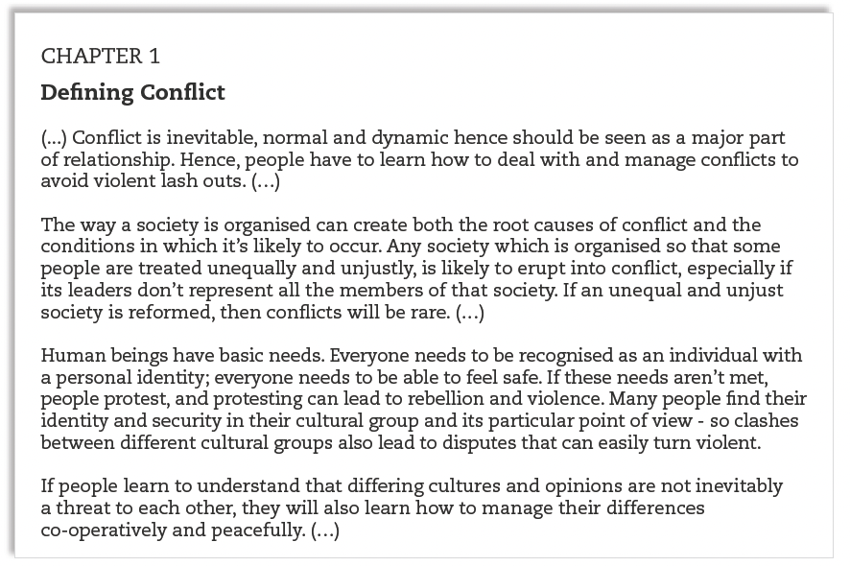
UNIT 3
HVOSTIK/SHUTTERSTOCK.COM
ADENIJI, Don Michael Olalekan (Ed.). Dynamics of conflict management. Abuja: Garamond Projects Limited, 2015. p. 11, 14, 21, 22.

Slide 21
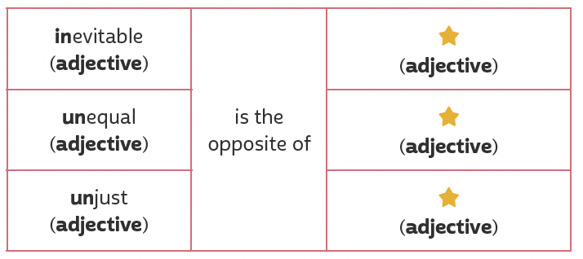
Unit 3
I. “Conflict is inevitable”
II. “an unequal and unjust society”
evitable
Word formation: prefixes
equal
just
TIP
O acréscimo de um prefixo não modifica a classe gramatical da palavra. Isso acontece tanto em inglês quanto em português.

Slide 22
Unit 3
Linking words/ phrases
in addition to
unless
as a result
after that
TIP
Conectores (linking words/ phrases, em inglês) são palavras ou expressões utilizadas para unir palavras ou orações. Ao ler um texto, busque identificar quais palavras ou orações os conectores ligam.

Slide 23
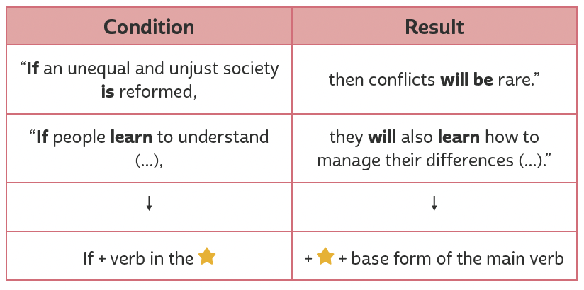
UNIT 3
First conditional
TIP
Com base nos exemplos, faça inferências para compreender regras de uso da língua inglesa.
simple present
will

Slide 24
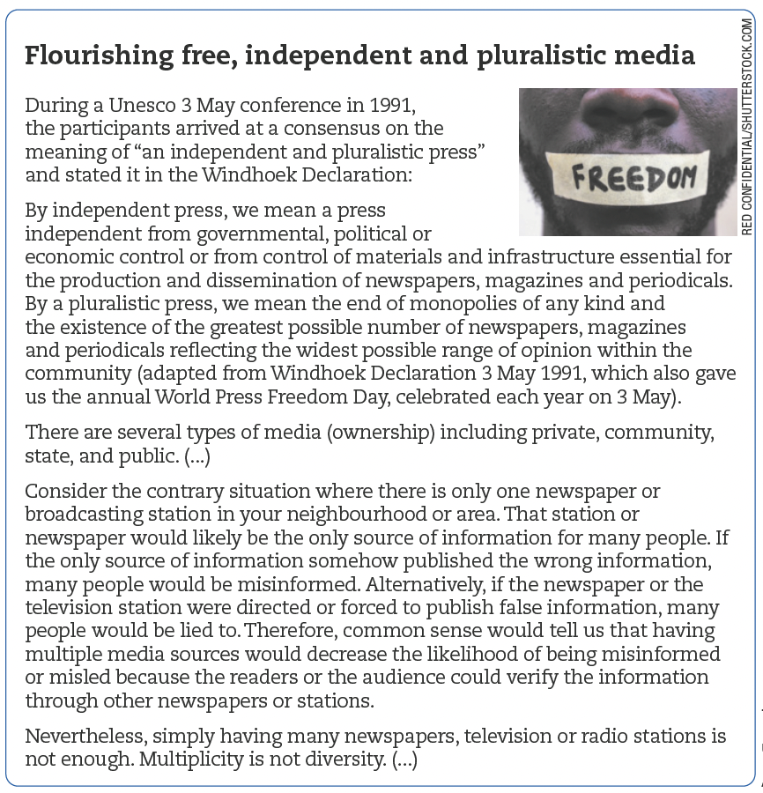
UNIT 4
LANGUAGE NOTE
O significado do prefixo
mis (misinformed, misled) é de forma incorreta, errada.
UNESCO. Freedom of expression toolkit: a guide for students. 2013. Disponível em: https://unesdoc.unesco.org/ark:/48223/pf0000218618. Acesso em: 9 jul. 2022.

Slide 25
UNIT 4
WRITE
PERFORM
PAINT
MAKE
ACT
SING
a novel, an essay, a letter
a concert, a task, in public
a portrait, a picture, a wall
a noise, a good impression, money
in a movie, in a circus, in a comedy show
a duet, a repertoire, like an angel
collocations
TIP
Estude combinações de palavras que ocorrem frequentemente em inglês para compreendê-las melhor e utilizá-las em seus textos.

Slide 26
UNIT 4
I. “Therefore, common sense would tell us that (…)” (4th paragraph)
II. “Nevertheless, simply having many newspapers (…)” (5th paragraph)
THEREFORE
is equivalent in meaning to
NEVERTHELESS
is equivalent in meaning to
as a result
however
LINKING WORDS/ PHRASES
TIP
Ao ler um texto, busque identificar os conectores utilizados, como therefore e nevertheless, para ajudar você a compreender como as ideias de um texto se relacionam.
but
nevertheless
so
therefore

Slide 27
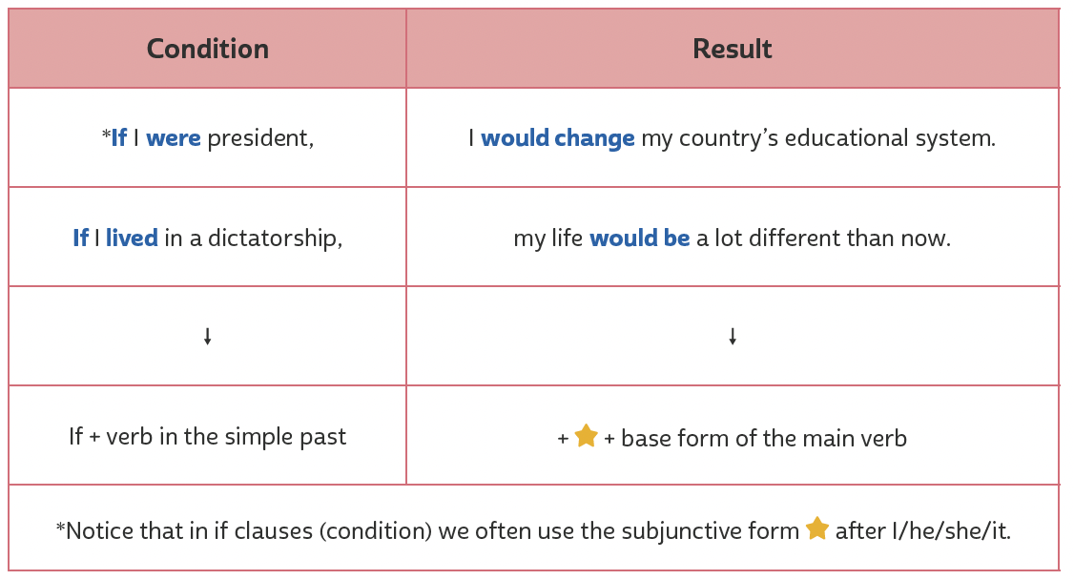
UNIT 4
second conditional
TIP
would
Com base nos exemplos, faça inferências para compreender regras de uso da língua inglesa.
were

Slide 28
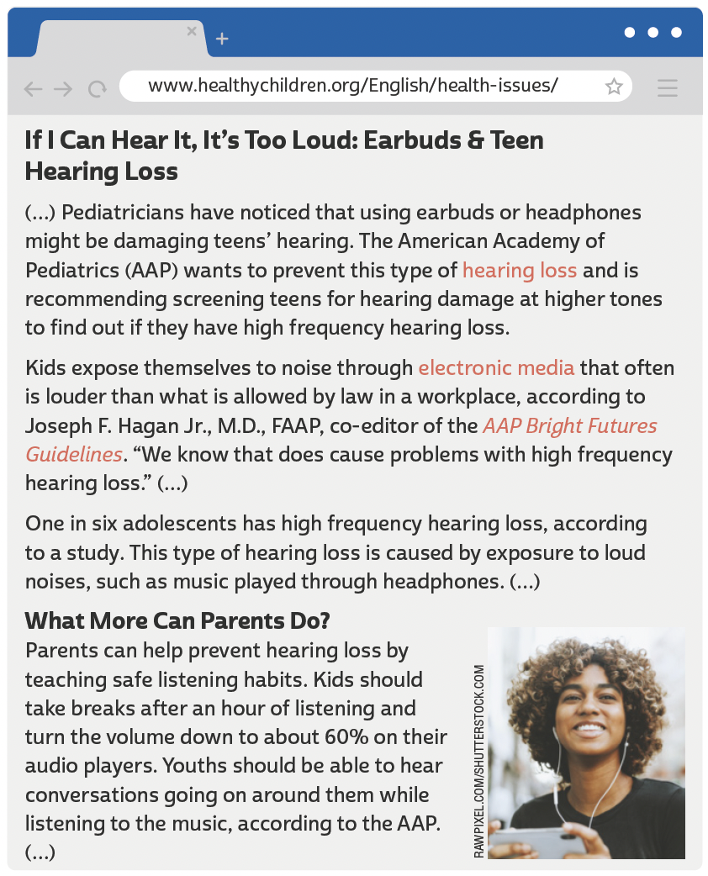
UNIT 5
LANGUAGE NOTE
Damage can be either a noun
(dano) or a verb (danificar).
In “earbuds or headphones
might be damaging teens’
hearing”, damage is a verb.
In “screening teens for
hearing damage at higher
tones”, damage is a noun.
AMERICAN ACADEMY OF PEDIATRICS. If I can hear it, it's too loud: earbuds & teen hearing loss. 16 mar. 2017. Disponível em: www.healthychildren.org/English/health-issues/conditions/ear-nose-throat/Pages/Acoustic-Trauma-Hearing-Loss-in-Teenagers.aspx. Acesso em: 21 jun. 2022.

Slide 29
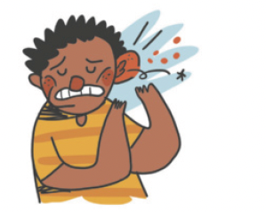
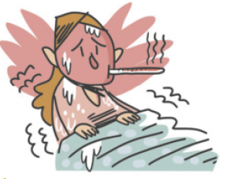
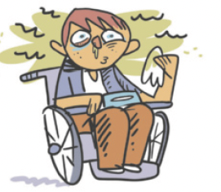
UNIT 5
backache
broken leg
cold
Health problems
earache
fever
flu

Slide 30
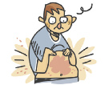
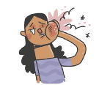
UNIT 5
headache
nausea
rash
Health problems
ILUTRAÇÕES: GALVÃO BERTAZZI
sore throat
stomachache
toothache

Slide 31
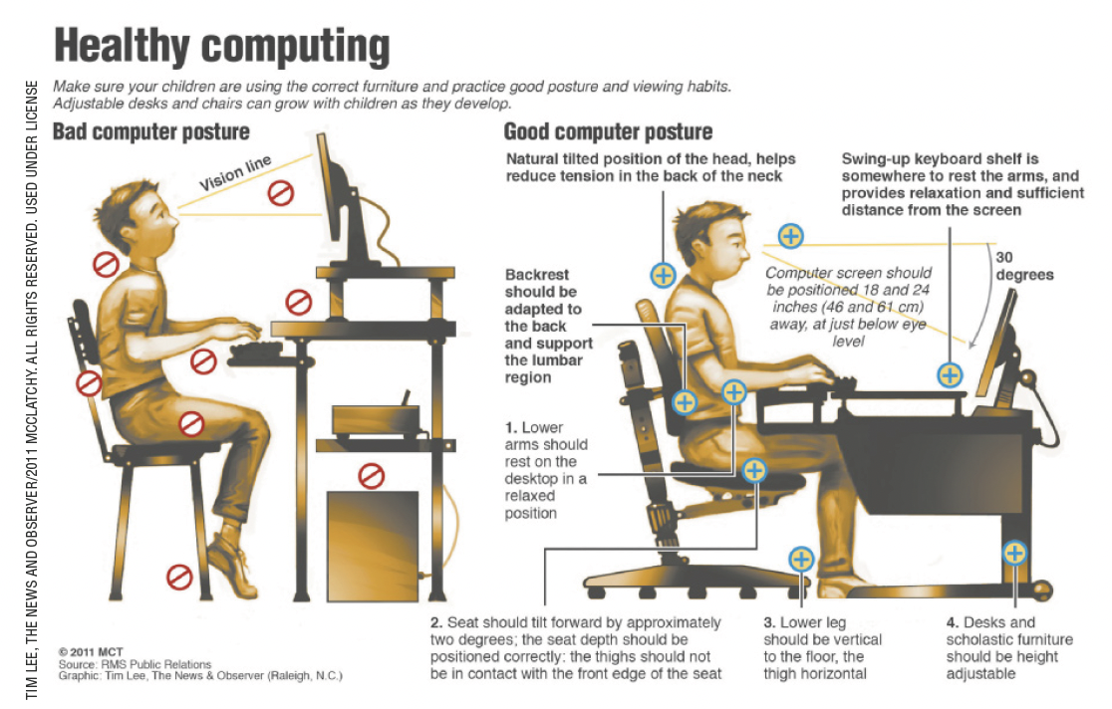
UNIT 5
MCT. Healthy computing. 2011. Infográfico. Disponível em: http://bloximages.chicago2.vip.townnews.com/journalstar.com/content/tncms/assets/v3/editorial/f/fa/ffa22316-f786-5f41-81ce-62198560508b/4d99e78ac99c8.pdf.pdf. Acesso em: 10 jul. 2022.

Slide 32
UNIT 5
I. “Kids should take breaks after an hour of listening (...)”
II. “Youths should be able to hear conversations going on around them (...)”
MODAL VERBS: should, must, have to
The modal verb SHOULD expresses
We use SHOULD
a recommendation.
before the main verb in the infinitive (without to).

Slide 33
UNIT 5
I. “The family will have to know soon because her pregnancy will become obvious”.
II. “When setting limits, it’s important always to be consistent. Rules must stay the same from one day to the next”.
MODAL VERBS: should, must, have to
The modal verbs must and have to express
We use must and have to
necessity, obligation.
before the main verb in the infinitive (without to).
In order to express an obligation/necessity in the past or future, we use the modal verb
have to.
LANGUAGE NOTE
We use must not (= mustn’t) to express a prohibition.
E.g.: You mustn’t come. (You are not allowed to come).
We use not have to to express lack of necessity or obligation.
E.g.: You don’t have to come. (You don’t need to come).

Slide 34
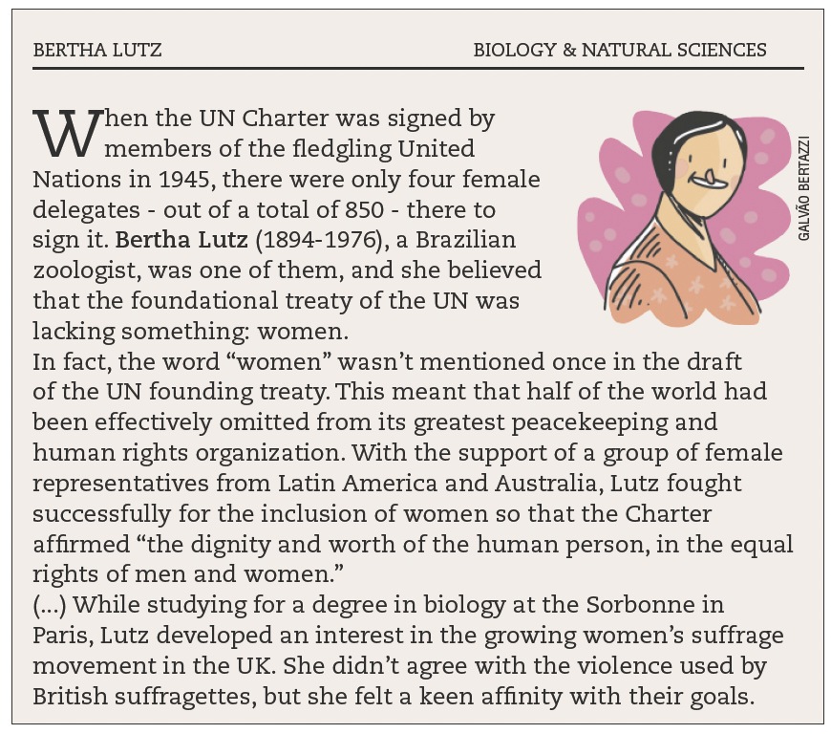
UNIT 6
LANGUAGE NOTE
UN (United Nations)
= ONU (Organização das Nações Unidas)

Slide 35
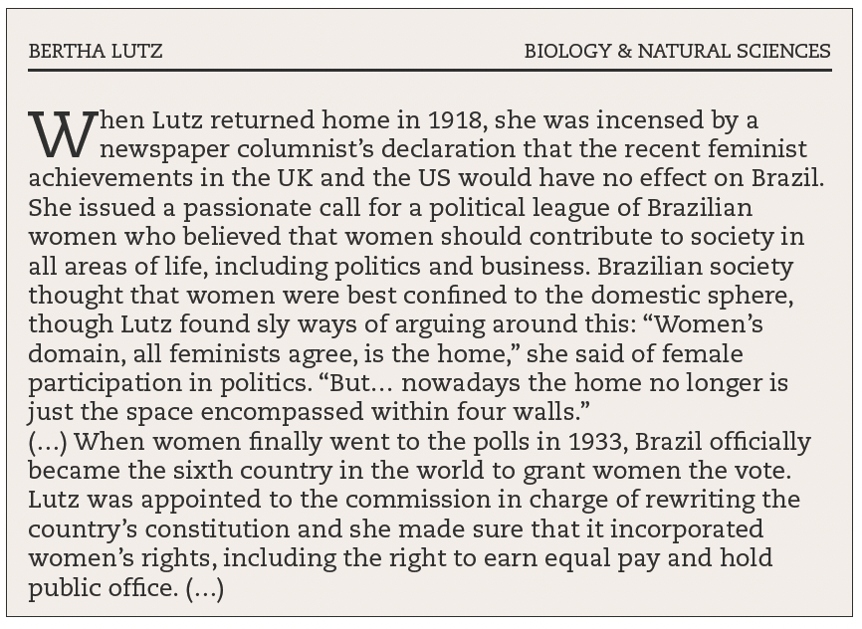
UNIT 6
TSJENG, Zing. Forgotten women: the scientists. Londres: Octopus Publishing Group, 2018. p. 50-52.

Slide 36
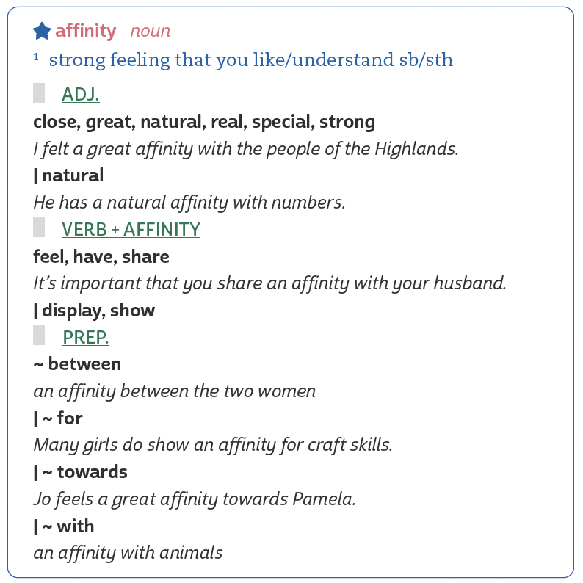
UNIT 6
collocations
TIP
Collocations são combinações de palavras que ocorrem frequente-mente em uma língua, como great affinity (adjetivo + substantivo) e affinity with (substantivo + preposi-ção). Estude essas combinações em inglês para compreendê-las melhor e utilizá-las em seus textos.
AFFINITY. In: OZDIC.COM. [2022?]. Disponível em: https://ozdic.com/collocation/affinity. Acesso em: 27 jun. 2022.

Slide 37
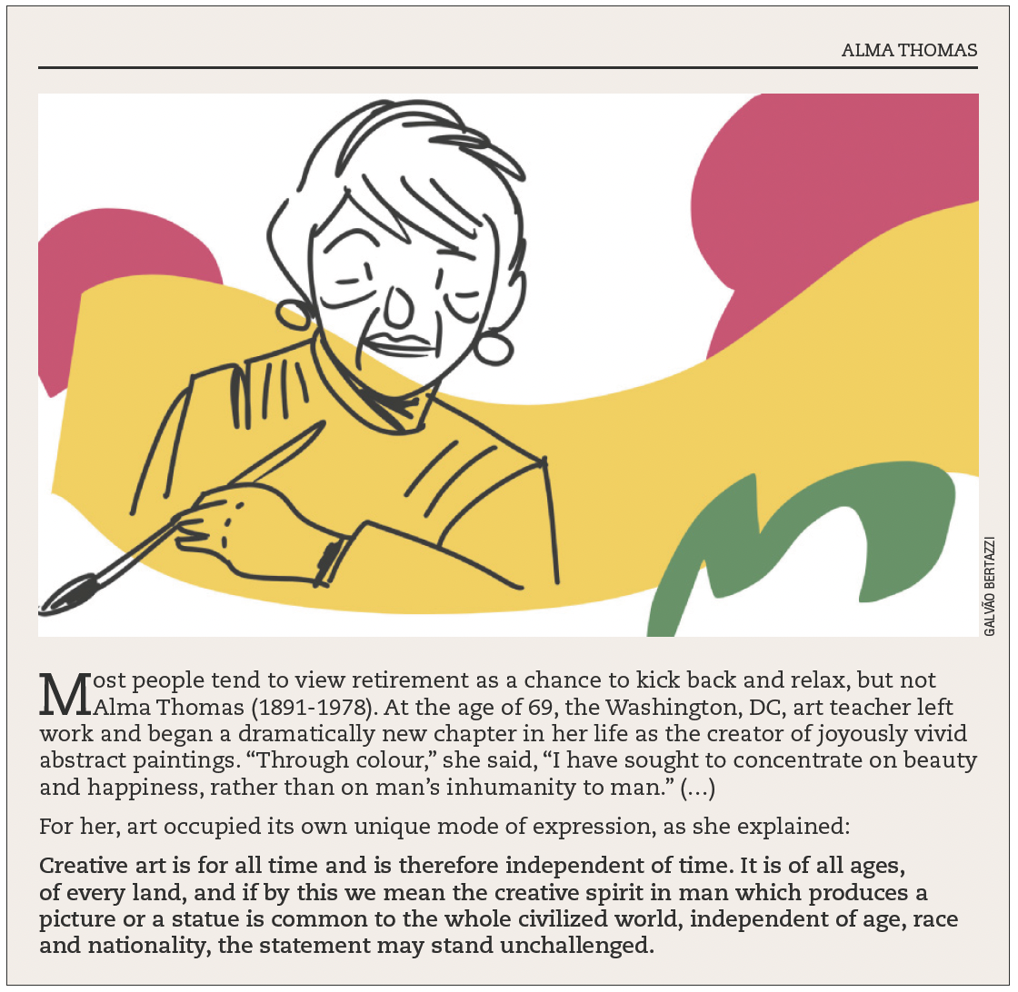
UNIT 6
THINK ABOUT IT!
Aos 69 anos, Alma Thomas iniciou uma nova fase de sua vida dedicando-se à criação artística. Para você, o que a decisão de Alma nos sugere a respeito do processo de envelhecimento? Você acredita que, em nossa sociedade, os/as idosos/as são devidamente respeitados/ as e valorizados/as? Por quê (não)? O que pode ser feito para que isso aconteça?
TSJENG, Zing. Forgotten women: the scientists. Londres: Octopus Publishing Group, 2018. p. 30-32.

Slide 38
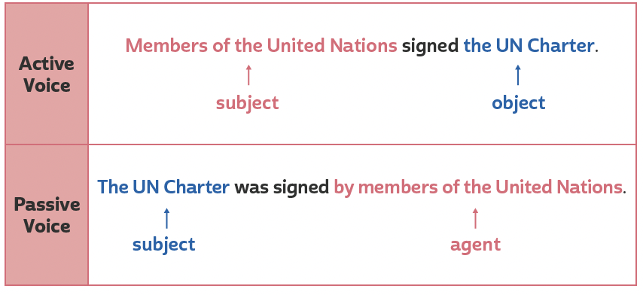
UNIT 6
Passive voice
TIP
The first sentence (in the active voice) focuses on
The second sentence (in the passive voice) focuses on
the performer of the action.
the action.
Note que a formação da voz passiva em inglês é semelhante à formação da voz passiva em português.

Slide 39
UNIT 6
Passive voice
TIP
In the passive voice, the performer of the action is
In the passive voice, the preposition by introduces
the agent.
the agent.
The structure of the passive voice is
subject + verb to be + main verb in the past participle.
Note que a formação da voz passiva em inglês é semelhante à formação da voz passiva em português.

Slide 40
UNIT 6
“The fact is that space and its resources belong to all of us, not to any one group.”
a. Do you agree with the quotes? If so, which one(s)?
b. What’s your favorite quote? Why?
c. In your opinion, is it easier for women to pursue a career in STEM today? Why (not)?
d. Can you give other examples of influential women in STEM? What do/did they do?
“My message was that Science has no passport, no gender, no race, no culture, no political party...science is universal and unifying.”
“We need feminine qualities to be both accepted and respected...I love that the new movement involves women joining their voices together.”
ARABIA, Jim. Women in STEM statistics to inspire future leaders. BigRentz. 23 fev. 2021. Disponível em: www.bigrentz.com/blog/women-in-stem-statistics. Acesso em: 27 jun. 2022.

Slide 41
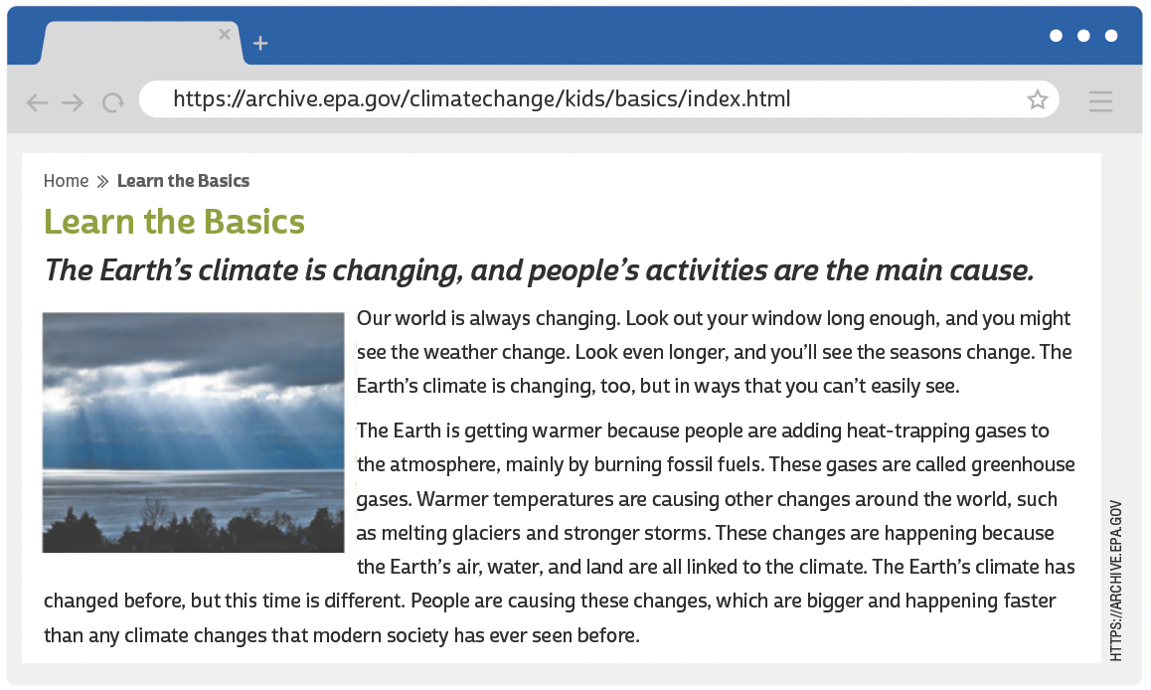
UNIT 7
LANGUAGE NOTE
Weather × Climate
Weather is a specific event or condition that happens over a period of hours or days.
Climate refers to the average weather conditions in a place over many years (usually at least 30 years).
UNITED STATES ENVIRONMENTAL PROTECTION AGENCY. Learn the basics. 5 set. 2017. Disponível em: https://archive.epa.gov/climatechange/kids/basics/index.html. Acesso em: 25 jun. 2022.

Slide 42
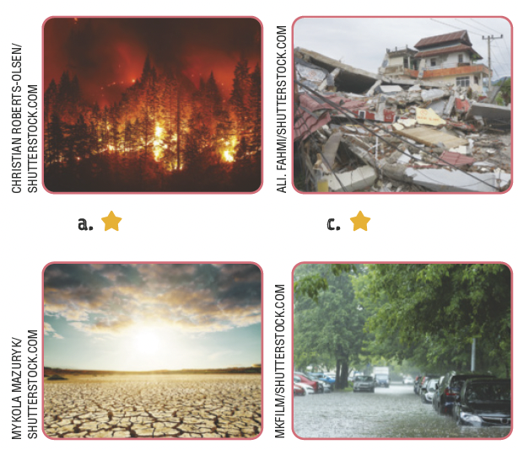
UNIT 7
Natural disasters
bushfire
earthquake
drought
flood

Slide 43
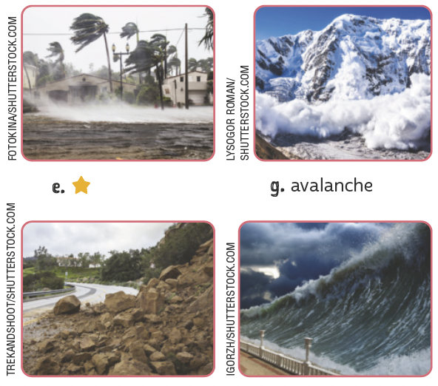
UNIT 7
Natural disasters
hurricane
avalanche
landslide
tsunami

Slide 44
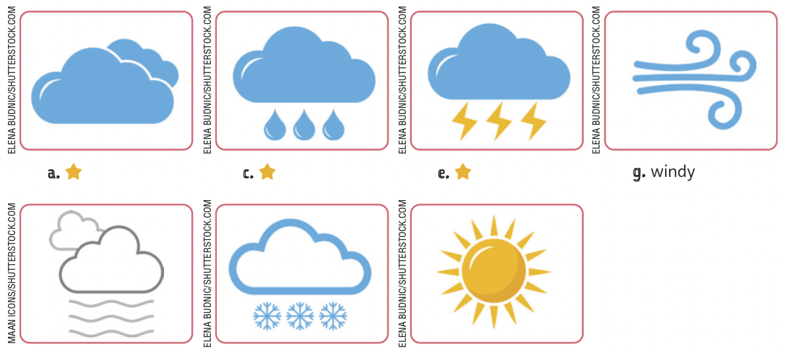
UNIT 7
The weather
cloudy
rainy
stormy
windy
TIP
Em inglês, o sufixo -y
geralmente é acrescentado
a substantivos para formar
adjetivos:
snow ➡️ snowy;
rain ➡️ rainy;
storm ➡️ stormy.
foggy
snowy
sunny

Slide 45
UNIT 7
affected
changed
rise
warned
warned
Present perfect
“The Earth’s climate has changed before (...)”
The structure of the present perfect is
auxiliary verb (have/has) +
“(...) modern society has ever seen before.”
main verb (past participle)
TIP
Consulte o quadro de verbos irregulares ao final do livro sempre que necessário.

Slide 46
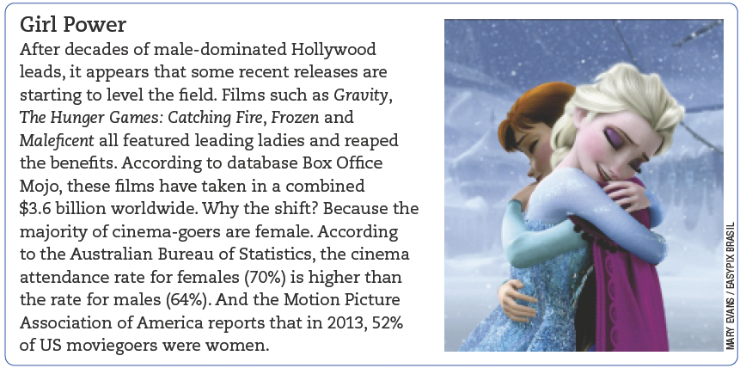
UNIT 8
TIP
Observe a diferença de usos de acordo com a variação linguística do inglês:
movie (AmE)
= film (AuE/BrE);
the movies/movie theater (AmE) = the cinema (AuE/BrE).
READER’S DIGEST, Austrália, vol. 187, n. 1 115, p. 118, jan. 2015.

Slide 47
UNIT 8
I. “Films such as Gravity, The Hunger Games: Catching Fire, Frozen and Maleficent (…)”
II. “According to the Australian Bureau of Statistics (…)”
Linking words/ phrases
SUCH AS
is used to
ACCORDING TO
is used to
introduce examples.
refer to a source.
ACCORDING TO
is equivalente in meaning to
with reference to.

Slide 48
UNIT 8
adventure
comedy
Kinds of movie
action
documentary
animation
drama

Slide 49
UNIT 8
fantasy
musical
Kinds of movie
science fiction
thriller
romance
western

Slide 50
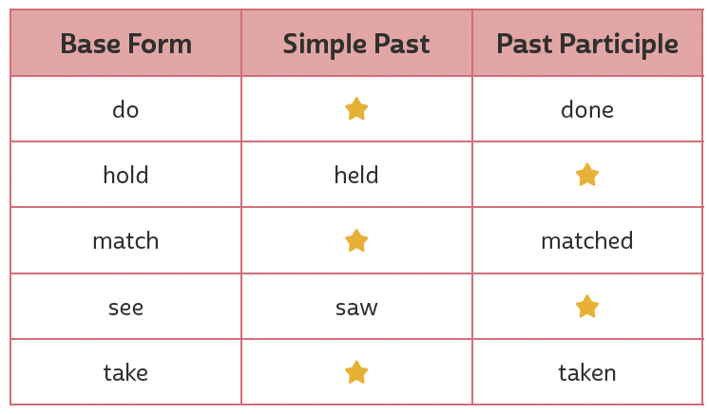
UNIT 8
did
held
matched
Present perfect or simple past?
seen
took
TIP
Consulte o quadro de verbos irregulares ao final do livro sempre que necessário.
Time expressions used with the simple past
yesterday, when I was a child, last month, a year ago
Time expressions used with the present perfect
recently, since I was a child, over the years, lately

Slide 51
VOCABULARY CORNER
2DAY
4EVER
B4
BFF
DM
GR8
ILU
today
forever
before
best friends forever
direct message
great
IMHO
B4N
bye for now
CYA
see ya/see you
FYI
for your information
IDK
I don't know
I love you
in my opinion
IMO
in my humble opinion
Unit 1:
Internet slang

Slide 52
VOCABULARY CORNER
K
PLS
TBT
THX/THKS
U2
UR
XOXO
laughing out loud
please
throwback Thursday
thanks
you too
your
hugs and kisses
OK
LOL
SRY
sorry
TBH
to be honest
TXT
text
Y
why
ZZZ
sleeping
Unit 1:
Internet slang

Slide 53
VOCABULARY CORNER
independent, inevitable
Personal answers.
adjective
Unit 3: word formation: prefixes
unequal, unhappy, unjust,
unsafe, unsustainable
Personal answers.
adjective

Slide 54
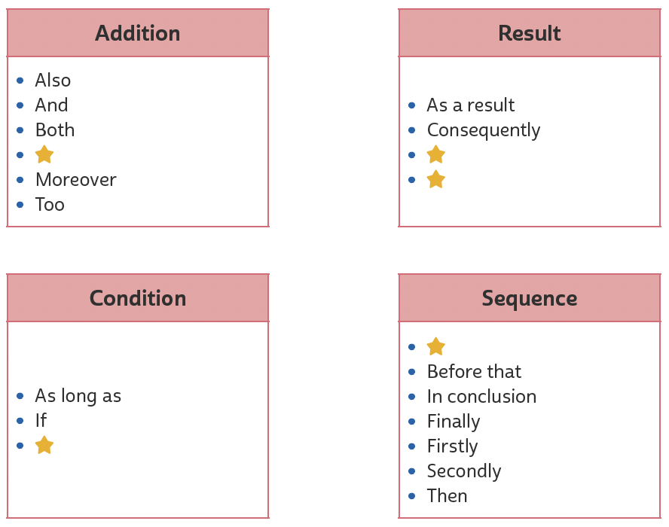
VOCABULARY CORNER
In addition to
So
Therefore
Unit 3: linking words/phrases
After that
Unless

Slide 55
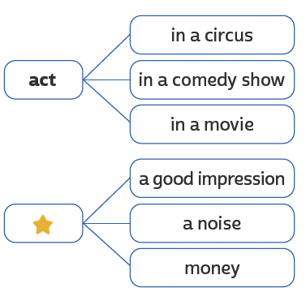
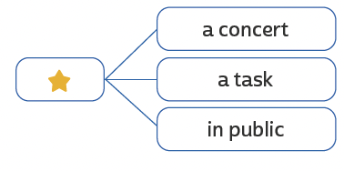
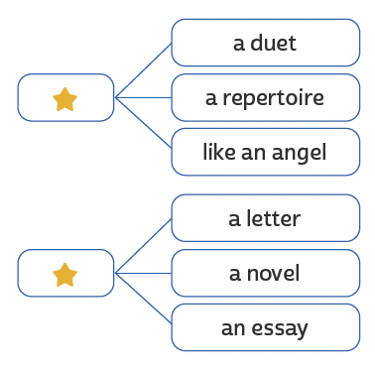
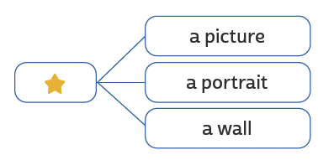
VOCABULARY CORNER
act
perform
Unit 4: collocations
make
sing
paint
write

Slide 56
VOCABULARY CORNER
Unit 4: linking words/phrases
Nevertheless
So
Therefore

Slide 57
VOCABULARY CORNER
backache
broken leg
cold
Unit 5: health problems
earache
fever
flu

Slide 58
VOCABULARY CORNER
headache
nausea
rash
Unit 5: health problems
ILUTRAÇÕES: GALVÃO BERTAZZI
sore throat
stomachache
toothache

Slide 59
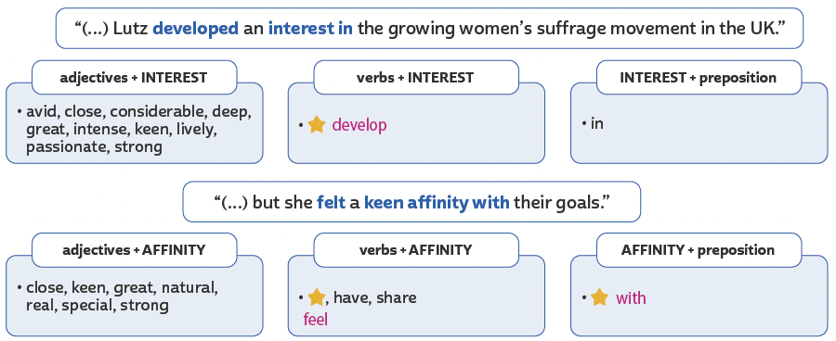
VOCABULARY CORNER
develop
in
Unit 6: collocations
feel, have, share
with

Slide 60
VOCABULARY CORNER
bushfire
earthquake
Unit 7: natural disasters
drought
flood

Slide 61
VOCABULARY CORNER
hurricane
avalanche
Unit 7: natural disasters
landslide
tsunami

Slide 62
VOCABULARY CORNER
Unit 7: the weather
cloudy
rainy
stormy
windy
foggy
snowy
sunny

Slide 63
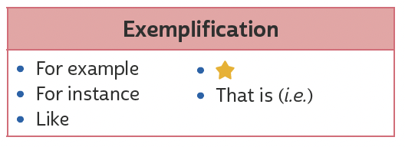
VOCABULARY CORNER
Unit 8: linking words/phrases
Such as

Slide 64
VOCABULARY CORNER
adventure
comedy
Unit 8: kinds of movie
action
documentary
animation
drama

Slide 65
VOCABULARY CORNER
fantasy
musical
Unit 8: kinds of movie
science fiction
thriller
romance
western

Slide 66
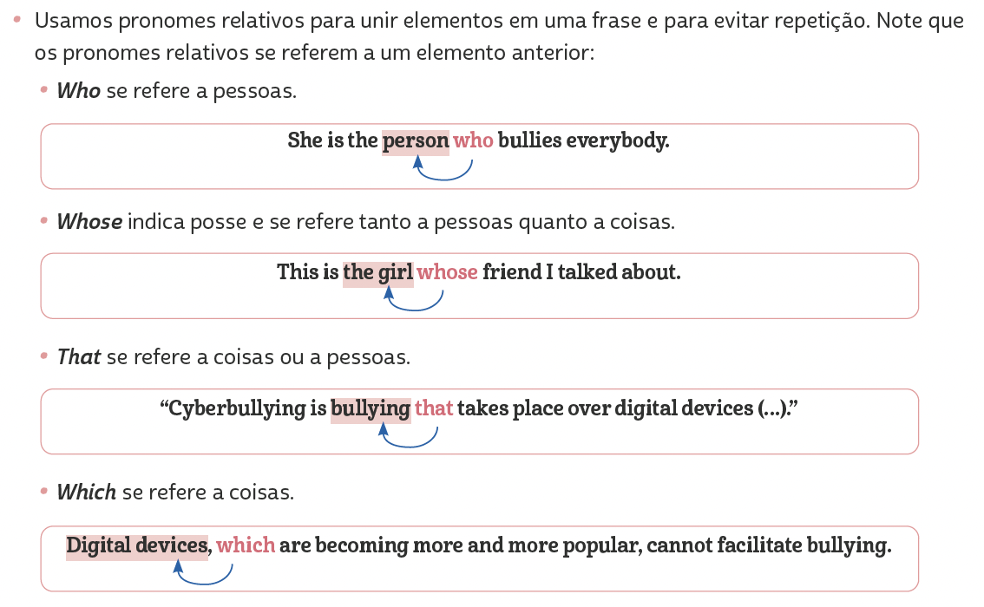
LANGUAGE REFERENCE
Unit 1:
REVIEW: RELATIVE PRONOUNS

Slide 67
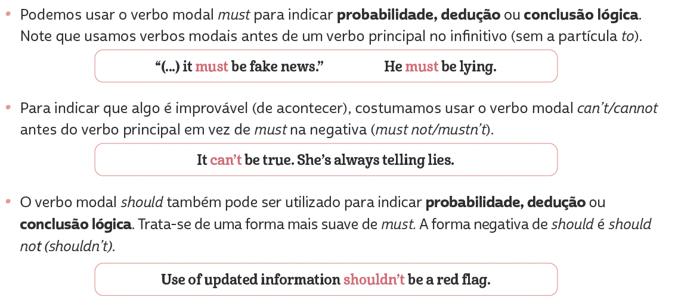
LANGUAGE REFERENCE
Unit 1:
MODAL VERBS: SHOULD, MUST

Slide 68
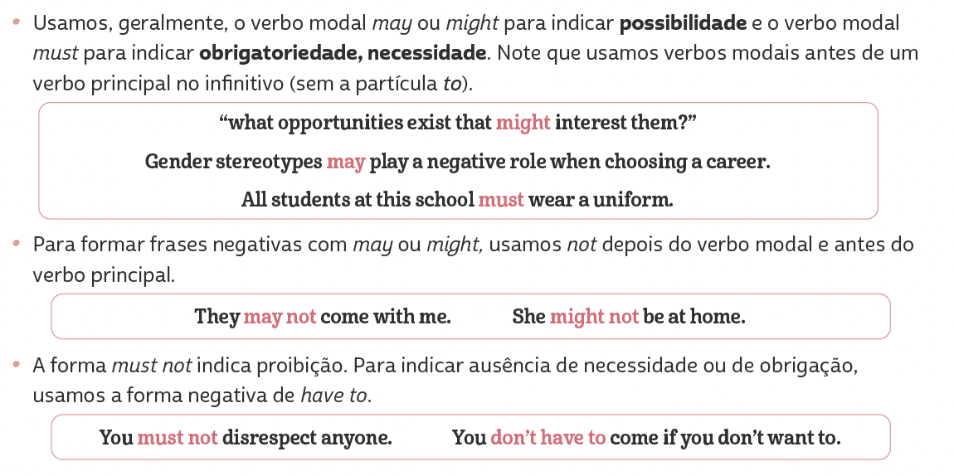
LANGUAGE REFERENCE
Unit 2:
MODAL VERBS: MAY, MIGHT, MUST

Slide 69
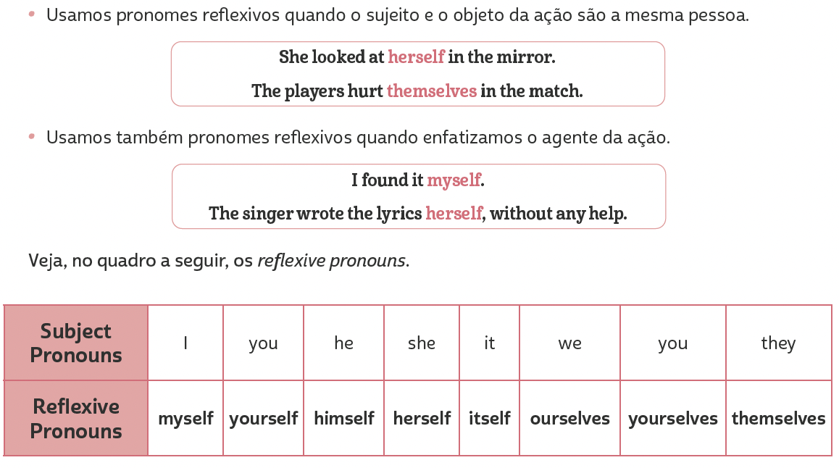
LANGUAGE REFERENCE
Unit 2: REFLEXIVE PRONOUNS

Slide 70
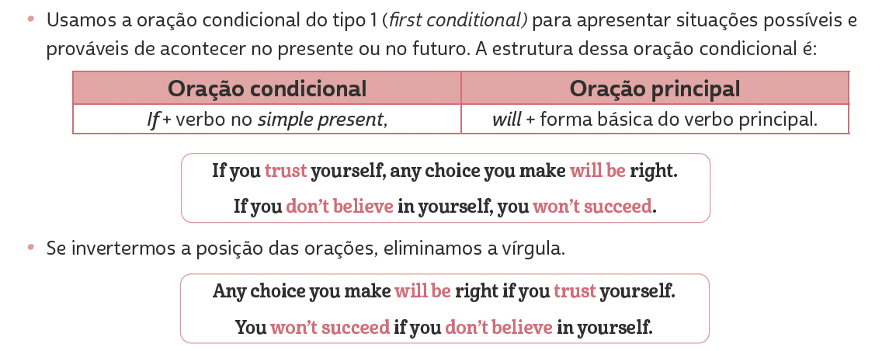
LANGUAGE REFERENCE
Unit 3: FIRST CONDITIONAL

Slide 71
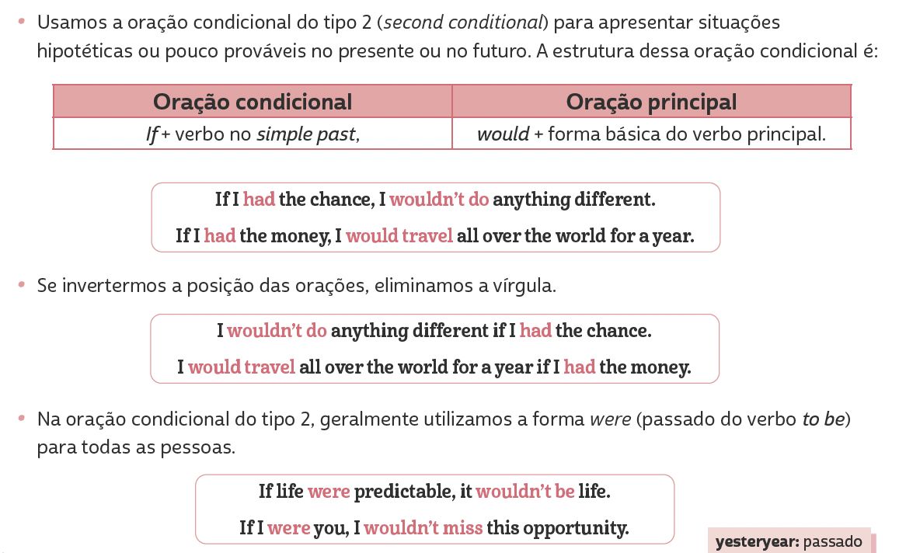
LANGUAGE REFERENCE
Unit 4:
Second conditional

Slide 72
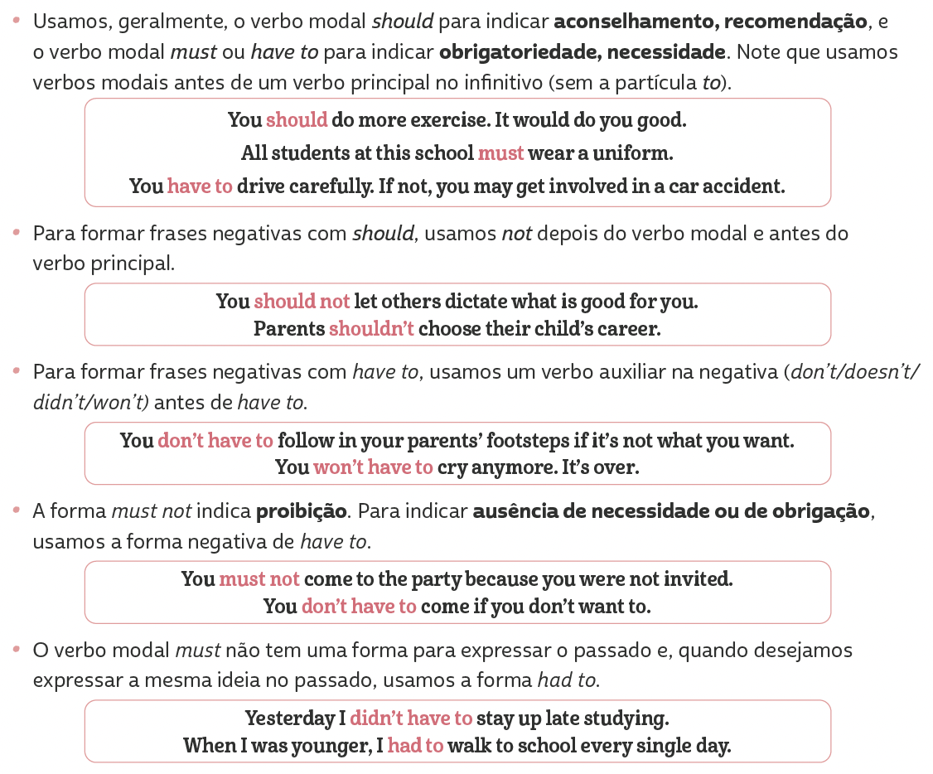
LANGUAGE REFERENCE
Unit 5:
Should, must, have to

Slide 73
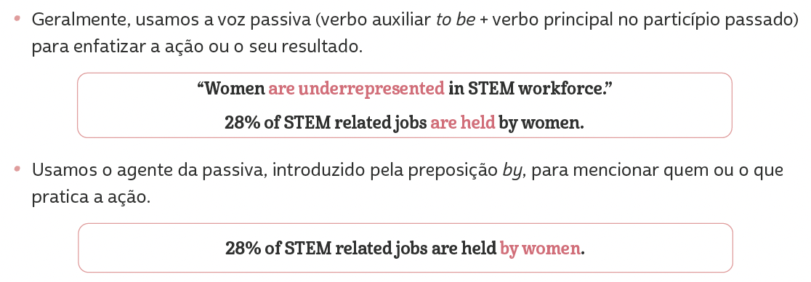
LANGUAGE REFERENCE
Unit 6:
Passive voice

Slide 74
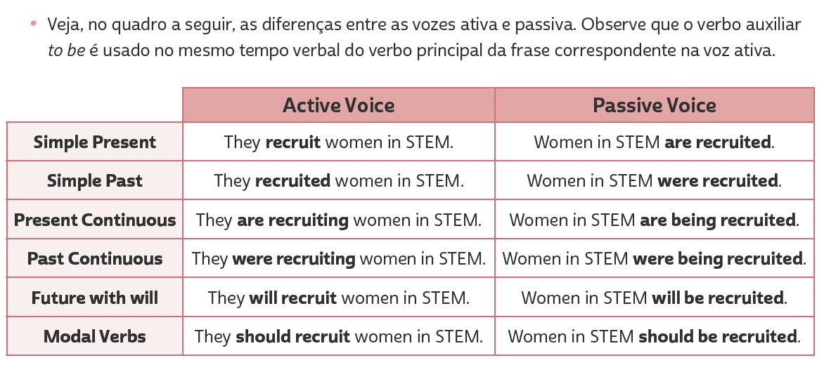
LANGUAGE REFERENCE
Unit 6:
Passive voice

Slide 75
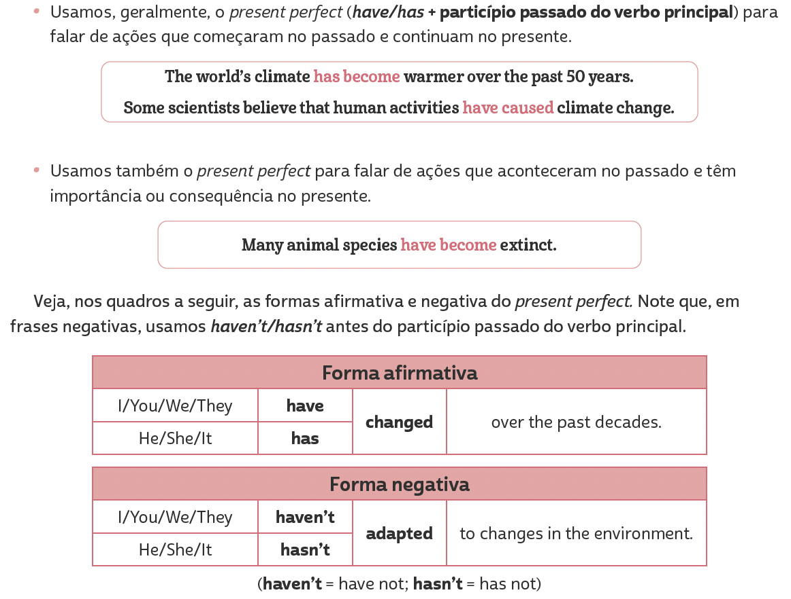
LANGUAGE REFERENCE
Unit 7: present perfect

Slide 76
LANGUAGE REFERENCE
Unit 7: present perfect

Slide 77
LANGUAGE REFERENCE
A. Passado e particípio passado
com o som
/ɔːt/
Unit 7: verbos irregulares agrupados por formas semelhantes

Slide 78
LANGUAGE REFERENCE
B. Passado e particípio passado
com o som
/ɛnt/
Unit 7: verbos irregulares agrupados por formas semelhantes

Slide 79
LANGUAGE REFERENCE
c. Passado e particípio passado
com o som
/ept/
Unit 7: verbos irregulares agrupados por formas semelhantes

Slide 80
LANGUAGE REFERENCE
d. Passado com o som
E particípio passado com o som
/an/ /aŋ/
/ʌn/ /ʌŋ/
Unit 7: verbos irregulares agrupados por formas semelhantes

Slide 81
LANGUAGE REFERENCE
e. Passado com o som
E particípio passado com o som
Terminado em en
/əʊ/
/əʊ/
Unit 7: verbos irregulares agrupados por formas semelhantes

Slide 82
LANGUAGE REFERENCE
F. Passado com o som
E particípio passado com o som
/uː/
/əʊn/
Unit 7: verbos irregulares agrupados por formas semelhantes

Slide 83
LANGUAGE REFERENCE
Unit 8: present perfect or simple past?

