Slide 1
Língua inglesa
8º ano

Slide 2
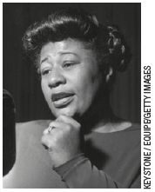
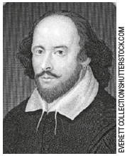
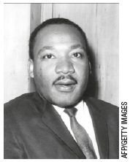
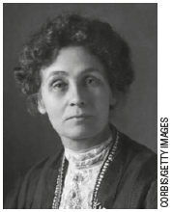
UNIT 0
Ella Fitzgerald
(1917-1996)
William Shakespeare
(1564-1616)
Ella Fitzgerald was an American singer.
William Shakespeare was an English playwright.
Martin Luther King, Jr. was an American activist.
Emmeline Pankhurst was an English activist.
Martin Luther
King, Jr. (1929-1968)
Emmeline Pankhurst
(1858-1928)

Slide 3
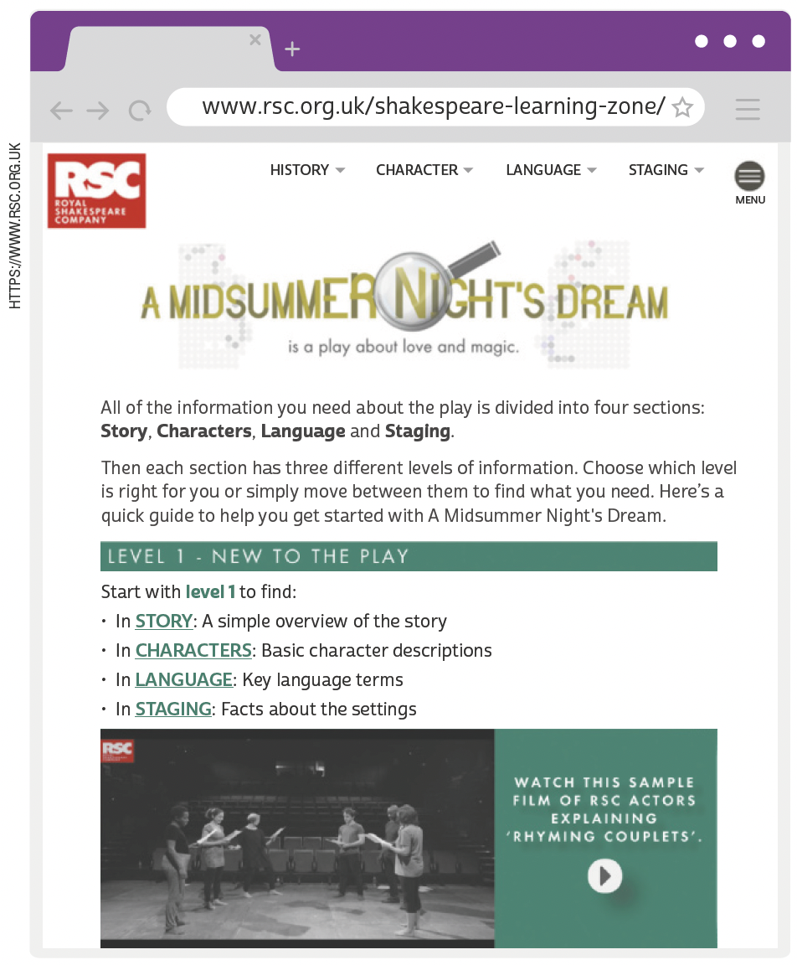
UNIT 0
RSC. A midsummer night’s dream is a play about love and magic. 2022. Disponível em: www.rsc.org.uk/shakespeare-learning-zone/a-midsummer-nights-dream. Acesso em: 15 jun. 2022.

Slide 4
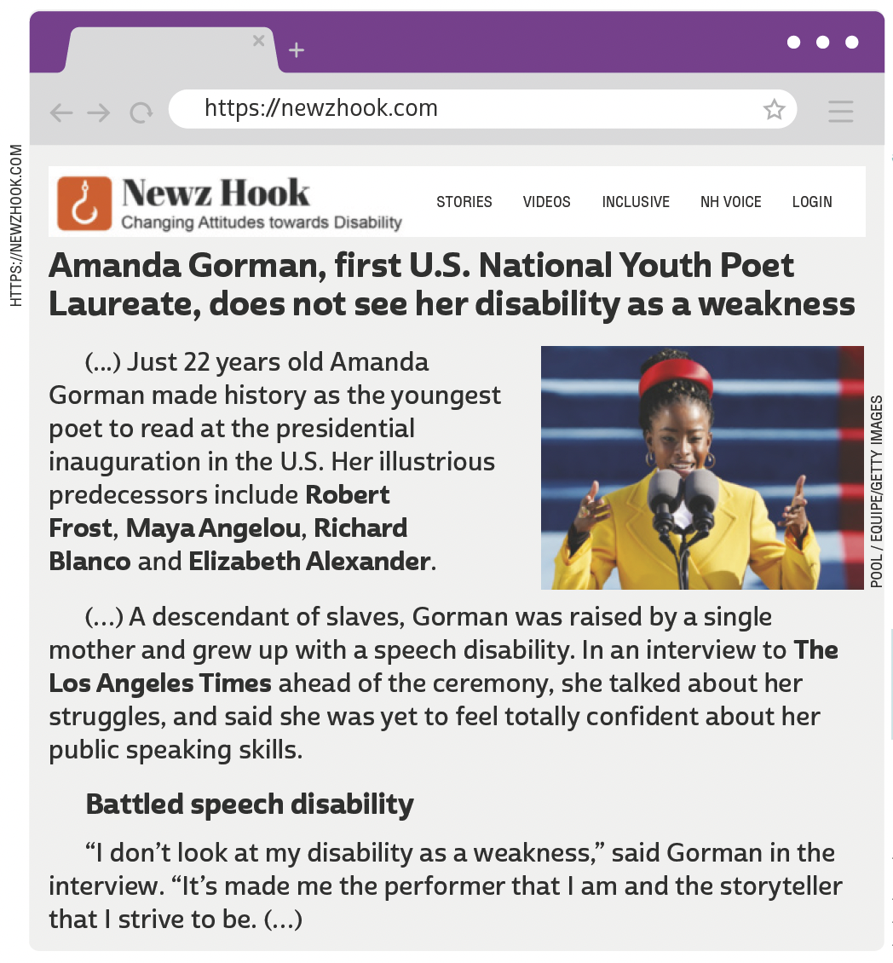
UNIT 0
TIP
Busque antecipar o
sentido global de textos em língua inglesa com base na observação de títulos e imagens.
NEWZ HOOK. Amanda Gorman, first U.S. National Youth Poet Laureate, does not see her disability as a weakness. 22 jan. 2021. Disponível em: https://newzhook.com/story/amanda-gorman-first-u-s-national-youth-poet-laureate-does-not-see-her-disability-as-a-weakness/. Acesso em: 16 jun. 2022.

Slide 5
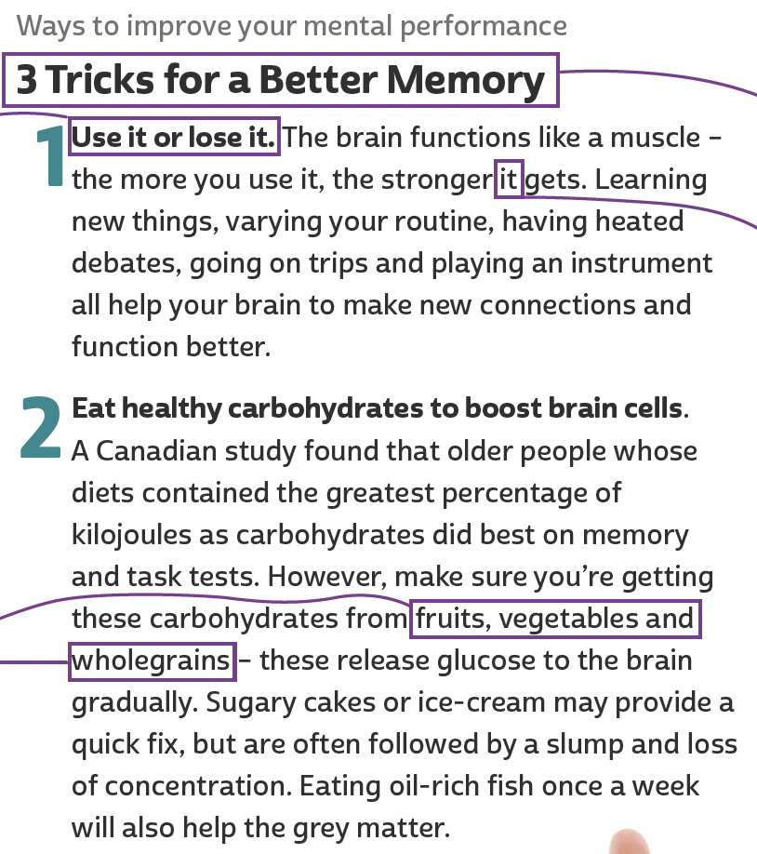
UNIT 0
TIP
Faça previsões
sobre o texto com base no título e nas
palavras-chave.
TIP
Preste atenção aos subtítulos para
compreender
melhor a
organização das
ideias no texto.
TIP
Busque sempre
identificar a
que elemento o pronome se refere para compreender
como as ideias se
relacionam em um texto.
TIP
TIP
Ative seu conhecimento prévio sobre o tema do texto para favorecer o estabelecimento de hipóteses sobre o que será lido.
Observe o que
palavras em uma
enumeração ou
listagem têm em comum para inferir possíveis
significados.

Slide 6
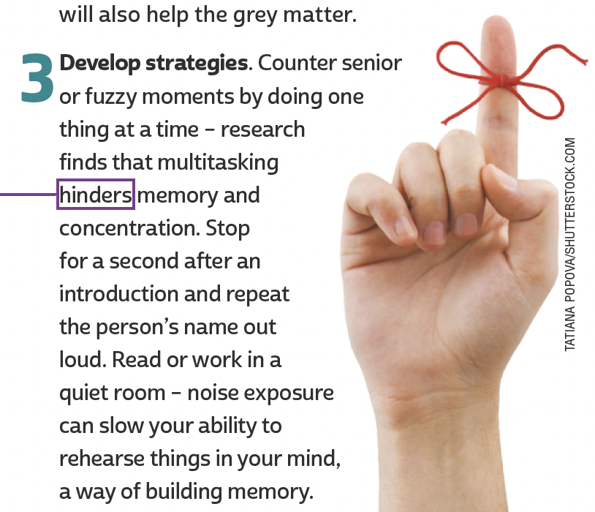
UNIT 0
TIP
Busque inferir
o significado
de palavras
desconhecidas com base na observação
do contexto em que
são utilizadas.
3 TRICKS for a better memory. Reader's Digest, Austrália, v. 187, n. 1115, p. 19, jan. 2015.

Slide 7
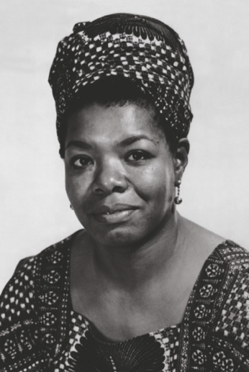
UNIT 0
Phenomenal Woman
BY MAYA ANGELOU
Pretty women wonder where my secret lies.
I’m not cute or built to suit a fashion model’s size
But when I start to tell them,
They think I’m telling lies.
I say,
It’s in the reach of my arms,
The span of my hips,
The stride of my step,
The curl of my lips.
TIP
Identifique se o texto é
uma carta, um poema,
um artigo de revista
etc. para, com base no
que você já sabe sobre
esse gênero discursivo,
compreender melhor o
texto, seus objetivos e
sua estrutura.
TIP
Observe os recursos
sonoros utilizados no
texto, como a rima.
MICHAEL OCHS ARCHIVES/GETTY IMAGES

Slide 8
UNIT 0
I’m a woman
Phenomenally.
Phenomenal woman,
That’s me.
I walk into a room
Just as cool as you please,
And to a man,
The fellows stand or
Fall down on their knees.
Then they swarm around me,
A hive of honey bees.
I say,
It’s the fire in my eyes,
And the flash of my teeth,
The swing in my waist,
And the joy in my feet.
I’m a woman
Phenomenally.
Phenomenal woman,
That’s me.
(...)
THINK ABOUT IT!
TIP
A poetisa e ativista estadunidense Maya Angelou (1928-2014) publicou dezenas de coletâneas de poemas. “Phenomenal
Woman” é um poema consagrado na literatura afro-americana e, desde a sua publicação, em 1978, já foi adaptado e utilizado em diversos países e manifestações culturais por inúmeras associações envolvidas com questões relacionadas à proteção dos direitos humanos. Você conhece outros poemas, em inglês e/ou português, que tenham se destacado por valorizar alguma questão de relevância social?
Observe o efeito das
repetições de versos
no texto.
ANGELOU, Maya. Phenomenal woman. In: ANGELOU, Maya. And still I rise. Londres: Hachette Digital, 1986.

Slide 9
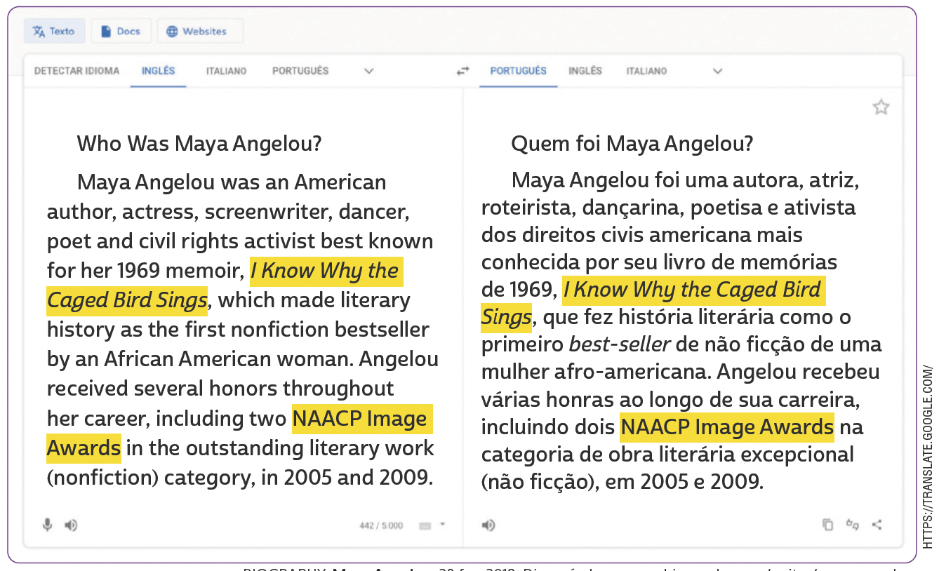
UNIT 0
Using an online translator
BIOGRAPHY. Maya Angelou. 28 fev. 2018. Disponível em: www.biography.com/writer/maya-angelou. Acesso em: 16 jun. 2022.

Slide 10
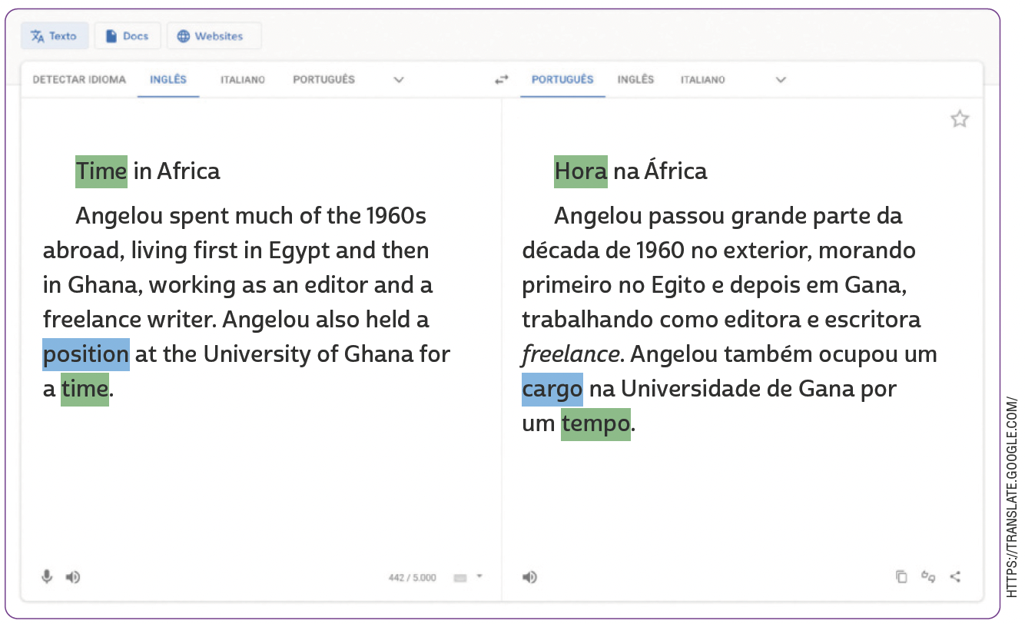
UNIT 0
Using an online translator
TIP
Observe se uma mesma
palavra ou expressão tem mais de um significado possível e escolha a melhor tradução a partir do seu contexto de uso.
BIOGRAPHY. Maya Angelou. 28 fev. 2018. Disponível em: www.biography.com/writer/maya-angelou. Acesso em: 16 jun. 2022.

Slide 11
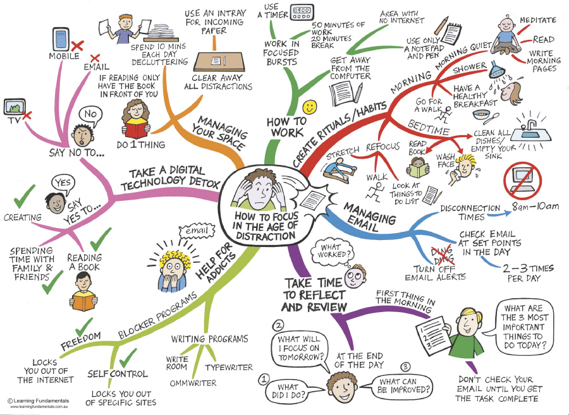
UNIT 1
TIP
© LEARNING FUNDAMENTALS WWW.LEARNINGFUNDAMENTALS.COM.AU
Note que o uso de cores em um mapa conceitual é importante para uma boa organização visual das
informações.
Adaptado de: HOW to focus in the age of distraction. David Hopkins / Education & Leadership. 9 dez. 2013. Disponível em: www.dontwasteyourtime.co.uk/social-network/how-to-focus-in-the-age-of-distraction/. Acesso em: 18 maio 2022.

Slide 12
UNIT 1
Digital devices
timer
television/ TV
computer
Mobile (phone)/ cell (phone)
Word groups
TIP
Agrupar palavras e
expressões por campo
semântico pode ajudar
você a ampliar e fixar o
vocabulário aprendido.

Slide 13
UNIT 1
Daily activities
take/have a shower
stretch
have/eat breakfast
wash face
clean all dishes
walk/ go for a walk
read (a book)
Word groups
TIP
Agrupar palavras e
expressões por campo
semântico pode ajudar
você a ampliar e fixar o
vocabulário aprendido.

Slide 14
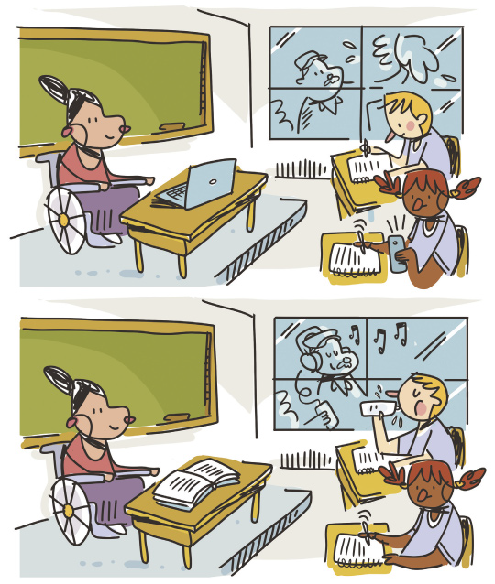
UNIT 1
Review:
simple present / present continuous
In picture A the teacher is using the computer. In picture B she’s reading a book.
ILUSTRAÇÕES: GALVÃO BERTAZZI

Slide 15
UNIT 1
Review:
simple present / present continuous
In picture A the girl is using her cell/mobile (phone) and writing (on her notebook). In picture B she’s only writing (on her notebook).
ILUSTRAÇÕES: GALVÃO BERTAZZI

Slide 16
UNIT 1
Review:
simple present / present continuous
In picture A the boy is writing (on his notebook). In picture B he’s drinking water.
ILUSTRAÇÕES: GALVÃO BERTAZZI

Slide 17
UNIT 1
Review:
simple present / present continuous
In picture A the man is cleaning the window. In picture B he’s listening to music.
ILUSTRAÇÕES: GALVÃO BERTAZZI

Slide 18

UNIT 2
Excerpt 1
The eight-year-old girl who had never been told “You’re worthy; you’re beautiful” suddenly found herself as a leading lady, and a mouthpiece for all the women who looked like her. (...) The obstacle blocking me was a four-hundred-year-old racist system of oppression and my own feeling of utter aloneness. My art, in this instance, was the best healing tool to resolve my past, the best weapon that I had to conquer my present, and my gift to the future.
EARL GIBSON III/GETTY IMAGES FOR BET
PRONUNCIATION NOTE
O primeiro nome da atriz Viola Davis nos remete ao nome de um instrumento musical, tanto em português quanto em inglês, mas, no nome próprio Viola, o “i” é
pronunciado como o pronome “I” /aɪ/.
DAVIS, Viola. Finding me: a memoir. Nova York: HarperCollins Publishers, 2022. p. 279.

Slide 19
UNIT 2
Excerpt 2
Every painful memory, every mentor, every friend and foe served as a chisel, a leap pad that has shaped “ME!” (...) I’m no longer ashamed of me. I own everything that has ever happened to me. The parts that were a source of shame are actually my warrior fuel. I see people – the way they walk, talk, laugh, and grieve, and their silence – in a way that is hyperfocused because of my past. I’m an artist because there’s no separation from me and every human being that has passed through the world including my mom. I have a great deal of compassion for other people, but mostly for myself. That would not be the case if I did not reconcile that little eight-year-old girl and FIND ME.
DAVIS, Viola. Finding me: a memoir. Nova York: HarperCollins Publishers, 2022. p. 291.

Slide 20
UNIT 2
I. “(…) ‘You’re worthy; you’re beautiful’ (…)”
– Excerpt 1
II. “Every painful memory, every mentor (…)”
– Excerpt 2
III. “(…) a four-hundred-year-old racist system of oppression (…)”
– Excerpt 1
IV. “I’m an artist because there’s no separation from me and every human being (…).”
– Excerpt 2
WORD FORMATION:
SUFFIXES
LANGUAGE NOTE
-FUL
(as in beautiful, painful)
-ION
(as in oppression, separation)
meaning: with; full of
turns verbs into nouns
A suffix goes at the end of
a word as in beautiful and
separation.

Slide 21
UNIT 2
III. “(…) a four-hundred-year-old racist system of oppression (…)”
– Excerpt 1
IV. “I’m an artist because there’s no separation from me and every human being (…).”
– Excerpt 2
WORD FORMATION:
SUFFIXES
-IST
(as in racist)
-IST
(as in artist)
forms adjectives as in pacifist, capitalist
refers to occupations
forms nouns as in scientist, journalist.
refers to “someone who believes in or practices something”

Slide 22
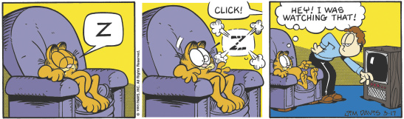
UNIT 2
Review: simple past / past continuous
DAVIS, Jim. Garfield. 2022. Disponível em: www.gocomics.com/garfield/1995/03/17. Acesso em: 24 maio 2022.
Garfield wasn’t watching television when Jon arrived.
Garfield was sleeping when Jon entered the room.

Slide 23
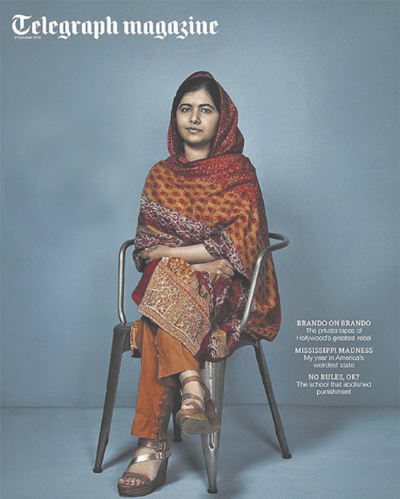
UNIT 2
LANGUAGE NOTE
Nobel laureate.
Icon.
Campaigner.
Daughter.
Schoolgirl.
Inside the ordinary
life of the
extraordinary
Malala
ordinary
= usual, not special
extraordinary
= very unusual, special
a. Who is the woman on the cover of the magazine?
b. What details about her are mentioned on the cover?
c. Based on the cover, does the woman have an ordinary or
extraordinary life?
d. What else do you know about her?
TELEGRAPH MAGAZINE. 17 out. 2015.

Slide 24
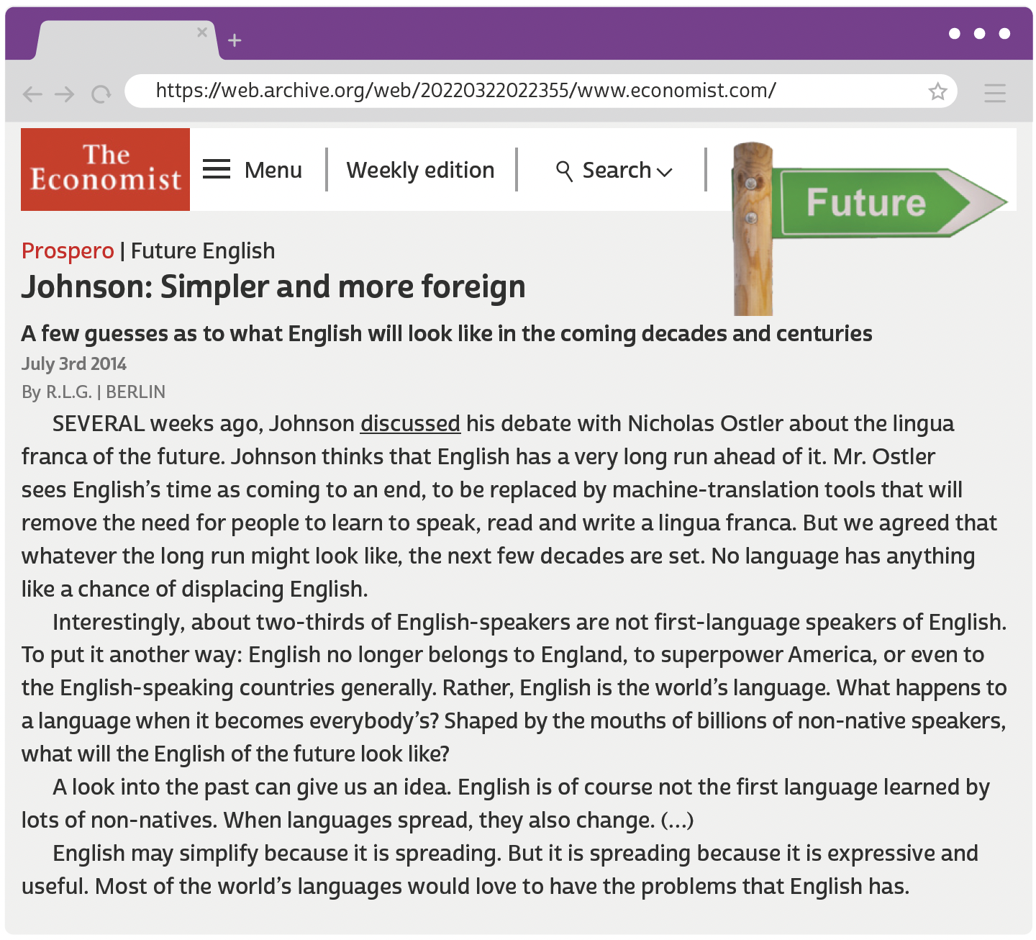
UNIT 3
GREENE, R. L. Johnson: simpler and more foreign. The Economist, 3 jul. 2014. Disponível em: https://web.archive.org/web/20220322022355/www.economist.com/prospero/2014/07/03/johnson-simpler-and-more-foreign. Acesso em: 22 mar. 2022.

Slide 25
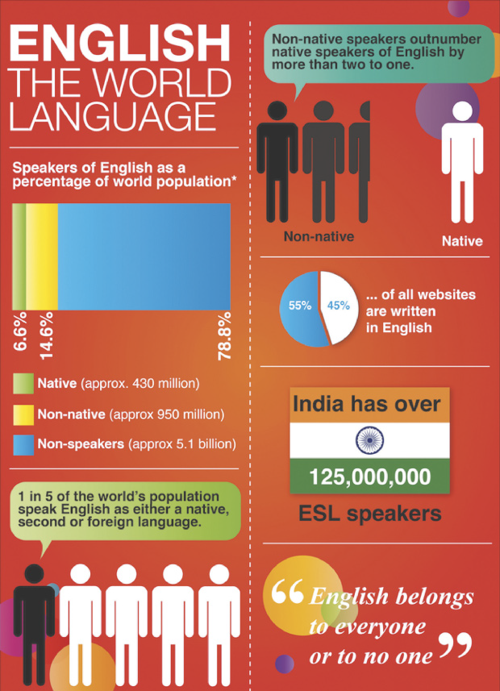
UNIT 3
THINK ABOUT IT!
Você concorda com a citação “English belongs to everyone or to no one”, presente neste infográfico?
Por quê (não)? Na sua opinião, ela se refere à visão de inglês como língua franca? Por quê (não)?
RAINE, Paul. English: the world language. Visually. 2022. Disponível em: https://visual.ly/community/Infographics/other/english-world-language. Acesso em: 30 maio 2022.

Slide 26
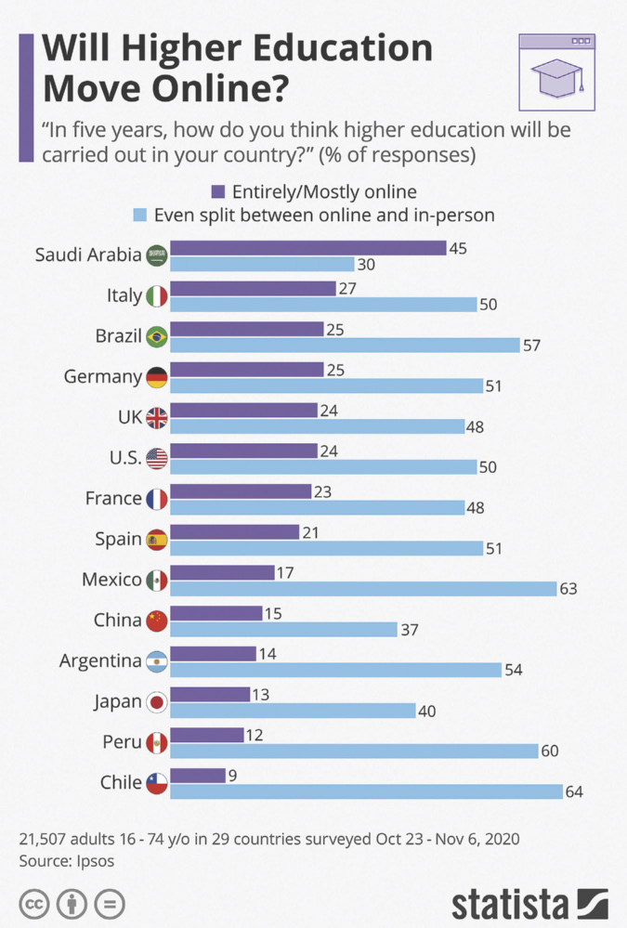
UNIT 3
TIP
Observe que gráficos que apresentam resultados de uma pesquisa de opinião (survey) costumam apresentar
informações sobre os respondentes e o período de coleta de dados.
BUCHHOLZ, Katharina. Will higher education move online? Statista. 4 dez. 2020. Disponível em: www.statista.com/chart/23695/higher-education-online. Acesso em: 30 maio 2022.

Slide 27
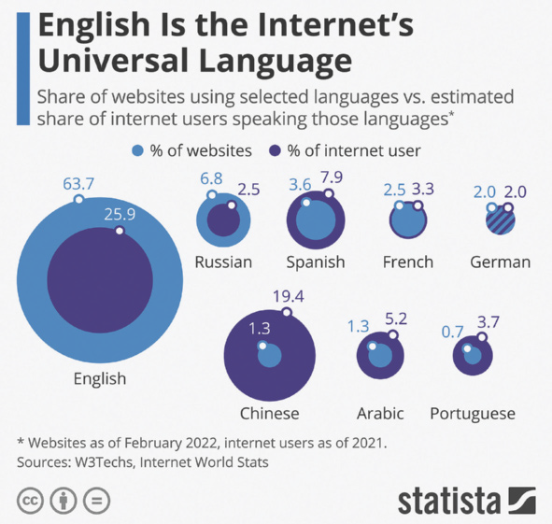
UNIT 3
THINK ABOUT IT!
De acordo com o gráfico, 3,7% de usuários da internet falam português. Qual é a porcentagem de websites em língua portuguesa? O que esses dados sugerem sobre a presença desse idioma na internet? A partir dos dados sobre a língua inglesa apresentados no gráfico, qual a importância de aprender inglês para facilitar o acesso a conteúdos disponíveis na internet?
RICHTER, Felix. English is the Internet's universal language. Statista. 21 fev. 2022. Disponível em: www.statista.com/chart/26884/languages-on-theinternet/. Acesso em: 30 maio 2022.

Slide 28
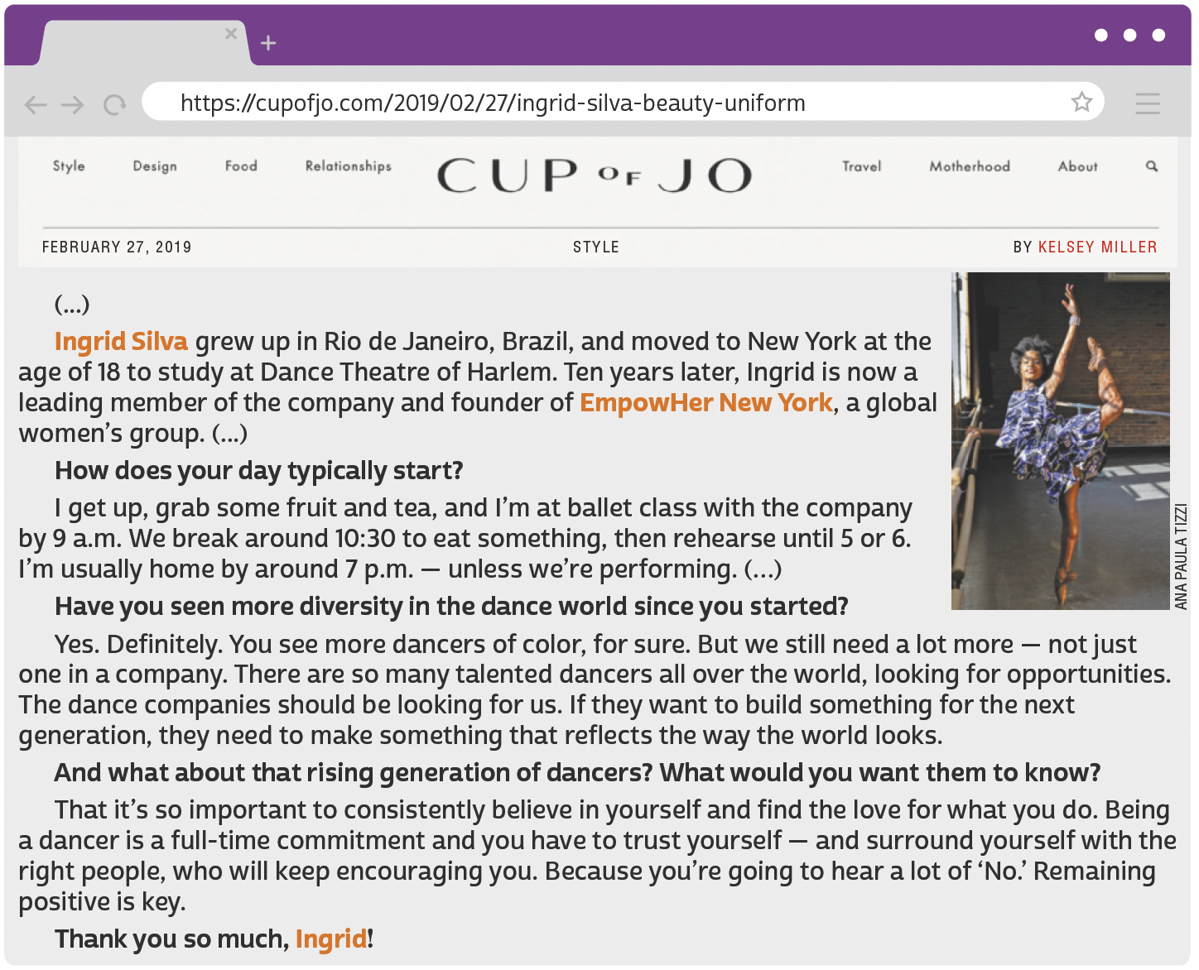
UNIT 4
TIP
A partir do que já
sabemos sobre o gênero
de um texto, podemos
compreendê-lo melhor.
MILLER, Kelsey. My beauty uniform: Ingrid Silva. Cup of Jo, 27 fev. 2019. Disponível em: https://cupofjo.com/2019/02/27/ingrid-silva-beauty-uniform/. Acesso em: 31 maio 2022.

Slide 29
UNIT 4
I. “Yes. Definitely.”
II. “That it’s so important to consistently believe in yourself”
III. “Being a dancer is a full-time commitment”
-LY
(as in definitely, consistently)
-MENT
(as in commitment)
indicates manner.
forms nouns.
WORD FORMATION:
SUFFIXES
LANGUAGE NOTE
Em inglês, acrescenta-se o sufixo
-ly a adjetivos para formar advérbios (consistent ➡️ consistently), assim como em português acrescenta-se o sufixo -mente (consistente ➡️ consistentemente).

Slide 30
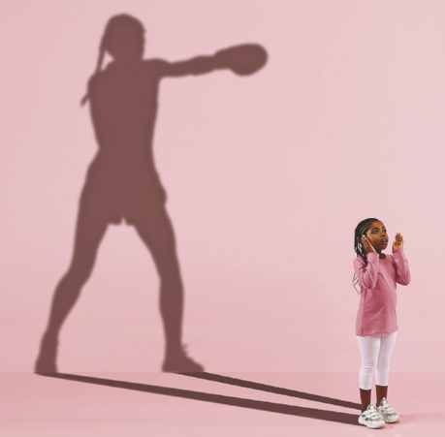
UNIT 4
Asking about future dreams and projects:
What do you want to/wanna do when you’re older?
What are you going to/gonna be when you grow up?
What are you going to/gonna do in ten/twenty/ thirty years?
LANGUAGE NOTE
Talking about future dreams and projects:
When I’m older, I want to/wanna…
I’m going to/gonna be a/an…when I grow up.
In ten/twenty/thirty years, I’m going to/gonna…
wanna ➡️ want to
gonna ➡️ going to
In spoken language, want to is often pronounced /’wɔ:nə/, and going to is often pronounced /’gɔ:nə/. This is sometimes shown in writing as wanna and gonna, respectively, especially in American English.
MASTER1305/SHUTTERSTOCK.COM

Slide 31
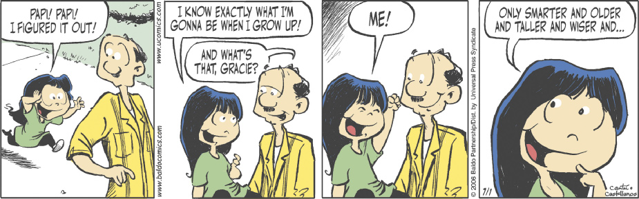
UNIT 4
LANGUAGE NOTE
Comparative adjectives in the comic strip:
old + er ➡️ older
(mais velho/a)
smart + er ➡️ smarter
(mais inteligente)
tall + er ➡️ taller
(mais alto/a)
wise + r ➡️ wiser
(mais sábio/a)
CANTÚ, Hector D.; CASTELLANOS, Carlos. Baldo. 2022. Disponível em: www.gocomics.com/baldo/2006/07/01. Acesso em: 31 maio 2022.

Slide 32
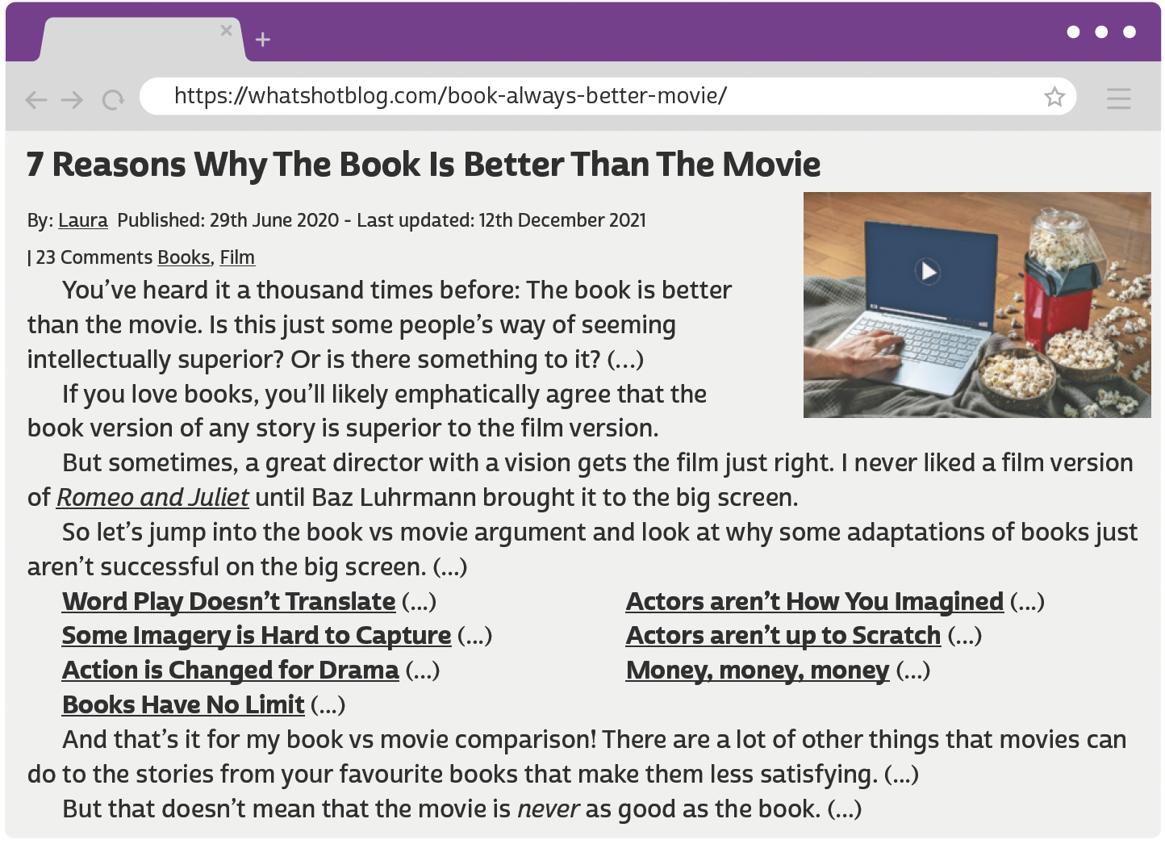
UNIT 5
CLICK98/SHUTTERSTOCK
LANGUAGE NOTE
better ➡️ comparative of good
E.g.: The movie is good, but the book is better.
LAURA. 7 Reasons why the book is better than the movie. What’s Hot?, 29 jun. 2020. Disponível em: https://whatshotblog.com/book-always-better-movie/. Acesso em: 5 jun. 2022.

Slide 33






UNIT 5
DISNEY-HYPERION
HARPERCOLLINS
DC
adventure novel
children’s novel
comics
BOOK GENRES
TIP
BROADWAY BOOKS
WORDSWORTH EDITIONS
HARVEST BOOKS
Agrupar as palavras por
assunto é uma boa forma
de aprender e fixar
vocabulário novo.
biography
classic
fable

Slide 34






Unit 5
INDEPENDENTLY PUBLISHED
HARPERONE
SCHOLASTIC
fanfiction
memoir
play script
book genres
SCHOLASTIC
WEST MARGIN PRESS
GLOBAL EDITORA
fantasy novel
mystery
poetry

Slide 35






Unit 5
GRAND CENTRAL PUBLISHING
RANDOM HOUSE TRADE
STORM HOUSE BOOKS
romance novel
self-help
suspense/ thriller
book genres
SIMON & SCHUSTER
MARINER BOOKS
PUFFIN BOOKS
science fiction
short stories
young adult novel

Slide 36
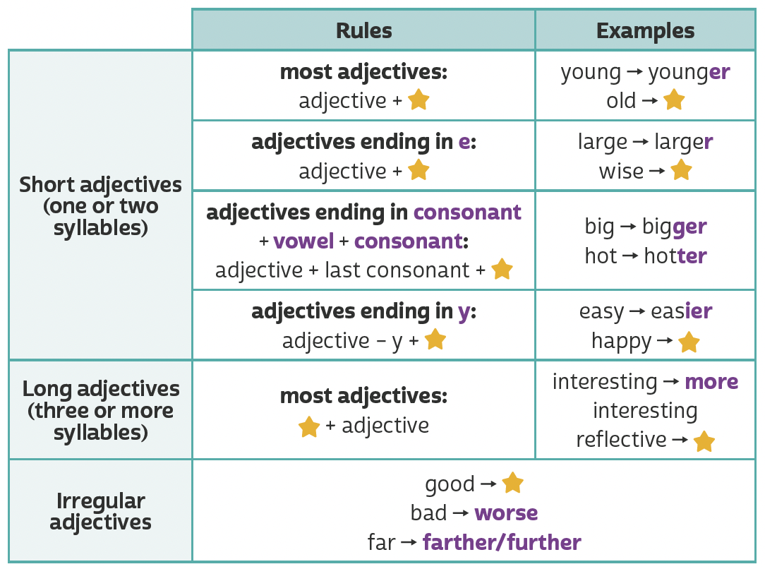
UNIT 5
er
older
r
wiser
Making comparisons (comparative adjectives)
er
ier
happier
TIP
more
more
reflective
A partir da observação dos exemplos, faça
inferências para
compreender regras
de uso da língua inglesa.
better

Slide 37
UNIT 5
What is your favorite book?
  What do you think of...?
  Is it better/worse/more interesting than...?
  Why (not)?
Who is your favorite character?
  Why?
  What do you think of...?
  Is he/she braver/smarter/more intelligent than...?
Who is your favorite writer?
  Why?
  What do you think of...?
  Is he/she more successful/more popular/better than...?
What are you reading right now?
  Who is it by?
  What is it about?
What was the last book that you read?
  Who was it by?
  What was it about?
LANGUAGE NOTE
Having a guess: Probably…/I’d say (that)…/Chances are (that)…
Remembering things: As I remember/recall…/If I’m not mistaken…/It’s on the tip of my tongue.
Expressing a preference: I (much) prefer memoirs to biographies./I’d (much) prefer to/I’d rather read a novel./Reading comic books is more my kind of thing.

Slide 38
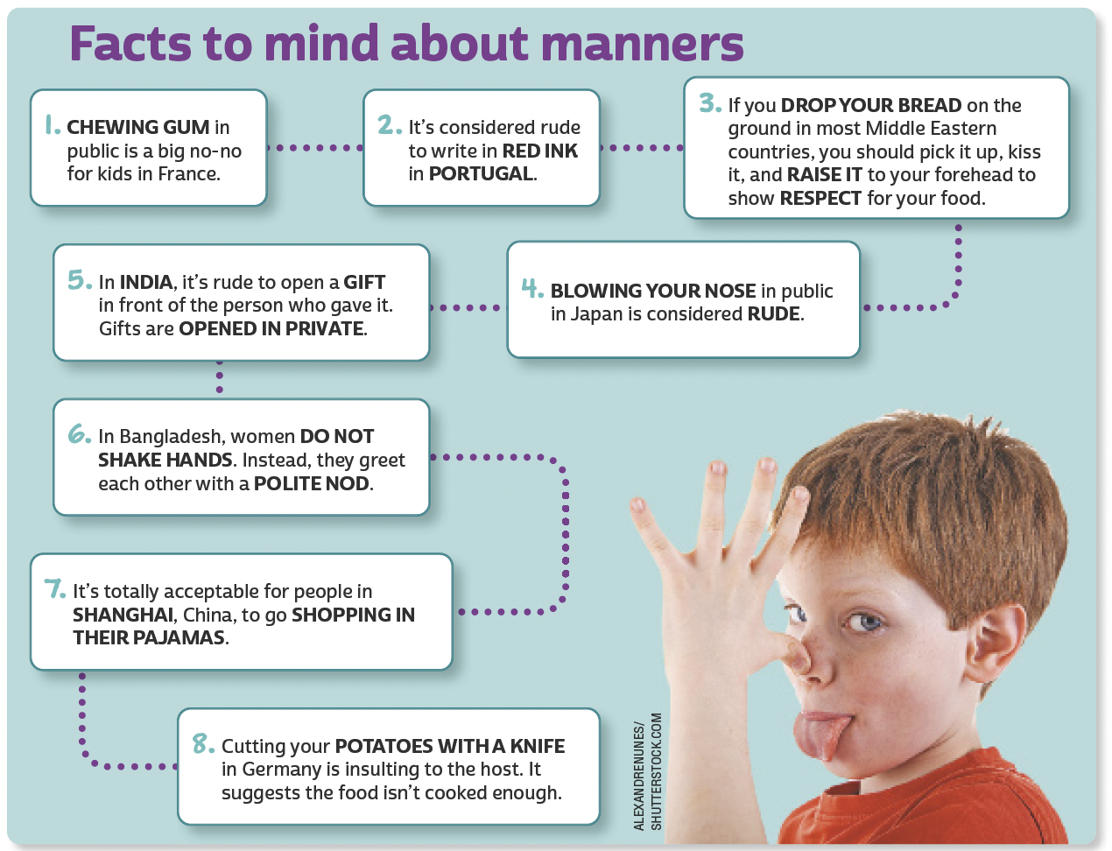
UNIT 6
Adaptado de: NATIONAL GEOGRAPHIC KIDS. 5,000 awesome facts 2 (About everything!). Washington, DC: National Geographic, 2014. p. 74-75.

Slide 39




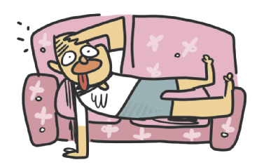


UNIT 6
quiet
talkative
adjectives
hard-working
lazy
LANGUAGE NOTE
My brother is a lazy person.
= My brother is lazy.
I’m a very shy person.
= I’m very shy.
ILUSTRAÇÕES: GALVÃO BERTAZZI
funny
serious

Slide 40


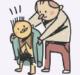

UNIT 6
outgoing/sociable
shy/timid
adjectives
ILUSTRAÇÕES: GALVÃO BERTAZZI
generous
mean

Slide 41
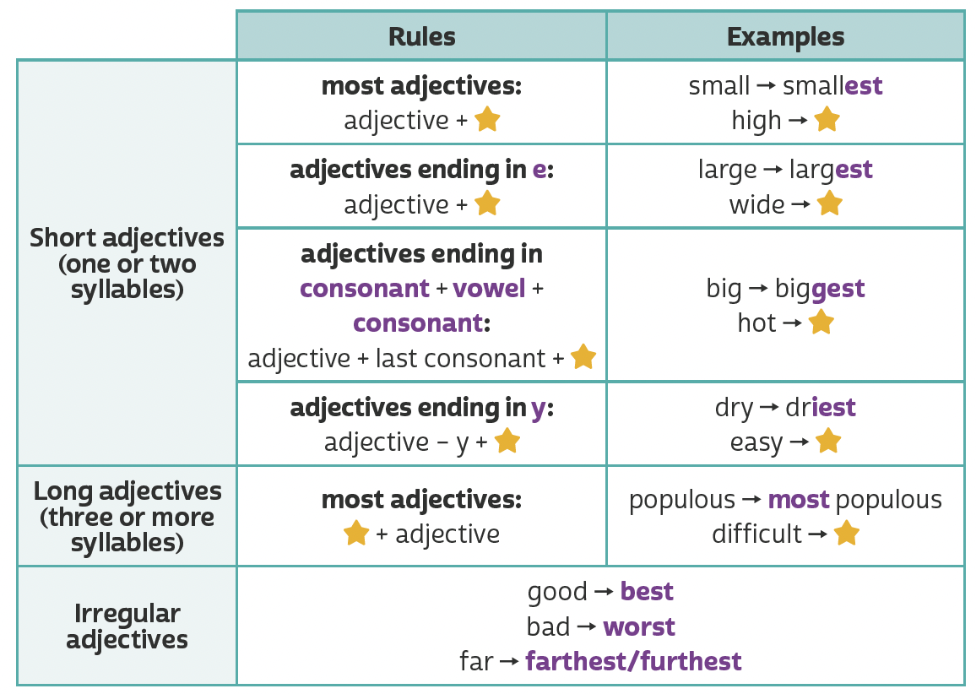
UNIT 6
est
highest
st
widest
Making comparisons (superlative adjectives)
hottest
est
iest
easiest
TIP
most
most difficult
A partir da observação dos exemplos, faça
inferências para
compreender regras
de uso da língua inglesa.

Slide 42
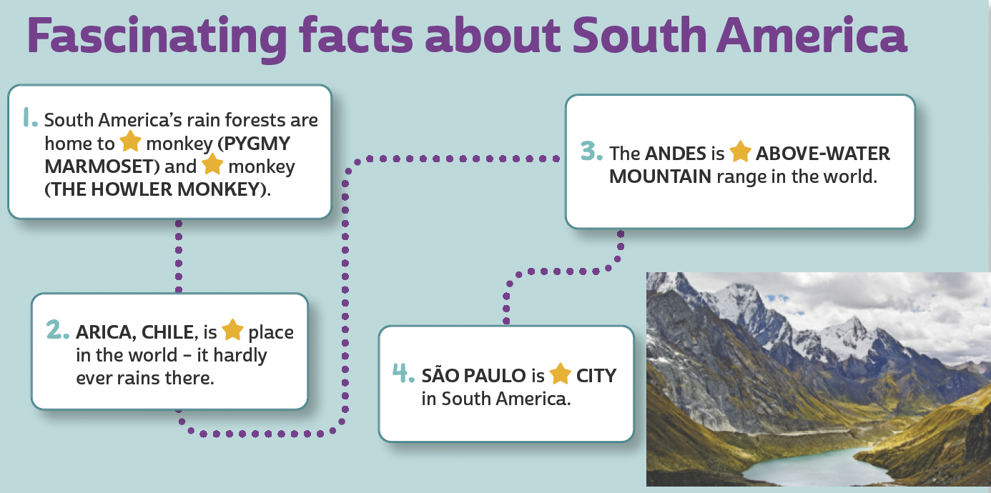
UNIT 6
Making comparisons (superlative adjectives)
the smallest; the loudest
the largest
the driest
the most populous
JUJUBIER/SHUTTERSTOCK.COM

Slide 43
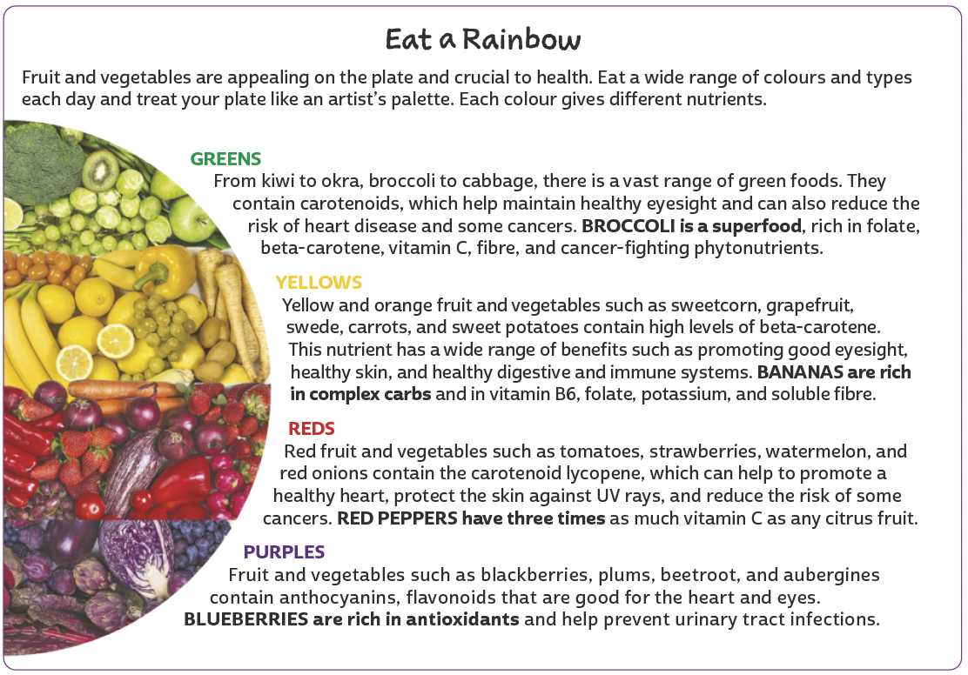
UNIT 7
TIP
Use o que você já sabe sobre
o assunto do texto para
estabelecer hipóteses sobre
o que você vai ler.
ELENA SCHWEITZER/SHUTTERSTOCK.COM
LANGUAGE NOTE
colour (BrE) = color (AmE)
fibre (BrE) = fiber (AmE)
Adaptado de: CLARKE, Jane. Complete family nutrition. Londres: DK Publishing, 2014. p. 34-35.

Slide 44
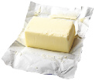



UNIT 7
dairy
FOOD
butter
milk
cheese
yogurt

Slide 45



UNIT 7
FRUIT
FOOD
apple
blueberries
kiwi
banana
grapes

Slide 46






UNIT 7
FRUIT
PHIVE/
SHUTTERSTOCK.COM
FOOD
lemon
mango
orange
lime
melon

Slide 47





UNIT 7
FRUIT
FOOD
papaya
strawberries
watermelon
PIXAHUB/
SHUTTERSTOCK.COM
pineapple
tomato

Slide 48




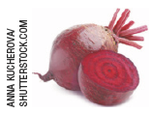



UNIT 7
VEGETABLES
FOOD
aubergine/ eggplant
broccoli
lettuce
TIP
Note que vegetables são plantas ou partes de plantas usadas como comida e
incluem tanto legumes quanto verduras. Informalmente, são chamados de veggies.
beetroot/ beet
carrot
okra

Slide 49
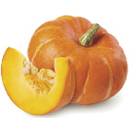

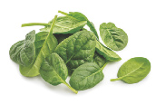

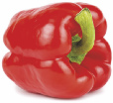



UNIT 7
VEGETABLES
HAPPY AUTHOR/
SHUTTERSTOCK.COM
FOOD
pumpkin
spinach
sweetcorn
red pepper
swede/ rutabaga
sweet potato

Slide 50


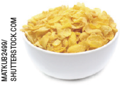

UNIT 7
grains
FOOD
bread
pasta
cereal
rice

Slide 51
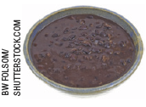




UNIT 7
Meat and beans
FOOD
black beans
egg
chicken
fish

Slide 52
UNIT 7
I. “Broccoli is a superfood, rich in folate (...)”
II. “Red peppers have three times as much vitamin C as any citrus fruit.”
III. “Bananas are rich in complex carbs (...)”
IV. “We do need some sugar, for energy (…)”
Countable and uncountable nouns
COUNTABLE NOUNS
(red pepper, banana)
UNCOUNTABLE NOUNS
(broccoli, sugar)
refer to things you can count. They have a singular and a plural form.
refer to things you can’t count. They only have a singular form.

Slide 53
UNIT 7
I. “Many people are unaware of how much sugar they’re eating”
II. “We do need some sugar, for energy”
III. “refined sugar doesn’t contain any other nutrients.”
Expressions of quantity
LANGUAGE NOTE
MANY
MUCH
refers to people (countable noun).
SOME and ANY
refer to an indefinite quantity.
refers to sugar (uncountable noun).
Some and any are used when it is not important or easy to say exactly how much/ how many of something we are thinking of. We usually use some in affirmative sentences and any in negative and interrogative sentences. We use some in interrogative
sentences (offers and requests) if we expect people to answer “affirmatively”.
E.g.: Can I have some sugar, please?

Slide 54
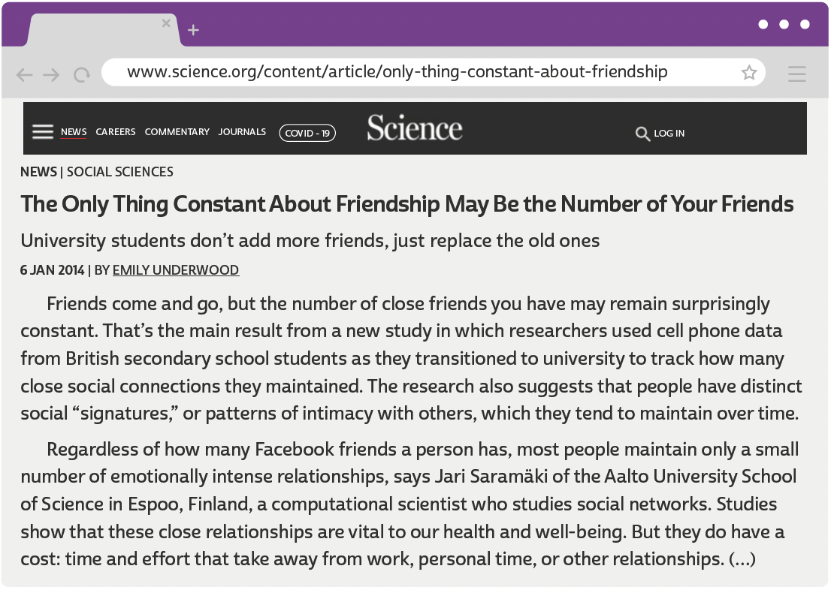
UNIT 8
UNDERWOOD, Emily. The only thing constant about friendship may be the number of your friends. Science, 6 jan. 2014. Disponível em:www.science.org/content/article/only-thing-constant-about-friendship-may-be-number-your-friends. Acesso em: 10 jun. 2022.

Slide 55
UNIT 8
I. “a new study in which researchers used cell phone data”
II. “these close relationships are vital to our health and well-being”
III. “the number of close friends you have may remain surprisingly constant”
WORD FORMATION:
SUFFIXES
-ER
(as in researcher)
-SHIP
(as in relationship)
forms a noun indicating an occupation.
forms a noun indicating a state or condition.
-LY
(as in surprisingly)
forms an adverb indicating a (specified) manner.
LANGUAGE NOTE
Observe que o sufixo -ship não é a sílaba tônica dos substantivos que forma.

Slide 56
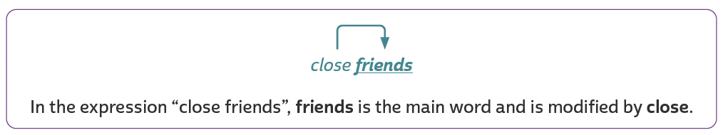
UNIT 8
“close friends”
“personal time”
“close social connections”
“these close relationships”
“a computational scientist”
“distinct social ‘signatures’”
“emotionally intense relationships”
“the main result from a new study”
“cell phone data from British secondary school students”
Noun phrases
The main word in each expression is a noun.

Slide 57
UNIT 8
I. “a computational scientist who studies social networks.”
II. “someone whose actions you respect”
III. “time and effort that take away from work”
IV. “patterns of intimacy with others, which they tend to maintain over time.”
Relative pronouns
WHO
THAT
WHICH
WHOSE
refers to “a computational scientist”
refers to “someone"
refers to “time and effort"
refers to “patterns of intimacy with others"
The relative pronouns who, whose, that and which refer to a previous element (= noun or noun phrase).

Slide 58
UNIT 8
We can use
WHO
in reference to
We can use
THAT
in reference to
people
people and things (possessive meaning)
We can use
WHICH
in reference to
things
people and things
We can use
WHOSE
in reference to
Relative pronouns
The relative pronouns who, whose, that and which are used to connect elements in a sentence and to avoid repetition.

Slide 59
VOCABULARY CORNER
Digital devices
mobile (phone)/ cell (phone)
computer
television/ TV
tablet
Unit 1:
WORD GROUPS

Slide 60
VOCABULARY CORNER
Daily activities
take/have a shower
have/eat breakfast
wash face
read (a book)
walk/ go for a walk
stretch
Unit 1:
WORD GROUPS

Slide 61
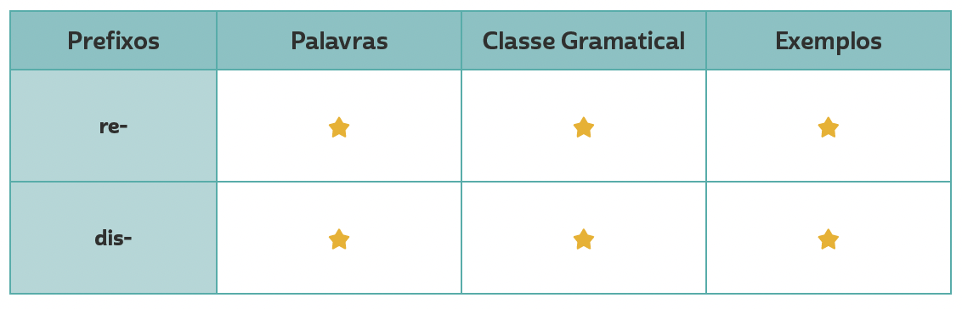
VOCABULARY CORNER
refocus
review
Personal answers.
Unit 1:
WORD FORMATION: PREFIXES
verb
Personal answers.
disconnection
noun

Slide 62
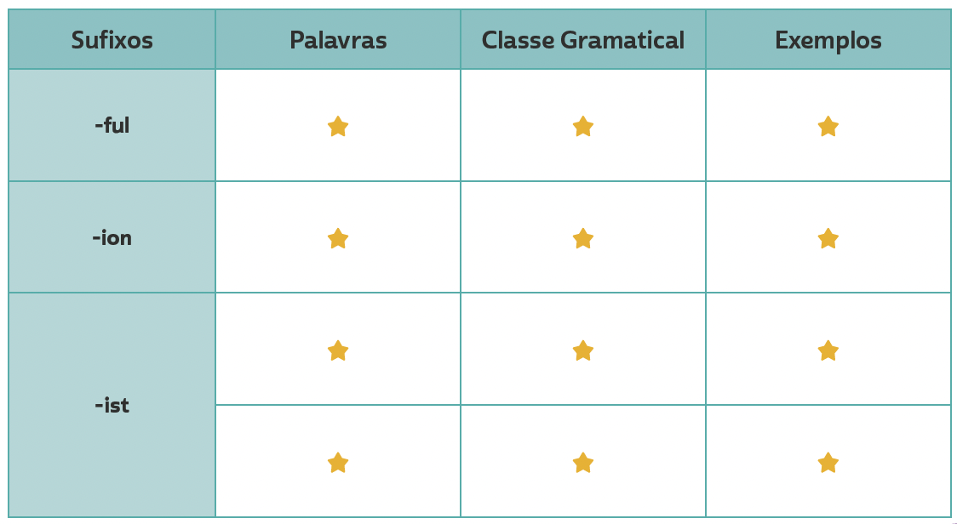
VOCABULARY CORNER
beautiful, painful
Personal answers.
adjective
oppression, separation
Personal answers.
Unit 2: word formation: suffixes
noun
artist, scientist, journalist
noun
Personal answers.
pacifist, racist
Personal answers.
adjective

Slide 63
VOCABULARY CORNER
brave
movie
of course
outgoing
rude
shy
to begin
to cope with
= courageous
= film
= definitely
= sociable
= impolite
= timid
= to start
= to deal with
Unit 3: synonyms

Slide 64
VOCABULARY CORNER
to cope with
to dislodge
to end
to set
useful
vital
wonderful
= to deal with
= to replace
= to finish
= to establish
= helpful
= essential
= marvelous
Unit 3: synonyms

Slide 65
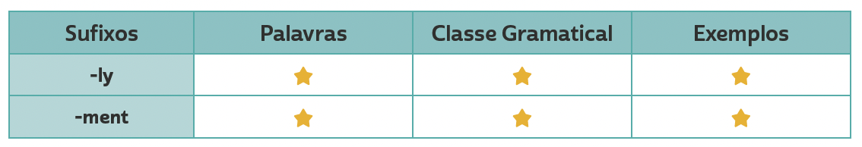
VOCABULARY CORNER
Unit 4: word formation: suffixes
consistenly, deeply
adverb
Personal answers.
commitment
noun
Personal answers.

Slide 66
VOCABULARY CORNER
DISNEY-HYPERION
HARPERCOLLINS
DC
adventure novel
children’s novel
comics
Unit 5: book genres
BROADWAY BOOKS
WORDSWORTH EDITIONS
HARVEST BOOKS
biography
classic
fable

Slide 67
VOCABULARY CORNER
INDEPENDENTLY PUBLISHED
HARPERONE
SCHOLASTIC
fanfiction
memoir
play script
Unit 5: book genres
SCHOLASTIC
WEST MARGIN PRESS
GLOBAL EDITORA
fantasy novel
mystery
poetry

Slide 68
VOCABULARY CORNER
GRAND CENTRAL PUBLISHING
RANDOM HOUSE TRADE
STORM HOUSE BOOKS
romance novel
self-help
suspense/ thriller
Unit 5: book genres
SIMON & SCHUSTER
MARINER BOOKS
PUFFIN BOOKS
science fiction
short stories
young adult novel

Slide 69
VOCABULARY CORNER
quiet
talkative
Unit 6: adjectives
hard-working
lazy
ILUSTRAÇÕES: GALVÃO BERTAZZI
funny
serious

Slide 70
VOCABULARY CORNER
outgoing/sociable
shy/timid
Unit 6: adjectives
ILUSTRAÇÕES: GALVÃO BERTAZZI
generous
mean

Slide 71
VOCABULARY CORNER
dairy
Unit 7: FOOD
butter
milk
cheese
yogurt

Slide 72
VOCABULARY CORNER
FRUIT
Unit 7: FOOD
apple
blueberries
kiwi
banana
grapes

Slide 73
VOCABULARY CORNER
FRUIT
PHIVE/
SHUTTERSTOCK.COM
Unit 7: FOOD
lemon
mango
orange
lime
melon

Slide 74
VOCABULARY CORNER
FRUIT
Unit 7: FOOD
papaya
strawberries
watermelon
PIXAHUB/
SHUTTERSTOCK.COM
pineapple
tomato

Slide 75
VOCABULARY CORNER
VEGETABLES
Unit 7: FOOD
aubergine/ eggplant
broccoli
lettuce
beetroot/ beet
carrot
okra

Slide 76
VOCABULARY CORNER
VEGETABLES
HAPPY AUTHOR/
SHUTTERSTOCK.COM
Unit 7: FOOD
pumpkin
spinach
sweetcorn
red pepper
swede/ rutabaga
sweet potato

Slide 77
VOCABULARY CORNER
grains
Unit 7: FOOD
bread
pasta
cereal
rice

Slide 78
VOCABULARY CORNER
Meat and beans
Unit 7: FOOD
black beans
egg
chicken
fish

Slide 79
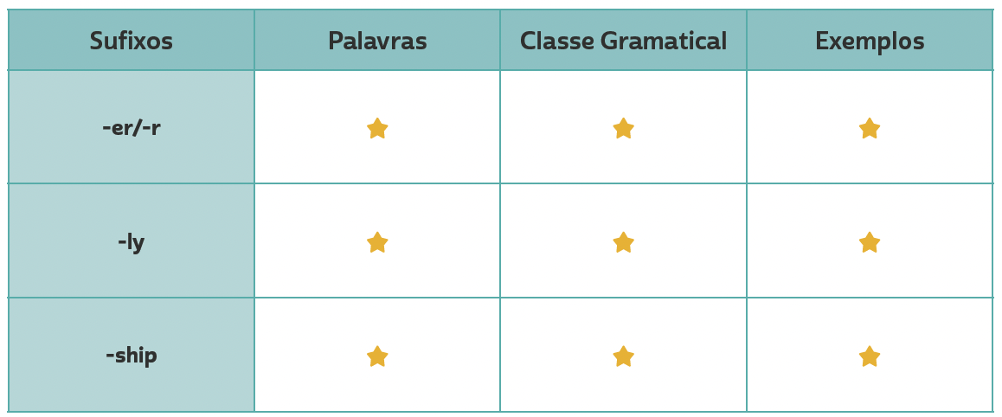
VOCABULARY CORNER
researcher, worker, observer
Personal answers.
noun
Unit 8: word formation: suffixes
gradually, quickly,
surprisingly
adverb
Personal answers.
friendship,
membership,
relationship
Personal answers.
noun

Slide 80
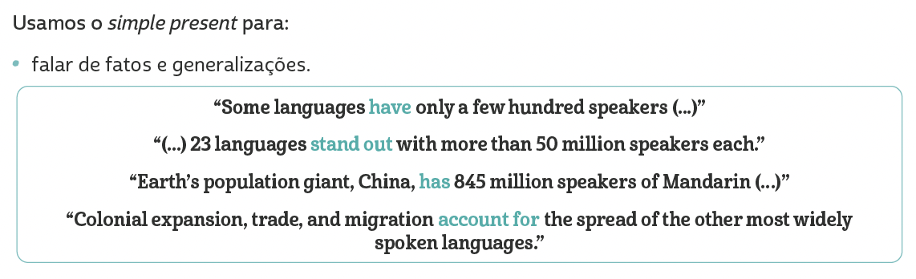
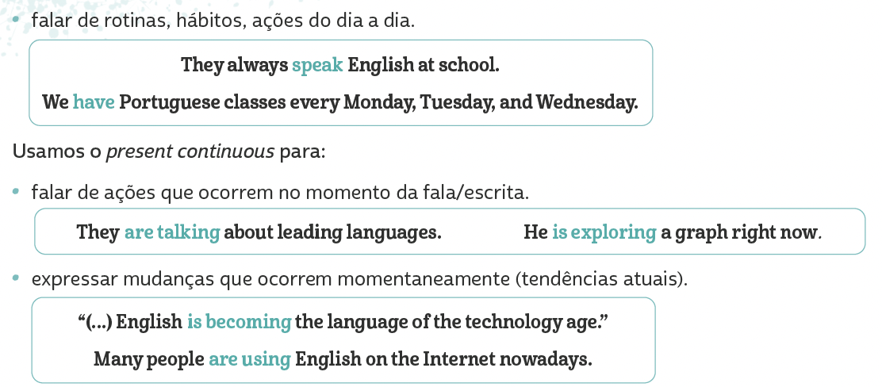
LANGUAGE REFERENCE
Unit 1:
REVIEW:
SIMPLE present/
Present Continuous

Slide 81
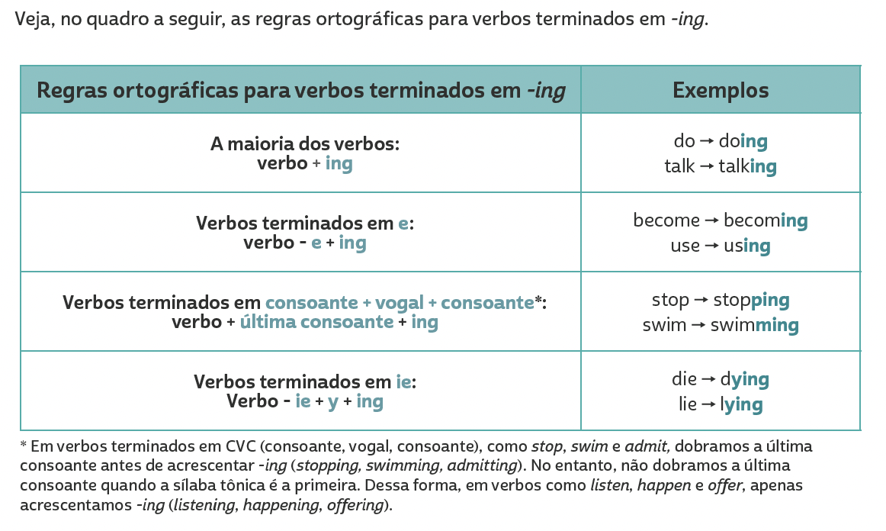
LANGUAGE REFERENCE
Unit 1:
REVIEW:
SIMPLE present/
Present Continuous

Slide 82
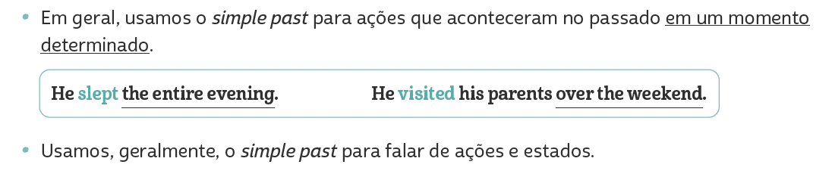
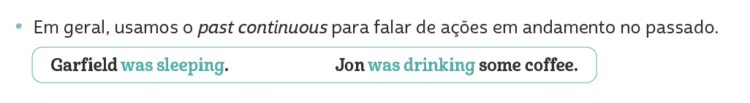
LANGUAGE REFERENCE
Unit 2:
REVIEW:
SIMPLE PAST/
PAST Continuous

Slide 83
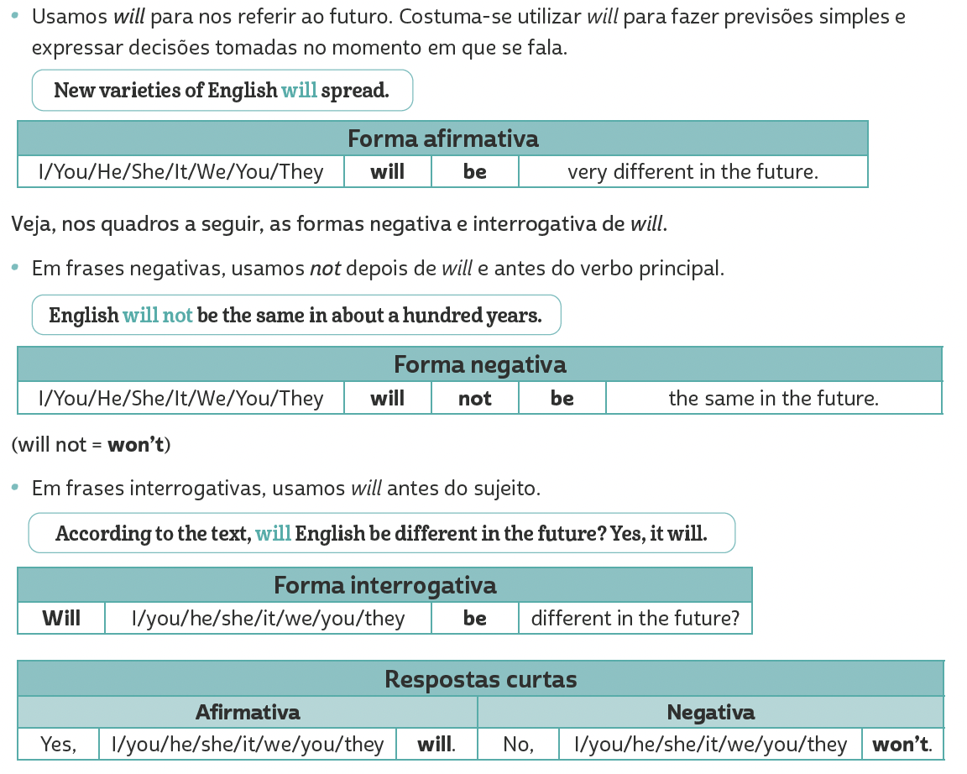
LANGUAGE REFERENCE
Unit 3:
Future with will

Slide 84
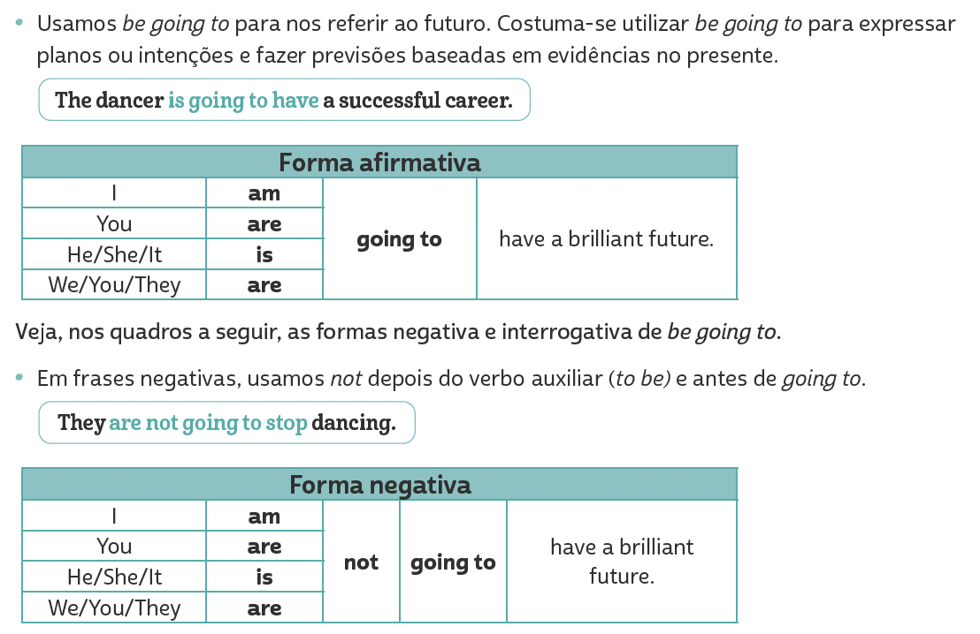
LANGUAGE REFERENCE
Unit 4:
Future with
be going to

Slide 85

LANGUAGE REFERENCE
Unit 4:
Future with
be going to

Slide 86

LANGUAGE REFERENCE
Para formar frases no comparativo de superioridade, usamos adjetivo no grau comparativo + than.
Unit 5:
MAKING COMPARISONS (COMPARATIVE ADJECTIVES)

Slide 87

LANGUAGE REFERENCE
Para formar frases no superlativo, usamos the + adjetivo no grau superlativo.
Unit 6:
MAKING COMPARISONS (SUPERLATIVE ADJECTIVES)

Slide 88


LANGUAGE REFERENCE
Unit 7: COUNTABLE AND UNCOUNTABLE NOUNS

Slide 89


LANGUAGE REFERENCE
Unit 7: expressions of quantity

Slide 90

LANGUAGE REFERENCE
Unit 8: relative pronouns

