Slide 1
Língua inglesa
7º ano

Slide 2
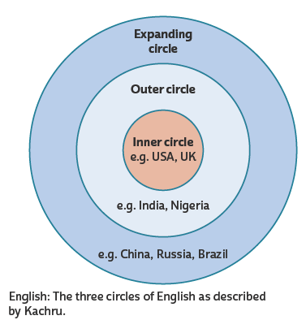
UNIT 0
WIKIMEDIA COMMONS. Kachru's three circles of English. 27 jun. 2017. 1 imagem. Disponível em: https://commons.wikimedia.org/wiki/File:Kachru%27s_three_circles_of_English.svg. Acesso em: 14 abr. 2022.
TIP
Observe o inglês à sua
volta e veja o que você já
sabe devido à presença do
idioma no seu dia a dia.
Círculo interno (Inner circle):
Países onde a língua inglesa é usada como primeira língua (first language) ou língua materna (mother tongue)
Círculo externo (Outer circle):
Países onde a língua inglesa é usada como segunda língua (second language)
Círculo em expansão (Expanding circle):
Países onde a língua inglesa é usada como língua internacional (international language)

Slide 3
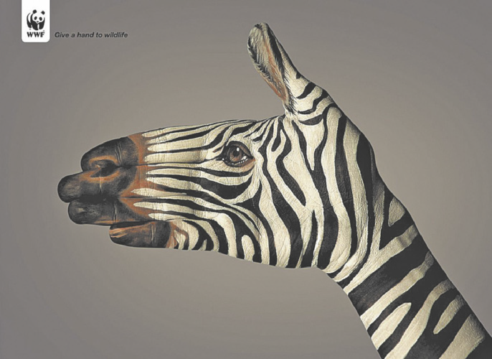
UNIT 0
WORLD WIDE FUND FOR NATURE - WWF. CRIAÇÃO: SAATCHI & SAATCHI
TIP
Faça previsões sobre o
texto a partir do que você já conhece sobre o assunto.
CREATIVE CRIMINALS. WWF: Give a hand to wildlife. 2022. Disponível em: https://creativecriminals.com/print/wwf/give-a-hand-to-wildlife. Acesso em: 14 abr. 2022.
TIP
Observe as relações entre os elementos verbais (palavras) e não verbais (imagens).

Slide 4
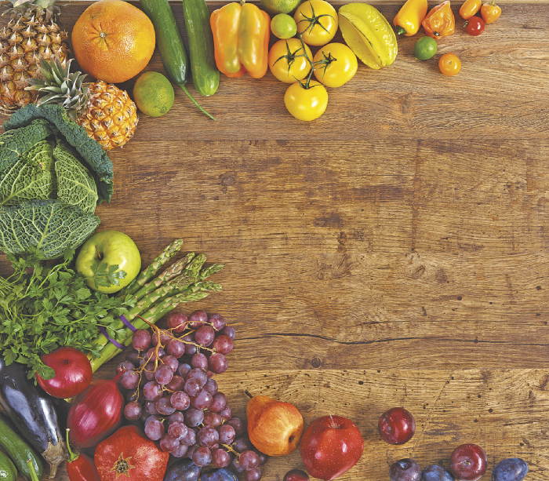
UNIT 0
TIP
Apoie-se no vocabulário já
conhecido e em
palavras parecidas com o português para ajudar você na
compreensão do texto.
Why are fruits and vegetables
good for you?
Fruits and vegetables are good for you because they provide important vitamins, minerals, fiber, and natural plant compounds
known as phytochemicals. As well as their health benefits, these phytochemicals are responsible for the color, taste and smell of a fruit or vegetable.
ROMARIOIEN/SHUTTERSTOCK.COM
TIP
Ative seu conhecimento
prévio sobre o tema do
texto para favorecer o estabelecimento de
hipóteses sobre o que
será lido.
TIP
Busque inferir o significado de
palavras-chave a partir da observação do contexto em que elas são utilizadas.
GRAIMES, Nicola. Kids’ fun & healthy cookbook. Nova York: DK Publishing, 2007. p. 8.

Slide 5
UNIT 0
TIP
Observe as relações entre os elementos verbais (palavras) e não verbais
(imagens, cores, tipos e tamanhos de fonte etc.).
TIP
Identifique se o texto é um anúncio, cartum, poema etc. para, com base no que você já sabe sobre esse gênero discursivo,
compreender melhor o texto, seus objetivos e sua
estrutura.
TIP
Note que os
subtítulos ampliam/ detalham a ideia apresentada no título.
NATIONAL GEOGRAPHIC
NATIONAL GEOGRAPHIC MAGAZINE. Washington: National Geographic Society, abr. 2021.

Slide 6
UNIT 0
TIP
Note que o título
apresenta a ideia
geral do texto.
TIP
Identifique a fonte do texto para ajudar você a criar hipóteses sobre o que será lido.
IC PUBLISHING
NEW AFRICAN. Londres: IC Publications, dez. 2021/jan. 2022, n. 611.

Slide 7
UNIT 0
Four tips for getting more precise results. You can also combine them!
a. Use + to include words in the results.
b. Use - to remove words from the results.
c. Use “ ” to search for specific terms or phrases.
d. Use * to substitute for one or more characters/words.
Doing research on the web

Slide 8
UNIT 0
WHO is the author of the website?
WHAT is the purpose of the website?
WHEN was the website created?
WHY is this website useful for my purposes?
WHERE does the content of the website come from?
Are they experts?
Is there a link to find out more about them?
Is there relevant information in it?
Is it different from other websites?
Are dates included for the last update?
Are the links current and all functional?
Are sources of factual information or statistics mentioned?
Is there a bibliography included?
Why should I use it?
Is it better than any other?
Evaluating websites
Fonte de pesquisa: STARK STATE DIGITAL LIBRARY. How to evaluate websites. 31 mar. 2020. Disponível em: https://libguides.starkstate.edu/websites. Acesso em: 14 abr. 2022.

Slide 9
UNIT 0
.edu
.org
.gov
an educational website
a nonprofit website
a federal government website
.com
a commercial website
TIP
A identificação do domínio
pode ajudar a avaliar a
confiabilidade do site.

Slide 10
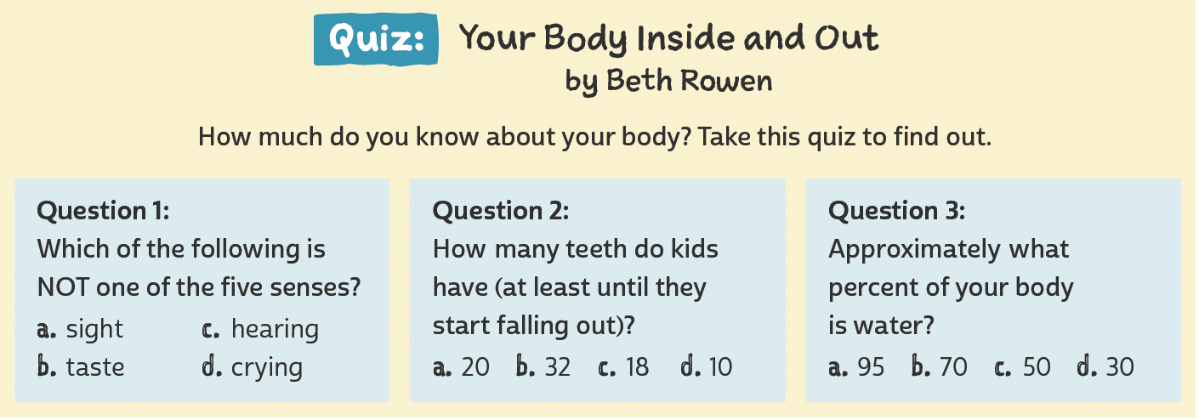
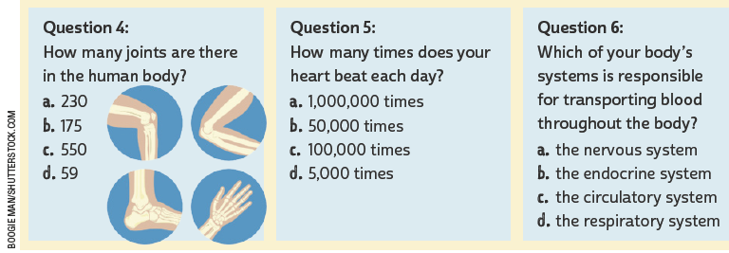
UNIT 1
LANGUAGE NOTE
We use How many…? to ask about the number of things or people (quantity).
How many friends do you have?
I have about 10 friends.
Adaptado de: ROWEN, Beth. Quiz: your body inside and out. Fact Monster. 2000-2019. Disponível em: www.factmonster.com/take-quiz/your-body-inside-out. Acesso em: 19 jun. 2022.

Slide 11
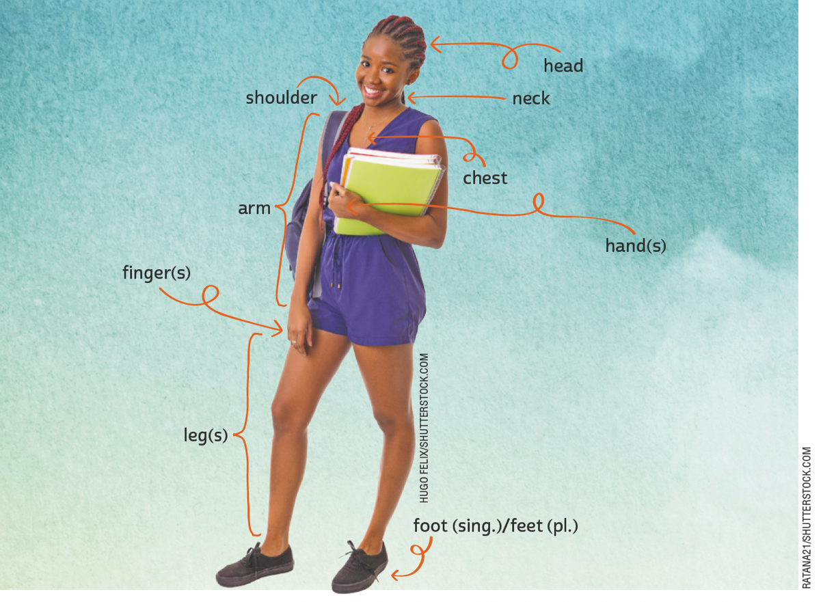
UNIT 1
head
shoulder
neck
chest
arm
The human body
finger(s)
hand(s)
leg(s)
foot (sing.)/feet (pl.)

Slide 12
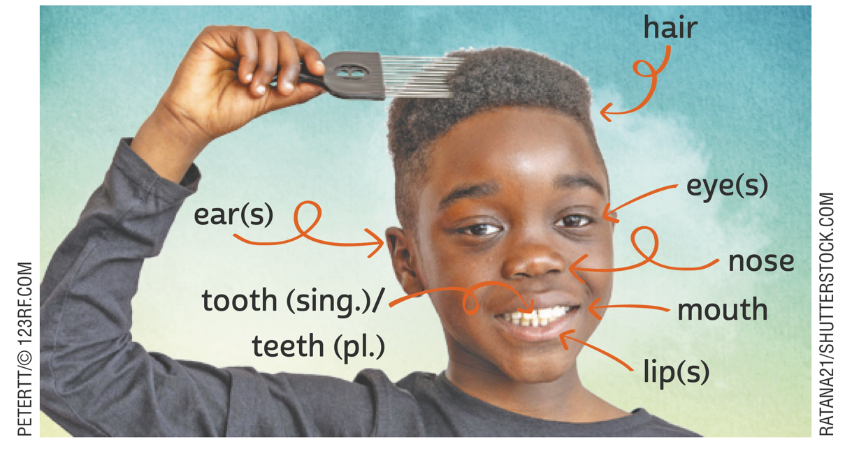
UNIT 1
hair
The human body
eye(s)
ear(s)
nose
tooth (sing.)/
teeth (pl.)
mouth
lip(s)
LANGUAGE NOTE
singular plural
tooth teeth
foot feet

Slide 13
UNIT 1
eyes
brown
black
green
blue
The human body
hair
brown
blond
curly
wavy
black
ginger
straight
ILUSTRAÇÕES: GALVÃO BERTAZZI

Slide 14
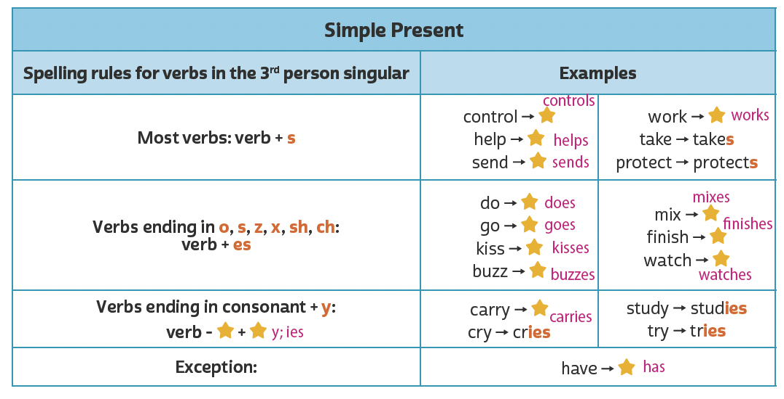
UNIT 1
REVIEW:
Simple present

Slide 15
UNIT 1
always
often/ frequently
sometimes
rarely
never
usually
100%
0%
Adverbs of frequency

Slide 16
UNIT 2
TIP
Apoie-se em palavras parecidas com o português para fazer previsões sobre o texto e compreendê-lo.
SPECIAL OLYMPICS. Mission. In: SPECIAL OLYMPICS. About. 2022. Disponível em: www.specialolympics.org/about/mission. Acesso em: 21 jun. 2022.

Slide 17
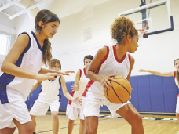
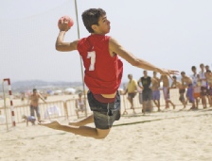
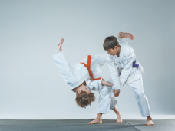
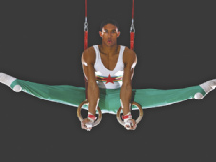
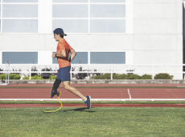
UNIT 2
basketball
handball
sports
MASTER1305/
SHUTTERSTOCK.COM
cycling
judo
JUICE DASH/
SHUTTERSTOCK.COM
ANTYPAN/
SHUTTERSTOCK.COM
gymnastics
running

Slide 18
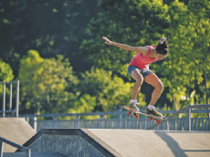
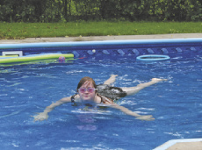
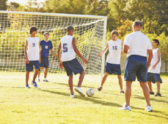
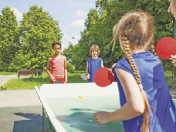
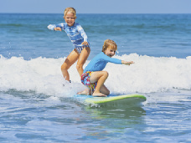
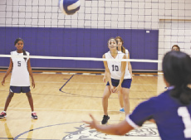
UNIT 2
LZF/SHUTTERSTOCK.COM
ANNSCREATIONS/
SHUTTERSTOCK.COM
skateboarding
swimming
MONKEY
BUSINESS IMAGES/
SHUTTERSTOCK.COM
sports
SERGEY NOVIKOV/
SHUTTERSTOCK.COM
soccer
table tennis
MONKEY
BUSINESS IMAGES/
SHUTTERSTOCK.COM
DENIS MOSKVINOV/
SHUTTERSTOCK.COM
surfing
volleyball

Slide 19
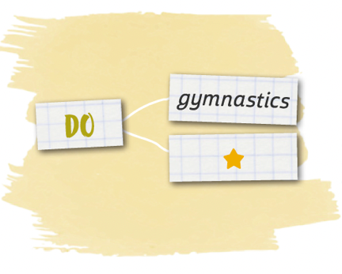
UNIT 2
soccer
handball
table tennis
volleyball
sports
gymnastics
judo
LANGUAGE NOTE
PLAY + ball or team sports
(play basketball, soccer)
DO + non-team sports
(do gymnastics, judo)
GO + sports that end in –ing
(go cycling, swimming)
running
skateboarding
surfing
swimming

Slide 20
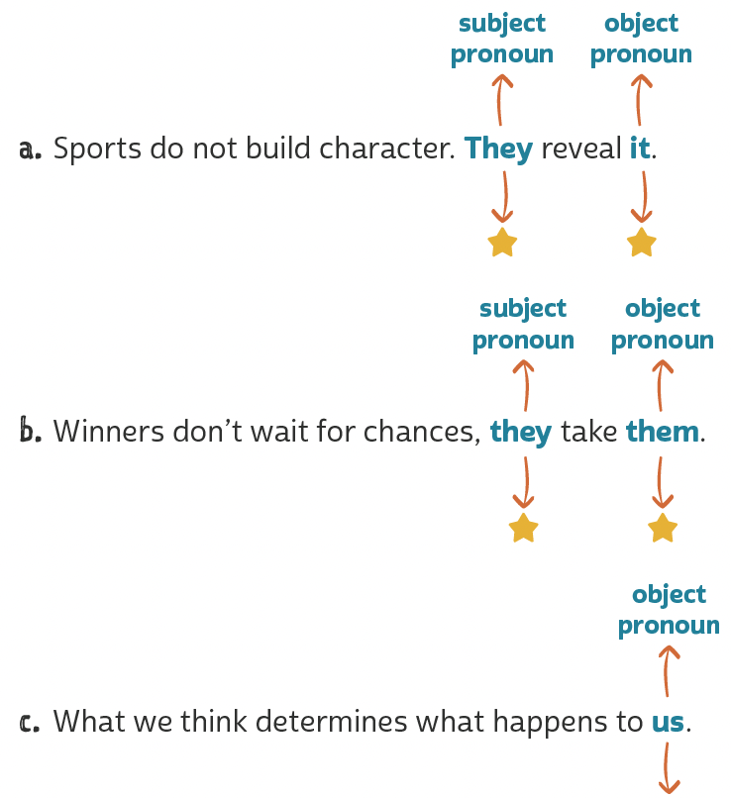
UNIT 2
= sports
= character
Object pronouns
TIP
= winners
= chances
Ao encontrar um pronome como me, you, him, her, it, us e them em uma frase, busque
identificar a que termo esse pronome se refere.
= we

Slide 21
UNIT 2
HTTPS://WWW.PASSITON.COM/
PASS IT ON. Marlon Shirley: lost leg, not heart. 1999-2022. Disponível em: https://assets.passiton.com/billboards/new_images/medium/overcoming_marlon_shirley.jpg?1558454270. Acesso em: 23 jun. 2022.
Quem deve ser Marlon Shirley?
O que “Lost leg, not heart.” significa?
Qual valor ou princípio está sendo promovido no texto?
Na sua opinião, qual é o objetivo de textos como este?

Slide 22
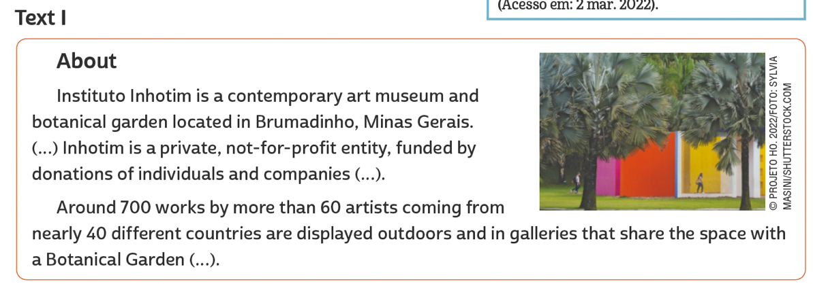
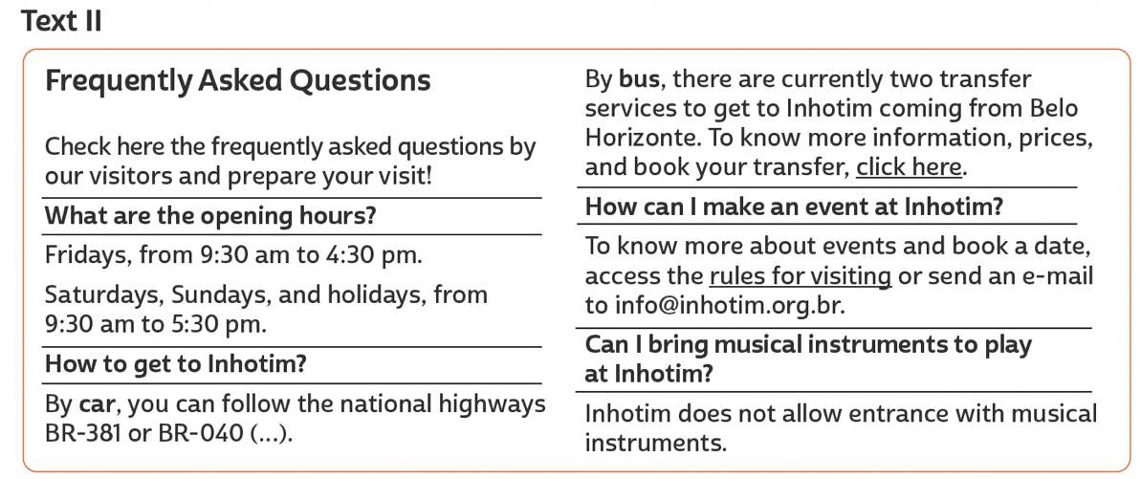
UNIT 3
INHOTIM. About. 2021. Disponível em: www.inhotim.org.br/en/institutional/about/. Acesso em: 21 jun. 2022.
TIP
Ao navegar na internet, observe o endereço do site visitado e veja se o domínio é comercial (.com), educacional (.edu),
acadêmico (.ac), de uma organização não governamental (.org) etc. De que tipo de domínio é o site do texto apresentado?
INHOTIM. Frequently asked questions. 2021. Disponível em: www.inhotim.org.br/en/frequently-asked-questions/. Acesso em: 21 jun. 2022.

Slide 23
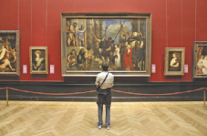
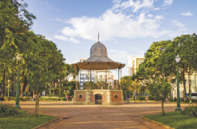
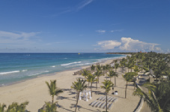
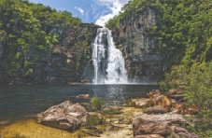
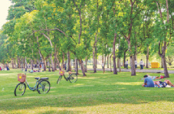
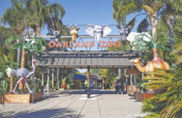
Unit 3
TUPUNGATO/
SHUTTERSTOCK.COM
NICK POON/
SHUTTERSTOCK.COM
HUGO
MARTINS OLIVEIRA/
SHUTTERSTOCK.COM
art museum
bridge
square
Tourist attractions
WWW.GGGPHOTO.COM/
SHUTTERSTOCK.COM
BUMIHILLS/
SHUTTERSTOCK.COM
VITORMARIGO/
SHUTTERSTOCK.COM
beach
opera house
waterfall
ANDY-OSK98/
SHUTTERSTOCK.COM
ZENZETA/
SHUTTERSTOCK.COM
BARBARA ASH/
SHUTTERSTOCK.COM
botanical garden
park
zoo

Slide 24
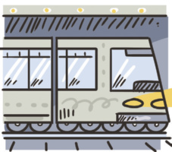
Unit 3
bicycle/bike
car
Means of transportation
boat
metro/subway
LANGUAGE NOTE
ON + foot
BY + bike, boat, bus, car etc.
ILUSTRAÇÕES: GALVÃO BERTAZZI
bus
train

Slide 25
UNIT 3
Como
a. How can you get to the Christ Statue?
By car, train, van or on foot.
b. Where does the train leave from?
Cosme Velho.
c. Why do people choose a van?
Because it’s the easiest option.
d. How many locations are there to get the van?
Three.
e. Who can choose a hike?
People looking for adventure.
Onde
Question words
Por quê
Quanto(s)
Quanta(s)
TIP
We use “Why” in questions
and “because” in answers.
Quem

Slide 26
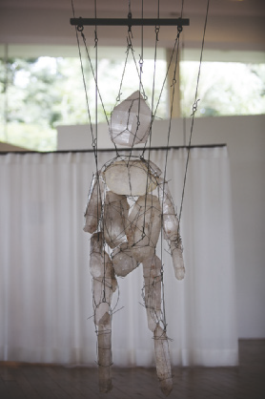
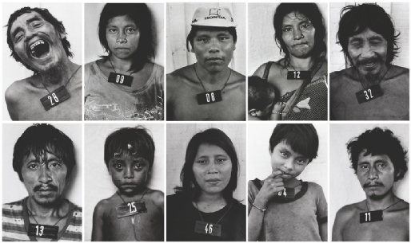
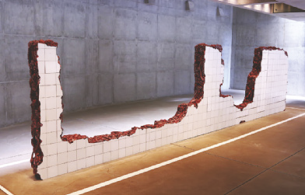
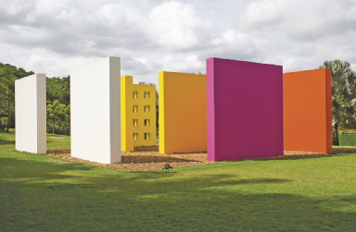
Unit 3
Claudia Andujar (1981-83)
LANGUAGE NOTE
The artwork is large/ small/ geometric/ contemporary/ traditional.
It is made of concrete/ wood/ glass/ paper.
The artist uses vibrant/ pale colors; black and white photos.
It looks like a mosaic/ a puppet/ a broken wall/ building blocks.
I feel amazed/ surprised at the artist’s innovative use of color.
I feel enchanted/ delighted with the geometric shapes of the artwork.
Tunga (2010)
IMAGEM LICENCIADA PELO INSTITUTO TUNGA” /©CHRISTIAN CRAVO; COLEÇÃO DA ARTISTA. CORTESIA GALERIA VERMELHO; ADRIANA VAREJÃO/INSTITUTO INHOTIM, BRUMADINHO, MG. FOTO: ARNALDO JR/SHUTTERSTOCK.COM; © PROJETO HO. 2022/FOTO: VANESSA VOLK/ SHUTTERSTOCK.COM
Adriana Varejão (2004)
Hélio Oiticica (1977)

Slide 27
UNIT 4
T. LESIA/SHUTTERSTOCK.COM;
PER-ANDERS PETTERSSON/
GETTY IMAGES
Adaptado de: THE LIFE of Nelson Mandela. Eyewitness News, 2022. Disponível em: https://ewn.co.za/2013/12/06/The-life-of-Nelson-Mandela. Acesso em: 22 jun. 2022.

Slide 28
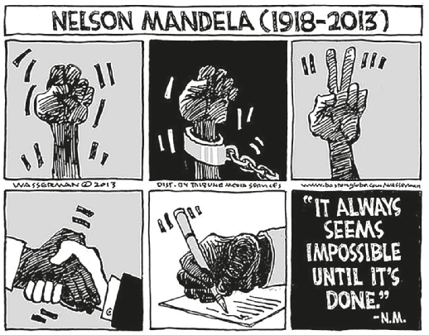
UNIT 4
“sentenced to
life imprisonment”
“co-founds ANC
Youth League”
“released from prison”
TIP
Busque sempre estabelecer
relações entre os textos que você lê para ampliar sua compreensão deles e do mundo.
DAN WASSERMAN/TCA
“wins the Nobel
Peace Prize”
“elected president”
WASSERMAN, Dan. Nelson Mandela (1918-2013). Star Tribune, 6 dez. 2013. Disponível em: www.startribune.com/editorial-cartoon-nelsonmandela/234683131/. Acesso em: 22 jun. 2022.

Slide 29
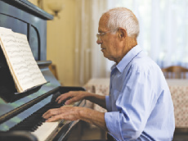
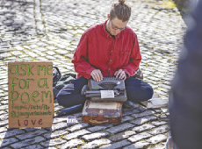
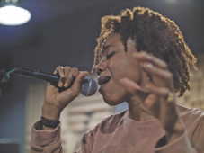
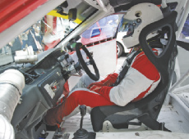
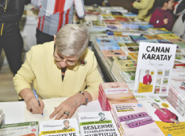
UNIT 4
CAFTOR/
SHUTTERSTOCK.COM
ABDUL HAFIZ AB HAMID/
SHUTTERSTOCK.COM
BALANCEFORMCREATIVE/
SHUTTERSTOCK.COM
architect
pianist
scholar
PROSTOCK-STUDIO/
SHUTTERSTOCK.COM
IGEL JARVIS/
SHUTTERSTOCK.COM
BO1982//
SHUTTERSTOCK.COM
occupations
doctor
poet
singer
AMEDEOEMAJA/
SHUTTERSTOCK.COM
THOR JORGEN UDVANG/
SHUTTERSTOCK.COM
EL_CIGARRITO/
SHUTTERSTOCK.COM
painter
racing car driver
writer

Slide 30
Unit 4
IN
ON
AT
years (1937, 2020)
dates (May 3, my birthday)
ages (12, eighteen)
a specific time (10 a.m., 3 o’clock)
days (Sunday, Tuesdays)
months (May, December)
centuries (the XIX century, last century)
seasons (summer, winter)
long periods (the past, the future)
Prepositions of time (in, on, at)

Slide 31
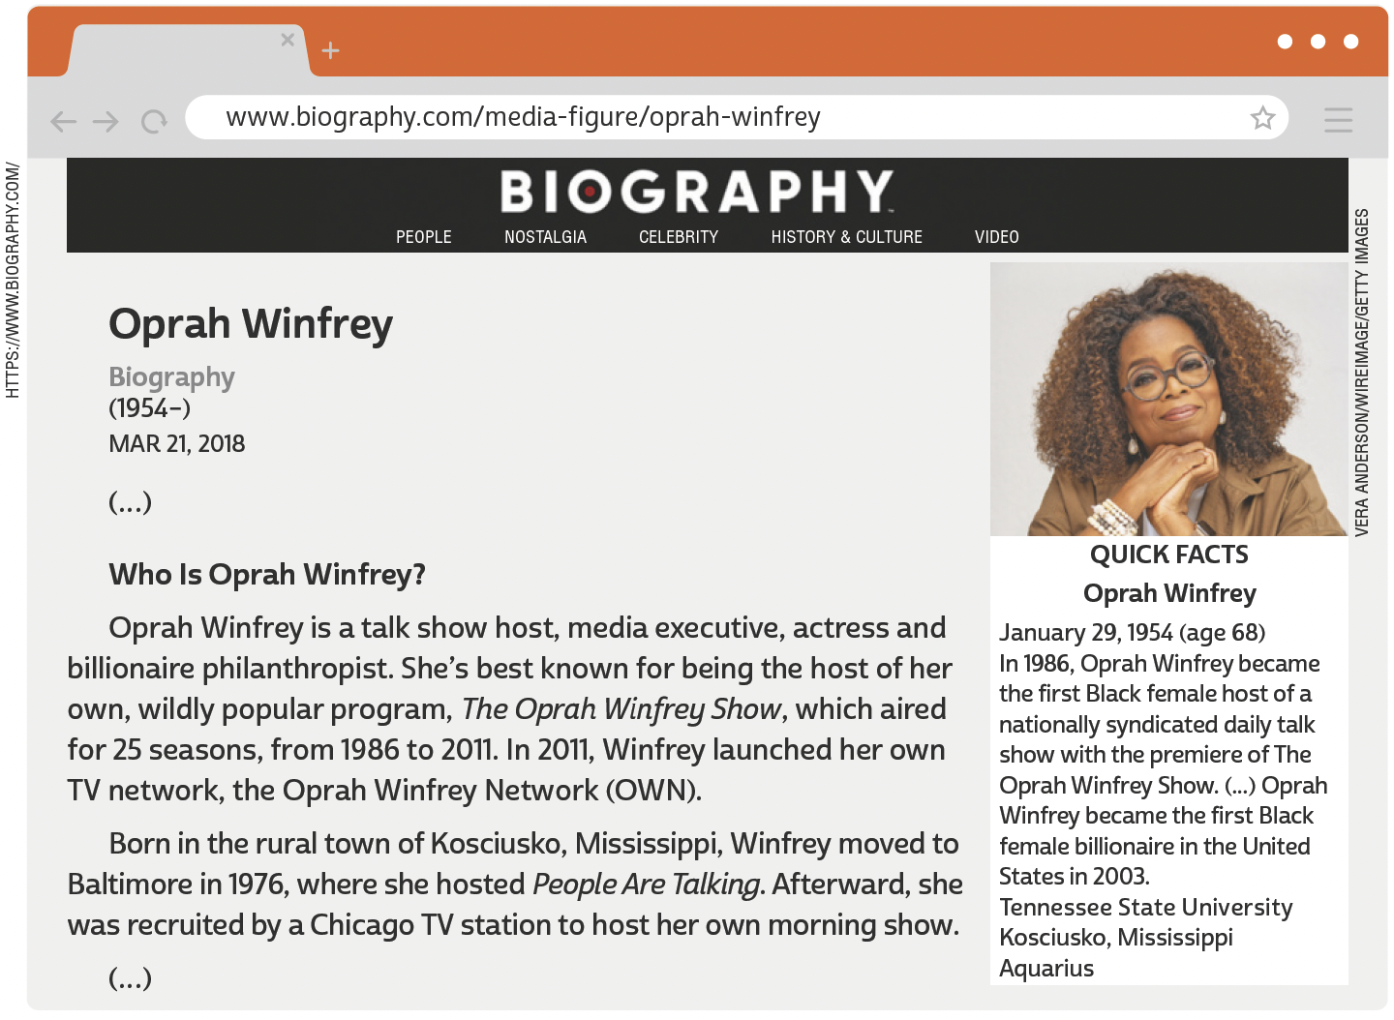
UNIT 5
TIP
Ao visitar um site, observe o menu de navegação e busque prever quais conteúdos serão apresentados em cada link.
Observe a reprodução da webpage e responda: Em qual item do menu de navegação você deveria clicar para encontrar biografias de outras pessoas?
BIOGRAPHY. Oprah Winfrey. 21 mar. 2018. Disponível em: www.biography.com/media-figure/oprah-winfrey. Acesso em: 24 jun. 2022.

Slide 32
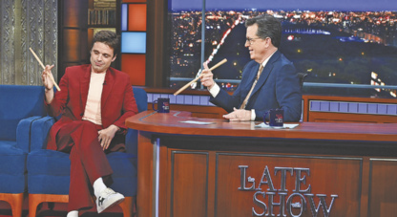
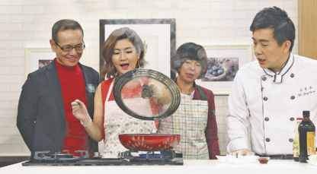
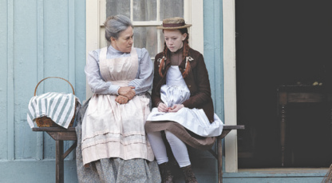
UNIT 5
CBS/GETTY IMAGES
talk show
CARTOON NETWORK /
COURTESY: EVERETT
COLLECTION / FOTOARENA
cartoon
Kinds of tv shows
TPG /GETTY IMAGES
cooking show
NETFLIX/KOBAL/
SHUTTERSTOCK.COM
series

Slide 33
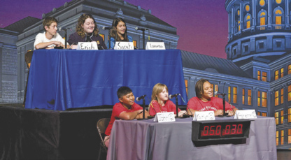
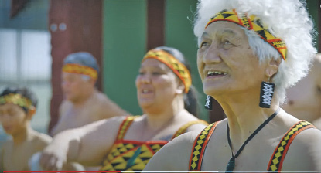
UNIT 5
BOB DAEMMRICH /
ALAMY / FOTOARENA
game show
NZFILM
documentary
Kinds of tv shows
SIMONKR /GETTY IMAGES
news
HTTPS://
WWW.NETFLIX.COM/BR
soap (opera)

Slide 34
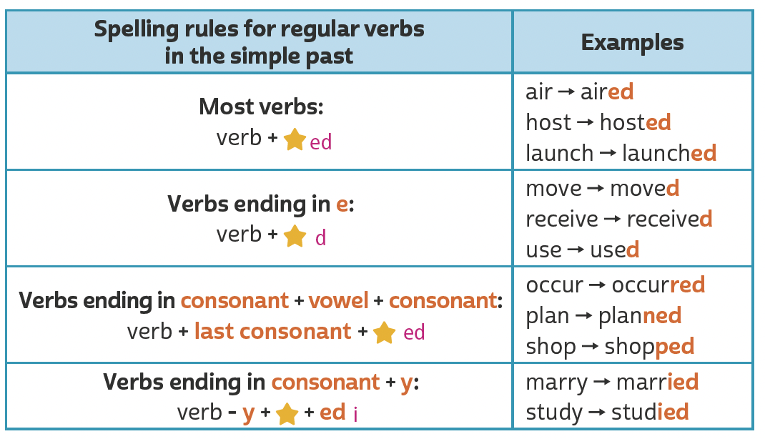
UNIT 5
ed
Simple past (regular verbs)
TIP
d
Em verbos terminados em CVC (consoante, vogal, consoante), como occur, plan e shop, dobramos a última consoante antes de acrescentar -ed (occurred, planned, shopped). No entanto, não dobramos a última consoante quando a sílaba tônica é a primeira. Dessa forma, em verbos como listen, happen e offer, apenas acrescentamos -ed (listened, happened, offered).
ed
i + ed

Slide 35
UNIT 5
Há três possibilidades de pronúncia para a terminação -ed:
/t/, /d/ ou /ɪd/.
Simple past (regular verbs)
/t/ | /d/ | /ɪd/
cooked | called | created
missed | listened | founded
stopped | played | painted

Slide 36
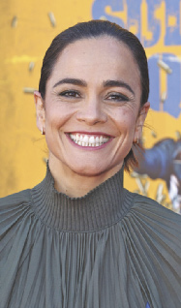
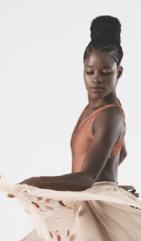
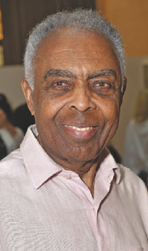
Unit 5
Alice Braga, actress and producer known for starring in successful movies and series.
Ingrid Silva, ballet dancer who currently performs with the Dance Theatre of Harlem in New York City.
Você conhece essas personalidades brasileiras? Qual delas não é da indústria do entretenimento?
Na sua opinião, como essas quatro personalidades podem influenciar a vida das pessoas? Você gostaria de ter uma influência positiva na vida de outras pessoas? Em caso afirmativo, como?
Você se lembra de outras personalidades brasileiras que são internacionalmente famosas/influentes? O que as tornou conhecidas?
KEVIN WINTER/GETTY IMAGES; ANGELA ZAREMBA; HANNES MAGERSTAEDT/GETTY IMAGES; FÁBIO BERRIEL / FUTURA PRESS
Miguel Nicolelis,
neuroscientist best known for his pioneering
work in “reading monkey thought”.
Gilberto Gil, singer and
songwriter known for his musical innovation.

Slide 37
UNIT 6
A MUTUAL CALLING
by Lauren Belski, New York, New York
Brian and I have been married three years, but we’ve been together ten. We met as AmeriCorps volunteers on the Pine Ridge Indian Reservation in Porcupine, South Dakota – a tucked-away place with a scattered population of 1,000. He taught computers and played guitar. I taught English and wrote poetry. In the volunteer house, we courted each other by making a phone out of tin cans and a string. I still remember his voice in my ear. Automatic goose bumps. A year later, our mothers discovered we were born in the same hospital in New Jersey, 1,600 miles away.
14 MINI essays that prove the meaning of love in 100 words or less. Reader's Digest, 14 fev. 2019. Disponível em: www.rd.com/article/100-word-love-stories/. Acesso em: 16 jun. 2022.

Slide 38
UNIT 6
A MUTUAL CALLING
by Lauren Belski, New York, New York
Lauren and Brian met as AmeriCorps volunteers.
ILUSTRAÇÕES: GALVÃO BERTAZZI
Lauren and Brian courted each other by making a phone out of tin cans and a string.
Lauren and Brian’s mothers discovered they were born in the same hospital.

Slide 39
UNIT 6
LOVE BOAT REUNION
by Rick Bennette, Tequesta, Florida
The moment I met Denise aboard the Love Boat, I knew she was someone special. She became my first love, but we lived 90 miles apart. After the cruise, we maintained our love affair
through handwritten letters. Eventually, geography took its toll. We went on to separate lives, yet I thought about her quite often. Thirty years later, we reunited in Grand Central Station. I hired a violinist to play our love song as we held each other for the first time in three decades. After wishing to be with her all those years apart, we finally married.
14 MINI essays that prove the meaning of love in 100 words or less. Reader's Digest, 14 fev. 2019. Disponível em: www.rd.com/article/100-word-love-stories/. Acesso em: 16 jun. 2022.

Slide 40
UNIT 6
LOVE BOAT REUNION
by Rick Bennette, Tequesta, Florida
Rick met Denise aboard the Love Boat.
Rick and Denise maintained their love
affair through handwritten letters.
ILUSTRAÇÕES: GALVÃO BERTAZZI
Rick and Denise reunited in Grand Central Station.
Rick and Denise finally married.

Slide 41
UNIT 6
Simple past (irregular verbs)
TIP
Para ajudar você na fixação de verbos regulares e irregulares
no simple past, organize-os em uma tabela como as apresentadas aqui.

Slide 42
UNIT 7
TIP
Preste atenção ao título e aos
subtítulos para compreender melhor a organização das
ideias no texto.
KIDS HEALTH. Volunteering. 1995-2022. Disponível em: https://web.archive.org/web/20220205040925/https://kidshealth.org/en/teens/volunteering.html. Acesso em: 5 fev. 2022.

Slide 43
UNIT 7
BEARFOTOS/
SHUTTERSTOCK.COM
GORODENKOFF/
SHUTTERSTOCK.COM
cooking/
preparing a recipe
taking out the trash
JOHN GIUSTINA/
THE IMAGE BANK/
GETTY IMAGES
Household chores
KATE_SEPT2004/E+/
GETTY IMAGES
washing the dishes
making the bed
GONZALO BELL/
SHUTTERSTOCK.COM
SYDA PRODUCTIONS/
SHUTTERSTOCK.COM
watering the plants
sweeping the floor

Slide 44
UNIT 7
condição
I. “If you’re feeling frustrated or overwhelmed by the news of a disaster (…).”
II. “If you’d like to support a cause but can’t afford to donate money (…).”
III. “So how do you go about it?”
IV. “Become a Big Brother or Big Sister (…).”
V. “(…) to keep the cats and dogs happy and well exercised.”
VI. “(…) because people really depend on you.”
oposição
conclusão
LINKING WORDS
alternativa
TIP
Conectores ou palavras de ligação (linking words, em inglês) são palavras utilizadas para unir palavras ou orações. Ao ler um texto, busque
identificar quais palavras ou orações os conectores ligam.
adição
causa

Slide 45
Unit 7
SCOTT DIKKERS
PAST CONTINUOUS
shorter action
(Simple Past)
Dave came over
while
I was putting the bags in the garage.
long action
(Past Continuous)

Slide 46
UNIT 8
TIP
Procure observar o título, as
primeiras e as últimas frases
dos parágrafos e palavras-chave repetidas para ajudar
você a antecipar o sentido
global do texto.
PRESS TRUST OF INDIA. Meet the artist who paints with her toes and mouth. HerStory, 2 set. 2019. Disponível em: https://yourstory.com/2016/08/sheela-sharma/amp. Acesso em: 21 jun. 2022.

Slide 47
UNIT 8
ROCKETCLIPS, INC./
SHUTTERSTOCK.COM
HAPPY TOGETHER/
SHUTTERSTOCK.COM
cook
fly a kite
ALINA REYNBAKH/
SHUTTERSTOCK.COM
IMAGES PRODUCTS/
SHUTTERSTOCK.COM
abilities
dance
paint
AFRICA STUDIO/
SHUTTERSTOCK.COM
FOTOKOSTIC/
SHUTTERSTOCK.COM
draw
play soccer

Slide 48
UNIT 8
FLAMINGO IMAGES/
SHUTTERSTOCK.COM
play the guitar
speak English
JACEK CHABRASZEWSKI/
SHUTTERSTOCK.COM
CESAR DINIZ/
PULSAR IMAGENS
abilities
ride a bike
swim
MARLON
LOPEZ MMG1 DESIGN/
SHUTTERSTOCK.COM
2P2PLAY/
SHUTTERSTOCK.COM
sing
whistle

Slide 49
UNIT 8
the tango
a horse
abilities
TIP
a picture
Happy Birthday
Estude combinações possíveis de palavras que costumam ser usadas
em inglês para aumentar seu vocabulário e utilize-as em seus textos. Organizar palavras e
expressões por campo semântico também pode ajudar você a ampliar
e fixar o vocabulário aprendido.
the piano
Portuguese

Slide 50
UNIT 8
CORTESIA SEBASTIÃO SALGADO
Sebastião Salgado can photograph pretty well
BRENDAN
SMIALOWSKI /AFP VIA
GETTY IMAGES
Can/could
Stevie Wonder can play the piano and sing very well.
CAFI ESPETÁCULO: VELOX/CIA. DE
DANÇA DEBORAH COLKER
Deborah Colker can dance really well.

Slide 51
UNIT 8
MATT CROSSICK /
ALAMY/FOTOARENA
Beatriz Milhazes can paint beautifully.
Can/could
WIREIMAGE
Tessanne Chin can sing well

Slide 52
VOCABULARY CORNER
shoulder
foot (sing.)/
feet (pl.)
leg
Unit 1:
THE HUMAN BODY
arm
elbow
knee
thigh
toe
finger
hand

Slide 53
VOCABULARY CORNER
hair
eye
ear
head
Unit 1:
THE HUMAN BODY
nose
mouth
neck
chest

Slide 54
VOCABULARY CORNER
basketball
handball
Unit 2: SPORTS
MASTER1305/
SHUTTERSTOCK.COM
cycling
judo
JUICE DASH/
SHUTTERSTOCK.COM
ANTYPAN/
SHUTTERSTOCK.COM
gymnastics
running

Slide 55
VOCABULARY CORNER
LZF/SHUTTERSTOCK.COM
ANNSCREATIONS/
SHUTTERSTOCK.COM
skateboarding
swimming
MONKEY
BUSINESS IMAGES/
SHUTTERSTOCK.COM
Unit 2: SPORTS
SERGEY NOVIKOV/
SHUTTERSTOCK.COM
soccer
table tennis
MONKEY
BUSINESS IMAGES/
SHUTTERSTOCK.COM
DENIS MOSKVINOV/
SHUTTERSTOCK.COM
surfing
volleyball

Slide 56
VOCABULARY CORNER
TUPUNGATO/
SHUTTERSTOCK.COM
NICK POON/
SHUTTERSTOCK.COM
HUGO
MARTINS OLIVEIRA/
SHUTTERSTOCK.COM
art museum
bridge
square
WWW.GGGPHOTO.COM/
SHUTTERSTOCK.COM
BUMIHILLS/
SHUTTERSTOCK.COM
VITORMARIGO/
SHUTTERSTOCK.COM
Unit 3: tourist attractions
beach
opera house
waterfall
ANDY-OSK98/
SHUTTERSTOCK.COM
ZENZETA/
SHUTTERSTOCK.COM
BARBARA ASH/
SHUTTERSTOCK.COM
botanical garden
park
zoo

Slide 57
VOCABULARY CORNER
bicycle/bike
car
Unit 3: means of transportation
boat
metro/subway
ILUSTRAÇÕES: GALVÃO BERTAZZI
bus
train

Slide 58
VOCABULARY CORNER
CAFTOR/
SHUTTERSTOCK.COM
ABDUL HAFIZ AB HAMID/
SHUTTERSTOCK.COM
BALANCEFORMCREATIVE/
SHUTTERSTOCK.COM
architect
pianist
scholar
PROSTOCK-STUDIO/
SHUTTERSTOCK.COM
IGEL JARVIS/
SHUTTERSTOCK.COM
BO1982//
SHUTTERSTOCK.COM
Unit 4: occupations
doctor
poet
singer
AMEDEOEMAJA/
SHUTTERSTOCK.COM
THOR JORGEN UDVANG/
SHUTTERSTOCK.COM
EL_CIGARRITO/
SHUTTERSTOCK.COM
painter
racing car driver
writer

Slide 59
VOCABULARY CORNER
CARTOON NETWORK /
COURTESY EVERETT
COLLECTION / FOTOARENA
cartoon
CARMONAGUERRERO/
CBS/GETTY IMAGES SHUTTERSTOCK.COM
cooking show
Unit 5: kinds of tv shows
VEPOINTSIX/
SHUTTERSTOCK.COM
documentary
CBS/GETTY IMAGES
game show

Slide 60
VOCABULARY CORNER
GORODENKOFF/
SHUTTERSTOCK.COM
news
HTTPS://WWW.YOUTUBE.
COM/C/MOVIERAZE
Unit 5: kinds of tv shows
series
ALEXANDRE REZENDE/
FOLHAPRESS
soap (opera)
PETER KRAMER/
GETTY IMAGES
talk show

Slide 61
VOCABULARY CORNER
Inglês - Português |  | Português - Inglês
actually | na verdade, de fato | atualmente | nowadays, today, currently
attend | frequentar, participar de | atender | answer, help
college | faculdade, ensino superior | colégio (Ensino Médio) | high school
confident | confiante | confidente | confidant
expert | especialista | esperto/a | smart, clever
Unit 6: false friends

Slide 62
VOCABULARY CORNER
Inglês - Português |  | Português - Inglês
eventually | finalmente | eventualmente | occasionally
journal | revista científica; diário pessoal; jornal; diário contábil | jornal | newspaper
large | grande, espaçoso/a | largo | wide
lecture | palestra, aula | leitura | reading
library | biblioteca | livraria | book shop
lunch | almoço | lanche | snack
Unit 6: false friends

Slide 63
VOCABULARY CORNER
Inglês - Português |  | Português - Inglês
notice | notar, perceber | notícia | news
novel | romance | novela | soap, soap opera
office | escritório | oficial | official
parents | pais | parentes | relatives
particular | específico/a, exato/a | particular | per sonal, private
policy | política (diretrizes) | polícia | police
Unit 6: false friends

Slide 64
VOCABULARY CORNER
Inglês - Português |  | Português - Inglês
realize | perceber, dar-se conta de | realizar | perform, carry out, fulfill, accomplish
stranger | desconhecido/a, estranho/a | estrangeiro/a | foreigner
support | apoiar | suportar (tolerar) | stand, tolerate
time | tempo | time | team
turn | vez, volta; virar, girar | turno | shift; round
Unit 6: false friends

Slide 65
VOCABULARY CORNER
BRICOLAGE/
SHUTTERSTOCK.COM
babysitting
Unit 7: household chores
PROSTOCK-STUDIO/
SHUTTERSTOCK.COM
cooking/ preparing a recipe
ODUA IMAGES/
SHUTTERSTOCK.COM
doing the ironing

Slide 66
VOCABULARY CORNER
PEOPLEIMAGES.COM - YURI A/
SHUTTERSTOCK.COM
making the bed
Unit 7: household chores
MONKEY BUSINESS IMAGES/
SHUTTERSTOCK.COM
setting the table
DEAN DROBOT/
SHUTTERSTOCK.COM
sweeping the floor

Slide 67
VOCABULARY CORNER
RANTA IMAGES/
SHUTTERSTOCK.COM
taking out the trash
ZURIJETA/
SHUTTERSTOCK.COM
Unit 7: household chores
washing the dishes
ANNGAYSORN/
SHUTTERSTOCK.COM
watering the plants

Slide 68
VOCABULARY CORNER
PARTY PEOPLE STUDIO/
SHUTTERSTOCK.COM
NIKS ADS/
SHUTTERSTOCK.COM
cook
fly a kite
MAVO/
SHUTTERSTOCK.COM
HADKHANONG/
SHUTTERSTOCK.COM
Unit 8: abilities
dance
paint
ESB PROFESSIONAL/
SHUTTERSTOCK.COM
VERVERIDIS VASILIS/
SHUTTERSTOCK.COM
draw
play soccer

Slide 69
VOCABULARY CORNER
STOCKIMAGEFACTORY.COM/
SHUTTERSTOCK.COM
LIGHTFIELD STUDIOS/
SHUTTERSTOCK.COM
play the guitar
sing
PAVEL KOBYSH/
SHUTTERSTOCK.COM
HALFPOINT/
SHUTTERSTOCK.COM
Unit 8: abilities
ride a bike
swim
SKUMER/
SHUTTERSTOCK.COM
ONGMOJI/
SHUTTERSTOCK.COM
ride a horse
whistle

Slide 70
LANGUAGE REFERENCE
Unit 1:
REVIEW SIMPLE PRESENT

Slide 71
LANGUAGE REFERENCE
always
often/ frequently
sometimes
rarely
never
usually
100%
0%
Unit 1:
Adverbs of frequency

Slide 72
LANGUAGE REFERENCE
Unit 2:
Object pronouns

Slide 73
LANGUAGE REFERENCE
Unit 3:
Question words

Slide 74
LANGUAGE REFERENCE
Unit 4:
Simple past
(verb to be)

Slide 75
LANGUAGE REFERENCE
Unit 4:
Simple past
(verb to be)

Slide 76
LANGUAGE REFERENCE
Unit 5:
Simple past (regular verbs)
TIP
Em verbos terminados em CVC (consoante, vogal, consoante), como plan, shop e admit, dobramos a última consoante antes de acrescentar -ed (planned, shopped, admitted). No entanto, não dobramos a última consoante quando a sílaba tônica é a primeira. Dessa forma, em verbos como listen, happen e offer, apenas acrescentamos -ed (listened, happened, offered).

Slide 77
LANGUAGE REFERENCE
Unit 5:
Simple past (regular verbs)

Slide 78
LANGUAGE REFERENCE
Unit 5:
Simple past (regular verbs)

Slide 79
LANGUAGE REFERENCE
Unit 6:
Simple past (irregular verbs)

Slide 80
LANGUAGE REFERENCE
Unit 6:
Simple past (irregular verbs)

Slide 81
LANGUAGE REFERENCE
A. Forma básica e passado com a mesma forma
Unit 6: verbos irregulares agrupados por formas semelhantes

Slide 82
LANGUAGE REFERENCE
B. Passado com o som /an/ /aŋ/
Unit 6: verbos irregulars agrupados por formas semelhantes

Slide 83
LANGUAGE REFERENCE
C. Passado com o som /əʊ/
Unit 6: verbos irregulars agrupados por formas semelhantes

Slide 84
LANGUAGE REFERENCE
D. Passado com o som /ɔːt/
Unit 6: verbos irregulars agrupados por formas semelhantes

Slide 85
LANGUAGE REFERENCE
E. Passado com o som /uː/
Unit 6: verbos irregulars agrupados por formas semelhantes

Slide 86
LANGUAGE REFERENCE
F. Passado com o som /ɛnt/
Unit 6: verbos irregulars agrupados por formas semelhantes

Slide 87
LANGUAGE REFERENCE
G. Passado com o som /ept/
Unit 6: verbos irregulars agrupados por formas semelhantes

Slide 88
LANGUAGE REFERENCE
Unit 7: past continuous or simple past?

Slide 89
LANGUAGE REFERENCE
Unit 8: can/could

Slide 90
LANGUAGE REFERENCE
Unit 8: can/could

