Slide 1
Língua inglesa
6º ano

Slide 2
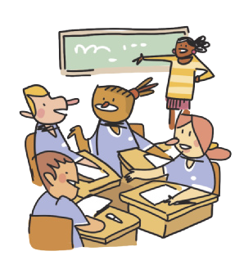
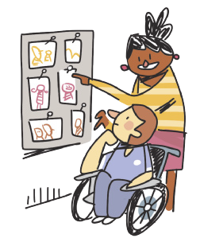
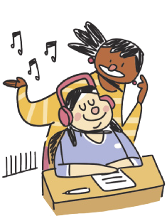
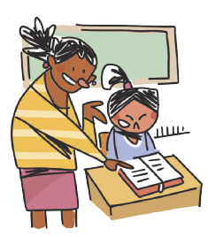
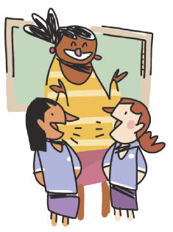
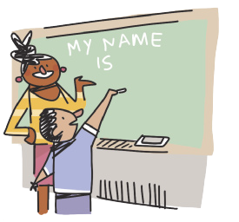
CLASSROOM LANGUAGE
WORK in groups.
LOOK at the photos.
READ the text.
LISTEN to the song.
ILUSTRAÇÕES: GALVÃO BERTAZZI
WRITE your name on the board.
TALK to your classmate.

Slide 3
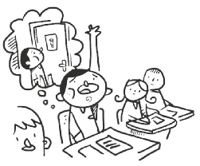
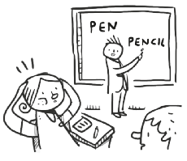
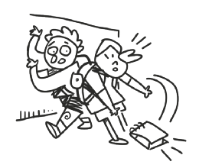
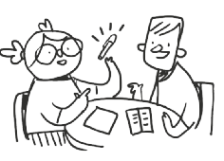
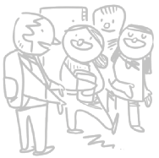
CLASSROOM LANGUAGE
May I go to the toilet?
I don’t understand.
I’m sorry.
How do you say “caneta” in English?
Excuse me.
ILUSTRAÇÕES: GALVÃO BERTAZZI

Slide 4
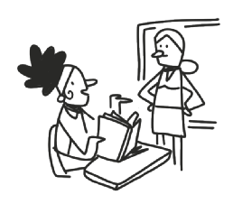
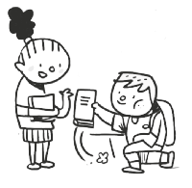
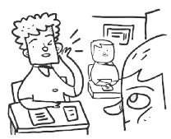
CLASSROOM LANGUAGE
What page?
Can you help me, please?
Thank you.
Can you repeat that, please?
ILUSTRAÇÕES: GALVÃO BERTAZZI

Slide 5
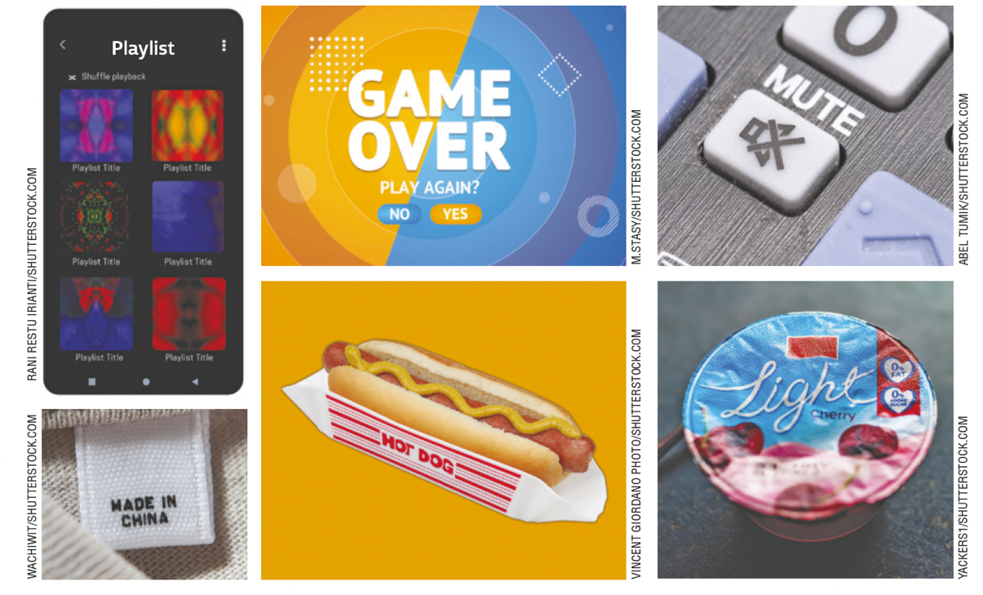
UNIT 0
TIP
Observe o inglês à sua
volta e veja o que você já
sabe devido à presença do
idioma no seu dia a dia.

Slide 6
UNIT 0
TIP
Fique atento/a aos textos
em inglês que estão à
sua volta — em pôsteres,
camisetas, postagens
em redes sociais etc.
Eles podem oferecer
oportunidades para você
aprender a língua inglesa.
PASSITON.COM
HABYARIMANA, Bangambiki. Respect is love in action. Pass it on. 1999-2022. Disponível em: www.passiton.com/inspirational-quotes/7559-respect-is-love-in-action. Acesso em: 25 maio 2022

Slide 7
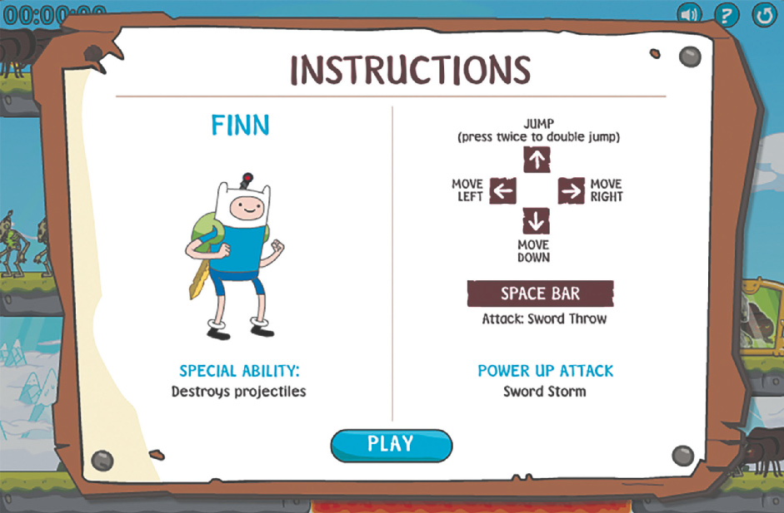
UNIT 0
HTTPS://ADVENTURETIME.FANDOM.COM/WIKI/GAME_CREATOR
TIP
O inglês está presente em diversas situações do seu dia a dia, como em jogos.
Aproveite essas oportunidades para aprender o idioma também fora da escola.
ADVENTURE TIME WIKI. Gallery: Screenshots. In: ADVENTURE TIME WIKI. Game creator. 2022. Disponível em: https://adventuretime.fandom.com/wiki/Game_Creator. Acesso em: 25 maio 2022.

Slide 8
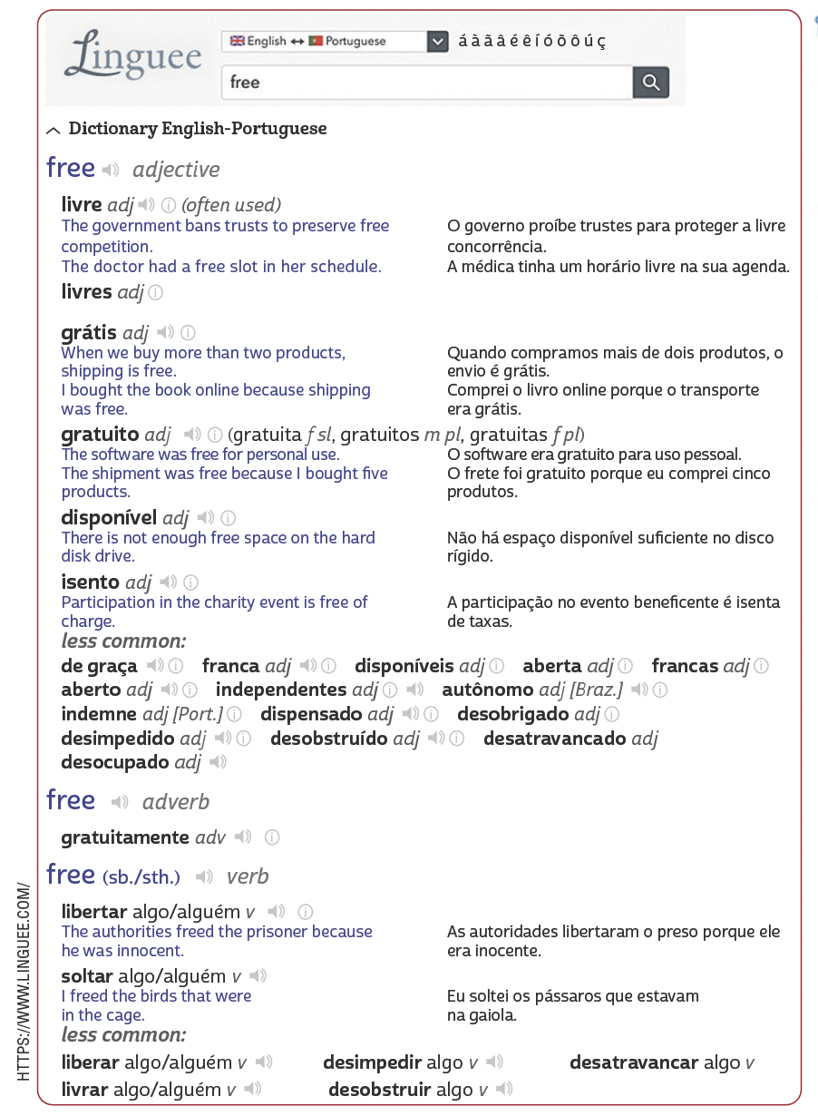
UNIT 0
TIP
A maioria dos dicionários digitais, como o que aparece aqui, está disponível para acesso pela internet e por aplicativo de celular. Alguns também oferecem a possibilidade de consulta off-line, ou seja, sem a necessidade de estar conectado à internet.
FREE. In: LINGUEE. 2022. Disponível em: https://www.linguee.com/english-portuguese/translation/free.html. Acesso em: 26 maio 2022.

Slide 9
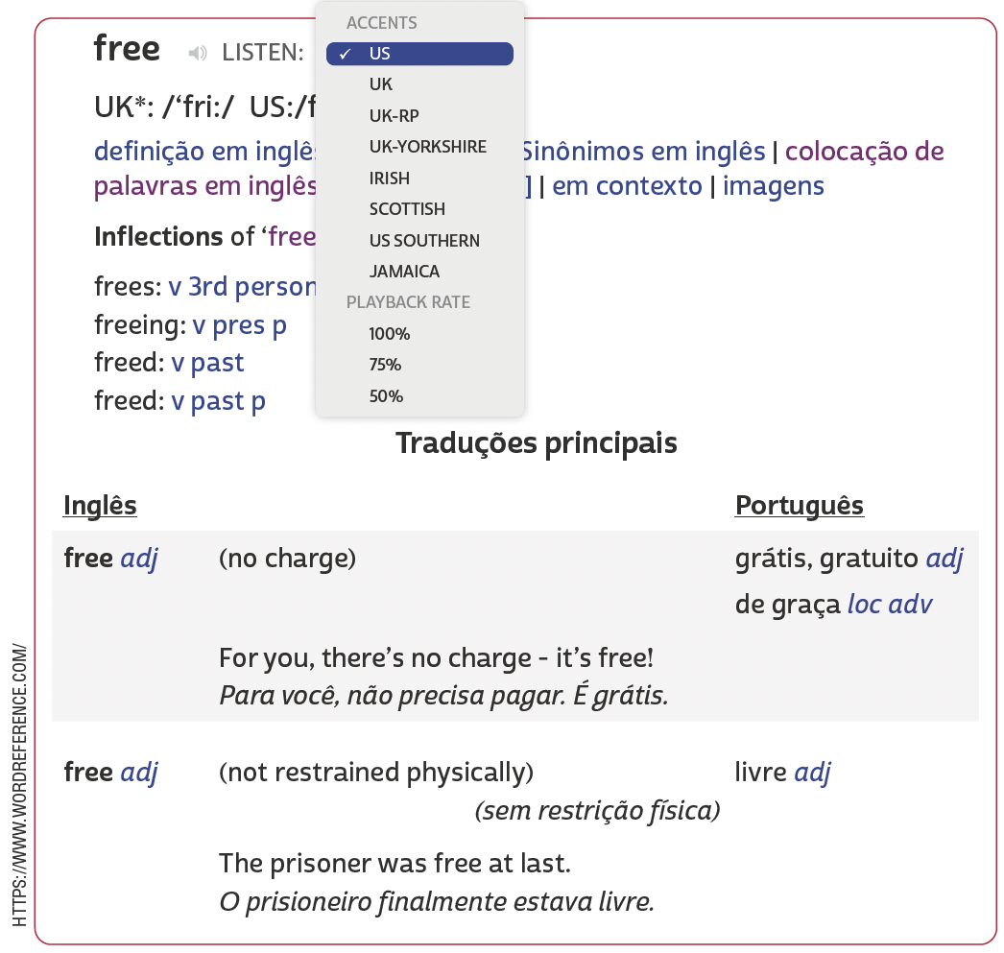
UNIT 0
TIP
Em alguns dicionários,
utiliza-se a abreviação
GB (Great Britain, ou
seja, Grã-Bretanha)
em vez de UK (United
Kingdom, ou seja,
Reino Unido).
FREE. In: WORDREFERENCE.COM. 2022. Disponível em: www.wordreference.com/enpt/free. Acesso em: 26 maio 2022.

Slide 10
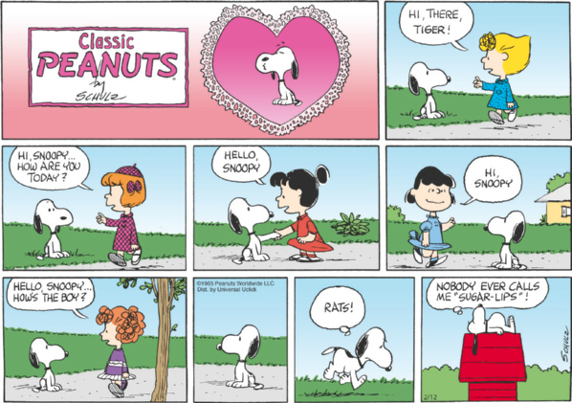
UNIT 1
PEANUTS, CHARLES SCHULZ © 1965 PEANUTS
WORLDWIDE LLC / DIST. BY ANDREWS MCMEEL SYNDICATION
TIP
Ao ler histórias em
quadrinhos, observe
as relações entre os
elementos verbais e
não verbais.
SCHULZ, Charles. The complete Peanuts 1965-1966. Seattle: Fantagraphics Books, 2013.

Slide 11
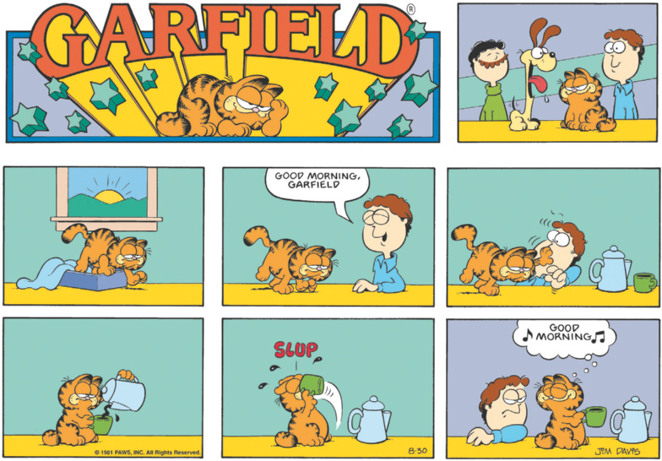
UNIT 1
GARFIELD, JIM DAVIS © 1981 PAWS, INC. ALL RIGHTS
RESERVED / DIST. BY ANDREWS MCMEEL SYNDICATION
TIP
Apoie-se em palavras parecidas com o português (television, temptation) para fazer previsões sobre o texto e compreendê-lo.
Tome cuidado com palavras que têm forma semelhante ao português, mas significados
diferentes. Late, por exemplo, parece uma forma do verbo “latir” em português, mas, em
inglês, na tirinha, significa “tarde”.
DAVIS, Jim. Garfield. 2022. Disponível em: www.gocomics.com/garfield/1981/08/30. Acesso em: 16 maio 2022.
PEANUTS, CHARLES SCHULZ © 1965
PEANUTS WORLDWIDE LLC / DIST. BY
ANDREWS MCMEEL SYNDICATION
SCHULZ, Charles. The complete Peanuts 1965-1966. Seattle: Fantagraphics Books, 2013.

Slide 12
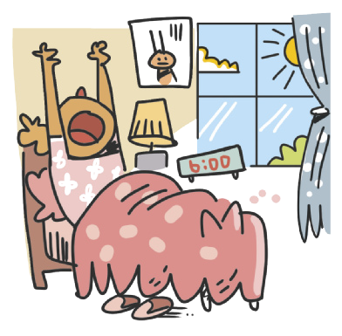
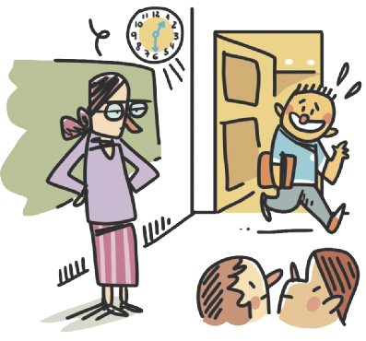
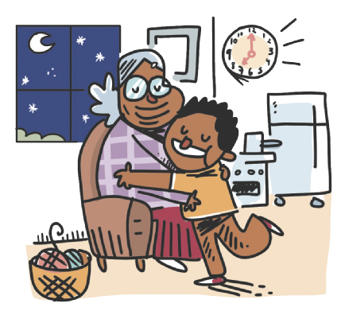
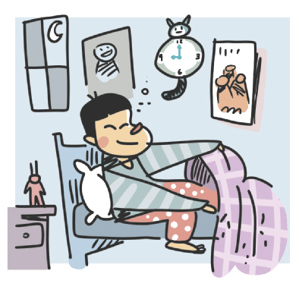
Unit 1
Good morning
Good afternoon
LANGUAGE NOTE
In the evening, we use good evening to say hello to a person.
In the evening, we use good night to say goodbye to a person.
ILUSTRAÇÕES: GALVÃO BERTAZZI
Good evening
Good night

Slide 13
Unit 1
TIP
Em inglês, assim como
em português, alguns
termos são mais usados
em determinados
lugares. A expressão
G’day, por exemplo,
é muito utilizada na
Austrália e na Nova
Zelândia.
THINK ABOUT IT!
O cartaz está em um site em que os usuários publicam cartazes com a expressão Keep calm. Na sua opinião, qual é o significado de mate no texto?
KEEPCALMS.COM
CHIZZ. Keep calm and g'day mate! 2009-2022. Disponível em: https://keepcalms.com/n/keep-calmand-g-day-mate-2/. Acesso em: 16 maio 2022.
LANGUAGE NOTE
G’day = Good day

Slide 14
UNIT 1
I am
He is
She is
It is
We are
You are
You are
They are
= I’m
= He’s
= She’s
= It’s
= We’re
= You’re
= You’re
= They’re
VERB TO BE: AFFIRMATIVE FORM
TIP
As formas verbais contraídas, tais como I’m, He’s, She’s, It’s, We’re, They’re, são usadas na linguagem coloquial, como em conversas entre amigos, tirinhas etc.

Slide 15
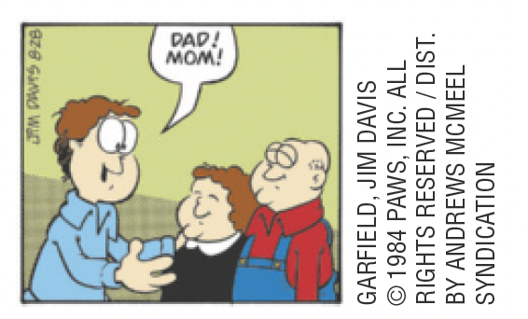
Unit 1
They’re
Mr. and Mrs. Arbuckle.
LANGUAGE NOTE
Pronomes de tratamento:
Mr. = para homens (solteiros ou casados)
Ms. = para mulheres (solteiras ou casadas)
Mrs. = para mulheres casadas
Miss = para mulheres solteiras

Slide 16
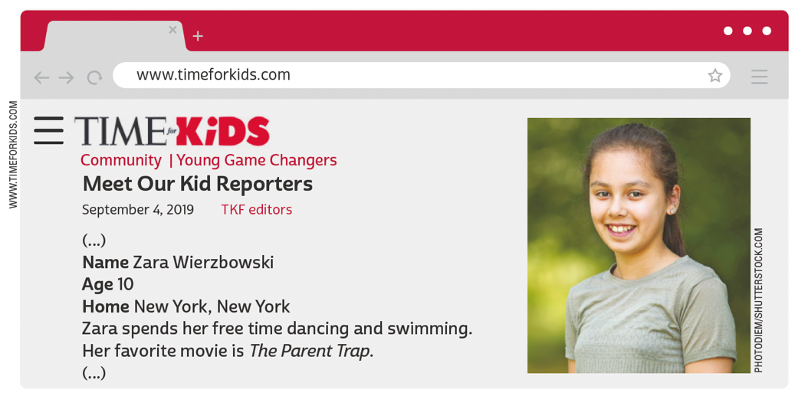
UNIT 2
THINK ABOUT IT!
Ao visitar uma página na internet, geralmente encontramos um menu de navegação com vários links disponíveis. Onde se deve clicar para ter acesso ao menu de navegação do site apresentado?
Adaptado de: MEET Our kid reporters. Time for Kids, 4 set. 2019. Disponível em: www.timeforkids.com/g56/meet-kid-reporters-2019/. Acesso em: 18 maio 2022.
LANGUAGE NOTE
parent = pai/mãe
relative = parente

Slide 17
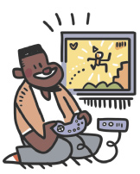
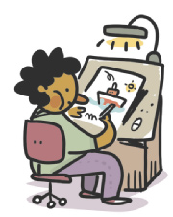
UNIT 2
dancing
playing video games
PERSONAL INTERESTS
drawing
playing soccer
ILUSTRAÇÕES: GALVÃO BERTAZZI
listening to music

Slide 18
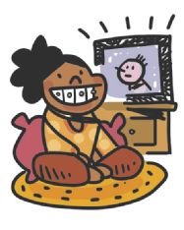
UNIT 2
reading
swimming
PERSONAL INTERESTS
ILUSTRAÇÕES: GALVÃO BERTAZZI
surfing the net
watching TV

Slide 19
UNIT 2
1 one
2 two
3 three
4 four
5 five
6 six
7 seven
8 eight
9 nine
10 ten
11 eleven
12 twelve
13 thirteen
14 fourteen
15 fifteen
16 sixteen
17 seventeen
18 eighteen
19 nineteen
20 twenty
21 twenty-one
22 twenty-two
23 twenty-three
29 twenty-nine
30 thirty
40 forty
50 fifty
60 sixty
70 seventy
80 eighty
90 ninety
100 a/one hundred
CARDINAL NUMBERS
TIP
Observe que os números
de 13 a 19 apresentam a
terminação -teen. A palavra
teenager se refere a quem
tem entre 13 e 19 anos.

Slide 20
UNIT 2
1st first
2nd second
3rd third
4th fourth
5th fifth
6th sixth
7th seventh
8th eighth
9th ninth
10th tenth
11th eleventh
12th twelfth
13th thirteenth
14th fourteenth
15th fifteenth
16th sixteenth
17th seventeenth
18th eighteenth
19th nineteenth
20th twentieth
21st twenty-first
22nd twenty-second
23rd twenty-third
29th twenty-ninth
30th thirtieth
40th fortieth
50th fiftieth
60th sixtieth
70th seventieth
80th eightieth
90th ninetieth
100th a/one hundredth
ORDINAL NUMBERS
LANGUAGE NOTE
1st = first
2nd = second
3rd = third
4th = fourth

Slide 21
UNIT 2
Our favorite singer is Beyoncé.
Our native language is English.
THINK ABOUT IT!
Observe que o pronome our
está no plural e se refere a quem fala. Converse com um(a) colega e escolha qual/quais das três frases se referiria/refeririam a vocês dois.
Our favorite musical is Hamilton.

Slide 22
UNIT 2
Possessive adjectives
my
TIP
Os pronomes possessivos (my, your, his, her etc.) se referem a alguém ou algo que possui algo.

Slide 23
UNIT 2
The alphabet
In pairs, ask a classmate the following questions and answer them. Take turns:
Can you spell your first name?
Can you spell your last name?
Can you spell your English teacher’s name?
TIP
Aprender o alfabeto em inglês fica mais fácil quando agrupamos as letras pelo som.

Slide 24
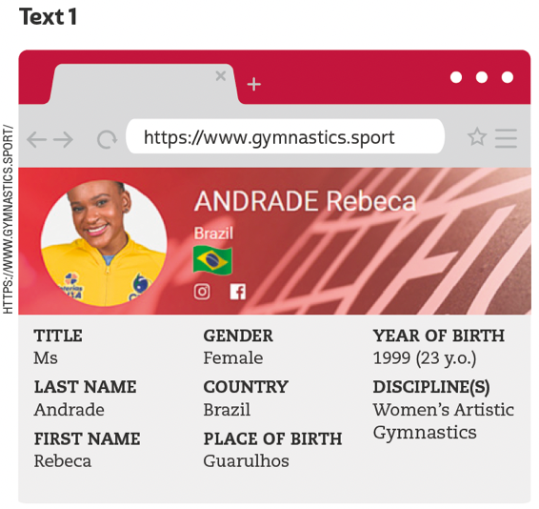
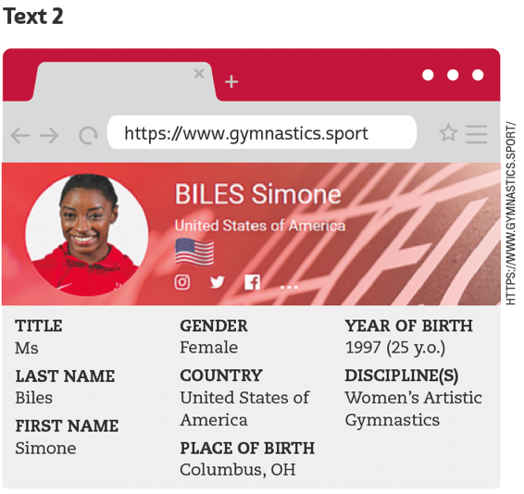
UNIT 3
TIP
Observe a estrutura do
texto, a fonte e as pistas
gráficas para formular
hipóteses sobre a finalidade dele.
FEDERATION INTERNATIONALE DE GYMNASTIQUE. Rebeca Andrade. 2021. Disponível em: www.gymnastics.sport/site/athletes/bio_detail.php?id=37359. Acesso em: 27 maio 2022.
FEDERATION INTERNATIONALE DE GYMNASTIQUE. Simone Biles. 2021. Disponível em: https://www.gymnastics.sport/site/athletes/bio_detail.php?id=38172. Acesso em: 27 maio 2022.
LANGUAGE NOTE
y.o. = years old

Slide 25
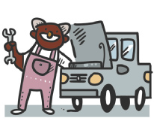
Unit 3
actor/actress
mechanic
teacher
occupations
PRONUNCIATION NOTE
Observe que, em inglês, o ch pode ser pronunciado de diferentes maneiras. Aqui, encontramos três palavras com ch (chef, mechanic, teacher) e, em cada uma, o ch representa um som diferente. Em chef, o ch representa o som de /ʃ/; em mechanic, o som de /k/; e, em teacher, o som de /tʃ/. Em português, o ch representa apenas um som, /ʃ/ como em “chefe”.
chef
police officer
vet
ILUSTRAÇÕES: GALVÃO BERTAZZI
doctor
student

Slide 26
Unit 3
countries
NATIONALITIES
Australia
Australian
Brazil
Brazilian
countries and nationalities
Canada
Canadian
TIP
Busque agrupar as palavras
pela terminação, como
Japanese, Portuguese.
France
French

Slide 27
Unit 3
countries
NATIONALITIES
Germany
German
India
Indian
countries and nationalities
Jamaica
Jamaican
Japan
Japanese

Slide 28
Unit 3
countries
NATIONALITIES
Portugal
Portuguese
South Africa
South African
countries and nationalities
Spain
Spanish
The United States
American

Slide 29
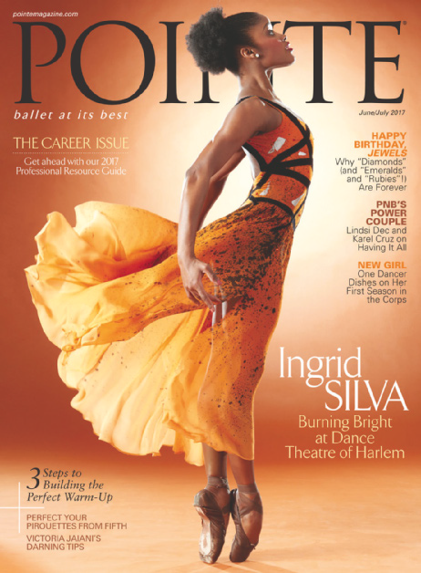
UNIT 3
THINK ABOUT IT!
Pointe é uma publicação internacional sobre balé. Na sua opinião, o que significa para Ingrid Silva estampar a capa dessa revista? Para você, como a trajetória profissional de Ingrid pode impactar a vida de jovens brasileiras/brasileiros que desejam se tornar bailarinas/ bailarinos?
POINTE MAGAZINE
POINTE. jun./jul. 2017. Disponível em: https://berksballettheatre.com/wp-content/uploads/2017/12/ingridjune-cover-753x1024.jpg. Acesso em: 27 maio 2022.

Slide 30
UNIT 3
I am not
He is not
She is not
It is not
We are not
You are not
You are not
They are not
= I’m not
= He isn't
= She isn't
= It isn't
= We aren't
= You aren't
= You aren't
= They aren't
VERB TO BE: NEGATIVE FORM
TIP
As formas verbais contraídas, tais como isn’t e aren’t, são usadas na linguagem coloquial, como em conversas entre amigos, tirinhas etc.

Slide 31
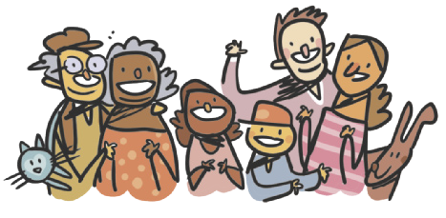
UNIT 4
What is a family?
Who is a family?
One and another makes two is a family!
Baby and father and mother: a family!
Parents and sister and brother: a family!
All kinds of people can make up a family
All kinds of mixtures can make up a family
What is a family?
Who is a family?
The children that lived in a shoe is a family!
A pair like a kanga and roo is a family!
A calf and a cow that go moo is a family!
All kinds of creatures can make up a family
All kinds of numbers can make up a Family
What is a family?
Who is a family?
Either a lot or a few is a family;
But whether there’s ten or there’s
two in your family,
All of your family plus you is a family!
ILUSTRAÇÕES: GALVÃO BERTAZZI
TIP
Note que, em poemas,
a linguagem é usada de
forma criativa.
HOBERMAN, Mary Ann. Fathers, mothers, sisters, brothers: a collection of family poems. Nova York: Hachette Book Group Inc., 2001. p. 3.

Slide 32
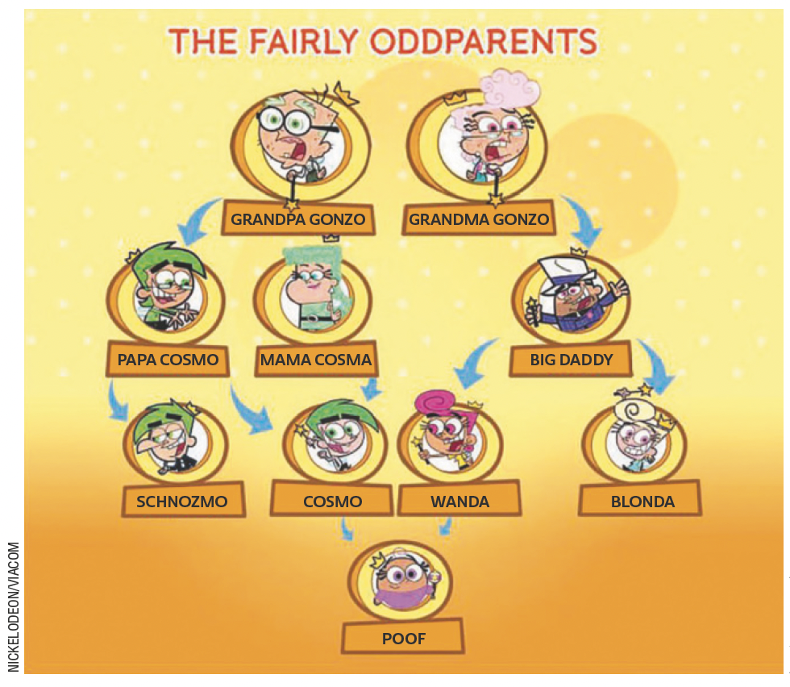
UNIT 4
LANGUAGE NOTE
dad (informal) = father
mom (informal) = mother
grandpa (informal) = grandfather
grandma (informal) = grandmother
Adaptado de: CREEK, Jeremy. Cosma-Fairywinkle family. Fairly Odd Parents Wiki. 2022. Disponível em: https://fairlyoddparents.fandom.com/wiki/Cosma-Fairywinkle_family. Acesso em: 30 maio 2022.

Slide 33
UNIT 4
parents
grandparents
children
mother
grandmother
sister
daughter
granddaughter
aunt
niece
father
grandfather
brother
son
grandson
uncle
nephew
Family members
TIP
O uso de cores é uma
estratégia que pode ajudar
você a organizar e fixar o
vocabulário.

Slide 34
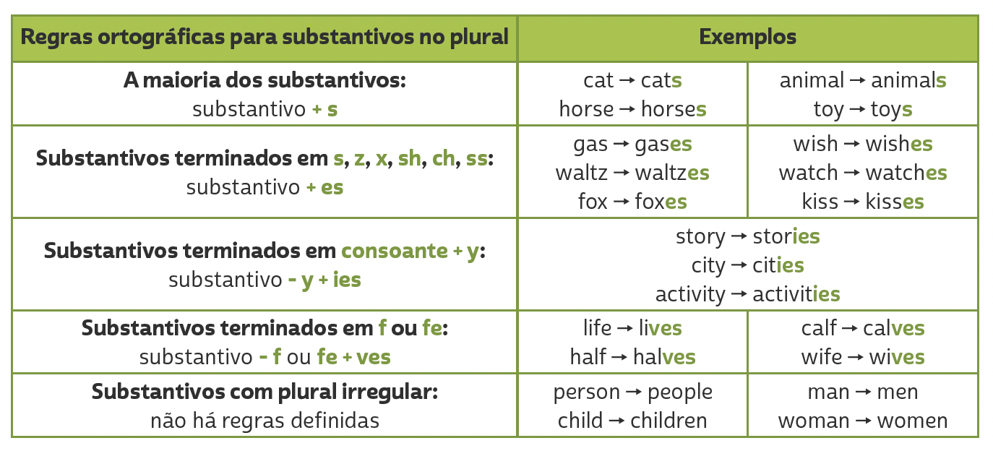
Unit 4
PLURALS

Slide 35
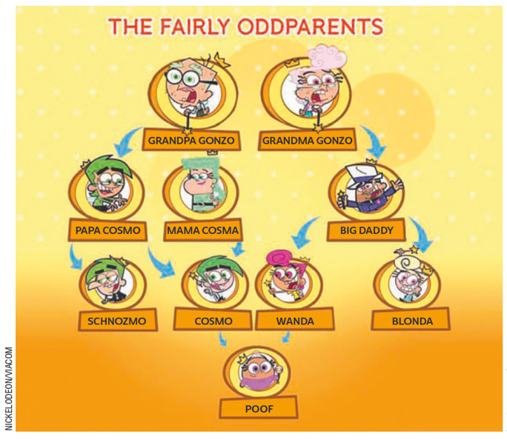
UNIT 4
Adaptado de: CREEK, Jeremy. Cosma-Fairywinkle family. Fairly Odd Parents Wiki. 2022. Disponível em: https://fairlyoddparents.fandom.com/wiki/Cosma-Fairywinkle_family. Acesso em: 30 maio 2022.
Genitive case ('s)
Who’s Papa Cosmo?
He is Cosmo’s father. (= the father of Cosmo)
b. Who’s Mama Cosma?
She is Cosmo’s mother. (= the mother of Cosmo)
c. Who are Grandpa Gonzo and Grandma Gonzo?
They are Cosmo’s grandparents. (= the grandparents of Cosmo)
TIP
Usamos o genitive case ('s) para indicar posse. O termo usado antes de 's se refere a que ou quem possui e o termo usado após 's se refere ao elemento possuído.

Slide 36
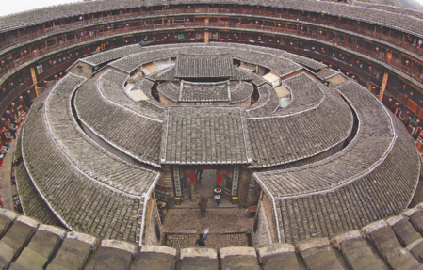
UNIT 5
COZYTA/SHUTTERSTOCK.COM
China
Living Together in a Circle
Deep in the mountains, there is a round building called a tulou. It is surrounded by a thick dirt wall. It is in the Fujian province of China. There are about three hundred people living in this tulou. It is very lively inside.
The tulou has four floors. There are four communal staircases, and more than 200 rooms of about the same size. On the first floor, there are kitchens all in a row. The second floor has warehouses, where the harvest and the farm tools are kept. The long hall is where the children play. The third and fourth floors have bedrooms that are also used for study. Parents and children share one room.
TIP
Não se preocupe em compreender todas as palavras de um texto. Nem sempre isso é necessário para você atingir seus
objetivos de leitura.
Adaptado de: KOMATSU, Yoshio. Wonderful houses around the world. California: Shelter Publications, 2004. p. 6, 8.

Slide 37
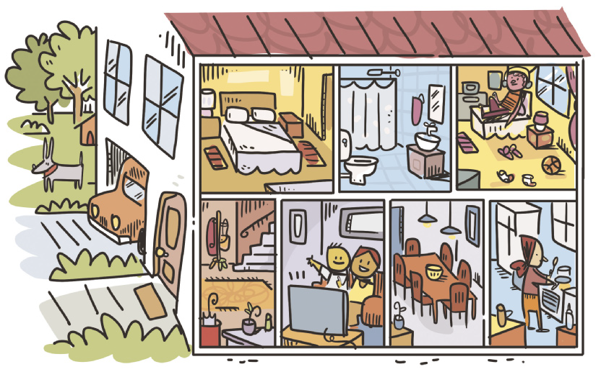
UNIT 5
garden
bedroom
bathroom
PARTS OF THE HOUSE
ILUSTRAÇÕES: GALVÃO BERTAZZI
stairs
garage
hall
living room
dining room
kitchen

Slide 38
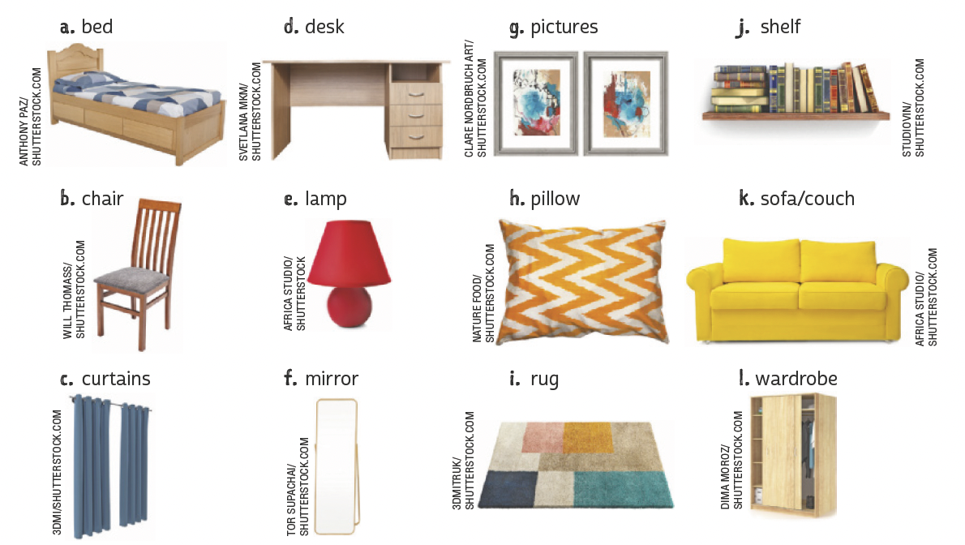
UNIT 5
bed
desk
pictures
shelf
chair
lamp
pillow
sofa/couch
furniture
curtains
mirror
rug
wardrobe

Slide 39
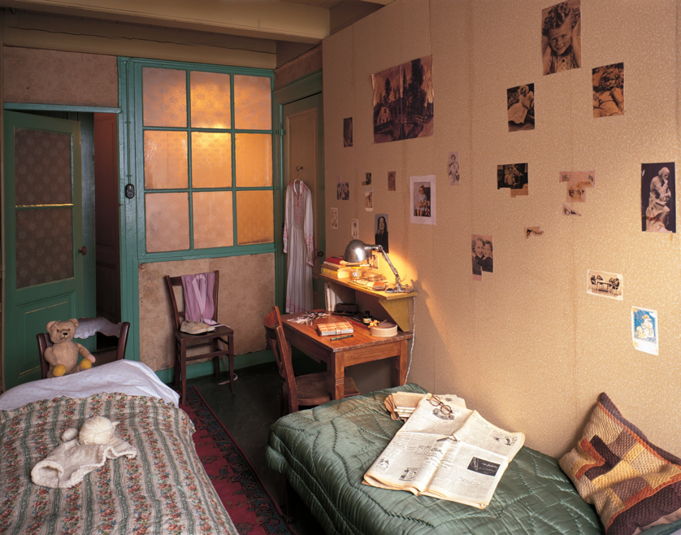
UNIT 5
COPYRIGHT © ANNE FRANK STICHTING/ALLARD
BOVENBERG, AMSTERDAM ANNE FRANK HOUSE/
ALLARD BOVENBERG
THINK ABOUT IT!
Na foto da página, vemos o quarto de Anne Frank, que ficava em um anexo secreto da casa. Por segurança, a porta para esse anexo foi escondida por uma estante de livros. Na sua opinião, escrever um diário ajudou Anne Frank a lidar com a difícil realidade que enfrentava? Por quê? Você tem o hábito de escrever sobre suas próprias experiências? Como Anne, você também tem um espaço para escrever e estudar?
BOVENBERG, Allard. Anne Frank's room in the secret annex. Amsterdam, [2018]. 1 fotografia. Disponível em: https://artsandculture. google.com/asset/annefrank-s-room-in-thesecretannex-allard-bovenberg/kAHP7XqswgMtsg. Acesso em: 6 jun. 2022.
There are two beds in the room.
There is a teddy bear on a chair.
There is a desk under the shelf.
There are a lot of pictures on the wall.

Slide 40
UNIT 5
on
in
between
PREPOSITIONS OF PLACE
under
behind
next to
IEMONO//SHUTTERSTOCK.COM
above
in front of

Slide 41
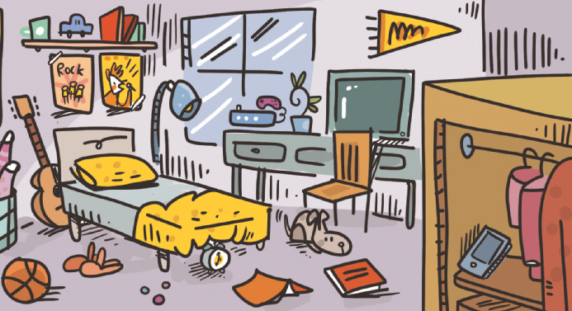
UNIT 5
ILUSTRAÇÕES: GALVÃO BERTAZZI
There is a guitar behind the bed.
There is a dog in front of the chair.
There are two posters on the wall.
There is a cell phone in the wardrobe.
There is a lamp next to the bed.
There is a plant between the television and the video game.
There is an alarm clock under the bed.
There is a shelf above the posters.

Slide 42
UNIT 6
TIP
Busque formular hipóteses sobre a finalidade de um texto em língua inglesa com base em sua estrutura, organização textual e elementos visuais (cores, tipos de fonte, imagens etc.). Na sua opinião, qual deve ser a finalidade deste texto?
PEOPLE FOR THE ETHICAL TREATMENT OF ANIMALS/PETA2
PETA2. NBA’s Metta World Peace wants peace for all. 25 jul. 2013. Disponível em: https://www.peta2.com/news/mettaworld-peace-peta2-protect-animals-psa/. Acesso em: 7 jun. 2022.

Slide 43
UNIT 6
THINK ABOUT IT!
O cartaz mostra um astro do basquete americano e faz um jogo de palavras com uma expressão usada no mundo esportivo. Nos esportes, o home team é o time da casa. Em sua opinião, a quem se refere a expressão home team na frase “Guard the home team” usada no cartaz? Você acha que o uso de jogos de palavras ajuda a chamar a atenção para um cartaz? Você já observou esse recurso em outros cartazes em inglês ou em português?
PEOPLE FOR THE ETHICAL TREATMENT OF ANIMALS/PETA2
PETA2. NBA’s Metta World Peace wants peace for all. 25 jul. 2013. Disponível em: https://www.peta2.com/news/mettaworld-peace-peta2-protect-animals-psa/. Acesso em: 7 jun. 2022.

Slide 44
UNIT 6
bear
canary
cat
chicken
dog
goldfish
hamster
lion
Animals and pets
macaw
rabbit
shark
turtle

Slide 45
UNIT 6
alligator
gorilla
elephant
pig
giraffe
tiger
snake
dolphin
Animals and pets
monkey
horse
penguin
cow

Slide 46
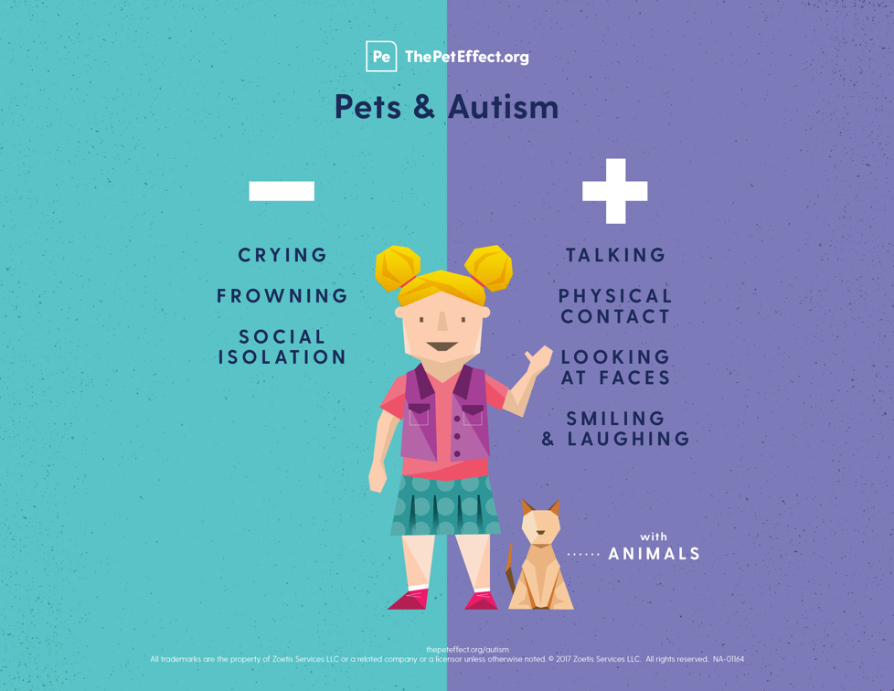
UNIT 6
TIP
HUMAN ANIMAL BOND RESEARCH INSTITUTE/HABRI
Apoie-se em vocabulário já
conhecido (pets, talking) e
em palavras parecidas com o
português (isolation, contact) para compreender melhor o texto.
HABRI. Pets and autism. 2017. Infográfico. Disponível em: https://habri.org/assets/uploads/HAB_The-Pet-Effect_Autism.png. Acesso em: 7 jun. 2022.
LANGUAGE NOTE
- less (= menos)
+ more (= mais)

Slide 47
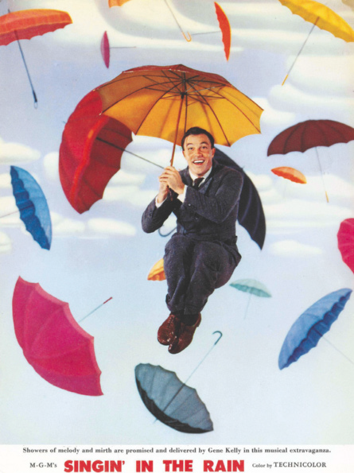
UNIT 7
Singin’ in the Rain
I’m singing in the rain
Just singin’ in the rain
What a glorious feeling
I’m happy again
I’m laughing at clouds
So dark up above
The sun’s in my heart
And I’m ready for love
Let the stormy clouds chase
Everyone from the place
Come on with the rain
I have a smile on my face
I walk down the lane
With a happy refrain
Just singin’, singin’ in the rain
Dancing in the rain
I’m happy again
I’m singin’ and dancin’ in the rain
I’m dancin’ and singin’ in the rain
METRO-GOLDWYN-MAYER
LANGUAGE NOTE
singin’ = singing
dancin’ = dancing
FREED, Arthur. Singin’ in the Rain. Intérprete: Gene Kelly. In: Singing in the Rain – Original Film Soundtrack. [S.l.]: River Records Scotland, 2008. 1 CD. Faixa 1.

Slide 48
UNIT 7
blues
dance
jazz
reggaeton
bossa nova
fado
pop
rock
classical
heavy metal
rap
samba
country
hip-hop
R&B
tango
Kinds of music
LANGUAGE NOTE
R&B = rhythm and blues

Slide 49
UNIT 7
accordion
cello
drums
electric guitar
flute
guitar
piano
saxophone
violin
Musical instruments
PRONUNCIATION NOTE
Tanto em inglês quanto em português, ao dizermos algumas
palavras, não pronunciamos certas letras. A letra u, por
exemplo, não é pronunciada ao dizermos guitar ou “guitarra”.

Slide 50
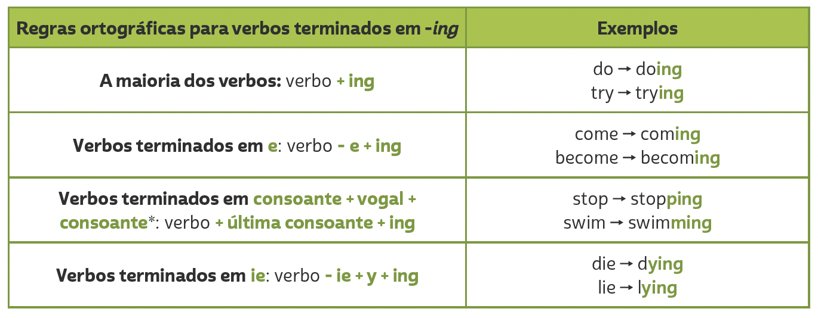
Unit 7
PRESENT CONTINUOUS
TIP
Em verbos terminados em CVC (consoante, vogal, consoante), como admit, get e run, dobramos a última consoante antes de acrescentar -ing (admitting, getting, running). No entanto, não dobramos a última consoante quando a sílaba tônica é a primeira. Dessa forma, em verbos como listen, happen e offer, apenas acrescentamos -ing (listening, happening, offering).

Slide 51
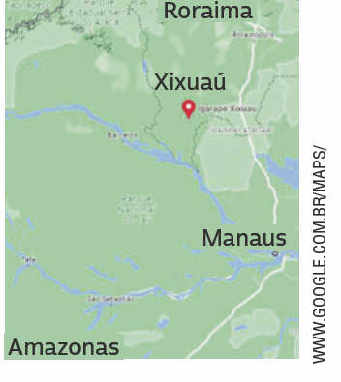
UNIT 8
My name is Mecias, and I am ten years old. I live in a village in the middle of the rainforest.
In my village, there are a few houses surrounded by the jungle, which has lots of animals and birds. We go fishing in
canoes built by the people here in the village. There is a crocodile in the village port!
At my school there are nineteen children, ranging in age from four to sixteen years old. We all study in the same classroom. We have wireless internet and a computer in our classroom! We study mathematics, the Portuguese language, history, natural sciences and geography, and very often we talk about conservation.
We learn not to throw rubbish into the river, not to kill the
animals, and not to cut down trees unnecessarily. I like my class.
My classmates, my teacher, and I like being in the middle of the forest and breathing clean air.
THINK ABOUT IT!
Em algumas regiões do Brasil, é um desafio assegurar acesso a escolas para crianças e adolescentes. Que consequências a falta de educação escolar pode ter na vida desses jovens? Em sua opinião, o que deve ser feito para garantir que todas as
crianças e adolescentes no Brasil frequentem a escola?
HUGHES, Susan. Off to class: incredible and unusual schools around the world. Toronto: Owlkids Books, 2011. p. 12.

Slide 52
UNIT 8
We
go
fishing.
study
about conservation.
talk
mathematics.
the Portuguese language.
history.
natural sciences.
geography.
learn not to throw
rubbish into the river.
Action verbs
TIP
Diagramas como este podem ajudar você a agrupar palavras e expressões por temas e, assim, contribuir para a ampliação e a fixação do vocabulário aprendido. Você pode fazer isso no papel ou no computador.

Slide 53
UNIT 8
GARFIELD, JIM DAVIS © 1985 PAWS, INC.
ALL RIGHTS RESERVED / DIST.
BY ANDREWS MCMEEL SYNDICATION
TIP
DAVIS, Jim. Garfield. 2022. Disponível em: www.gocomics.com/garfield/1985/08/12. Acesso em: 9 jun. 2022..
Ao ler tirinhas, observe as relações entre os elementos verbais e os não verbais.
LANGUAGE NOTE
Uma forma de organizar o vocabulário que aprendeu é usar antônimos, como em:
before X after
love X hate
sleep X wake up

Slide 54
UNIT 8
Simple present
(He/SHE/IT)

Slide 55
VOCABULARY CORNER
SAYING HELLO:
SAYING GOODBYE:
ILUSTRAÇÕES: GALVÃO BERTAZZI
Unit 1:
GREETINGS AND FAREWELLS
Hi.
Hi, there.
Hiya.
Bye.
Bye bye.
See you./See ya.

Slide 56
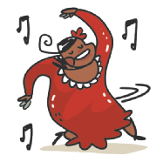
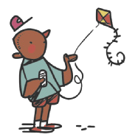
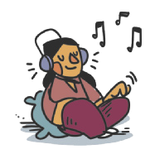
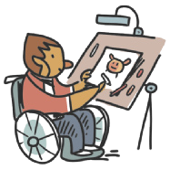
VOCABULARY CORNER
dancing
flying a kite
Unit 2: PERSONAL INTERESTS
doing judo
listening to music
ILUSTRAÇÕES: GALVÃO BERTAZZI
drawing
playing soccer

Slide 57
VOCABULARY CORNER
playing the guitar
reading
Unit 2: PERSONAL INTERESTS
playing the piano
riding a bike/cycling
ILUSTRAÇÕES: GALVÃO BERTAZZI
playing video games
singing

Slide 58
VOCABULARY CORNER
surfing the net
watching movies
Unit 2: PERSONAL INTERESTS
ILUSTRAÇÕES: GALVÃO BERTAZZI
swimming
watching TV

Slide 59
VOCABULARY CORNER
1 one
2 two
3 three
4 four
5 five
6 six
7 seven
8 eight
9 nine
10 ten
11 eleven
12 twelve
13 thirteen
14 fourteen
15 fifteen
16 sixteen
17 seventeen
18 eighteen
19 nineteen
20 twenty
21 twenty-one
22 twenty-two
23 twenty-three
29 twenty-nine
30 thirty
40 forty
50 fifty
60 sixty
70 seventy
80 eighty
90 ninety
100 a/one hundred
Unit 2: CARDINAL NUMBERS
TIP
Observe que os números
de 13 a 19 apresentam a
terminação -teen. A palavra
teenager se refere a quem
tem entre 13 e 19 anos.

Slide 60
VOCABULARY CORNER
1st first
2nd second
3rd third
4th fourth
5th fifth
6th sixth
7th seventh
8th eighth
9th ninth
10th tenth
11th eleventh
12th twelfth
13th thirteenth
14th fourteenth
15th fifteenth
16th sixteenth
17th seventeenth
18th eighteenth
19th nineteenth
20th twentieth
21st twenty-first
22nd twenty-second
23rd twenty-third
29th twenty-ninth
30th thirtieth
40th fortieth
50th fiftieth
60th sixtieth
70th seventieth
80th eightieth
90th ninetieth
100th a/one hundredth
Unit 2: ORDINAL NUMBERS
LANGUAGE NOTE
1st = first
2nd = second
3rd = third
4th = fourth

Slide 61
VOCABULARY CORNER
actor/actress
doctor
Unit 3: occupations
chef
engineer
dentist

Slide 62
VOCABULARY CORNER
MONKEY BUSINESS IMAGES/
SHUTTERSTOCK.COM
farmer
nurse
Unit 3: occupations
PCRUCIATTI/
SHUTTERSTOCK.COM
lawyer
police officer
STUDIO 72/
SHUTTERSTOCK.COM
mechanic

Slide 63
VOCABULARY CORNER
RIDO/
SHUTTERSTOCK.COM
singer
student
TOMWANG/
© 123RF.COM
MONKEY BUSINESS IMAGES/
SHUTTERSTOCK.COM
Unit 3: occupations
PCRUCIATTI/
SHUTTERSTOCK.COM
vet
teacher
scientist

Slide 64
VOCABULARY CORNER
January
February
March
April
May
June
July
August
September
October
November
December
Unit 3: months of the year

Slide 65
VOCABULARY CORNER
countries
NATIONALITIES
Argentina
Argentine, Argentinean (Argentinian)
Australia
Australian
Unit 3: countries and nationalities
Brazil
Brazilian
TIP
Busque agrupar as palavras
pela terminação, como
Japanese, Portuguese.
Canada
Canadian

Slide 66
VOCABULARY CORNER
countries
NATIONALITIES
China
Chinese
England
English
Unit 3: countries and nationalities
France
French
Germany
German

Slide 67
VOCABULARY CORNER
countries
NATIONALITIES
India
Indian
Italy
Italian
Unit 3: countries and nationalities
Jamaica
Jamaican
Japan
Japanese

Slide 68
VOCABULARY CORNER
countries
NATIONALITIES
Mexico
Mexican
Nigeria
Nigerian
Unit 3: countries and nationalities
Portugal
Portuguese

Slide 69
VOCABULARY CORNER
countries
NATIONALITIES
South Africa
South African
Spain
Spanish
Unit 3: countries and nationalities
The United States
American

Slide 70
VOCABULARY CORNER
grandfather
grandmother
Unit 4: family members
aunt
father
mother
uncle
ME
cousin
brother
sister
ILUSTRAÇÕES: GALVÃO BERTAZZI

Slide 71
VOCABULARY CORNER
black
green
gray/ grey
purple
white
Unit 4: COLORS
blue
dark green
orange
red
yellow
brown
light green
pink

Slide 72
VOCABULARY CORNER
ERKANATBAS/
SHUTTERSTOCK.COM
bathroom
garage
FOTOCRAFT/
SHUTTERSTOCK.COM
Unit 5: PARTS OF THE HOUSE
bedroom
garden
dining room

Slide 73
VOCABULARY CORNER
MADHOURSE/
SHUTTERSTOCK.COM
INSTA_PHOTOS/
SHUTTERSTOCK.COM
hall
stairs
MADHOURSE/
SHUTTERSTOCK.COM
JODIE JOHNSON/
SHUTTERSTOCK.COM
Unit 5: PARTS OF THE HOUSE
kitchen
study
ALEX GORINS/
SHUTTERSTOCK.COM
living room

Slide 74
VOCABULARY CORNER
VOYSLA/
SHUTTERSTOCK.COM
DIMA MOROZ/
SHUTTERSTOCK.COM
bed
chest of drawers
Unit 5: FURNITURE
ANTHONY PAZ/
SHUTTERSTOCK.COM
PAIKONG/
SHUTTERSTOCK.COM
bookcase
couch/sofa
AV_PHOTO/
SHUTTERSTOCK.COM
chair

Slide 75
VOCABULARY CORNER
MARGO HARRISON/
SHUTTERSTOCK.COM
desk
table
Unit 5: FURNITURE
GRIGVOVAN/
SHUTTERSTOCK.COM
OKCAMERA/
SHUTTERSTOCK.COM
kitchen cabinet
wardrobe
STUDIOVIN/
SHUTTERSTOCK.COM
shelf

Slide 76
VOCABULARY CORNER
alligator
cat
Unit 6: animals and pets
bear
chicken
canary
cow

Slide 77
VOCABULARY CORNER
dog
giraffe
Unit 6: animals and pets
dolphin
goldfish
DMUSSMAN/
SHUTTERSTOCK.COM
POPIK22/
SHUTTERSTOCK.COM
elephant
gorilla

Slide 78
VOCABULARY CORNER
hamster
macaw
FA01813/
SHUTTERSTOCK.COM
Unit 6: animals and pets
horse
monkey
lion
penguin

Slide 79
VOCABULARY CORNER
KVASILEV/
SHUTTERSTOCK.COM
KEN GRIFFITHS/
SHUTTERSTOCK.COM
pig
snake
ROSELYNNE/
SHUTTERSTOCK.COM
Unit 6: animals and pets
THINKER360/
SHUTTERSTOCK.COM
rabbit
tiger
KASCHIBO/
SHUTTERSTOCK.COM
DAVID CARBO/
SHUTTERSTOCK.COM
shark
turtle

Slide 80
VOCABULARY CORNER
accordion
electric guitar
Unit 7: musical instruments
cello
flute
ILUSTRAÇÕES: GALVÃO BERTAZZI
drums
guitar

Slide 81
VOCABULARY CORNER
harmonica
piano
Unit 7: musical instruments
harp
saxophone
ILUSTRAÇÕES: GALVÃO BERTAZZI
keyboard
violin

Slide 82
VOCABULARY CORNER
YUGANOV KONSTANTIN/
SHUTTERSTOCK.COM
BBERNARD/
SHUTTERSTOCK.COM
brush my teeth
go to school
HALFPOINT/
SHUTTERSTOCK.COM
Unit 8: action verbs
PRESSMASTER/
SHUTTERSTOCK.COM
do homework
have/eat breakfast
PRPICTURESPRODUCTION/
SHUTTERSTOCK.COM
UFABIZPHOTO/
© 123RF.COM
go to bed
have/eat dinner

Slide 83
VOCABULARY CORNER
MONKEY BUSINESS IMAGES/
SHUTTERSTOCK.COM
VALIZA/SHUTTERSTOCK.COM
have/eat lunch
take a shower
THIRAWATANA
PHAISALRATANA/
SHUTTERSTOCK.COM
TRAVELPIXS/
SHUTTERSTOCK.COM
Unit 8: action verbs
play with the dog
wake up
WAVEBREAKMEDIA/
SHUTTERSTOCK.COM
DANI LLAO CALVET/
SHUTTERSTOCK.COM
sleep
watch TV

Slide 84
VOCABULARY CORNER
Arts/Art
History
Unit 8: school subjects
English
ICT (Information and Communication Technologies)
ILUSTRAÇÕES: GALVÃO BERTAZZI
Geography
Literature

Slide 85
VOCABULARY CORNER
Maths/Math/Mathematics
Science
Unit 8: school subjects
Physical Education (P.E.)
Spanish
ILUSTRAÇÕES: GALVÃO BERTAZZI
Portuguese

Slide 86
VOCABULARY CORNER
Wednesday
Unit 8: days of the week
Thursday
weekend

Slide 87
VOCABULARY CORNER
Unit 8: telling the time

Slide 88
LANGUAGE REFERENCE
Unit 1:
Subject pronouns

Slide 89
LANGUAGE REFERENCE
Unit 1:
VERB TO BE: AFFIRMATIVE FORM

Slide 90
LANGUAGE REFERENCE
Unit 2:
Possessive adjectives

Slide 91
LANGUAGE REFERENCE
Unit 3:
Verb to be: negative and interrogative forms

Slide 92
LANGUAGE REFERENCE
Unit 4:
PLURALS

Slide 93
LANGUAGE REFERENCE
Unit 4:
GENITIVE CASE (‘S)

Slide 94
LANGUAGE REFERENCE
Unit 5:
THERE IS/THERE ARE

Slide 95
LANGUAGE REFERENCE
on
in
between
Unit 5: PREPOSITIONS OF PLACE
under
behind
next to
IEMONO//SHUTTERSTOCK.COM
above
in front of

Slide 96
LANGUAGE REFERENCE
Unit 6: imperative

Slide 97
LANGUAGE REFERENCE
Unit 7: present continuous

Slide 98
LANGUAGE REFERENCE
Unit 7: present continuous
TIP
Em verbos terminados em CVC (consoante, vogal, consoante), como admit, get e run, dobramos a última consoante antes de acrescentar -ing (admitting, getting, running). No entanto, não dobramos a última consoante quando a sílaba tônica é a primeira. Dessa forma, em verbos como listen, happen e offer, apenas acrescentamos -ing (listening, happening, offering).

Slide 99
LANGUAGE REFERENCE
Unit 8: simple present (i/you/we/they)

Slide 100
LANGUAGE REFERENCE
Unit 8: simple present (HE/SHE/IT)

